Slide 1
Capstone project
Presented by: Vesna Cari ​​

Slide 2

Introduction
I was assigned to perform a sales analysis for EmporiUm, a student bookstore chain that also sells tech products, art supplies, and other products in the state of Maine.
Erbayne Middleton is the manager for Maine assigned me….

Slide 3
Sales analysis:
What is total revenue overall for sales in the assigned territory, plus the start date and end date that tell you what period the data covers?
What is total revenue overall for sales in the assigned territory, plus the start date and end date that tell you what period the data covers?
Provide a comparison of total revenue for the specific sales territory and the region it belongs to.
What is the number of transactions per month and average transaction size by product category for the sales territory?
Can you provide a ranking of in-store sales performance by each store in the sales territory, or a ranking of online sales performance by state within an online sales territory?
What is your recommendation for where to focus sales attention in the next quarter?

Slide 4
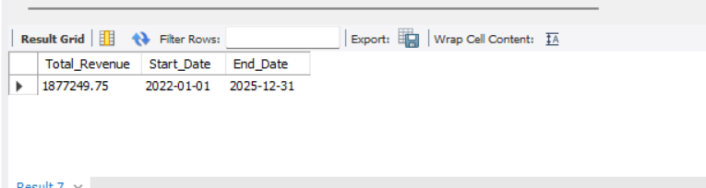
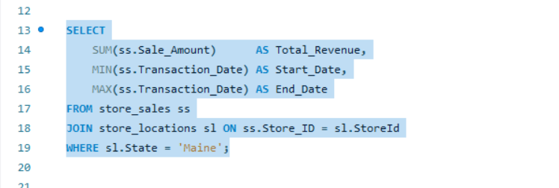
What is total revenue overall for sales in the assigned territory, plus the start date and end date that tell you what period the data covers?
Result
Query

Slide 5
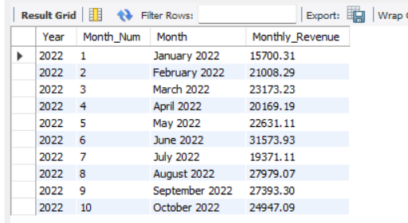
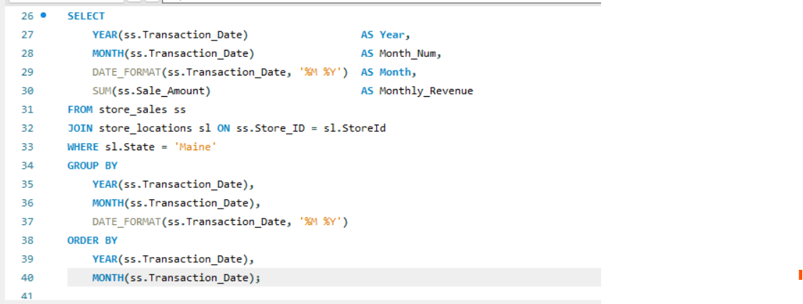
What is the month by month revenue breakdown for the sales territory?
Result
Query

Slide 6
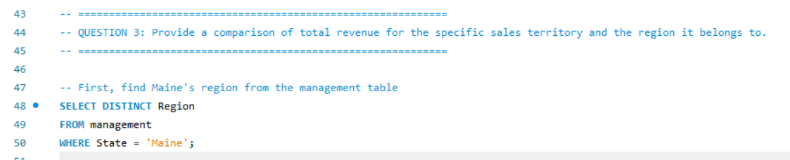
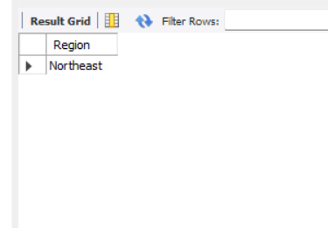
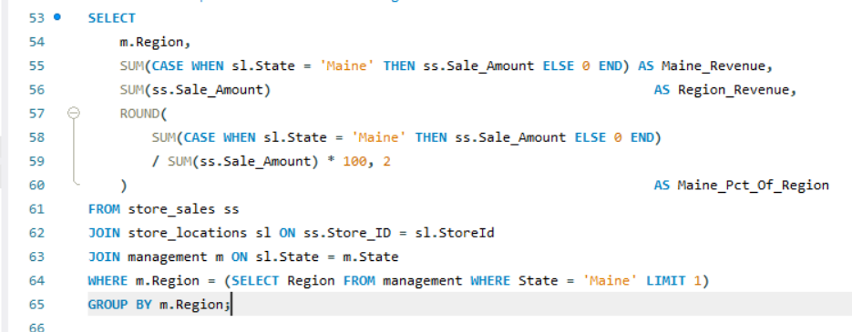
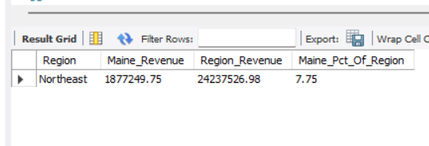
Provide a comparison of total revenue for the specific sales territory and the region it belongs to
Query
Result

Slide 7
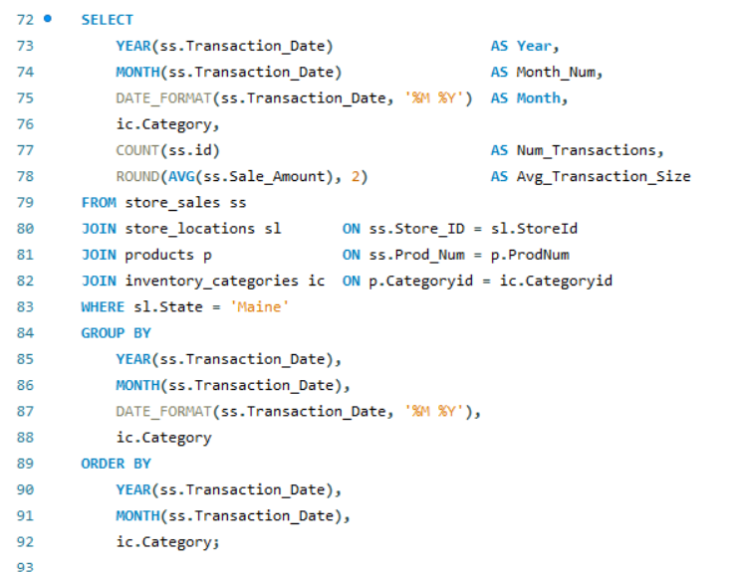
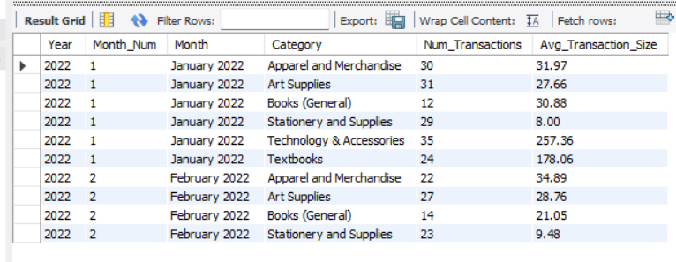
What is the number of transactions per month and average transaction size by product category for the sales territory?
Result
Query

Slide 8
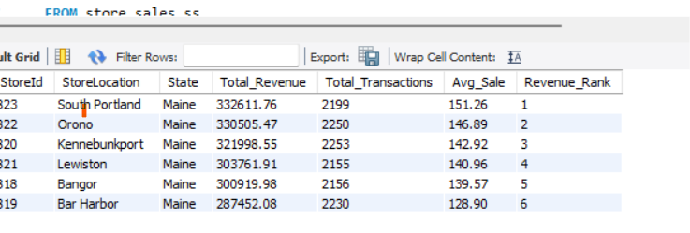
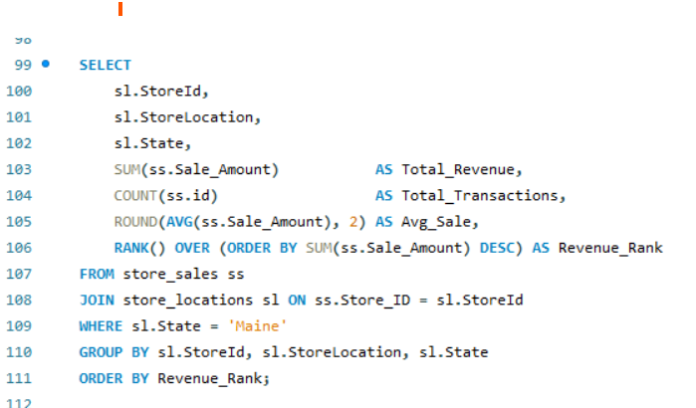
Can you provide a ranking of in-store sales performance by each store in the sales territory, or a ranking of online sales performance by state within an online sales territory?
Query
Result

Slide 9
What is your recommendation for where to focus sales attention in the next quarter?
FOCUS ON BAR HARBOR (lowest ranked store): Bar Harbor ranks last in both total revenue ($287,452) and average transaction size ($128.90), despite having 2,230 transactions — the second highest transaction count. This means customers are coming in but spending less. A targeted upselling strategy, particularly around high-value categories like Technology & Accessories and Textbooks, could significantly boost revenue without needing to increase foot traffic.
CAPITALIZE ON SEASONAL PEAKS: January is consistently the weakest month (e.g., $15,700 in Jan 2022). A post-holiday promotion in January targeting Textbooks (back to semester) and Stationery could help offset this seasonal dip. June shows strong performance and should be supported with adequate inventory heading into summer.
.

Slide 10
Visualization
Maine Store Revenue Summary
Store Location | Total Revenue | % of Total
South Portland | $332,611.76 | 17.7%
Orono | $330,505.47 | 17.6%
Kennebunkport | $321,998.55 | 17.2%
Lewiston | $303,761.91 | 16.2%
Bangor | $300,919.98 | 16.0%
Bar Harbor | $287,452.08 | 15.3%
Grand Total | $1,877,249.75 | 100.0%

Slide 11
GitHub Repository

