Slide 1
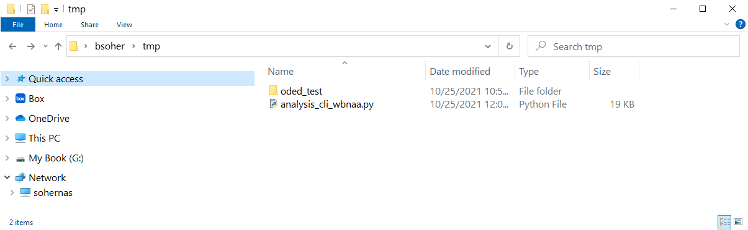
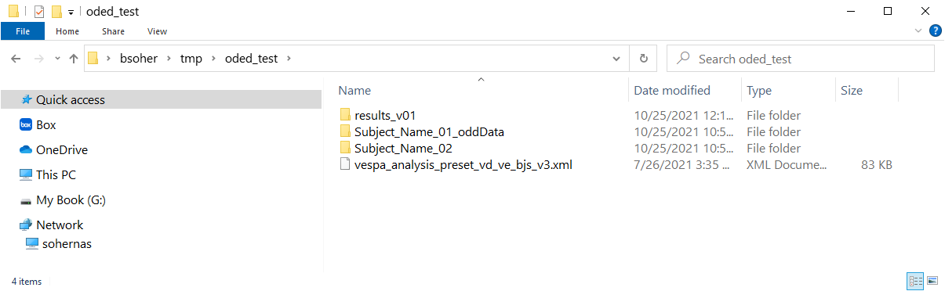
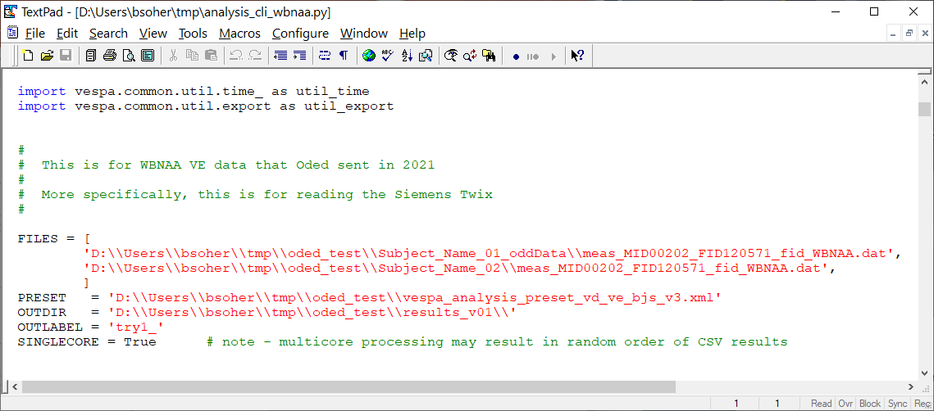
1. Create a directory, put the batch file (analysis_cli_wbnaa.py) in there and make a sub-directory (here called ‘oded_test’). This will be where data files, preset files and results are stored.
2. In ‘oded_test’ sub-directory, create another sub-directory for the results (here called ‘results_v01’). Copy data to sub-directories inside ‘oded_test’. This is just the *.dat file for each subject. You can use a separate sub-directory for each subject, or put them all into one directory. Last, copy the Preset file into ‘oded_test’ (here called vespa_analysis_preset_vd_ve_bjs_v3.xml).
Open up the batch file (analysis_cli_wbnaa.py) in a text editor.
Edit the values for FILES, PRESET, and OUTDIR to match your directory structure and file names
In the FILES list, add all the files that you want to fit
File names have to be in double quotes, and the directory symbol (‘\’ backslash) has to be doubled
There should be a comma after each file name.
Edit PRESET to have to correct directory path
Edit OUTDIR to be the directory path to the sub-directory you created
Optionally, you can change OUTLABEL to some (short) string that will be added to the front of each result file to personalize a batch run.
For now, leave SINGLECORE as True

Slide 2
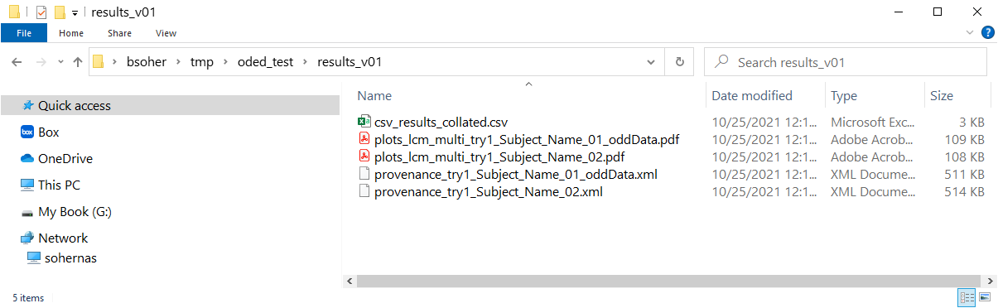
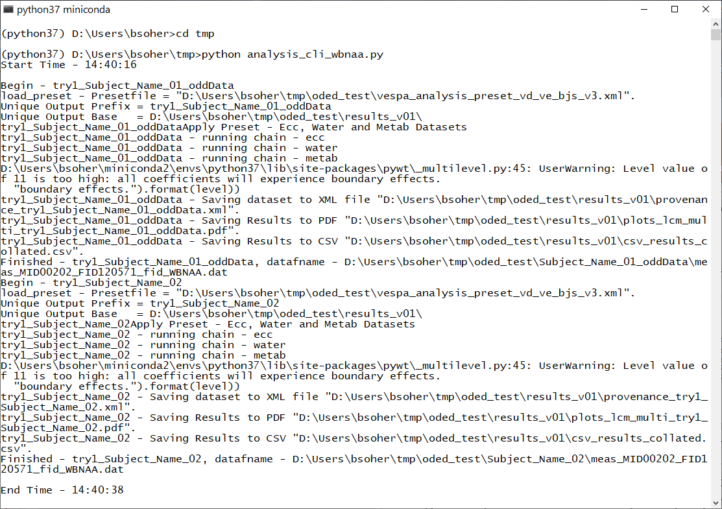
4. Results will be stored in the directory you list in a fashion similar to below. A PDF file will show plots of the fit. An XML file will save the Vespa-Analysis session for provenance (i.e. you can read it back into Vespa-Analysis later if you want to see what was done). And CSV output for each fitted data file is appended into the ‘csv_results_collated.csv’ file.
To run the script, open a Python command window. You should use the same Python installation you use for Vespa generally. CD to the directory that you put the ‘analysis_cli_wbnaa.py’ script. At the command line type > python analysis_cli_wbnaa.py
and hit Enter. A bunch of messages should print out, but at the end there should be a message saying “End Time …”
Commands to launch the batch script
6. Note. Once you are sure that the batch file is working for you, maybe start with just a few filenames to test it, you can turn on the parallel processing by setting SINGLECORE = False. For now, this will cause the batch script to try to use 4 cores to process the data files listed. No worries if you have less than 4 files. Likely no worries if you have less than 4 cores, I think it’ll just use your max number of cores. This may slow down your computer until the processing finishes. Also, results are saved as each core finishes. Thus the results rows appended into the ‘csv_results_collated.csv’ file may be in a different order than the data files were listed. This can be easily ‘fixed’ by opening the csv file in Excel and sorting the rows by the filename column (assuming you want to sort by path/filename).

