Slide 1


Deus Ex Machina
Victor Espidol and Adam Novak

Slide 2
Overview of Pipeline
Ready the data
Split data to training and testing
Standardize / Normalize data
Gray scale and flatten data
Attempted to use four different classifiers to determine which is best
K-Nearest Neighbors
Random Forests
Multilayer Perceptron
Convolutional Neural Network
Perform Accuracy Checks on each model

Slide 3
Model #1: K-NN
Easy to implement and understand
Compares associated neighbors
Parameters Tweaked:
Number of neighbors evaluated 1-10
Unweighted neighbors
Evaluated with Euclidean Distance

Slide 4
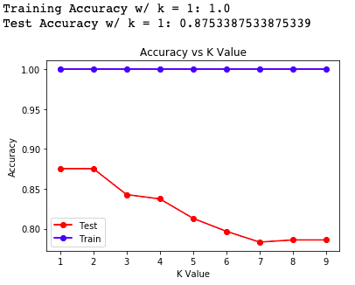
K-NN Performance
Downfalls
Overfitting
Could not get test accuracy > 90%.

Slide 5
Random Forests
Constructs many decision trees during training
Then outputs the class of the individual trees
Parameters Changed
Number of estimators
1, 5 ,10, 20, 50, 100, 500

Slide 6
Random Forests Performance
Best accuracy achieved with 100 estimators
85% accuracy on test data
Downfalls
No matter how parameters tuned, we could not get higher than 85%

Slide 7
MLP
Feedforward artificial neural network
Involving multiple layers of perceptrons with activation functions
Input layer, hidden layers, output layers
Tested with tanh and logistic activation
Tested with sgd and adam solver
Best combination: logistic activation with sgd solver

Slide 8
MLP Performance
Test data yielded 81% accuracy
Downfalls
Many parameters need to be fine tuned
Run time was very long
Not enough time to play around to increase score

Slide 9
CNN
Construct a feature hierarchy by combining low level features to create a high-level feature
Such as blobs and edges
Very popular for image processing
Thus invested time into this

Slide 10
CNN - Nets
Used different nets to determine which accuracy we could get
Net 1:
Used tanh activation and linear transformation
Net 2:
Same as Net 1 with inclusion of dropout and batch normalization
Net 3:
Same as Net 1 but uses ReLU for activation instead
Net 4:
Same as Net 4 but uses ReLU for activation instead

Slide 11
CNN - Performance
All Characters
Easy Characters
Net 1 - 86%
Net 2 – 90%
Net 3 – 74%
Net 4 – 71%
Net 1 – 93%
Net 2 – 98%
Net 3 – 83%
Net 4 – 81%

Slide 12
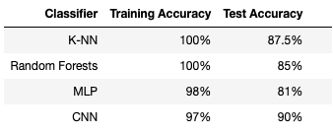
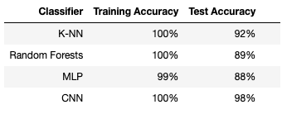
Accuracy Comparison
Normal Characters
Easy Characters

Slide 13
Thank you, questions?

