Slide 1
Delivery Time
Linear regression model

Slide 2
Objective
Data of delivery time for sorting time is given.
Aim is to build model using Linear regression model.
And, is to predict the Delivery time using Sorting time

Slide 3
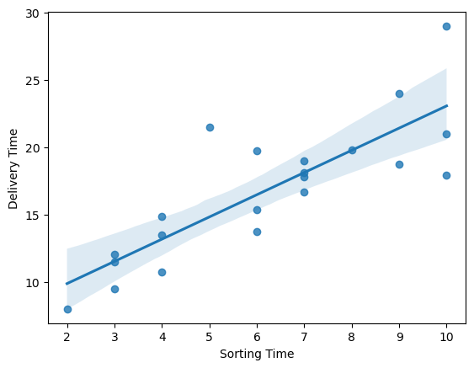
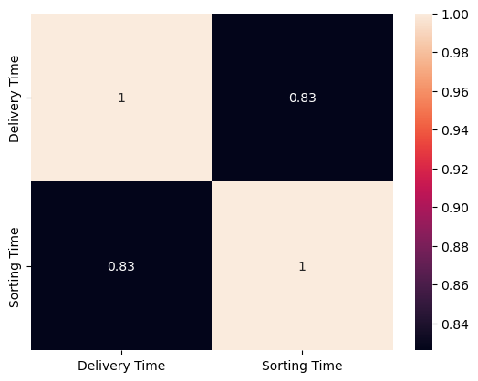
Solution
Correlation factors
Linear regression fitting
Coefficient : 1.5999
Intercept : 6.6721
R-Square Score: 0.9014

Slide 4
Business Impact
Delivery time shows strong correlation with sorting time.
With increasing sorting time, delivery time also increases.
Prediction model can help business with their decision. Business can evaluate the sorting time for target delivery time.

