Slide 1
Salary
Linear regression model

Slide 2
Objective
Data of Salary against years of experience is given.
Aim is to build model using Linear regression model.
Is to build a prediction model for Salary Hike.

Slide 3
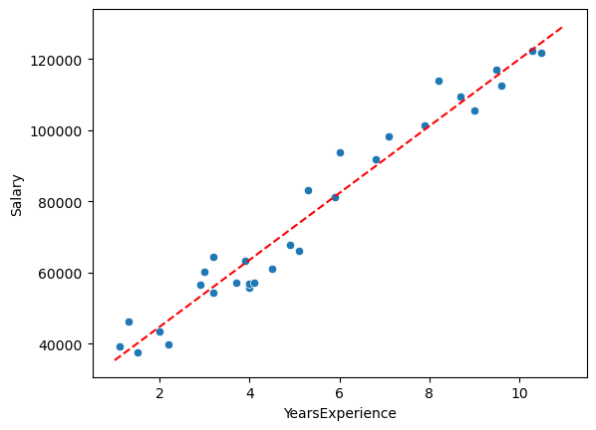
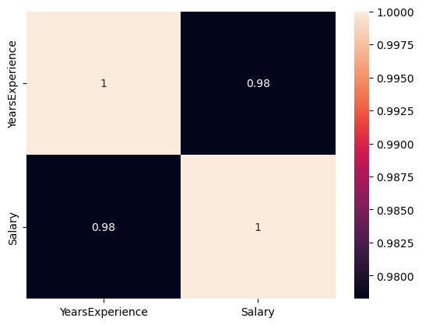
Solution
Linear regression fitting
Coefficient : 9398.08
Intercept : 25977.43
R-Square Score: 0.988
Correlation factors

Slide 4
Business Impact
Salary hike shows strong correlation with years of experience.
With increasing experience, salary hikes linearly.
Prediction model can help individual with their decision. Employee can evaluate their salary based on years of experience.

