Slide 1
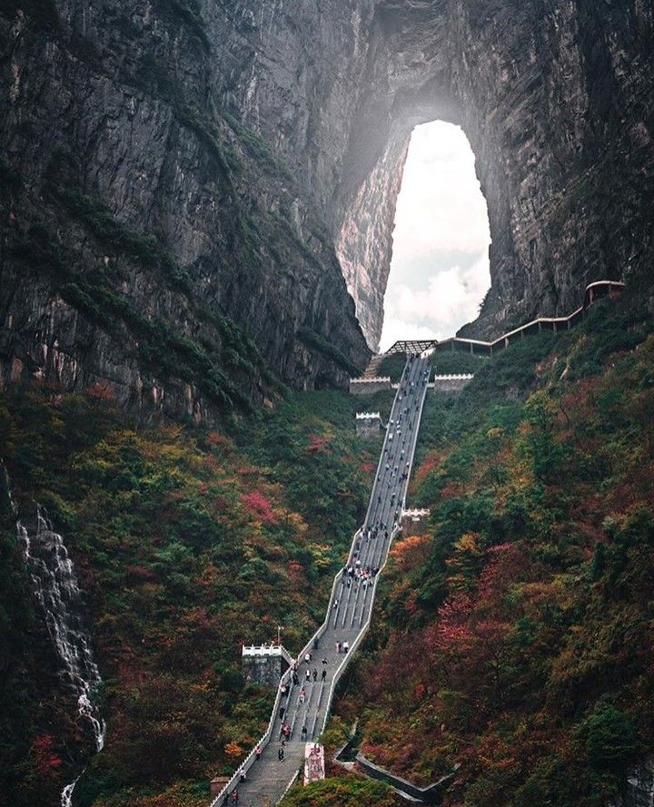

Development portal for people and companies
- side-by-side -

Slide 2
The performance of people and the companies for which they work are governed by each others’ level of development towards the purpose they set for themselves.
Educated, proficient, engaged
Start here to see your current individual development level and to set targets for your career. Click to enter
World class people and business development processes
People
Alignment between people and company
Companies
Uneducated, inexperienced, disengaged
No people processes, undefined business processes
Start here to see your current company’s people development level and to set targets for your company. Click to enter
P1

Slide 3
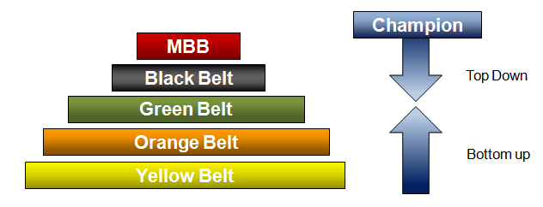
Continuous Improvement (CI) Program
At Sample Company (SAMPLE) we recognize that our people are our biggest asset and we understand that in order to achieve ambitious growth and profitability goals for the company we must attract and retain people who are just as committed to reach ambitious growth and development targets for them and their families. The SAMPLE Continuous Improvement (CI) program aims to accomplish this win-win synergy by offering our people a full range of training and development materials developed by the world’s best minds.
All training, including internal and external educational courses and books read will all qualify to earn CI Credits (CICs) for each SAMPLE employee using the Rules specified below. The CI Credits earned will be acknowledged as part of your annual performance reviews.
The development of each SAMPLE employee will be further recognized by awarding different color belts to individuals based on the CI Credits earned, together with certain additional development criteria listed below:
P2

Slide 4
Company Assessment (to follow)
Username:
Password:
P1

Slide 5
Individual Assessment (to follow)
Username:
Password:
P1

Slide 6
ADMIN
CI Program Settings
Requirement per Belt |  |  | Y | Y | Y | Y
 | Belt | Cumm. Credits | A3 or Eq. Diagrams | Kaizen Events | Savings | 360° Evaluation
 | Yellow | 20 | 1 | 1 | $ - | 0
 | Orange | 35 | 2 | 2 | $ - | 0
 | Green | 50 | 3 | 3 | $ 10,000 | Top 2/3
 | Black | 70 | 4 | 4 | $ 25,000 | Top 1/2
 | MBB | 100 | 5 | 5 | $ 100,000 | Top 1/3
Apply test scores to CEC's? |  |  | Y
Earned CEC per event
 | Event | Credits
 | A3 | 1
 | Kaizen | 5
P2

Slide 7
ADMIN
Company Library
No | Author | Title | Publisher | Yr | Rating
 | Add book
We need a way to add and delete books – admin only
P1

Slide 8
ADMIN
Employees
ID | Employee Name | Role | Mentor Name | Edit
30133 | John Abbott | Fabricator | Matthew Chamlin
23125 | Catherine Buckley | Sales Manager | Paul Tudesky
17899 | Matthew Chamlin | Production Lead | Westly Kramer
31455 | Jane Edwards | CFO | Eddy Kazinsky (e)
16677 | Sean Higgens | Assembly | Matthew Chamlin
29112 | Westly Kramer | Production Manager | Paul Tudesky
37144 | Becky Langford | Administrator | Jane Edwards
12578 | Jeffrey Martin | Quality Control | Paul Tudesky
16739 | Andy Newton | Engineer | Westly Kramer | ●
26687 | Michael Preston | Assembly | Matthew Chamlin
10106 | Susan Ross | HR Manager | Paul Tudesky
22469 | Mary Swenson | Sales | Catherine Buckley
31258 | Paul Tudesky | President/CEO | Eddy Kazinsky (e)
32221 | Charles West | Accountant | Jane Edwards
18184 | Gena Yule | Fabricator | N/A
 | Add employee
We need a way to add and delete people – admin only
Edit
P1

Slide 9
ADMIN
Add New Training Event
Available for Admin, Mentors/Managers and Individuals; All types of training entered here will populate the credit log once approved by mentors/leads
Responsible trainer/lead:
Auto-fill current user
Planned training date:
calendar drop-down
Training format:
drop-down
- A3 Diagram - Kaizen Event - Video training - Custom Training
Training Description:
Max 80 characters
Training Notes:
Max 300 Words (1p)
Submit
P1

