Slide 1
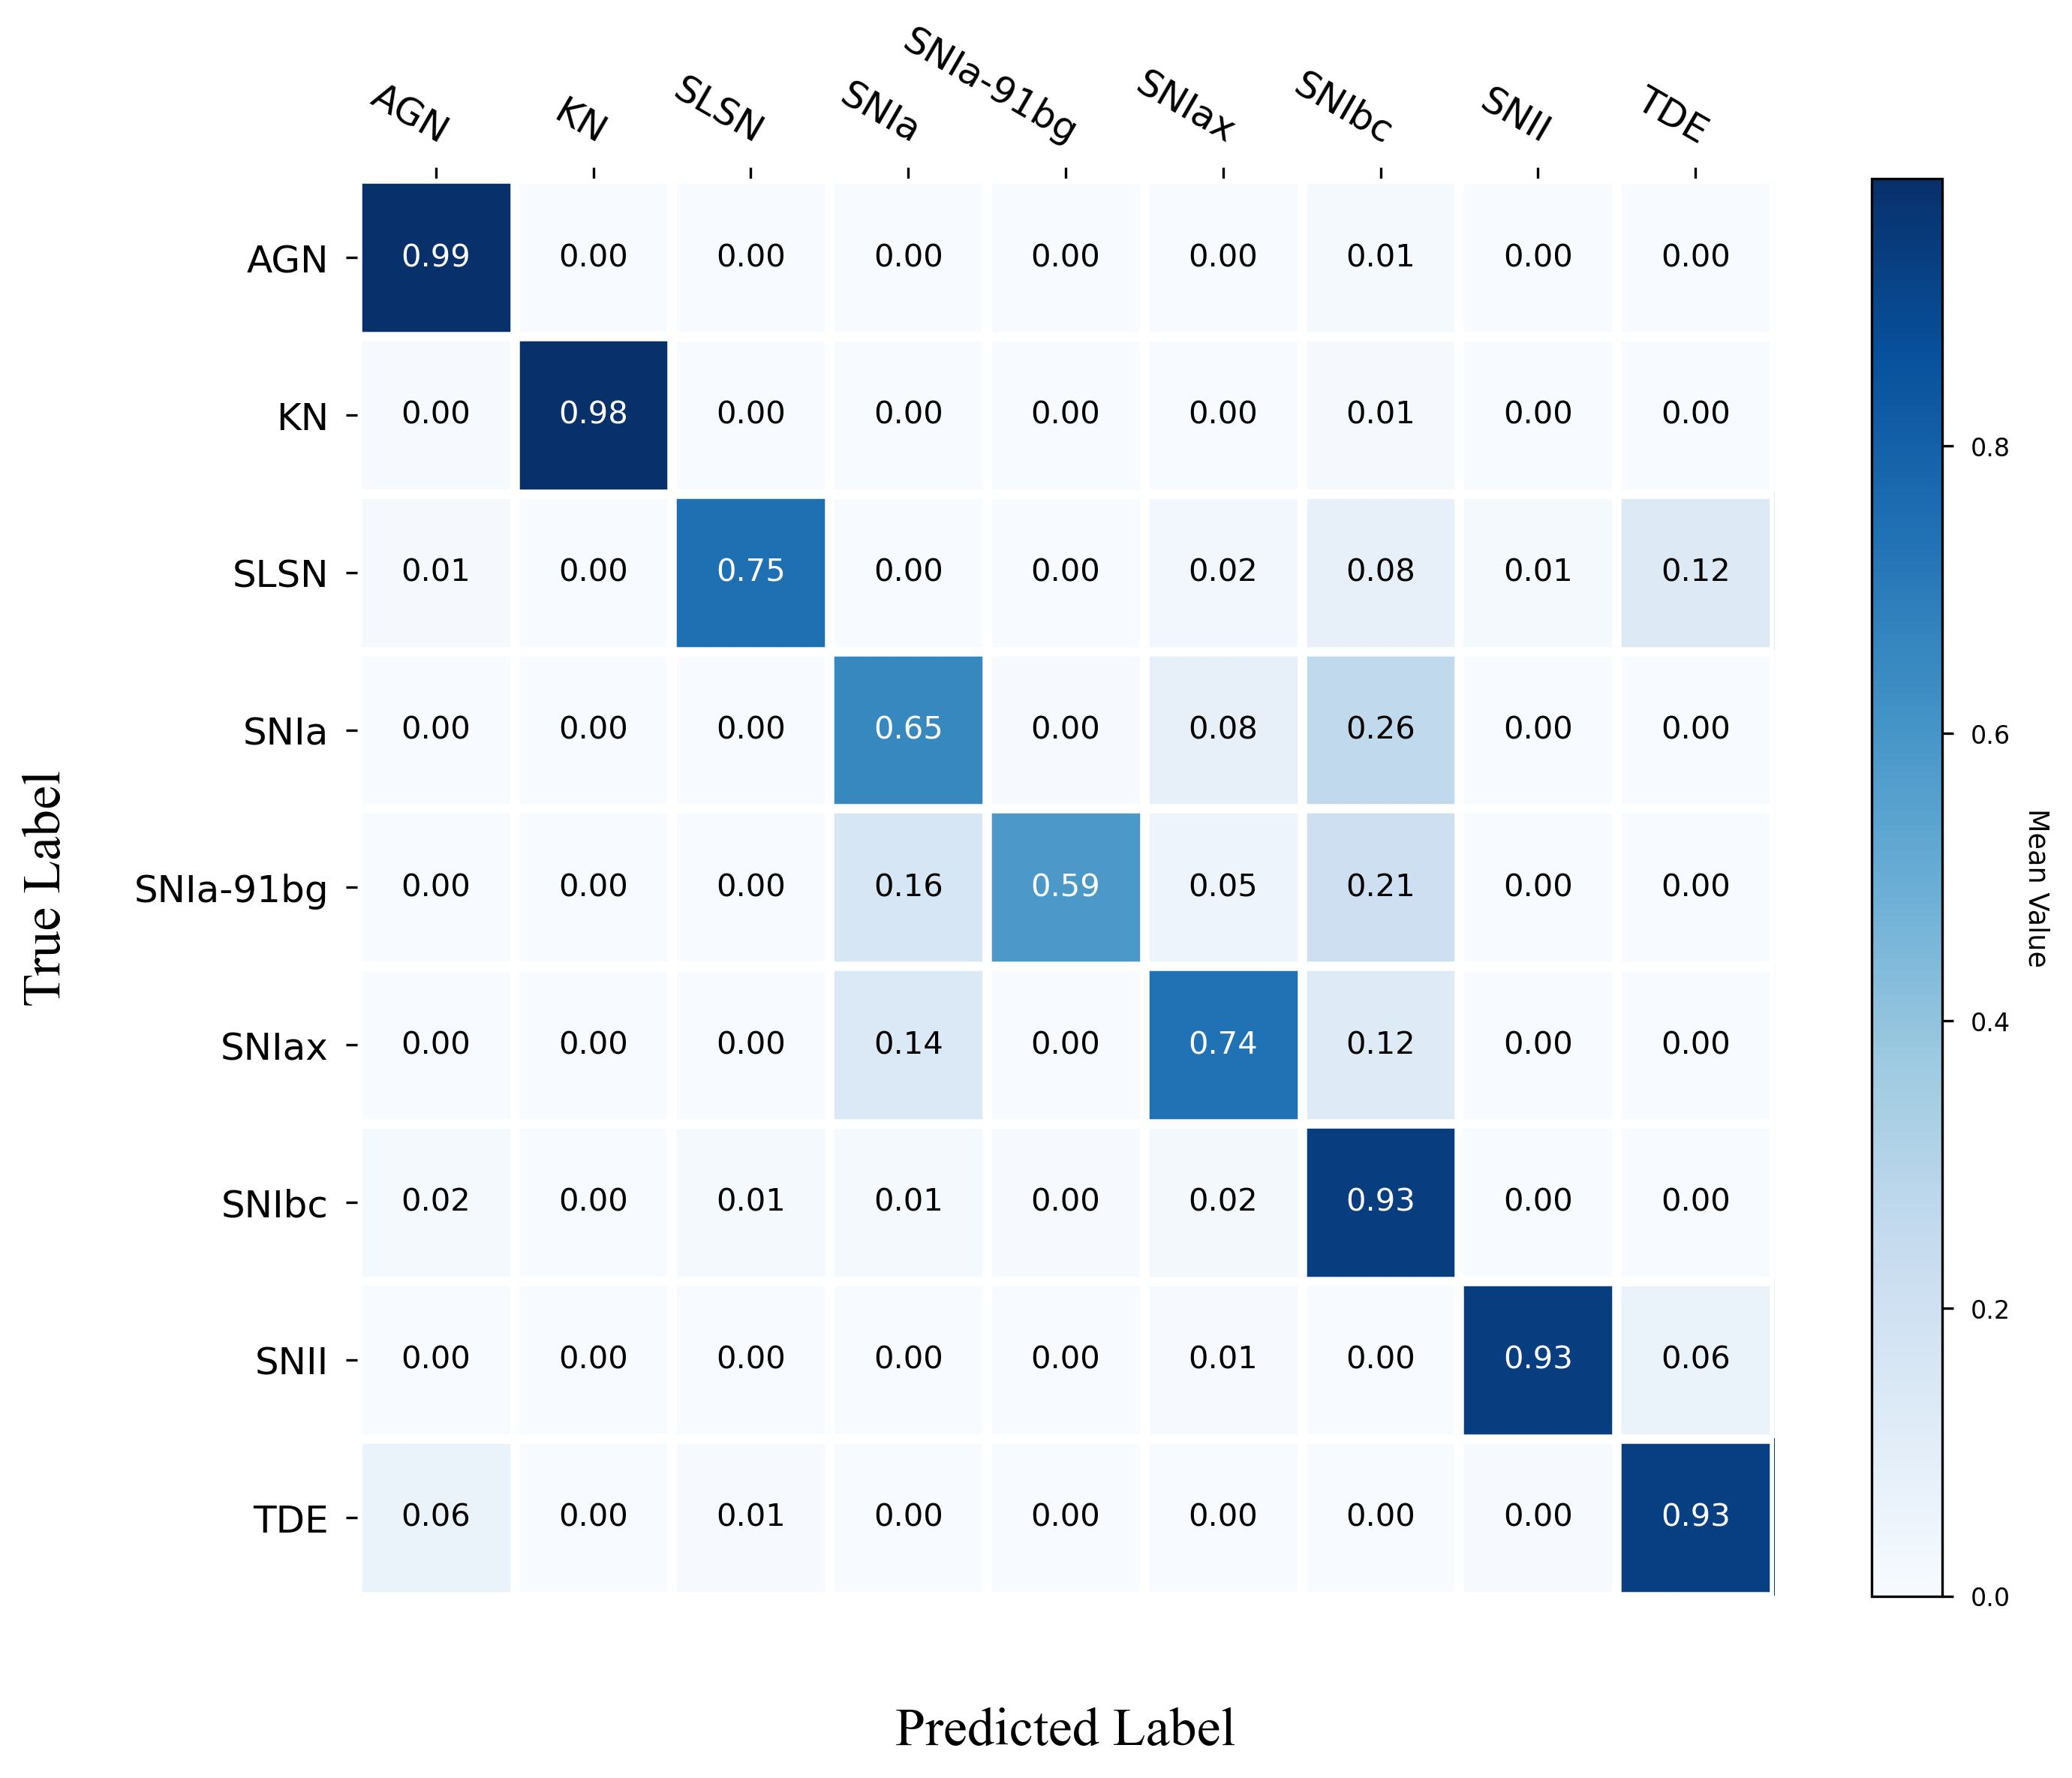

True Label
Predicted Label

