Slide 1
Computational Geosciences
Mathematics and Cybernetics
- Erlend Syljuåsen, Vetle Nevland

Slide 2
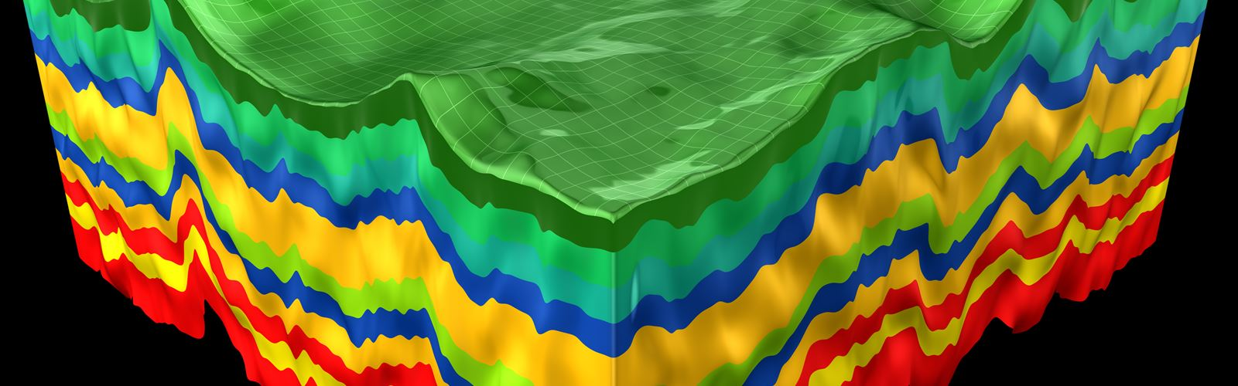

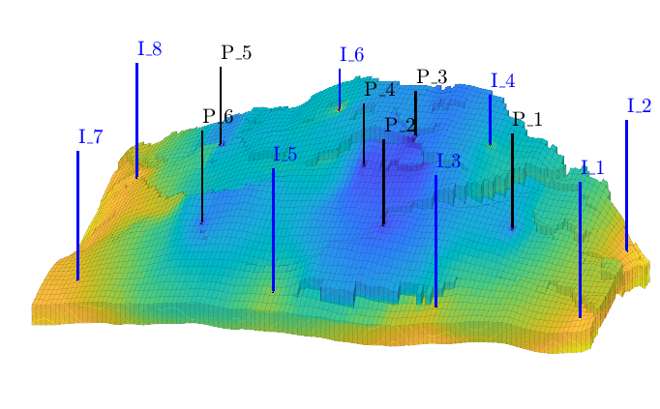
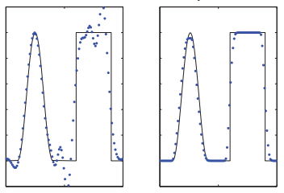
The group
16 permanent scientists
Numerical methods and simulation tools
Subsurface applications
MRST
Gemini center on quantum computing
Lie, K. (2019)
Notes:
Group constitute 16 permanent scientists, in addition to postdocs and supervised phds and master students.
Traditionally, the group has performed generic research on numerical methods and simulation tools. Most of the research is done for geoscientific applications, hence the naming of the group. Still the researchers in the group think of themselves more as applied mathematicians and computer scientists rather than specific application experts.
Much of research is done within subsurface applications, including oil recovery and carbon capture storage. The self-developed software MRST in MATLAB is extensively used. It is a large-spanning library of mathematical methods and numerical solvers, particularly used for solving nonlinear PDEs.
The group is currently also involved in a Gemini center on future applications of quantum computing. This is a collaboration between UiO, NTNU, Simula and SINTEF, which was founded in 2020. Currently we do not know exactly when quantum computers will be powerful enough to overtake classical computers for certain tasks, but maybe in a timeframe of 5-10 years?. So the overall goal for this project is to make Norway "quantum ready" in a sense.

Slide 3
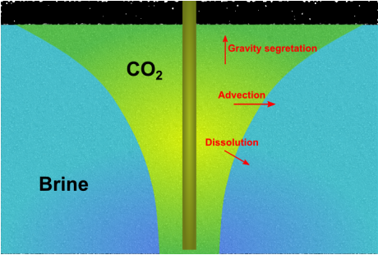
My project – CO2 migration
What?
Flow of CO2 in reservoirs
CO2-storage
Notes:
What?
My project involves an analysis of how CO2 migrates after injection into a reservoir. Since CO2 is lighter than water, it will principally ascend in vertical direction, but the path is further complicated by the structure of layers in the reservoir, their permeability (the ability of the layer to transmit fluids) and other properties of rock and fluid.
So an essential part of my project is to assess how different structures and properties of reservoir affect flow behavior of CO2. This amounts to running stochastic simulations with different settings, and find relations between the parameters and paths taken by CO2.
Most relevant application area: CO2 storage in subsurface --> a growing industry for mitigating the impact of climate change.

Slide 4
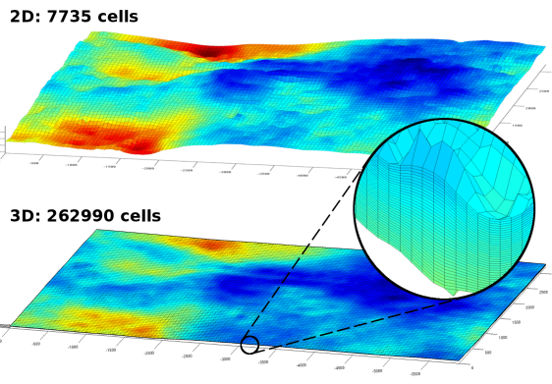
My project – CO2 migration
What?
Flow of CO2 in reservoirs
CO2-storage
Why?
Minimize leakage
Large temporal + spatial scales
Notes:
Why is this kind of study important?
Understanding how CO2 flows subject to various reservoir conditions will facilitate more accurate prediction of path taken from injection point to endpoint. Therefore, crucial to acquire data of relations between CO2 migration and reservoir properties in order to find optimal injection site that minimize future leakage, and at same time maximizes capacity of injected CO2.
Drawback of simulating CO2 storage: prominent one -> very large temporal and spatial scales. It becomes challenging to accurately discretize the reservoir at full scale. It is simply not feasible to reproduce every fine detail of the reservoir.
Simplification and coarsening required.
In other words, there WILL be deviations between numerical representation and real data. Therefore, it is important to address how sensitive CO2 migration is to minor changes in reservoir conditions – as this indicates how detailed the numerical representation should be.

Slide 5
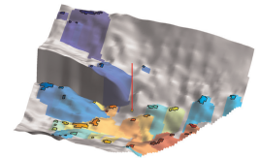
My project – CO2 migration
What?
Flow of CO2 in reservoirs
CO2-storage
Why?
Minimize leakage
Large temporal + spatial scales
How?
Numerical discretization
Predict migration paths
Notes:
How do we do this kind of study?
Using MRST library in MATLAB to numerically discretize the grid and solve the system of equations.
With these tools, the migration path of CO2 can be predicted up to a certain accuracy. After sufficient stochastic simulations, one can estimate how much CO2 is trapped under certain conditions, and also how large error the discretization imposes.

Slide 6
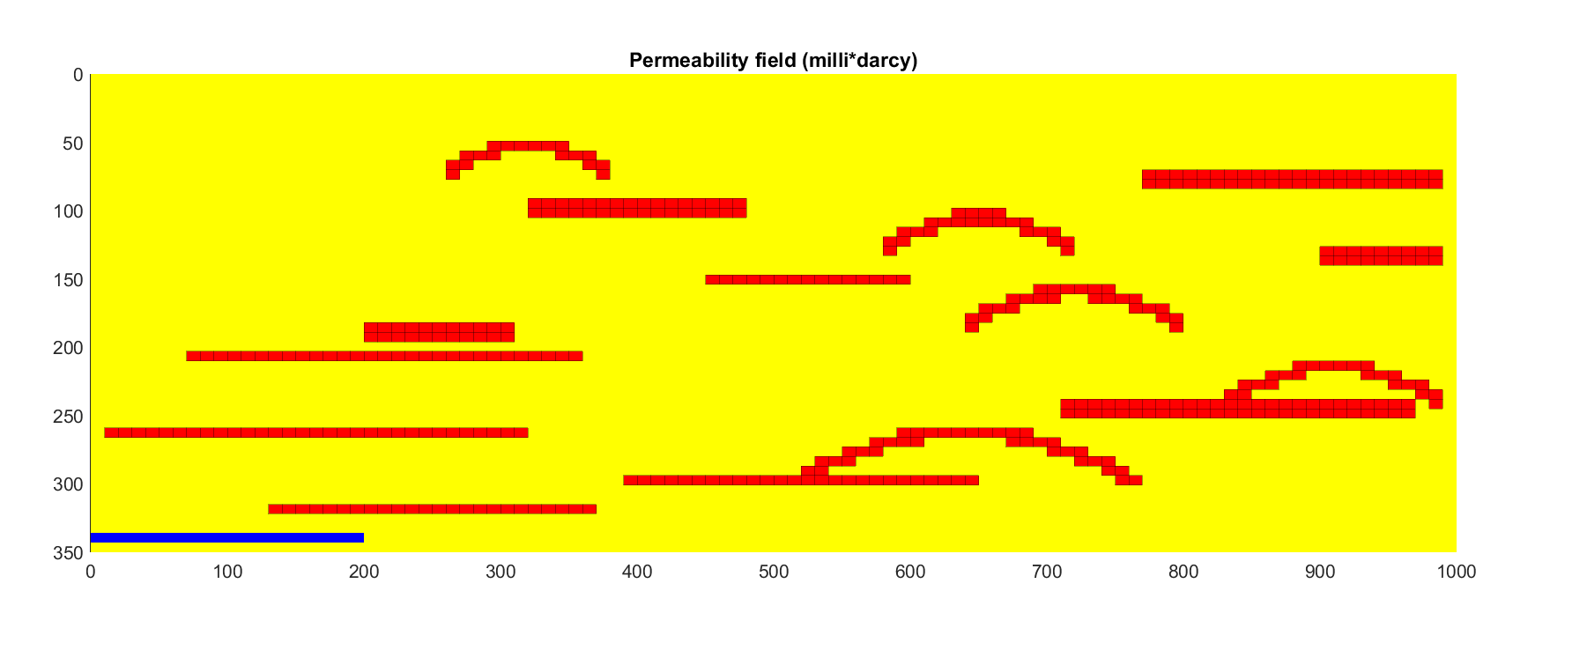
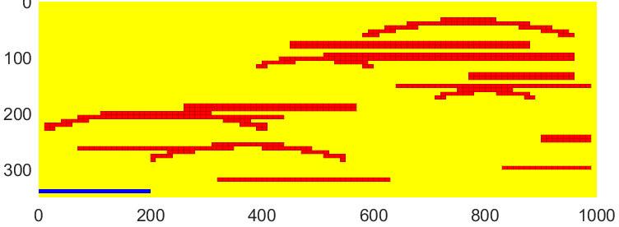
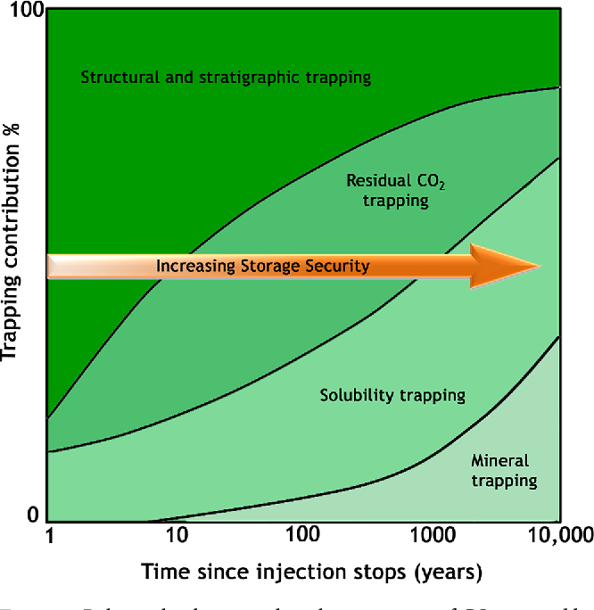
Overarching goal
Sensitivity to reservoir parameters
Trapped vs. leaked CO2
Max injected CO2 before leakage
Synthetic grids
Altman, Susan Jeanne et al. (2014)
Notes:
In general terms, the goal with the project is as follows.
Analyse how sensitive migration of CO2 is to variations in reservoir parameters such as number of layers, types of layers, grid resolution.
For example, will a slightly different CONFIGURATION of the layers introduce completely new migration paths (UPPER TWO FIGURES)? If that's the case, it indeed needs to be accounted for when choosing a numerical discretization.
Based on the sensitivity, there will be a certain loss imposed by the numerical discretization. A relevant question to ask is then: how much loss of details is “acceptable”?
Also addressed: How much of injected CO2 volume will be trapped inside reservoir and how much will leak out?
Will prioritize two main trapping mechanisms: structural trapping – below impermeable layers, and residual trapping – CO2 immobilized inside pores of rock
The plan is to implement a script to find the maximum amount of CO2 we can inject before leakage occurs – for different reservoir conditions, [ and also categorize the final volume into main trapping mechanisms. ]
The test cases are run for synthetic grids. Why? Because – as mentioned – simulating CO2 storage is computational expensive – not feasible to experiment on real data - at least not the full 3D set. Instead, make coarser representations – gradually add more complexity to mimic real reservoirs.
[ Benefit: Using synthetic grids, we can freely modify the model parameters just as desired – will further facilitate generalization ]

Slide 7

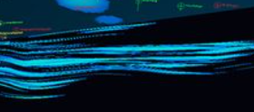
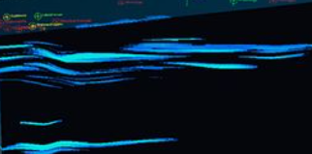
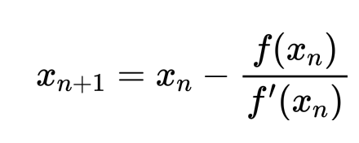
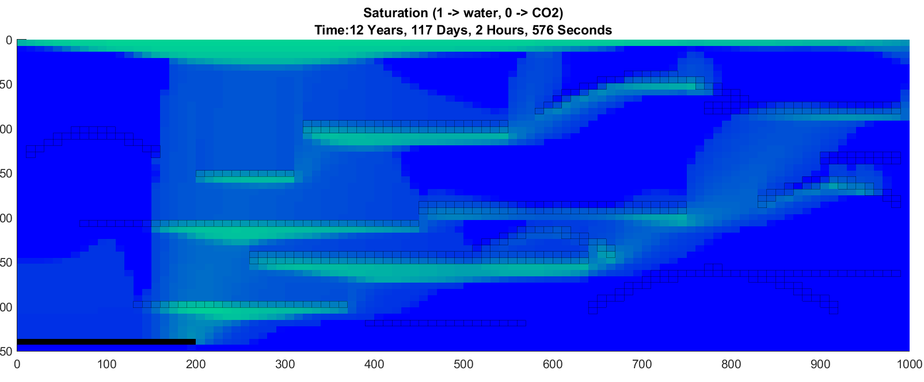
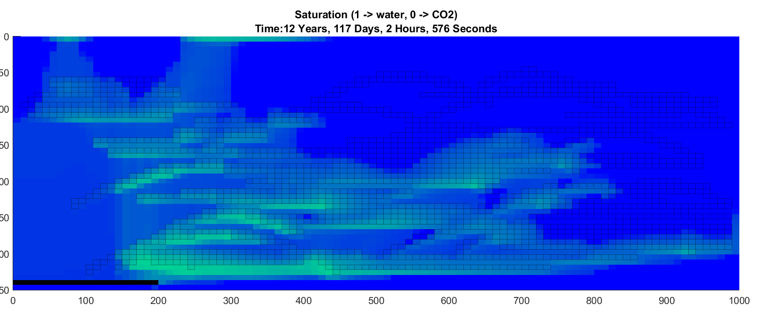
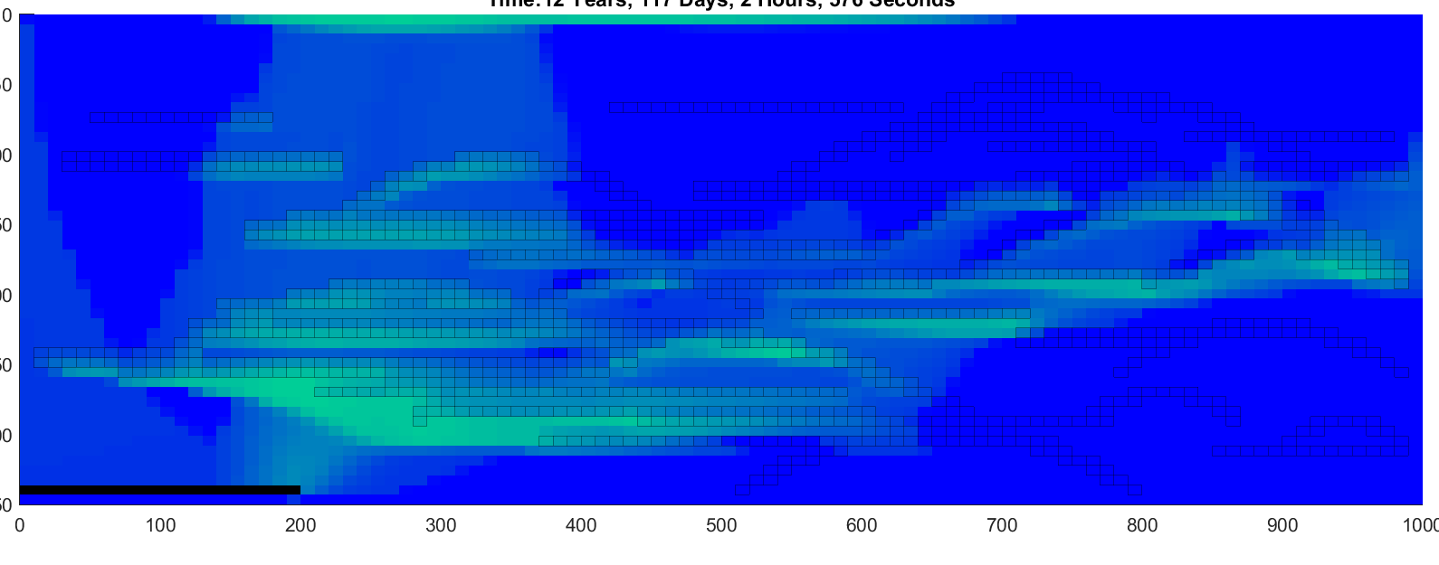
Tentative plan
Palermo,Denis et al. (2012)
Get acquainted with MRST
Start off simple
Progressively increase complexity
(Generalise to real datasets)
Notes:
The current plan for the project is subject to changes --> a lot to look into, so need to prioritize most interesting or feasible parts.
First step -> Get acquainted with MRST:
- Includes - the procedure from defining domain, setting up fluid/rock properties, define boundary conditions and initial state, and finally to run simulations.
Plan is to perform case studies in a progressive fashion
Start off simple – get to know basic behavior
Progressively add new elements and complexity – closer and closer resemble real injection scenario, including:
Different number of layers, of different permeability
Capillary forces – pressure induced by presence of different fluids
Effect of hysteresis –> a system where current state depends on the system's history of states, not just previous state.
If time permits, results and findings from synthetic data could be used as basis for a simulation of a real dataset -> restrict to 2D - have considered looking into a 2D section of Sleipner field.

Slide 8

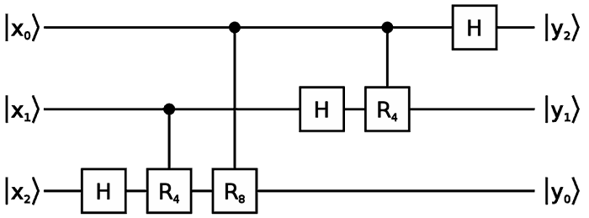
Quantum computing
Qubits
Quantum circuit
Possible applications
Cryptography
Search problems
Simulation of quantum systems
Optimization
Notes:
I am involved in SINTEFs quantum computing project. The overall goal of this project is to investigate possibilites and application areas of quantum computers to solve practically relevant problems. We do not have a quantum computer here at SINTEF, so the research is more about gaining knowledge of quantum algorithms and how they perform.
I assume that not all of you know what a quantum computer is, so first I am going to give a quick introduction of the topic. For a quantum computer we use quantum bits or so called "qubits". A qubit is a two-state quantum mechanical system. An example of such a system could be the spin of an electron. Like, spin up and spin down.
So at a specific time instance you know that a classical bit has to be either "1" or "0", but a qubit can be in so called superposition of "1" and "0", or it may actually exist in both states at the same time. However when we measure a qubits state we only get "0" or "1".
A quantum circuit can look like this. You read such a circuit from left to right, so in the far left we have three qubits which are prepared in some state. In the middle we see gates or operators. At the end we measure the circuit and for every qubit we get "0" or "1". So if we measure many times, we would get a probability distribution for the states.
Currently there are many possible known applications where quantum computers could outperform classical computers. I have listed some here.

Slide 9
QAOA- Quantum Approximate Optimization Algorithm
Combinatorial optimization problems
Notes:
For this summer I only focus on one algorithm, the so called Quantum Approximate Optimization Algorithm.
The algorithm aims to give approximate solutions to combinatorial optimization problems. An example of such a problem is the Max 2 – cut problem.
Given a discrete graph, here with 4 nodes and 4 edges, we want to color each node in red or blue, and then count edges going between the red and the blue group. We want the configuration that gives the maximum number of edges between the two groups.
For this graph, one possible solution could look like this

Slide 10
QAOA- Quantum Approximate Optimization Algorithm
Combinatorial optimization problems
Notes:
Here we count one-two-three edges between the red and the blue group.
Or you could think about cutting the graph into two separate parts like this. (tegn), so we have 3 edges crossing the cut.

Slide 11
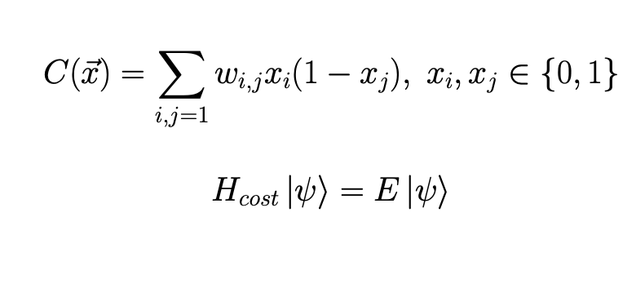
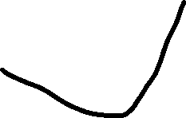
QAOA- Quantum Approximate Optimization Algorithm
Combinatorial optimization problems
Notes:
More mathematically we can write the problem by maximizing a cost function. You can see the cost function for the max-cut problem here, where xi, xj are binary variables and w is the weight of the edge. To solve this problem with the algorithm we first need to map the cost function to act on qubit states. We do this by rewriting the cost function to an operator which acts on a state of qubits. The maximum cost becomes the maximum eigenvalue, and the solution configuration becomes the eigenvector corresponding to the maximum eigenvalue.

Slide 12



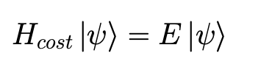
QAOA- Quantum Approximate Optimization Algorithm
Step 1: Prepare state
Step 2: Measure state
Step 3: Classical optimizer
(adjust parameters)
Notes:
Without getting too technical the first step of the algorithm is to create a quantum circuit to prepare a state. We start of with some qubits in a state psi. Then we apply gates with parameters gamma and beta to the state, such that we end up with a state dependent on gammas and betas.
Step 2 consists of measuring the circuit to obtain an expectation value of the cost operator. We then get a possible solution to our problem, but maybe not the maximum as we want to. Therefore we feed this result in to a classical optimizer, which changes the beta and gamma parameters. We then perform this multiple times until we find the maximum eigenvalue as the expected value of the cost operator, or an approximate maximum eigenvalue, which is the solution to our problem.
The algorithm performs good even for a low amount of parameters
This summer I am looking on how to effectively do step 1. The challenge is how to parametrize the state with using as few qubits and gates as possible. The cost operator is given from the problem formulation, but the mixer operator is the one I experiment with.
I am using quantum computer simulators to run tests and I am also part of developing an open source code to run this algorithm effectively.

Slide 13

quantumcomputing.no
github.com/OpenQuantumComputing
Notes:
If you want to read more about this project, or look at the code you can check out these to webpages.

Slide 14
Notes:
Thanks for listening, if you have any questions feel free to ask the now.

