Slide 1
DIGITAL PORTFOLIO
STUDENT NAME: Vetrivel J
REGISTER NO AND NMID: 32324u09078 &
astvu32332324u09078
DEPARTMENT: BCA
COLLEGE: Voorhees College/Thiruvalluvar University

Slide 2
Presentation title
2
Project Title Digital portfolio
Student digital portfolio
Portfolio Website using HTML, CSS & JavaScrip

Slide 3
Presentation title
3
AGENDA:
Problem Statement
Project Overview
End Users
Tools and Technologies
Portfolio design and Layout6
Features and Functionality
Results and Screenshots
Conclusion
Github Link

Slide 4
Presentation title
4
PROBLEM STATEMENT
Traditional resumes lack interactivity and design.Students need a digital platform to showcase skills and projects.A portfolio website acts as a personal brand identity.Slide 3 – Project OverviewA personal portfolio website built using HTML, CSS, and JavaScript.Displays information about me, my skills, projects, and contact details.Fully responsive design to work on desktop and mobile

Slide 5
Presentation title
5
PROJECT OVERVIEW
A personal portfolio website built using HTML, CSS, and JavaScript.Displays information about me, my skills, projects, and contact details.Fully responsive design to work on desktop and mobile.

Slide 6
Presentation title
6
End Users
Students who want to showcase their projects.Recruiters and hiring managers.Teachers and evaluators.General audience interested in my work.Slide 5 – Tools & TechnologiesHTML5 → StructureCSS3 → Styling & LayoutJavaScript → InteractivityVS Code → Development ToolGitHub → Hosting & Version Control

Slide 7
Presentation title
7
Tools and Technologies
HTML5 → StructureCSS3 → Styling & LayoutJavaScript → InteractivityVS Code → Development ToolGitHub → Hosting & Version Control

Slide 8
PORTFOLIO DESIGN AND LAYOUT
Presentation title
8
Navbar with Home, About, Projects, ContactHero Section with introductionAbout Me section with profile photo & bioProjects Grid to showcase workContact Section with email & phone

Slide 9
FEATURES AND FUNCTIONALITY
Presentation title
9
Responsive design (mobile-friendly)Hamburger menu toggle for small screensSmooth navigation using anchor linksProject showcase cards with hover effectsSimple and attractive UI

Slide 10
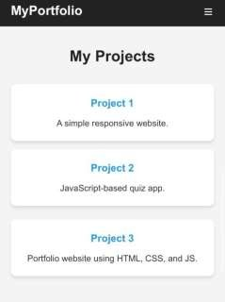
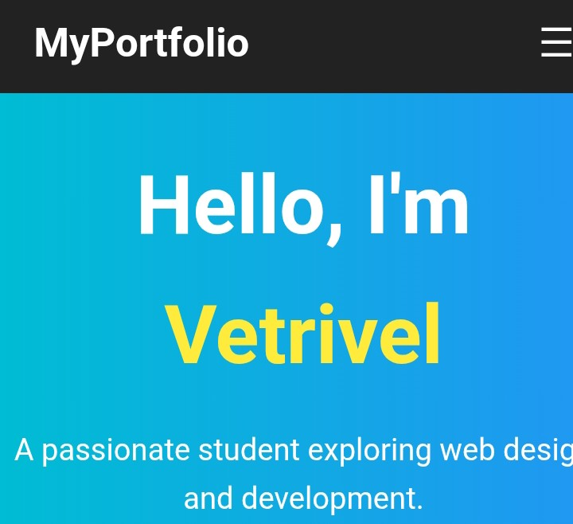
10
Results and Screenshots

Slide 11
CONCLUSION
Created a modern portfolio website using HTML, CSS & JS.Enhanced my web development skills.Can be improved by adding more projects & advanced features (like animations, blogs, dark mode).

