Slide 1

Revolutionizing Data Wrangling: Unleashing the Potential of Neural Networks

Slide 2
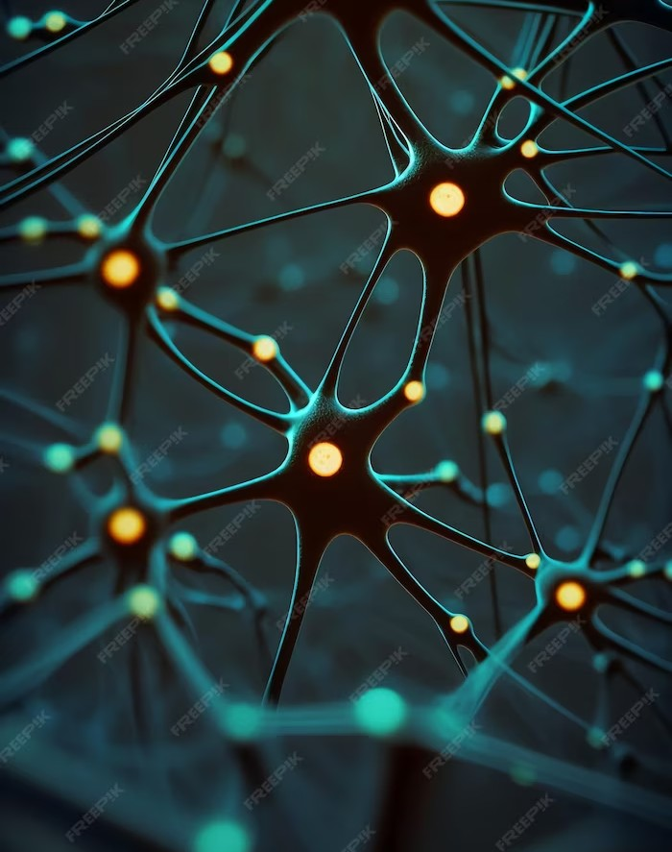
Introduction
Revolutionizing Data Wrangling: Unleashing the Potential of Neural Networks
In today's data-driven world, traditional methods
of data wrangling are no longer sufﬁcient. This presentation explores how neural networks can transform the way we handle and process data. By leveraging the power of artiﬁcial intelligence and machine learning, we can unlock new insights and make better decisions. Join us on this journey to revolutionize data wrangling.

Slide 3

Challenges in Data Wrangling
Challenges in Data Wrangling Data wrangling is a complex process that involves cleaning, transforming, and preparing data for analysis. However, traditional methods often suffer from issues such as incomplete data, inconsistent formats, and data quality problems. These challenges can lead to inaccurate insights and hinder decision- making. Neural networks offer a promising solution to address these issues and revolutionize the data
wrangling process.

Slide 4

The Power of Neural Networks
The Power of Neural Networks
Neural networks are a class of machine learning algorithms inspired by the human brain. They excel at pattern recognition, data classiﬁcation, and predictive modeling. By leveraging their ability to learn from vast amounts of data, neural networks can automate and optimize data wrangling tasks. This empowers organizations to uncover valuable insights, improve data quality, and make data-driven decisions with conﬁdence.

Slide 5
Conclusion
Revolutionizing Data Wrangling: Unleashing the Potential of Neural Networks
In conclusion, neural networks have the potential to revolutionize the way we handle and process data. By addressing the challenges of traditional data wrangling methods and harnessing the power of artiﬁcial intelligence, organizations can unlock new insights and drive innovation. Embracing neural networks in data wrangling enables us to make more accurate predictions, improve data quality, and ultimately make better decisions.
Let's embrace this transformative technology and unleash its full potential.

