Slide 1

HAND GESTURE CONTROLLED
VIRTUAL MOUSE
Team Members: Supervisor:
BALASUBRAMANIYAN.M ( 621321205006) Mr .J.SATHISHKUMAR,M.Tech(Ph.D).,
HARIPRASATH.S (621321205014) Assistant Professor/IT
KARTHICK RAJA.S.S (621321205021)

Slide 2
TABLE OF CONTENTS
S.NO | TOPICS | PAGE NO
1 | ABSTRACT | 3
2 | INTRODUCTION | 5
3 | LANGUAGE USED IN PROJECT | 6
4 | SYSTEM REQUIREMENTS | 7
5 | EXISTING SYSTEM | 8
6 | PROPOSED SYSTEM | 9
7 | ALGORITHM | 10
8 | SYSTEM ARCHITECTURE | 11
9 | MODULES | 12
10 | OUTPUT | 15
11 | CONCLUSION | 16
12 | REFERENCE | 17

Slide 3
ABSTRACT
The virtual mouse control system using hand gestures and Python programming. The aim is to provide an intuitive and natural way of interacting with a computer system, eliminating the need for physical mouse devices.
The system utilizes computer vision techniques and machine learning algorithms to detect and interpret hand gestures captured through a camera. These gestures are then mapped to corresponding mouse actions, such as cursor movement, left and right clicks, and scrolling.

Slide 4
CONT……
The project leverages the OpenCV library for image processing, and a trained machine learning model for gesture recognition.
Through this approach, users can control the computer's cursor and perform various actions by simply moving their hand in predefined ways.
This technology uses a camera to record the user's hand movements.

Slide 5
INTRODUCTION
Virtual mouse using hand gesture system that allows users to control the movement and actions of a computer mouse using hand movements and gestures.
The system uses a camera or sensor to track hand movements and translate them into mouse movements on the computer screen.
Hand gestures can be used to perform various mouse actions such as clicking, scrolling, and dragging.
The introduction of a virtual mouse has enhanced tracking accuracy, responsiveness, hand gesture detection, and machine learning algorithms.

Slide 6
LANGUAGE USED IN PROJECT
FRONT END
PyCharm Ver:2023.2.1
Camera view

Slide 7
SYSTEM REQUIREMENTS
HARDWARE REQUIREMENT:
8 GB RAM
512 GB SSD
SOFTWARE REQUIREMENT:
Windows 11
Visual studio Ver:17.7.3

Slide 8
EXISTING SYSTEM
The existing system might involve using a regular physical mouse to control the cursor on a computer screen. This traditional approach requires the user to move the physical mouse on a surface to manipulate the cursor's position and interact with the computer
disadvantages
• Limited Accuracy
• Limited Gesture Recognition
• Limited Compatibility

Slide 9
PROPOSED SYSTEM
This proposed system offers the advantage of hands-free cursor control, which can be especially useful in scenarios where a physical mouse is not convenient or accessible. Keep in mind that developing such a system involves a combination of computer vision, machine learning, and user interface programming skills.
Users can customize hand gestures to perform different mouse actions, such as assigning specific hand movements for clicking, scrolling, and dragging.
User Interface Interaction Integrate the virtual mouse system with the operating system's graphical user interface so that the cursor's movements and actions mimic those of a physical mouse.

Slide 10
ALGORITHM
1. CONVOLUTIONAL NEURAL NETWORK(CNN)
It recognize patterns and features in images and videos
HAAR-CASCADE CLASSIFIER
It can detect specific features like edges, corners, and contours in an image.
STEP 1: Import OpenCV
STEP 2: ImportXML file
STEP 3: Import test Image
STEP 4: Converting the image to greyscale
STEP 5: Detecting Multi-scale hands
STEP 6: Mentioning sides of the rectangle for detection
STEP 7: Displaying the detected image
ALGORITHM

Slide 11
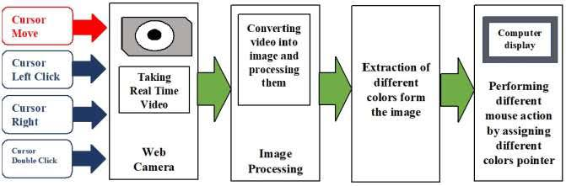
SYSTEM ARCHITECTURE

Slide 12
LIST OF MODULES
There are some list of modules below:
  Camera or sensor array module
  Preprocessing module
  Gesture recognition module
  Virtual mouse control module
  User interface module
  Calibration module

Slide 13
MODULES DESCRIPTION
Camera or Sensor Array Module:
  A method for controlling mouse movement using a real-time camera This module is responsible for capturing images of the user's hand movements and translating them into data that can be processed by the system.
Preprocessing Module:
  The preprocessing module is responsible for preprocessing the images captured by the camera or sensor array to remove noise and enhance the relevant features of the hand movements.
Gesture Recognition Module
  The Recognition module is responsible for recognizing the hand gestures made by the user and translating them into virtual mouse commands.
Virtual Mouse Control Module:
  Virtual mouse module is responsible for translating the virtual mouse commands generated by the gesture recognition module into actions that can be understood by the computer or electronic device. This may involve emulating mouse movements and clicks, as well as keyboard inputs.

Slide 14
CONT..
User Interface Module :
  Interface module provides the user with a visual interface that displays the virtual mouse movements and allows the user to interact with the system.
Calibration Module:
  The calibration module allows the user to calibrate the system to their specific hand movements and preferences. This may involve performing a set of predefined gestures to train the system on the user's hand movements, or adjusting various settings to optimize the system's performance.

Slide 15
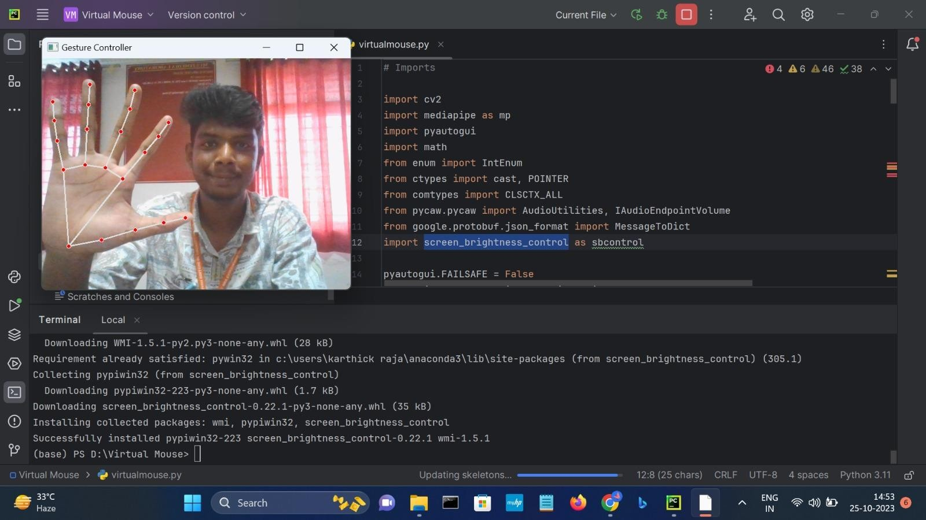
Sample screenshots

Slide 16


Slide 17
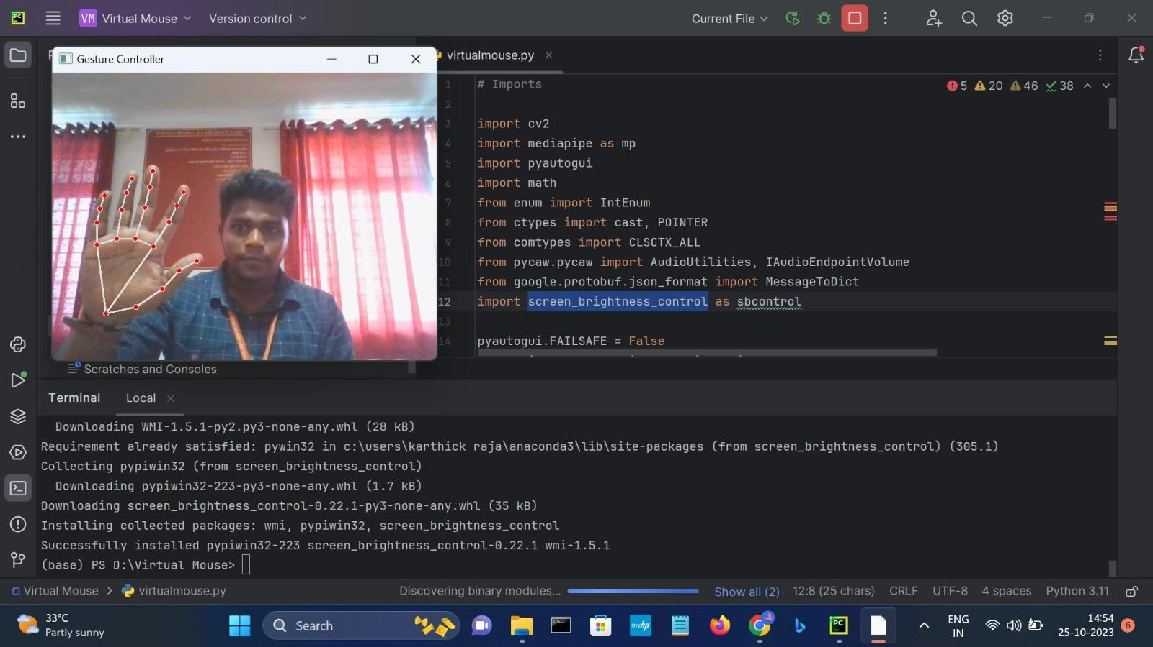
output

Slide 18
CONCLUSION
virtual mouse using hand gestures can be achieved by training a machine learning model to recognize specific hand gestures, detecting and tracking the movement of the hand in real-time using computer vision techniques, and mapping those gestures to specific mouse actions. The algorithms will depend on the specific requirements and constraints of the application.
Design and testing, a virtual mouse system that responds to hand gestures can provide an intuitive and convenient way to control a computer without the need for a physical mouse or touchpad.

Slide 19
REFERENCES
[1] Banerjee, A., Ghosh, A., Bharadwaj, K., & Saikia, H. (2021). Mouse control using a web camera based on color detection. arXiv preprint arXiv:1403.4722.
[2] Niyazi, K. (2020). Mouse Simulation Using Two Colored Tapes. International Journal of Information Science and Technology, 2(2), 57-60.
[3] Niyazi, K.et.al., (2012). Mouse Simulation Using Two Colored Tapes. International Journal of Information Science and Technology, 2(2), 57-60.
[4] Park, H.et.al., (2016). A method for controlling mouse movement using a real-time camera. In Proceedings of the 2008 ACM symposium on Applied computing (pp. 1329-1330)
[5] Chu-Feng, L.et.al., (2017). Portable Vision-Based HCI. IEEE Transactions on Systems, Man, and Cybernetics-Part A: Systems and Humans, 38(6), 1337- 1348.

