Slide 1
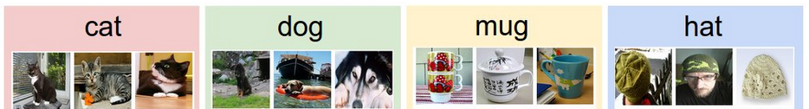

1. Training set: N images of K classes
2. Learning: training a classifier
3. Evaluation: against the ground truth

