Slide 1
Smart CCTV Violence Detection System
Team members: (Batch No: 12)
Under the guidance of
1) Vayigandla Tulasi -22B01A45B8
2) Ravuri Yamini - 22B01A4595
3) Vetsa Yasaswi - 22B01A45C3
4) Sajja Tejaswini - 22B01A45A0
Dr.G.Durga Prasad
Asst. Professor,
AI Department,
Shri Vishnu Engineering College for Women.

Slide 2
Motivation
What is the reason for taking up this project on the chosen topic?
Our team chose this project because monitoring multiple CCTV cameras manually is difficult and many violent incidents may go unnoticed. By using AI and deep learning, we can automatically detect violent activities in video footage and assist security personnel in identifying dangerous situations quickly.
Importance in a real-world scenario:
In public places like malls, railway stations, and campuses, security teams cannot continuously watch every camera feed. An automated violence detection system can analyze CCTV footage in real time and alert authorities when suspicious or violent activities occur, helping prevent serious incidents.
The impact of solution:
This system can improve public safety by detecting violent events early and sending alerts to security teams. It reduces the burden on human monitoring, enables faster emergency response, and helps maintain safer environments in public spaces.

Slide 3
Objectives
1. Automated Violence Detection Develop a deep learning model to classify video clips as violent or non-violent. This helps the system automatically identify suspicious or aggressive human actions in surveillance videos.
2. Real-Time Video Analysis Process CCTV video streams and analyze human activities continuously. This enables the system to monitor live camera feeds and detect violent events immediately.
3. Alert Generation System Send alerts to security teams when violent activity is detected. This allows security personnel to respond quickly and take necessary action to control the situation.
4. Efficient Surveillance System Design a system that can work with multiple CCTV cameras. This makes the solution scalable and suitable for large public places like malls, campuses, and railway stations.

Slide 4
Background
Important Concepts
Spatiotemporal Analysis: Technique used in video understanding that analyzes both spatial information (objects in frames) and temporal information (motion across frames) to recognize actions.
Convolutional Neural Networks (CNN): Deep learning models that automatically extract visual features such as shapes, textures, and human posture from video frames.
Long Short-Term Memory (LSTM): A type of recurrent neural network used to capture motion patterns and temporal dependencies across consecutive video frames.
Person Detection: Technique used to identify humans in video frames using models like YOLO, helping the system focus on human actions rather than background movements.
Real-Time Video Analytics: Continuous processing of live CCTV streams to detect events instantly with minimal delay.

Slide 5
Background
Definitions and Explanations
Frame Extraction: The process of converting video streams into individual image frames so that deep learning models can analyze them.
Violence Detection: The process of automatically identifying violent activities such as fights or physical aggression in surveillance videos.
Temporal Modeling:Learning motion patterns across multiple frames to understand actions that occur over time.
Alert Generation System: A mechanism that automatically sends notifications when violent activity is detected in the video stream.
Keywords
Smart Surveillance, Deep Learning, CNN-LSTM Architecture, Video Action Recognition, Real-Time Violence Detection

Slide 6
Literature Survey
Ullah, F. U. M., Ullah, A., Muhammad, K., Haq, I. U., & Baik, S. W. (2019). Violence Detection Using Spatiotemporal Features with 3D Convolutional Neural Network. Sensors, 19(11), 2472.
Focus: Presents an end-to-end deep learning framework combining MobileNet for person detection with 3D CNN (C3D) for spatiotemporal feature extraction. The three-staged architecture reduces computational overhead by processing only frames containing persons, achieving 99.9% accuracy on the Movie Violence dataset..
Key Contribution: Proposes intelligent alert system with real-time deployment on edge devices using Intel OPENVINO toolkit optimization. Demonstrates superior performance on benchmark datasets and addresses practical deployment constraints for surveillance systems..
Jahlan, H. M. B., & Elrefaei, L. A. (2022). Detecting Violence in Video Based on Deep Features Fusion Technique. Presented at RFMI 2019, International Workshop on Representation, Analysis and Recognition of Shape and Motion From Imaging Data.
Focus: Proposes novel dual-stream feature fusion approach combining AlexNet and SqueezeNet architectures with separate ConvLSTM layers. Demonstrates that fusion of features from diverse CNN architectures improves detection robustness, achieving 100% accuracy on Movie Violence dataset.
Key Contribution: Shows that combining complementary features from different CNN architectures enhances detection robustness. Achieves exceptional performance metrics (Hockey: 97%, Movies: 100%, Violent Flow: 96%) through intelligent feature fusion before classification.

Slide 7
Literature Survey
Omarov, B., Narynov, S., Zhumanov, Z., Gumar, A., & Khassanova, M. (2022). State-of-the-art violence detection techniques in video surveillance security systems: A systematic review. PeerJ Computer Science, 8, e920.
Focus: Comprehensive systematic review analyzing 80 research papers from 2015-2021. Categorizes violence detection methods into conventional approaches, end-to-end deep learning-based methods, and machine learning techniques. Discusses benchmark datasets, evaluation metrics, and open research challenges.
Key Contribution: Provides comprehensive taxonomy of violence detection methods. Identifies gaps in existing approaches and suggests future research directions including multi-modal analysis, adaptive learning, and edge computing integration for real-time performance.
Vosta, S., & Yow, K. C. (2023). KianNet: A Violence Detection Model Using an Attention-Based CNN-LSTM Structure. IEEE Access, 11, 120998-121009.
Focus: Proposes attention-based CNN-LSTM architecture combining ResNet50 with ConvLSTM for enhanced temporal and spatial feature learning. Attention mechanisms selectively focus on important regions and patterns, improving detection accuracy on multiple benchmark datasets.
Key Contribution: Demonstrates that attention mechanisms significantly improve temporal feature learning compared to traditional CNN+LSTM approaches. Achieves state-of-the-art results through selective feature refinement, addressing the limitation of treating all features equally.

Slide 8
Literature Survey
Dündar, N., & Keceli, A. S. (2024). A shallow 3D convolutional neural network for violence detection in videos. Egyptian Informatics Journal, 25(3), 100432..
Focus: Addresses practical deployment challenges by developing a lightweight 3D CNN model with only 54,634 parameters suitable for edge devices and mobile systems. Balances accuracy with computational efficiency for real-world surveillance deployment.
Key Contribution: Provides trade-off analysis between detection accuracy and model complexity. Demonstrates that lightweight architectures can achieve satisfactory performance while enabling deployment on resource-constrained devices, critical for distributed surveillance systems.
Su, J., Her, P., Clemens, E., Yaz, E., Schneider, S., & Medeiros, H. (2022). Violence Detection using 3D Convolutional Neural Networks. IEEE International Conference on Advanced Video and Signal Based Surveillance (AVSS), 1-7.
Focus: Conducts comprehensive hyperparameter tuning study for 3D CNN violence detection. Demonstrates that proper parameter adjustment in general action recognition networks can effectively detect violence without architectural modifications, achieving 94% accuracy on RWF-2000 dataset.
Key Contribution: Provides insights into optimal hyperparameter selection for deep learning-based violence detection. Shows that reasonable network parameter adjustments are effective mechanisms for improving model generalization across different surveillance scenarios.

Slide 9
Problem Identification
Manual Monitoring Limitations: Security personnel cannot continuously monitor multiple CCTV camera feeds at the same time. This often leads to important incidents being missed.
Delayed Response to Violent Events: Violent activities may escalate quickly before authorities become aware of them. Delayed detection can result in serious consequences and safety risks.
High False Alarms in Traditional Systems: Conventional surveillance systems may confuse normal fast movements with violence. This reduces reliability and increases unnecessary alerts.
Lack of Intelligent Automation: Most existing CCTV systems only record footage without analyzing it automatically. There is a need for AI-based systems that can detect and report violent events in real time.

Slide 10
Proposed Solution
AI-Based Violence Detection System: Develop a deep learning–based system that can automatically detect violent activities from CCTV video footage. The model analyzes human actions and classifies them as violent or non-violent.
Real-Time Video Stream Analysis: The system processes live CCTV streams by extracting frames and analyzing them continuously. This enables quick identification of suspicious activities.
CNN–LSTM Deep Learning Model: CNN is used to extract spatial features from video frames, while LSTM captures motion patterns across multiple frames. This combination helps accurately recognize violent actions over time.
Automated Alert Generation: When violence is detected, the system generates alerts with event details and timestamps. This allows security personnel to respond quickly and take necessary action.

Slide 11
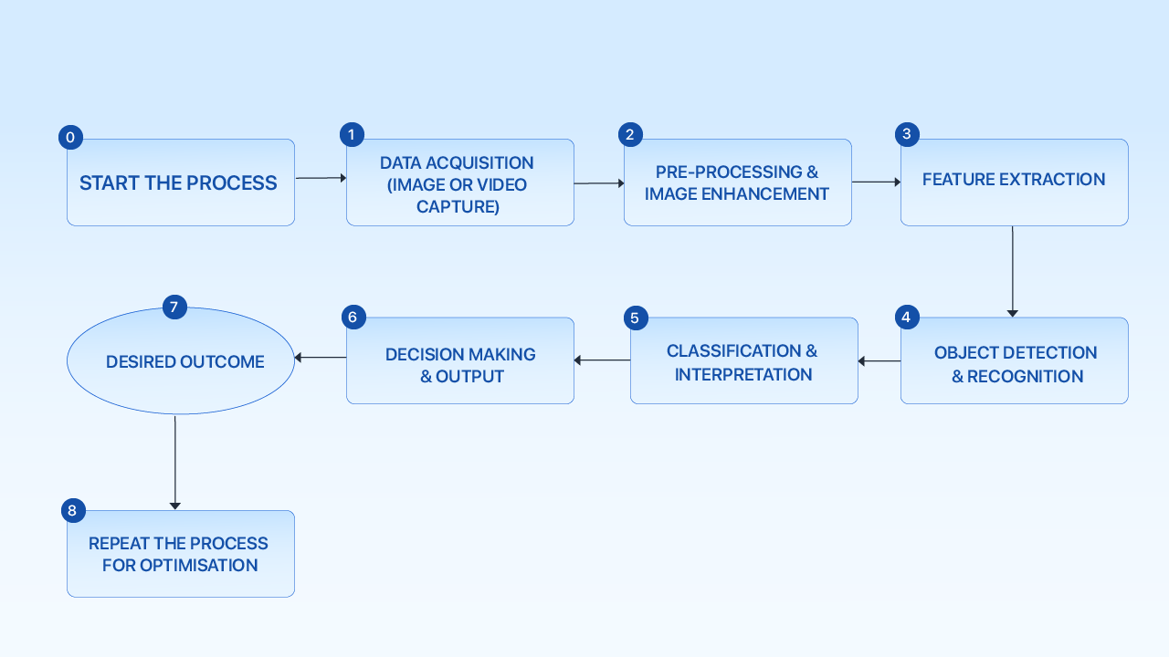
Project Implementation Details
Fig: Flow Chart for CCTV Violence Detection System

Slide 12
Project Implementation Details
Concept Diagram Explanation:
The system begins with capturing video data from CCTV cameras or surveillance datasets. These videos contain different human activities that may include both violent and non-violent actions. The captured video is then provided as input for further analysis.
The video stream is converted into individual frames and preprocessed to improve quality. Steps such as resizing frames, normalization, and noise removal are applied to ensure consistent input for the deep learning model.
Important visual features are extracted from the video frames using deep learning techniques. A CNN model identifies spatial features such as human posture and interactions, while an LSTM network captures motion patterns across multiple frames.
The extracted features are analyzed by the trained CNN–LSTM model to classify activities as violent or non-violent. Based on the prediction results, the system generates alerts and displays the final output for monitoring and security response.

Slide 13
Project Implementation Details
Explanation - Handwriting Analysis Model:
The system begins with collecting video data from CCTV cameras or surveillance datasets containing both violent and non-violent activities.
During preprocessing, the video streams are converted into frames and processed by resizing, normalization, and noise reduction to improve video quality and ensure consistent input.
Important visual features such as human posture, body movement, and interaction patterns are extracted from the frames using deep learning techniques.
A hybrid deep learning model (CNN–LSTM) analyzes these features and classifies the video activity as Violence or Non-Violence, enabling automatic detection and alert generation.

Slide 14
Dataset Description
Dataset Overview
The dataset used in this project is the RWF-2000 (Real-World Fight Dataset).
It is a publicly available benchmark dataset designed for violence detection in surveillance videos.
The dataset contains real CCTV footage capturing both violent and non-violent human activities.
These videos are collected from real-world environments such as streets, public places, and crowded areas.
The dataset is specifically designed to represent real surveillance conditions, including camera motion, lighting variations, crowd movement, and occlusions.
The video clips contain different types of human interactions that help deep learning models learn patterns of violent and normal behavior.

Slide 15
Dataset Description
Dataset Statistics & Examples
Total videos: 2,000 surveillance video clips Violent videos: 1,000 clips containing fight scenes Non-violent videos: 1,000 clips showing normal human activities
Class distribution: Balanced dataset (50% violence, 50% non-violence)
Video Characteristics:
Short surveillance video clips
Indoor and outdoor environments
Different lighting conditions
Various camera angles and crowd movements
Example Activities:
Violent Scene → Physical fight between individuals
Non-Violent Scene → Normal walking, talking, or crowd movement

Slide 16
Dataset Description
Dataset – Video Data Analysis
Before training the deep learning model, the video data undergoes several preprocessing steps.
Frame Extraction: Each video is converted into multiple frames to allow frame-by-frame analysis.
Frame Preprocessing: Frames are resized and normalized to maintain consistent input for the model.
Sequence Creation: Frames are grouped into 16-frame sequences to capture temporal motion patterns.
Feature Representation: These frame sequences are used as input to the CNN-LSTM deep learning model, which learns spatial features (from CNN) and motion patterns (from LSTM) for accurate violence detection.

Slide 17
Data Preparation
Video Data Preprocessing
Background noise and silent segments were removed to improve signal quality.
The videos were divided into individual frames to enable detailed frame-by-frame analysis of human activities.
Each frame was resized and normalized to a fixed dimension to maintain consistency for deep learning model input.
Unnecessary frames and noise were reduced to improve video quality and enhance important motion information.
The processed frames were organized into frame sequences to capture motion patterns required for violence detection.

Slide 18
Data Preparation
Frame Processing & Feature Preprocessing
The extracted frames were grouped into short sequences (e.g., 16–30 frames) to capture temporal information in videos.
Each frame sequence was labeled as violent or non-violent based on the dataset annotations.
Spatial features such as human posture, movement, and interaction patterns were automatically extracted using CNN layers.
Temporal motion features across frame sequences were captured using LSTM networks.
The processed sequences and extracted features were then used to train the deep learning model for violence classification.

Slide 19
Approach
Model Architecture
The proposed system uses a CNN–LSTM deep learning architecture to detect violent activities from CCTV video streams. Input: Video clips from the dataset are converted into sequences of frames and provided as input to the model.
CNN Layer (Feature Extraction):Convolutional Neural Networks extract spatial features from each frame such as human posture, body movement, and interactions between individuals.
LSTM Layer (Temporal AnalysisThe LSTM network processes sequences of frames to capture motion patterns and temporal dependencies across time.
Fully Connected Layer & Output:The learned features are passed through a dense layer with Softmax activation to classify the activity as Violence or
Non-Violence.

Slide 20
Approach
Models & Baselines
Baseline Model: CNN based video frame feature extractor
Improved Model: CNN + LSTM hybrid deep learning model
Why CNN+LSTM?
CNN extracts spatial features such as human posture, body movement, and interactions from video frames.
LSTM captures temporal motion patterns and sequential dependencies across multiple frames.
For Video Violence Detection:
Model: CNN–LSTM Deep Learning Architecture
Evaluation Metrics Used:
Accuracy, Precision, Recall, F1-Score, Confusion Matrix

Slide 21
Objective-wise results
Smart CCTV Violence Detection System Analysis:
Objective : To automatically detect violent activities in CCTV surveillance videos using deep learning techniques and improve security monitoring.
Intermediate Results :
CCTV surveillance videos successfully collected from the RWF-2000 dataset.
Video clips converted into frames and preprocessed for analysis.ML models trained and evaluated for classification.
Important spatial features such as human posture and interaction patterns extracted from video frames.
Frame sequences processed using a CNN–LSTM model to learn motion patterns associated with violent activities.
Random Forest classifier trained to detect abnormal drawing patterns
Result Achieved : The system successfully detected violent and non-violent activities from surveillance videos, enabling automated monitoring and faster identification of security threats.

Slide 22
Objective-wise results
Automated Video Surveillance Analysis:
Objective : To analyze human activities in real-time CCTV footage using deep learning models for accurate violence detection.
Intermediate Results :
Video frames extracted and normalized for consistent model input.
Frame sequences created to capture temporal motion patterns.
CNN model used to extract visual features from frames.
LSTM network trained to recognize sequential movement patterns across frames.
Deep learning model trained and evaluated for violence classification.
Result Achieved : The proposed system achieved reliable performance in identifying violent activities in surveillance videos, demonstrating the potential for real-time automated security monitoring.

Slide 23
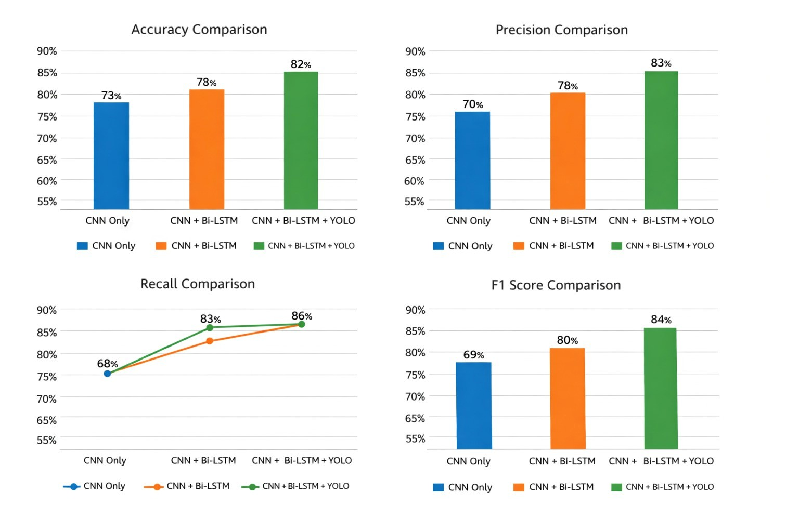
Results Analysis and Comparisons

Slide 24
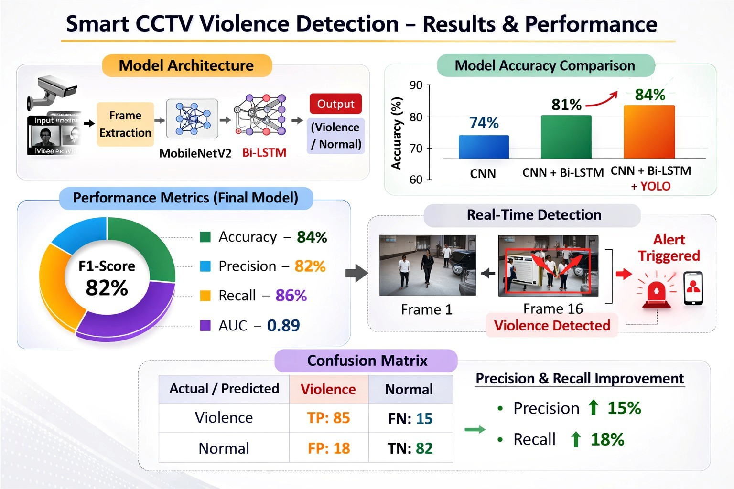
Quantitative Result Analysis

Slide 25
Demonstration
Demonstration Procedure :
Upload a CCTV video clip or provide a surveillance video stream to the system.
The system preprocesses the input video by extracting frames and resizing them for consistent analysis.
Important visual features such as human posture, body movement, and interactions between individuals are extracted from the frames.
The extracted frame sequences are passed to the trained CNN–LSTM deep learning model for violence detection.
Automated Processing :
Video clips are converted into frame sequences for analysis.
Deep learning models automatically extract spatial and temporal features from the frames.
The trained model analyzes these features and classifies the activity as Violence or Non-Violence.

Slide 26
Demonstration
Output & Validation
The system generates an automatic prediction result indicating Violent Activity or Normal Activity.
The prediction confidence score and classification probability are displayed on the output screen.
The analyzed video frames and detection results are stored for further monitoring and evaluation.
Key Validation Points
The system works on new unseen surveillance video clips.
Violence detection is performed automatically without manual monitoring.
Demonstrates the capability of real-time CCTV surveillance monitoring using AI-based violence detection.

Slide 27
Research Article Progress
Work Completed :
Problem statement and literature survey finalized
Video dataset preprocessing and frame extraction implemented using the RWF-2000 surveillance dataset.
Deep learning model developed using CNN–LSTM architecture for recognizing violent and non-violent activities in CCTV footage.
Model training, testing, and performance evaluation completed using metrics such as Accuracy, Precision, Recall, and F1-Score.
Work Pending :
Detailed result comparison with baseline models and preparation of performance graphs.
Improvement of result analysis and discussion section in the research paper.
Formatting and editing of the research paper according to conference/journal guidelines.
Current Status :
Approximately 90% of the research work completed and the paper is ready for final review before submission.

Slide 28
Software and Hardware Required
Tools and Libraries Used:
OpenCV: Stream capture and preprocessing.
PyTorch / TensorFlow: Deep learning model training and inference.
Ultralytics YOLO: Person detection.
Flask / Streamlit: Monitoring dashboard.
NumPy / Pandas: Data handling.
FFmpeg: Video processing.
SQLite / Firebase: Alert storage and metadata.
Software: Python, PyTorch/TensorFlow, OpenCV, Ultralytics YOLO, Flask/Streamlit, FFmpeg, Docker (optional)
Hardware: GPU (for model training), CPU or Edge Device (Jetson Nano / Intel NUC), CCTV cameras, High-speed network

Slide 29
Contributions
V.Tulasi: Prepared the RWF-2000 dataset by performing frame extraction, sequence creation, and basic preprocessing to ensure consistent input for model training.
R.Yamini: Designed and implemented the CNN–LSTM architecture, integrating spatial feature extraction with temporal modeling for violence detection.
V.Yasaswi: Trained the model and evaluated its performance using metrics such as accuracy and ROC-AUC, and analyzed training behavior.
S.Tejaswini: Integrated the trained model with the inference pipeline and conducted qualitative evaluation on unseen surveillance videos.

Slide 30
Model Building Environment
Development Setup :
Desktop-based system
Python programming language
Visual Studio Code (IDE)
Core Technologies :
Deep learning algorithms for violence detection in surveillance videos
Computer vision techniques for video frame processing and feature extraction
CNN–LSTM hybrid architecture for spatial and temporal activity recognition
System Requirements :
CPU-based execution (GPU optional for faster training)
Python libraries: NumPy, Pandas, Scikit-learn, TensorFlow/Keras, OpenCV, Matplotlib
Lightweight architecture suitable for real-time surveillance monitoring systems

Slide 31
Application Deployment Tools
Front-End :
React framework for interactive UI
Video Upload interface for CCTV clips or surveillance video input
Dashboard for displaying violence detection results and alert notifications
Back-End :
Python modular structure:
Video Preprocessing Module
Frame Extraction & Feature Processing Module
Deep Learning Prediction Module (CNN–LSTM Model)
Alert Generation & Result Visualization Module
Deployment :
Local deployment using React development server + Python backend
Integration with CCTV camera streams for real-time monitoring

Slide 32
Timeline
December
Project initiation and defining the project objectives for AI-based violence detection in surveillance videos. Study computer vision, action recognition techniques, and deep learning models used for video analysis. Selection of dataset (RWF-2000), development tools, and deep learning frameworks.
January
Design system architecture and workflow diagrams for the violence detection system. Development of video preprocessing pipeline including frame extraction and normalization. Preparation of dataset structure and initial feature extraction setup.
February
Implementation of the CNN–LSTM deep learning model for violence detection. Training and testing the model using the RWF-2000 dataset. Performance evaluation and model optimization to improve accuracy.
March
System integration and development of the video analysis interface. Testing the complete system with different surveillance video samples. Fixing bugs, improving performance, and finalizing the project implementation.

Slide 33
References
https://www.mdpi.com/1424-8220/19/11/2472
https://arxiv.org/abs/2204.07443
https://peerj.com/articles/cs-920
https://ieeexplore.ieee.org/document/10341243
https://www.sciencedirect.com/science/article/pii/S1110866524000185
https://par.nsf.gov/biblio/10392017

Slide 34
Thank you.

