Slide 1
Orthomyxoviridae
Influenza viruses
Group V (-)ssRNA
Segmented genome

Slide 2
What is Orthomyxoviridae?
The Orthomyxoviridae are a family of RNA viruses that includes :
Influenza virus A- infects humans, other mammals, and birds, and causes all flu pandemics
Influenza virus B-infects humans and seal
Influenza virus C – infects humans ,pigs and dogs
Isavirus (Infect salmons)
Thogotovirus (infect vertebrates and invertebrates, such as mosquitoes and sea lice)
Quaranjavirus:
Johnston Atoll virus (JAV)
Lake Chad virus (LCV)

Slide 3
Influenza History
The Name Originates From 18th Century Italy, Disease Thought To Be Due To “Influence” of Stars
Many People Confuse Cold With Flu
  Flu is by influenza viruses and very severe
  Cold is due to rhinoviruses, coronaviruses, adenoviruses
20,000-30,000 People Die From Flu and Flu Related diseases
Pandemics
  Spanish Flu, 1918 (20 million deaths)
  Asian Flu, 1956 (60,000 deaths)
  Hong Kong Flu, 1967

Slide 4
Structure of virus
Helical symmetry
Pleomorphic to spherical
80-120 nm in diameter
Outermost covering is lipid envelope through which two types of peplomers project out:
Rod shaped haemagglutanin which is a trimer and mushroom shaped neuraminidase which is a tetramer.
Both H and N are glycoproteins and carry subtype specific antigenic determinants.
Beneath this is a matrix protein M1.
The second protein M2 occurs in small numbers and project as pore through the membrane.

Slide 5
Nomenclature of Orthomyxovirus
The nomenclature of isolated strains is after the virus type (A, B, C), the host and location of initial isolation, number of the isolate, the year of isolation, and the anitgenic designation of the hemagglutinin and neuraminidase in paranthesis.
eg. A/equi/Prague/1/56 (H7N7)
Eighteen hemagglutinin antigenic subtypes and 11 neuraminidase antigenic subtypes are designated.
In birds, 16 HA and 9 NA subtypes have been identified.

Slide 6
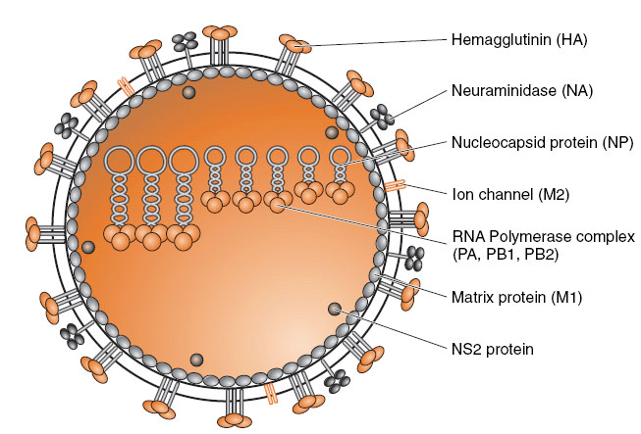
Structure

Slide 7
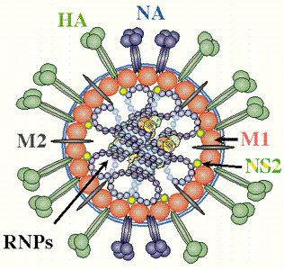
Internal Structure
HA Helps the virus to bind to cell surface
NA Helps the virus during the elution process
Lipid envelope Virus takes it from the host cell
M1 & M2 Matrix proteins Help in the binding of the virus to the endosome and act as channels for the transmission of ions
NP Attached to the RNA
PB1, PB2 and PA non structural proteins synthesized during the replication of the virus (RNA Polymerases)

Slide 8
Hemagglutinin (HA)
HA is a homotrimer whose globular domain contains a receptor binding site (RBS) specific for sialic acid (SA), stalk is for membrane fusion
The specificity of HA for various types of SA linkage is a major contributor to their host and organ tropism. HA from human isolates generally prefer α2,6-linked SAs, while avian lineage HAs favor α2,3 linkages
The HA spike is responsible for the agglutination of erythrocytes
Notes:
The HA has a higher affinity for the SA ‘N-5-acetylneuraminic acid (Neu5Ac)’. This Neu5Ac can be linked to the penultimate galactose of the glycoproteins and glycolipids in two different ways: α2,3 or α2,6 linkages. The α2,6 SA are found on bronchial epithelial cells of the human upper respiratory tract and the α2,3 SA are found on epithelial cells of the birds’ intestine and on the lower respiratory tract of humans

Slide 9
Neuraminidase (N)
Tetrameric protein less abundant than the HA at the viral surface,
The neuraminidase or RDE spike is responsible for the receptor destroying activity (sialidase activity) of the virus
NA plays three major roles during IV infections:
(i) it facilitates the access of viruses to the epithelial cells by degrading mucins rich in sialic acids of the respiratory tract,
(ii) it desialilates the virion and/or the cell surface, optimizing the fusogenic potential of the HA, and
(iii) it promotes the release of new virions and prevents their aggregation on the host cell surface

Slide 10
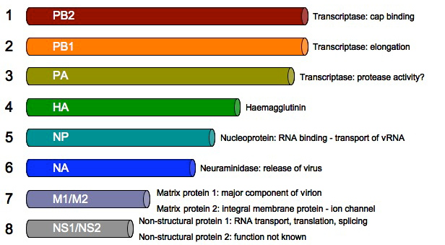
Genome
Segmented Genome consists of linear negative sense single stranded RNA
The segments have terminal repeats at both the ends.
There are eight segments present Influenza virus A and B.
Influenza virus C – seven segments

Slide 11
Viral Entry and HA
The HA envelope protein is used as an attachment/entry receptor
HA binds to sialic acid residue found on many receptors
  Ex. Intestinal cells, lung epithelial cells
The HA is synthesized as a precursor named HA0, which needs to be cleaved into the two polypeptide chains, HA1 and HA2.
The cleavage efficiency depends on the proteases, the pH and the HA subtype.
After this cleavage, the pH and temperature are also important for the HA conformational change, which allows fusion between the viral particle and the endosomal membrane

Slide 12
HA and Endosomal Virion Release
Once virion enters propagates endosomal pathway, pH decreases progressively
Decrease in pH results in conformational change of HA
The cleavage of HA is required to enable the exposure of the fusion peptide on the N-terminus of the HA2 upon decrease in pH in the endosome
Once exposed, the fusion peptide inserts into the endosomal membrane, while the C-terminal transmembrane domain (TMD) anchors HA2 in the viral membrane, creating a hairpin conformation

Slide 13
M2 Ion Channel Protein
M2 via formation of a tetramer pore allows H⁺ to enter virion
↑ in H⁺ is needed for nuclecapsids release into cytosol
Release is thought to be due to ↓ interaction between M1 proteins and nucleocapsids
The antiviral drug amantadine is a specific blocker of M2 H⁺ channel
In presence of amantadine nucleocapsid release is incomplete

Slide 14
Nucleocapsids
Influenza nucleocapsids use nucleocapsid protein (NP) as building block
-ve strand RNA runs around NP proteins
Each nucleocapsid contains a trimeric RNA polymerase complex (heterotrimer)
  Polymerase acidic protein (PA),
  Polymerase Basic Protein 1 (PB1) and
  Polymerase Basic Protein 2 (PB2)
Sequences at 5' and 3' ends are highly conserved in all genome segments

Slide 15
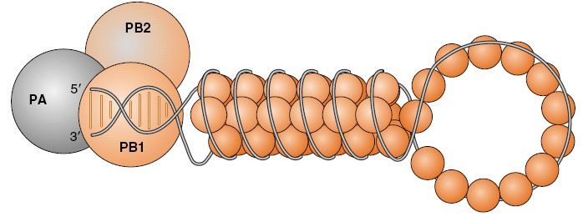
Nucleocapsids

Slide 16
Nucleocapsid Entry Into Nucleus
Orthomyxoviruses replicate inside nucleus
  This is contrary to most RNA viruses
Nucleocapsids enter nucleus via nuclear pores
  Both NP, PA, PB1 and PB2 contain NLS (nuclear localization sequences)
  They all interact with host cell importin-α
  The complex then interacts with importin-β and nuclear translocation occurs

Slide 17
Viral Genome Transcription
Viral polymerase cannot transcribe independently!
Cellular mRNAs used as primers
“Cap snatching” -the viral endonuclease (PB2) cleaves the 5'- methylguanosine cap plus about 10-13 nucleotides from heterogeneous cellular pre-mRNAs, and attaches them to its own mRNA.
These cap sequences allow the viral mRNA to be transported to the cytoplasm, where it is translated by host ribosomes by the viral RNA polymerase (transcriptase; PB1).
  PB1 cleaves at an A or G residue
PB1 then acts as polymerase moving towards 5' end of genome

Slide 18
Thus eight Transcripts are formed.
Of these six are monocistronic and two are bicistronic.
These mRNA get poly A tail at 3’ end and are transported to cytoplasm where protein synthesis takes place.
For genome replication + sense RNA intermediates are formed which lack 5’ cap and 3’ poly A tail.
NP attach to these templates and genomic RNA are formed.
H and N proteins get glycosylated and are inserted in Plasma membrane.
Virus bud out from these regions.

Slide 19
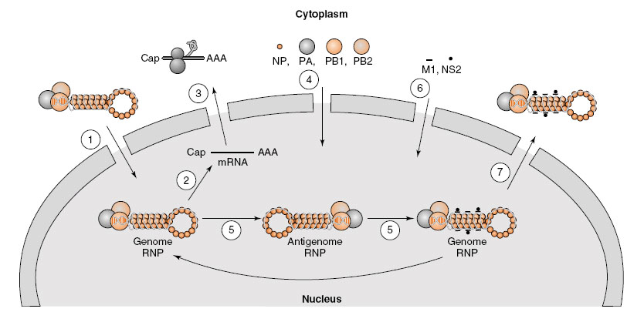
Genome Transcription

Slide 20
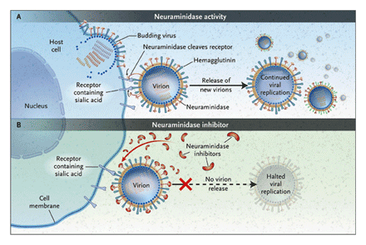
Neuraminidase helps in buding out of the virions.
NJEM, 2005

Slide 21
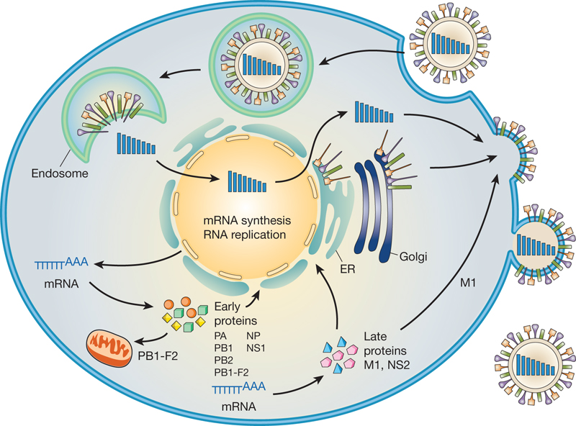

Slide 22
Influenza Epidemiology
Influenza virus can mutate rapidly and this leads to antigenic shifts and drifts.
Antigenic drifts and shifts can lead to epidemics and pandemics.
Antigenic Drift: These are caused by point mutations, i.e. nucleotide substitution, insertion and deletions.
Antigenic shifts are caused by genomic reassortments.
The virus are divided into subtypes all of which share common nucleoproteins and matrix proteins but differ in HA and NA.

Slide 23
Equine Influenza
Equine influenza is caused by two subtypes: H7N7 (formerly subtype 1) and H3N8 (formerly subtype 2) of influenza.
Since 2010, the Florida H3N8 clades 1 and 2 sublineage strains (from American lineage) have predominated in EIV outbreaks worldwide
It is an acute disease affecting both upper and lower respiratory tract of equines.
The equines of all ages are susceptible but horses of age 2-6 months are the most susceptible.
Morbidity may be as high as 100%.

Slide 24
In fully susceptible equidae, clinical signs include pyrexia, nasal discharge and a harsh dry cough; pneumonia in young foals and donkeys and encephalitis in horses have been described as rare events.
Characteristically, influenza spreads rapidly in a susceptible population. The virus is spread by the respiratory route, and indirectly by contaminated personnel, vehicles and fomites.
The incubation period in susceptible horses may be less than 24 hours.

Slide 25
In partially immune vaccinated animals the incubation period may be extended, one or more clinical signs may be absent and spread of the disease may be limited.
This makes clinical diagnosis of equine influenza more difficult as other viral diseases, such as equine herpesvirus-associated respiratory disease, may clinically resemble a mild form of influenza.
Horses infected with equine influenza virus become susceptible to secondary bacterial infection and may develop mucopurulent nasal discharge, which can lead to diagnosis of bacterial disease with the underlying cause being overlooked.
Equine influenza viruses are believed to be of avian ancestry, and more recent transmission of avian viruses to horses and donkeys has been recorded.

Slide 26
Recently, avian H5N1 was associated with respiratory disease of donkeys in Egypt.
Equine influenza viruses have the potential to cross species barriers and have been associated with respiratory disease in dogs primarily in North America.
Close contact with infected horses was thought to be involved in each outbreak in the UK. Equine influenza viruses have also been isolated from pigs in central China.
Despite the occasional identification of seropositive persons with occupational exposure there is currently little evidence of zoonotic infection of people with equine influenza.

Slide 27
Pathogenesis
Virus replicates in the epithelial cells of upper and lower respiratory tract .
Infection causes inflammation which leads to serous nasal discharge.
There is laryngitis, tracheitis, bronchitis and interstitial pneumonia.
Definitive diagnosis requires isolation of virus or demonstration of viral antigen by CFT and HI.
For isolation of the virus amniotic or allantoic cavity of chicken embryo can be used.

Slide 28
Treatment and control
Quarantine of stable where outbreak has occurred for at least 4 weeks.
Vaccination can be done with inactivated virus (I/M)
These are oil adjuvanted.
Initially two vaccines 2-4 weeks apart are used followed by a single booster when horse is one year of age and then six monthly boosters till horse is 3 years of age.
After 3 years yearly boosters can be given.
Intranasal modified-live influenza vaccine, designed to induce mucosal (local) antibody protection,

Slide 29
Swine Influenza
Three influenza A virus subtypes are enzootic in pigs throughout the world: H1N1, H3N2, H1N2
Major cause of acute respiratory disease in pigs, but most infections are subclinical
SIVs evolve at a much slower rate than their human counterparts, but some extent of antigenic drift may occur.
Genetic reassortment occurs frequently in pigs.
The incubation period of the disease is very short, as little as 12-48 hours and the onset is usually rapid and dramatic.

Slide 30
Clinical Signs
Piglets
It would be unusual to see any signs of swine flu in the sucking pig unless disease entered the herd for the first time. Colostrum may prevent infection during the sucking period.
Coughing.
Pneumonia.
Fever.
Sows
High temperatures which cause abortions.
Widespread coughing.
Pneumonia

Slide 31
When the virus first enters the herd two or three animals may be observed sick for the first two days, followed by:
A rapid explosive outbreak of inappetence and clinically very ill pigs.
The effects on the reproductive system follow the sudden onset of a rapid spreading respiratory disease with coughing, pneumonia, fevers and inappetence.
Acute respiratory distress persists over a period of 7-10 days (depending on the amount of contact between groups of sows).
Increased numbers of stillbirth rates and slow farrowings.
Premature farrowings.

Slide 32
Endemic disease: Here the virus remains in the herd, affecting small groups of pigs often weaners. It may be responsible for continuing respiratory diseases with symptoms as in acute disease but less dramatic.
Causes / Contributing factors- SI can be introduced by:
Infected animals including people, pigs and birds.
Carrier pigs.
Birds particularly water fowl, are reservoirs of infection.
Secondary bacterial infections.
Fluctuating temperatures.
Stress.
Wet bedding and floor surfaces.
Poor nutrition.

Slide 33
Public health risk
Swine influenza is not a foodborne disease.
Human infections with swine influenza viruses are occasionally reported, usually in persons who have direct contact with infected pigs and resembling seasonal influenza.
Swine influenza viruses spread very rarely in human populations.

Slide 34
Diagnosis
This can often be made reliably on clinical grounds with acute disease because there are no other diseases that are so dramatic in their onset and clinical effects.
No other disease affects so many pigs so quickly.
Blood samples taken at the time of onset of disease from affected sows and repeated 2-3 weeks later show rising levels of antibody to the specific virus.
SIV can be readily grown from nasal and throat swabs and identified in the laboratory. This is often the best approach to confirm the diagnosis.
In acute disease the spread is so dramatic across all ages that little else can be confused with it.

Slide 35
Why pigs are called the mixing vessels for influenza virus?
Influenza A viruses - infect many species.
Birds are the reservoir for all known influenza A subtypes; and novel influenza viruses can emerge from birds and infect mammalian species including humans.
Because swine are susceptible to infection with both avian and human influenza viruses, novel reassortant influenza viruses can be generated in this mammalian species by reassortment of influenza viral segments leading to the “mixing vessel” theory.
Genetic reassortment among avian, human and/or swine influenza virus gene segments has occurred in pigs and some novel reassortant swine viruses have been transmitted to humans.

Slide 36
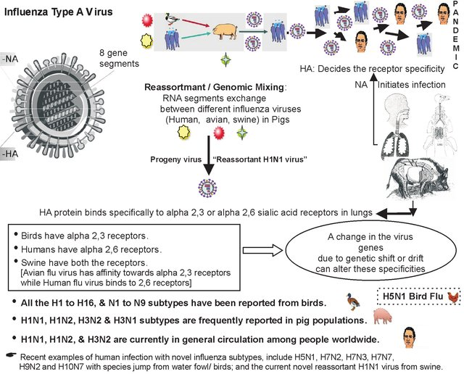

Slide 37
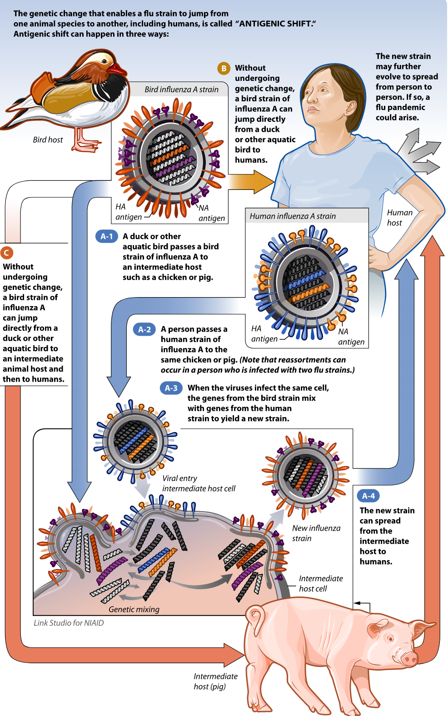

Slide 38



Avian Influenza
Blue Wing Teal
Mallards
Herring Gulls
Avian Influenza is naturally found in wild birds
Virus infection is not normally thought to cause disease in its natural host (Viruses are low pathogenic)
Wild bird surveys have shown certain duck, gull, and shorebirds species are commonly infected at different times of the year
All type A influenza viruses are thought to originate from wild birds

Slide 39
Avian Influenza in Poultry
AIV is not normally found in domestic ducks, chickens and turkeys
Transmission of AIV from wild birds to domestic poultry species occurs commonly (ducks>turkeys> chickens)
AIV on rare occasions may become established in chickens and turkeys and result in serious disease outbreaks
AIV once adapted to chickens and turkeys can be difficult to eradicate

Slide 40
Avian Influenza: Infection and Disease
Infection may cause a wide range of clinical signs from no disease (asymptomatic), respiratory disease, to severe disease with high mortality
Localized Infection-mild to moderate disease
  Intestinal-wild ducks and shorebirds, poultry
  Respiratory-humans, swine, horses, poultry, domestic ducks, seal, mink
Systemic Infection-high mortality
  chickens, turkeys, other gallinaceous birds

Slide 41
The virus replicates in the intestinal as well as respiratory tract.
There is viremia and multifocal lymphoid and visceral necrosis.
Pancreaitis, Myocarditis, myositis and encephalitis may be seen.

Slide 42
Pathotypes of Avian Influenza
Low Pathogenic (LAPI)and Highly Pathogenic(HAPI) Avian Influenza A Viruses
When an influenza virus causes more than 75% mortality in the flock they are called HAPI.
Most avian influenza A viruses are LPAI viruses that are usually associated with mild disease in poultry.

Slide 43
Avian influenza A viruses of the subtypes H5 and H7,including H5N1, H7N7, and H7N3 viruses, have been associated with HPAI and human infection with these viruses have ranged from mild (H7N3, H7N7) to severe and fatal disease (H7N7, H5N1).
Human illness due to infection with LPAI viruses has been documented, including very mild symptoms (e.g., conjunctivitis) to influenza-like illness. Examples of LPAI viruses that have infected humans include H7N7 and H7N2.

Slide 44
LPAI versus HPAI
In outbreaks of Highly Pathogenic Avian Influenza (HPAI) mortality can be up to 100%
Low Pathogenic Avian Influenza (LPAI) in chickens may even go unnoticed

Slide 45
Clinical signs of HPAI in chickens
depression
decreased appetite
decreased egg production
nervous signs
swollen blue combs and wattles
coughing
sneezing
diarrhea
sudden death

Slide 46
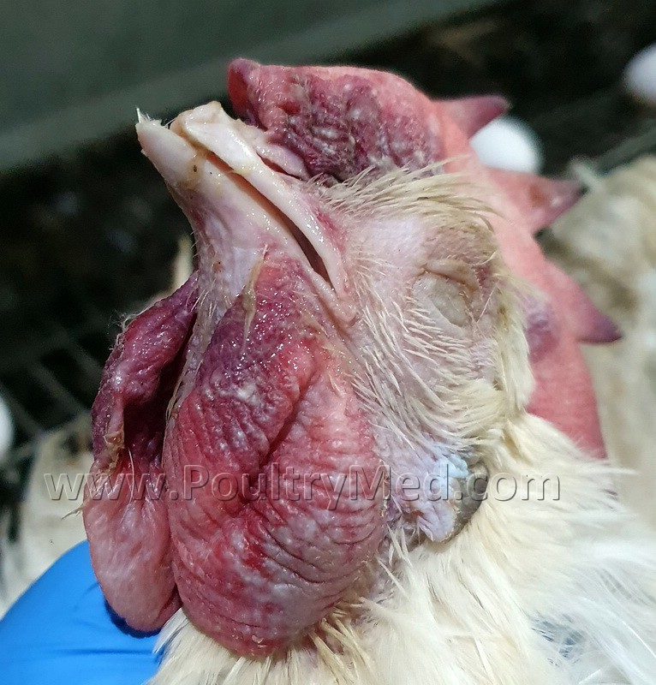

Slide 47
Clinical signs of LPAI in chickens
mild respiratory disease
depression
decreased egg production

Slide 48
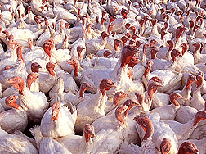
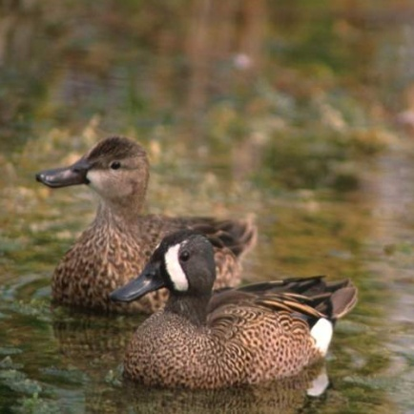
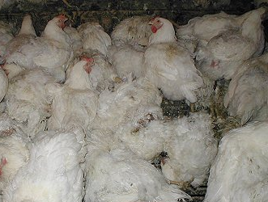
Emergence of HPAI
LPAI H5 or H7 virus transmitted to poultry
LPAI virus circulates in poultry with mild disease
LPAI Virus Mutates to HPAI with severe disease

Slide 49
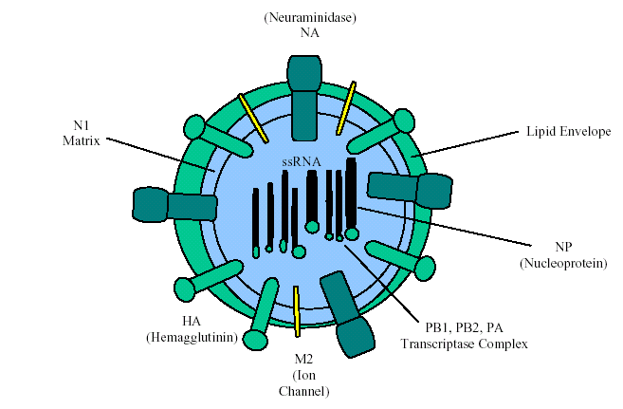
Influenza virus becomes more pathogenic when………
Its HA receptors are easily cleaved.
It has altered NS1 protein as it can act as an interferon antagonist
Its PB1, PA, & NP protein are altered to evade host cellular responses.
Its HA & NA are altered to evade host humoral immune responses.
Its PB2 protein is altered and invokes severe cytokine response from the host primary immune system.

Slide 50
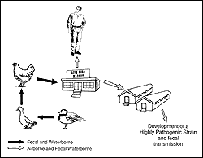
Avian Influenza (H5N1) Epidemiology
It is postulated that a nonpathogenic H5N1 influenza spread from migrating shorebirds to ducks by fecal contamination of water. The virus was transmitted to chickens and became established in live bird markets in Hong Kong. During transmission between different species, the virus became highly pathogenic for chickens and occasionally was transmitted to humans from chickens in the markets. Despite high pathogenicity for chickens (and humans), H5N1 were nonpathogenic for ducks and geese.

Slide 51
DIAGNOSIS
BY HISTORY AND CLINICAL SIGNS
GROSS AND HISTOLOGICAL FINDINGS
LABORATORY DIAGNOSIS
Samples Collected
Identification of the agent Tracheal and cloacal swabs (or feces) from live birds or from pools of organs and feces from dead birds.
Serological tests Clotted blood samples or serum

Slide 52
LABORATORY DIAGNOSIS
Identification of the agent
• Inoculation of 9-11 day-old embryonated chicken eggs
followed by:
a. Demonstration of hemagglutination
b. Immunodiffusion test to confirm the presence of influenza A virus
c. Subtype determination with monospecific antisera
d. Strain virulence evaluation: intravenous pathogenicity index (IVPI) in 4-8 week-old chickens
Serological tests
• Hemagglutination and hemagglutination inhibition tests
• Agar gel immunodiffusion
Genetic tests
RT PCR

Slide 53
TREATMENT
No specific treatment
Sanitary prophylaxis
a. Avoidance of contact between poultry and wild birds, particularly waterfowl
b. Avoidance of the introduction of birds of unknown health status into a flock
c. Control of human traffic
d. Proper cleaning and disinfection procedures
e. Practice an “all in-all out” system in the poultry farm
In outbreaks
a. Slaughtering of all birds
b. Disposal of carcasses and all poultry products
c. Cleaning and disinfection
d. Allow at least 21 days before restocking

