Slide 1
Prions
Proteinaceous Infectious Particle
No nucleic acid

Slide 2
Introduction
Stanley B. Prusiner coined the term proin from Proteinaceous infective particle and changed to prion to sound it rhythmic.
The word prion derived from the initial letters of the words proteinaceous'' and infectious'‘.
In1997, Pruisner was awarded Nobel Prize in Medicine for discovery of infectious proteins (prion) and their mechanism of amplification
A prion is an infectious agent, composed primarily of protein in misfolded form.

Slide 3
Not classified like viruses--there are no families, genera, or species.
They first are identified by their host species and disease association Then, they are characterized by their molecular and biological properties.
Non-immunogenic, evoke no detectable acquired immune response in their host
extremely resistant to inactivation by heating,
chemicals and ultraviolet & γ-irradiation irradiation
Prions are stable at a wide pH range

Slide 4
Prion Diseases (Transmissible Spongiform Encephalopathy)
Human
Animals
Kuru
Fatal Familial Insomnia (FFI)
Creutzfeldt-Jakob disease (CJD)
Gerstmann-Straussler-Scheinker syndrome (GSS)
Scrapie
Bovine Spongiform Encephalopathy (BSE)
Chronic Wasting Disease (CWD)
Feline transmissible encephalopathy

Slide 5
The basic lesion is a spongiform degeneration in the gray matter of the brain and astrogial hypertrophy and proliferation.
Scrapie is the prototype of prion disease with the longest history of the known animal prion diseases
The first prion disease evidenced to be both infectious and transmissible in natural settings
Scrapie is endemic in sheep in all countries except Australia and New Zealand.

Slide 6
Classification of Prion diseases
Infectious/Exogenous
  e.g., Kuru, BSE (mad cow disease), Scrapie
  Spread by
    Consumption of infected material containig PrPsc gene
    Transfusion.
Sporadic- Rarely, random spontaneous conversion of native PrPC to PrPSc
Familial/Hereditary
  Due to autosomal dominant mutation of PrPc gene.
  ‘Species barrier‘- The resistance of some species to infection by prions derived from another species

Slide 7
Prion Structure
Isoforms
The protein that prions are made of (PrP) is found throughout the body,
The normal form of the protein is called PrP^{C}, the infectious form is called PrP^{Sc}

Slide 8
PrP^{C}
The cellular prion protein (PrPC) is a cell surface protein expressed in a variety of different organs and tissues with high expression levels in the central and peripheral nervous systems
It has 209 amino acids and mainly alpha-helical structure.
It is anchored to the membrane through a glycosyl-phosphatidyl inositol link, with the protein chain on the outside of the neuronal plasma membrane.
The PrPc (without the PI link) is water soluble, protease sensitive, and consists of 42% alpha helix and 3% beta sheet.

Slide 9
PrP^{C} binds copper (II) ions with high affinity.
Related to PrP structure or function.
PrP^{C} play important roles in cell-cell adhesion and intracellular signaling ''in vivo'‘.
Therefore is involved in cell-cell communication in the brain.

Slide 10
PrP^{Sc}
The infectious isoform of PrP, known as PrP^{Sc},
''Sc'' refers to 'scrapie',
It is able to convert normal PrP^{C} proteins into the infectious isoform by changing their conformation, or shape; alters the way the proteins interconnect.
Occurs as a result of post-translational processing of a normal cellular protein.
It has a higher proportion of β-sheet structure.
Aggregations of these abnormal isoforms form amyloid fibers, which accumulate to form plaques.
The end of each fiber acts as a template onto which free protein molecules may attach, allowing the fiber to grow.

Slide 11
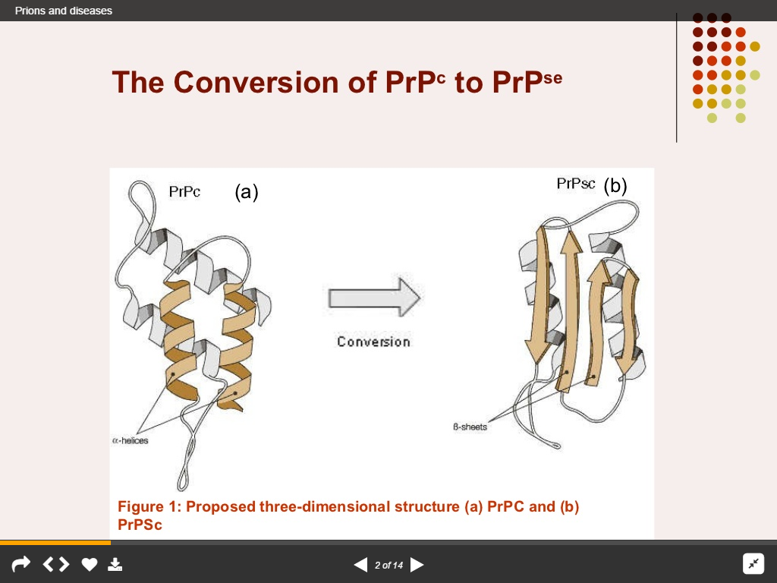

Slide 12
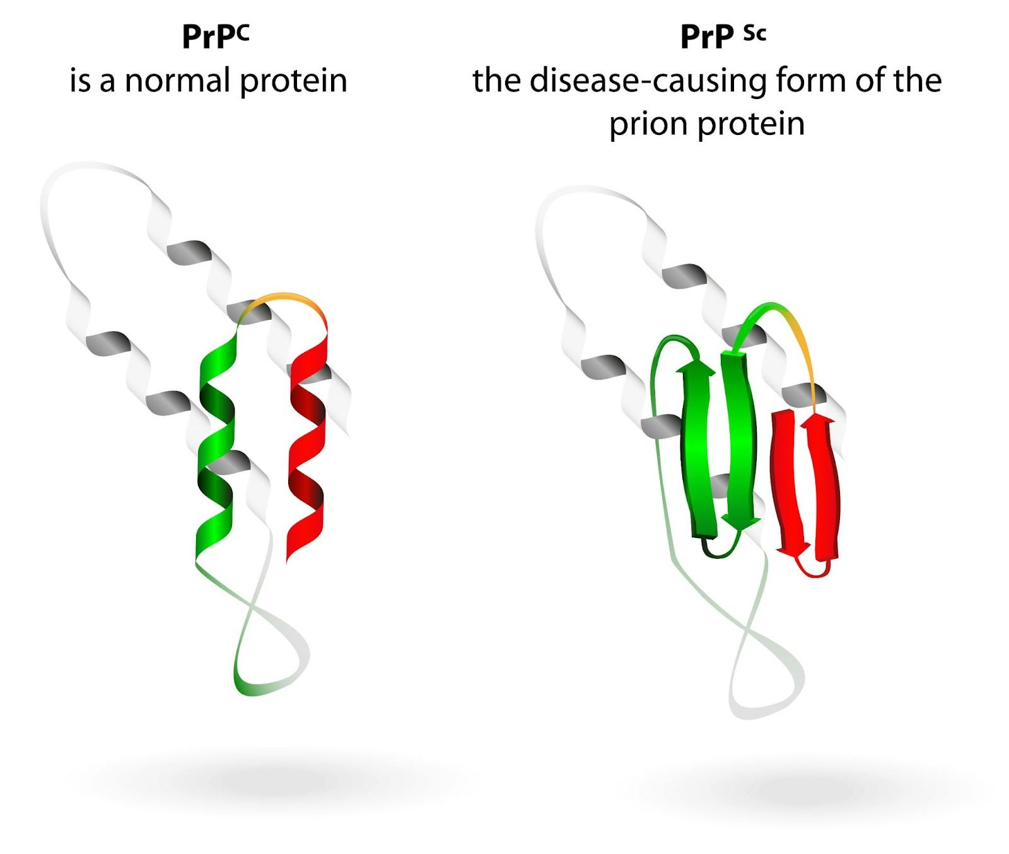

Slide 13
Prion Function
It has been proposed that neurodegeneration caused by prions may be related to abnormal function of PrP that causes brain damage
Normal function is maintenance of long term memory

Slide 14
Prion replication mechanism
Heterodimer model
A single PrP^{Sc} molecule binds to a single PrP^{C} molecule and catalyzes its conversion into PrP^{Sc}.
The two PrP^{Sc} molecules then come apart and can go on to convert more PrP^{C}
Fibril model
Assumes PrPSc exists only as fibrils, fibril ends bind PrPC and convert it into PrPSc
The quantity of prions would increase linearly, forming ever longer fibrils.
Exponential growth of both PrPSc and the quantity of infectious particles is explained by taking into account fibril breakage

Slide 15
The mechanism of prion replication has implications for designing drugs.
An effective drug does not need to eliminate all prions,
But simply needs to slow down the rate of exponential growth.
By binding to fibril ends and blocks them from growing any further

Slide 16
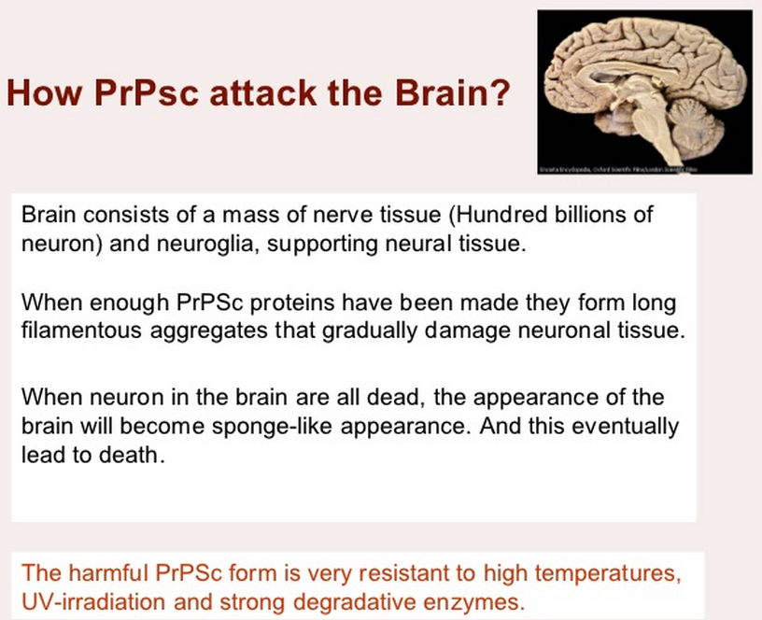

Slide 17
Prion Disease
.
Prions cause neurodegenerative disease by aggregating extracellularly within the CNS to form plaques known as amyloid, disrupt the normal tissue structure characterized by "holes" in it with resultant spongy architecture due to the vacuole formation in the neurons.
Other histological changes include
Astrogliosis
Absence of an inflammatory reaction.
‘Species barrier‘- The resistance of some species to infection by prions derived from another species is species barrier.

Slide 18
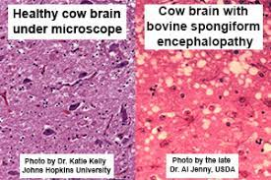

Slide 19
IP is long but once symptoms appear the disease progresses rapidly, leading to brain damage and death.
Neurodegenerative symptoms can include
Convulsions,
Dementia, Ataxia (balance and coordination dysfunction),
Behavioural or personality changes

Slide 20
BOVINE SPONGIFORM ENCEPHALOPATHY
Commonly known as Mad cow disease.
A fatal, neurodegenerative disease causes a spongy degeneration in the brain and spinal cord.
BSE has a long incubation period, about 4 years.
usually affecting adult cattle at a peak age onset of four to five years.
All breeds being equally susceptible.
The disease may be transmitted to human beings who eat the brain or spinal cord of infected carcasses.
In humans, it is known as Creutzfeldt–Jakob disease

Slide 21
Types of BSE
1. Classical BSE:
➢ occurs through the consumption of contaminated feed
2. Atypical BSE:
➢ refers to naturally and sporadically occurring forms
➢ believed to occur in all cattle populations at a very low rate
➢ have only been identified in older cattle

Slide 22
Clinical signs
The onset of disease is insidious, with tremors, hyperaesthesia with kicking during milking,
abnormal posture,
hindlimb ataxia,
progressive apprehensive behavior,
aggression and even frenzy,
reduced milk yield, and weight loss.

Slide 23
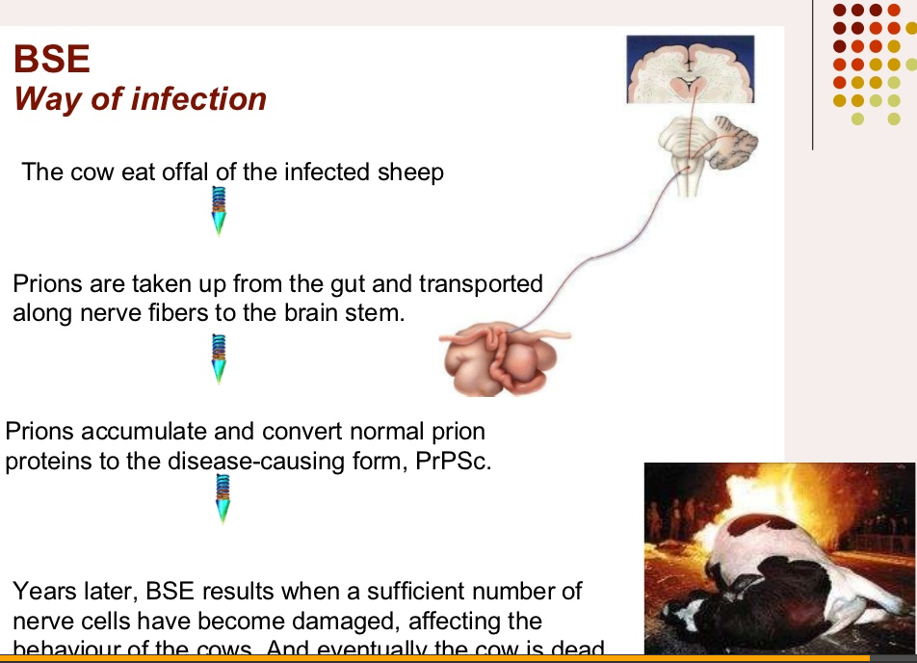

Slide 24
SCRAPIE
A fatal, degenerative disease that affects the nervous systems of sheep and goats.
The name scrapie is derived from one of the symptoms of the condition, wherein affected animals will compulsively scrape off their fleece against rocks, trees or fences.
The disease expresses:
severe itching sensation
lip-smacking
strange gaits,
convulsive collapse.
Scrapie is infectious and transmissible among similar animals

Slide 25
Pathogenesis
Following natural infection, PrPSc is usually first detected in tissues of the lymphoreticular system including spleen, palatine tonsil and retropharyngeal and mesenteric lymph nodes
 In lymph nodes, replication apparently occurs in follicular dendritic cells
 Following ingestion of prions, infection is initiated in gut lymphoid tissues
 Prions produced in these tissues then move to the central nervous system

Slide 26
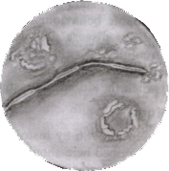
Diagnosis
    Diagnosis can be made by:
    1. Clinical signs and Symptoms.
    2. Detection of Scrapie
    Associated fibrils.
3. Detection of Abnormal Prion protein (PrP^{sc}) by Western blotting.
4. Two dimensional Gel Electrophoresis.
5. Immunodiagnosis of Prion disease.
6. Bioassay in Mice.
    Scrapie Associated fibrils.

