Slide 1
VIRAL GENETICS AND INTERFERENCE

Slide 2
VIRAL GENETICS
Viruses grow rapidly, there are usually a large number of progeny virions per cell
There is, therefore, more chance of mutations occurring over a short time period
The nature of the viral genome (RNA or DNA; segmented or nonsegmented) plays an important role in the genetics of the virus
The two possible reasons for variations in viruses are
  Mutation
  Recombination

Slide 3
MUTATION
Spontaneous mutations
  These mutations occur naturally during virus replication.
  DNA viruses are stable genetically than RNA viruses
  This may be due to the lack of error correction mechanisms in RNA replication
Induced mutations
  Chemicals
  Nitrous acid – direct action on bases
  Base analogues – indirect action, mispairing thus generating mutations
  Physical
  UV and X rays
“The virus strain that derive out of mutation is called as a mutant”

Slide 4
TYPES OF MUTATIONS
Mutation can be point mutation as a result of one base replaced by another or insertion/deletion of base (Frame shift mutation)
The changes in mutation may be very mild and go unnoticed
Sometimes it can also result in altered phenotypic characters
Some of the common examples of such mutants are given below
Conditional lethal mutants: These mutants multiply under some conditions but not others (whereas the wild-type (wt) virus grows under both sets of conditions)
  e.g. temperature sensitive (ts) mutants – These will grow at low temperature e.g. 31°C but not at e.g. 39°C, wt grows at 31 and 39°C.
  e.g. host range – These mutants will only grow in a subset of the cell types in which the wt virus will grow – such mutants provide a means to investigate the role of the host cell in viral infection

Slide 5
TYPES OF MUTATIONS
Plaque size:
  Plaques may be larger or smaller than in the wt virus, sometimes such mutants show altered pathogenicity
Drug resistance:
  This is important in the development of antiviral agents – the possibility of drug resistant mutants arising must always be considered
Enzyme-deficient mutants:
  Some viral enzymes are not always essential and so we can isolate viable enzyme-deficient mutants; e.g. herpes simplex virus thymidine kinase is usually not required in tissue culture but it is important in infection of neuronal cells
“Hot” mutants:
  These grow better at elevated temperatures than the wt virus
  They may be more virulent since host fever may have little effect on the mutants but may slow down wt
Attenuated mutants:
  Many viral mutants cause much milder symptoms (or no symptoms) compared to the parental virus – these are said to be attenuated
  These have a potential role in vaccine development and they also are useful tools in determining why the parental virus is harmful

Slide 6
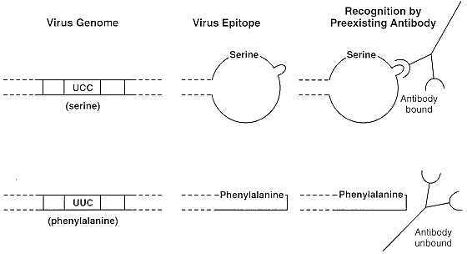
Effect of mutation
The changes in mutation may be very mild and go unnoticed
Some times mutation may alter the shape of epitope preventing its binding to antibodies
This is also one of the reasons for breakdown in immunity

Slide 7
RECOMBINATION
Exchange of genetic information between two genomes are referred as recombination
The recombination involves breaking of covalent bonds within the nucleic acid, exchange of genetic information, and reforming of covalent bonds
This kind of break/join recombination is common in DNA viruses or those RNA viruses, which have a DNA phase (retroviruses)
The host cell has recombination systems for DNA
Recombination of this type is very rare in RNA viruses (there are probably no host enzymes for RNA recombination)
So far, there is no evidence for recombination in the negative stranded RNA viruses giving rise to viable viruses

Slide 8
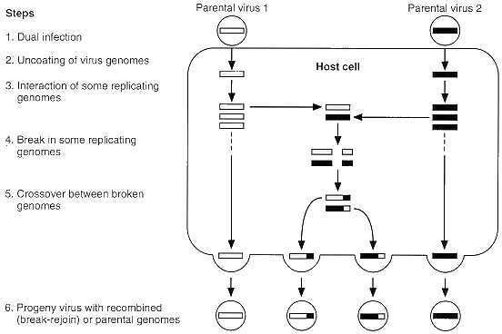
Mechanisms of recombination

Slide 9
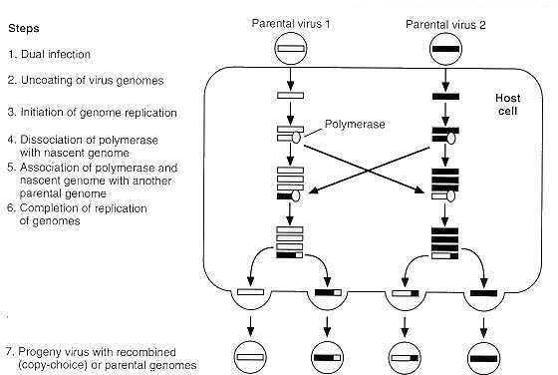
Mechanisms of recombination

Slide 10
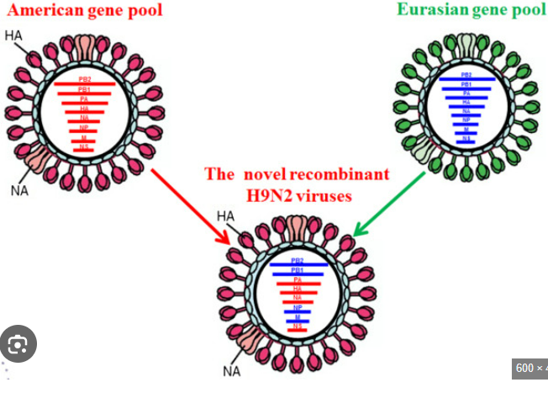
Reassortment
It is a non-classical type of recombination
If a virus has a segmented genome and if two variants of that virus infect a single cell, progeny virions can result with some segments from one parent, some from the other
This is an efficient process – but is limited to viruses with segmented genomes (eg.Orthomyxovirus)

Slide 11
COMPLEMENTATION
It is interaction at a functional level
There is no exchange of genetic material
Viral complementation is the phenomenon where two viruses, each with a non-functional mutation in the same gene, can produce viable and functional virus particles by complementing or compensating for each other's defects

Slide 12
PHENOTYPIC MIXING
When two viruses infect a cell the progeny viruses may contain coat components derived from both parents and will have coat properties of both the parents, this is called phenotypic mixing
It involves no alteration in the genetic material
The progeny of such virion is determined by which parental genome is packaged and not by the nature of the coat proteins
Phenotypic mixing can occur between related or between unrelated viruses

Slide 13
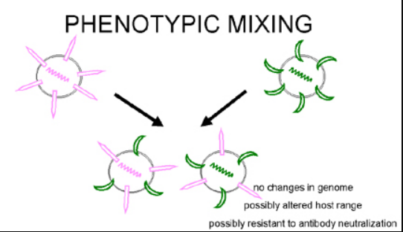
PHENOTYPIC MIXING
Some times the coat is entirely different that of another virus
This is also called pseudotype (pseudovirion) formation
  Eg: retrovirus nucleocapsid in a rhabdo virus envelope
This pseudotype has adsorption –penetration – surface antigenicity characteristics of rhabdo virus but after infection behaves as a retro virus and produce progeny retro viruses

Slide 14
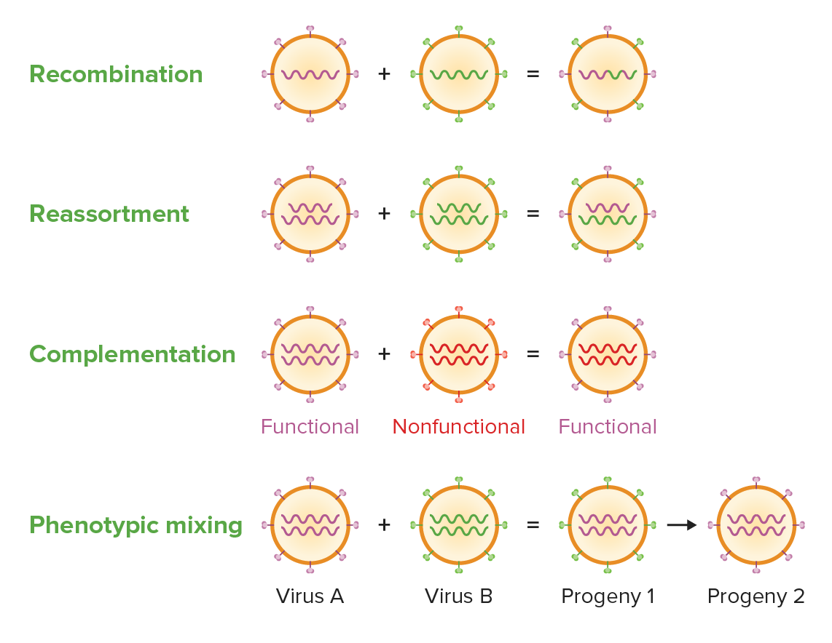

Slide 15
MULTIPLICITY REACTIVATION
When two or more viruses, each containing lethal genomic damages (by exposure to a mutagen), infect the same cell, the genome can often pair with each other and undergo homologues recombination repair to produce viable progeny.

Slide 16
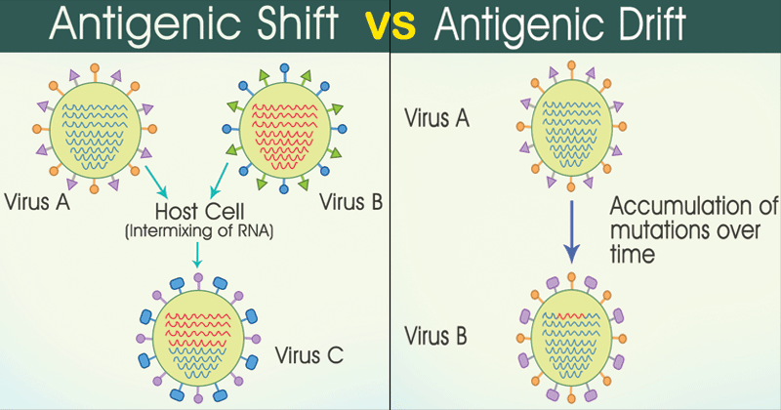
Antigenic drift & Antigenic shift
Recombination can result in a slow change of phenotypic character referred as antigenic drift or sudden and abrupt change in phenotypic character referred as antigenic shift
Antigenic shift result in pandemics
These changes are also responsible for breakdown of immunity in the field

Slide 17
INTERFERENCE

Slide 18
INTERFERENCE
Viral interference is a phenomenon mediated by interferon (IFN) and defective interfering particle
IFN was discovered by Issacs and Lindemann who showed that supernatant fractions from virus-infected cells contained a protein that could confer resistance to infection to other cells
IFN do not react directly on the virus, but it acts on the cells to make them resistant to infection
IFN are host specific and not virus specific
IFN is one of the first lines of defense against viruses because it is induced early after virus infection before any of the other defense mechanisms appear (e.g. antibody, CTLs etc.)
The time after which IFN begins to be made will vary depending on the dose of virus

Slide 19
Types and Properties of Interferon
There are three types of interferon,
  IFN-alpha (also known as leukocyte interferon)
  IFN-beta (also known as fibroblast interferon) and
  IFN-gamma (also known as immune interferon)
IFN- alpha and IFN-beta are also referred to as Type I interferon and IFN-gamma as Type II
There are approximately 20 subtypes of IFN-alpha but only one IFN-beta and IFN-gamma
The interferons have different characteristics that could be used to distinguish them (e.g. pH stability and activity in the presence of SDS)
Apart from these three interferons two more types have also been identified they are IFN-omega and IFN-tau, both are produced by embryonic trophoblastic cells

Slide 20
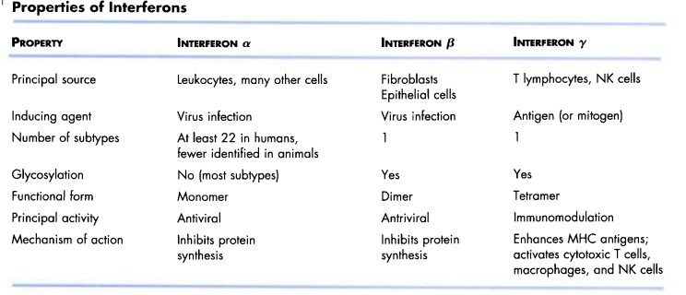
Types and Properties of Interferon

Slide 21
Production of interferon:
Normal cells do not contain preformed IFN nor do they secret interferon constitutively
This is because the interferon genes are not transcribed in normal cells
Transcription of the IFN genes occurs only after exposure of cells to an appropriate inducer
Inducers of IFN-alpha and IFN-beta include virus infection, double stranded RNA, LPS, and components from some bacteria
Among the viruses, the RNA viruses are the best inducers while DNA viruses are poor IFN inducers, with the exception of poxviruses

Slide 22
Mechanism of IFN action:
The IFN genes are not expressed in normal cells because the cells produce a labile repressor protein that binds to the promoter region upstream of the gene and inhibits transcription
Once the gene is turned on, it is transcribed, the mRNA is translated and the protein is secreted from the cell
The IFN will bind to IFN-receptors on neighboring cells and induce an antiviral state in the second cell
The binding of IFN to its receptor results in the transcription of a group of genes that code for antiviral proteins involved in preventing viral replication in that cell
As a consequence the cell will be protected from infection with a virus until the antiviral proteins are degraded, a process which takes several days
The antiviral state in IFN-treated cells results from the synthesis of two enzymes that result in the inhibition of protein synthesis
IFNs have been used in the treatment of a number of viral and other diseases
The short shelf life and certain harmful side effects prevent their use

Slide 23
Mechanism of Type-I IFN action:
2'5'Oligo A synthetase mediated bresk down the viral mRNA
  It is an enzyme that converts ATP into a unique polymer (2'5' Oligo A) containing 2'- 5'phophodiester bonds
  Double stranded RNA is required for the activity of this enzyme
  The 2'5'Oligo A in turn activates RNAse L which then breaks down viral mRNA.
2. protein kinase mediated inhibiton of viral mRNA translation
  It is in the presence of double stranded RNA, is autophosphorylated and thereby activated
  The activated protein kinase in turn phosphorylates elongation factor eIF-2 and inactivates it
  By the action of these two IFN- induced enzymes protein synthesis is inhibited
Other means of IFN action
  Apart from these two important proteins IFN also stimulate the production certain other proteins like nitric oxide synthase, Mx protein, polymyelocytic leukemic protein, which also possess antiviral properties.

Slide 24
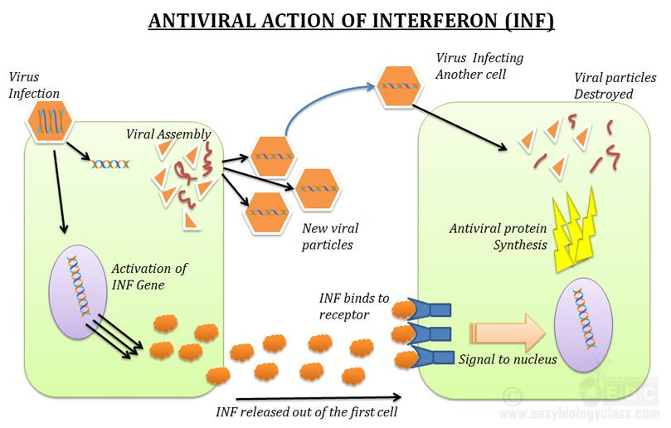

Slide 25
Mechanism of Type-II IFN action:
Another type of interferon called gamma interferon is produced mainly by T cells and NK cells when trigerred by certain molecules released during immune responses(eg:IL-2)
It has number of effects including stimulation of antigen presentation and activation of phagocytes and NK cells

Slide 26
Defective viruses
Defective viruses lack the full complement of genes necessary for a complete infectious cycle (many are deletion mutants) - and so they need another virus to provide the missing functions - this second virus is called a helper virus
Some examples of defective viruses:
  Some retroviruses have picked up host cell sequences but have lost some viral functions
  These need a closely related virus which retains these functions as a helper
  Some defective viruses can use unrelated viruses as a helper: For example, hepatitis delta virus (an RNA virus) does not code for its own envelope proteins but uses the envelope of hepatitis B virus (a DNA virus)

Slide 27
Defective interfereing (DI)particles
The defective virus particles compete with the helper virus for the functions the helper provides
This may lead to decrease in the replication of the helper virus
This phenomenon is known as interference and such defective particles are called defective interfrering (DI) particles
Not all defective particles cause interference
DI particles can modulate natural infection

Slide 28
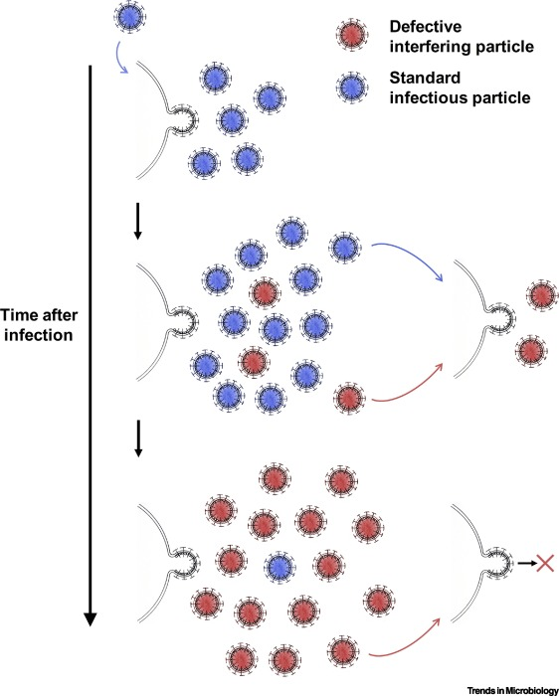
Why DI (Defective Interfering) virus particles replicate faster than wild-type viruses
Due to their smaller genome size, which requires fewer resources and less time for replication
combination of genetic, evolutionary, and possibly immunological advantages that allow them to exploit host cells more efficiently

Slide 29
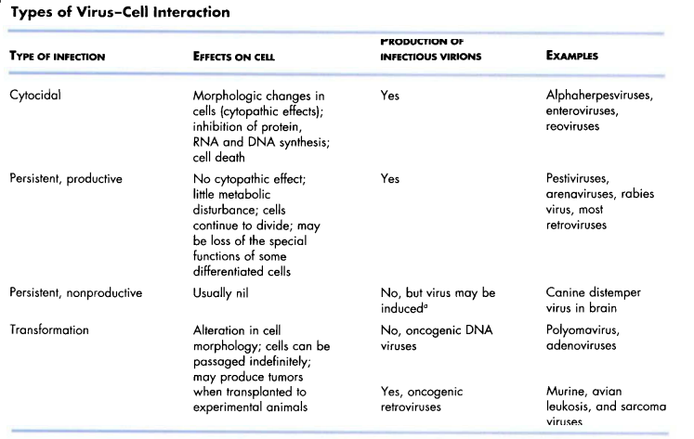
Virus-cell interaction
(latent infection)
(Viral oncogenesis)

Slide 30
Cytopathic effect (CPE)
Cytopathic effect (CPE) refers to structural changes in host cells that are caused by viral invasion.
Types of Cytopathic Effects
  Total Destruction (death of all the cells in the monolayer)
  Subtotal Destruction (only a few cells detach from the glass surface)
  Focal Degeneration (cells are enlarged, rounded, and refractile followed by detached from the surface)
  Swelling and Clumping (cells swell and become enlarged, clump together, and eventually detach from the surface)
  Foamy Degeneration (large cytoplasmic vacuoles are formed)
  Syncytium (also known as cell fusion)
  Inclusion Bodies

Slide 31
Persistant Viral Infections
The term persistent infection simply describes an infection that lasts a long time
Persistant viral infections are disease processes that occur over a long period and are generally fatal

Slide 32
Latent Viral Infections
The term latent infection describes an infection that "exists but is not exhibited," i.e., an infection in which infectious virions are not formed
In either case, the virus or its genome is maintained indefinitely in the cell, either by the integration of the viral nucleic acid into the host cell DNA or by carriage of the viral nucleic acid in the form of an episome
In these instances, the cell survives, indeed may divide repeatedly
In some instances such cells never release virions, in others the infection may become productive when induced by an appropriate stimulus

Slide 33
Viruses and Cancer
The earliest relationship between cancer and viruses was demonstrated in the early 1900s, when chicken leukemia and chicken sarcoma were transferred to healthy animals by cell- free filtrates

Slide 34
Transformation of Normal Cells into Tumor Cells
When activated, oncogenes transform normal cells into cancerous cells
Viruses capable of producing tumors are called oncogenic viruses
Several DNA viruses and retroviruses are oncogenic
The genetic material of oncogenic viruses becomes integrated into the host cell's DNA
Transformed cells lose contact inhibition, contain virus-specific antigens (TSTA and T antigen), exhibit chromosomal abnormalities, and can produce tumors when injected into susceptible animals

Slide 35
DNA Oncogenic Viruses
Oncogenic viruses are found among the
  Adenoviridae,
  Herpesviridae,
  Poxviridae, and
  Papovaviridae
The EB virus, a Herpesvirus, causes Burkitt's lymphoma and nasopharyngeal carcinoma
Hepadnavirus causes liver cancer

Slide 36
RNA Oncogenic Viruses
Among the RNA viruses, only retroviruses seem to be oncogenic
Human T-lymphotropic virus type 1 & 2 (HTLV-I and HTLV-2) have been associated with human leukemia and lymphoma
The virus's ability to produce tumors is related to the production of reverse transcriptase
The DNA synthesized from the viral RNA becomes incorporated as a provirus into the host cell's DNA
A provirus can remain latent, can produce viruses, or can transform the host cell

Slide 37
The Immune System and Cancer
Cancer cells are normal cells that have undergone transformation, divide uncontrollably, and possess tumor-associated antigens
The response of the immune system to cancer is called immunological surveillance which involves cell-mediated immunity
T_{c} cells (cytotoxic T cells) recognize and lyse cancerous cells
Cancer cells can escape detection and destruction by the immune system
Cancer cells may (i) suppress T cells or (ii) grow faster than the immune system can respond

Slide 38
Immunotherapy
Immunotherapy or biological therapy is the treatment of disease by modulation (either activating or suppressing) the immune system
  Tumor necrosis factor (TNF) and other cytokines are being tested as cancer treatments
  Immunotoxins are chemical poisons linked to a monoclonal antibody; the antibody selectively locates the cancer cell for release of the poison
  A vaccine consisting of tumor antigens has been effective in controlling one type of cancer in poultry

