Slide 1
Virology

Slide 2
What is a Virus?
Virus are very small infectious agents with size ranging from 20-300nm in diameter
Viruses are non-cellular entities so they are also called as particles
Virus lacks their own independent metabolism and cannot replicate outside the host cell (So they required cellular machinery, also called as obligate intracellular parasites)
Virus that infects bacteria are called bacteriophage or simply phage
Animal virus infects animals and similarly plant virus infects plants
Viruses can also be crystallized, which no other living organisms can do
“A virus is a non-cellular, obligate intracellular parasites made u of genetic material (either DNA or RNA) and protein”

Slide 3
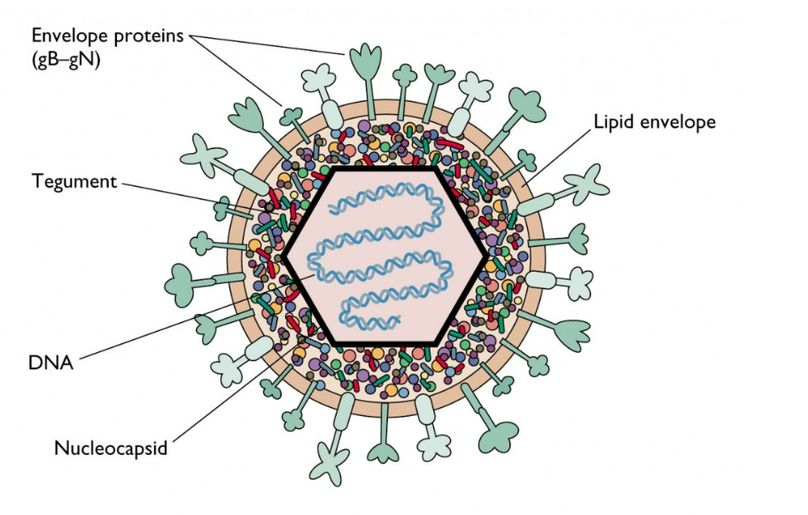
Structure of virus
A basic structure of virus is nucleic acid core (either DNA or RNA but not both) surrounded by protein coat
Central core of nucleic acid of a virus is called genome and the protein coat surrounding is called as capsid
In some virus, an envelope made up of glycoprotein and phospholipid bilayer is present outside the capsid
Some viral derived proteins are studded in the envelope

Slide 4
The basic structural components of a virus are
Genome
Capsid
Envelope
Enzymes

Slide 5
1. Genome
Virus contains either DNA or RNA as genetic material but not both
Virus which contains DNA as genetic material are called DNA virus and those containing RNA are called RNA virus
Unlike other living cell where ds DNA is always a genetic material, a viral genome may consists of linear or circular ds DNA, single stranded DNA, ss linear RNA or ds linear RNA
Eg.
  Reo virus is a RNA virus which contains ds RNA genome
  Parvovirus contains ss DNA,
  Papovavirus contains ds circular DNA as genetic materials

Slide 6
2. Capsid
Capsid is the outer layer (Sometime it is refered as coat or shell)
Capsid serves as impenetrable shell around the nucleic acid core
Capsid also helps to introduce viral genome into host cell during infection
The protein coat or capsid is made up of number of morphological similar sub units called capsomere
Capsomere are arranged precisely and tightly together in a repetitive pattern to form complete capsid
The number of capsomere in a capsid varies from virus to virus
The complete complex of nucleic acid and protein coat of a virus particle is called as virus nucleo-capsid
Structure of capsid give the symmetry to the virus
Virus particle may be either cubicl or helical or binal or complex symmetry

Slide 7
3. Envelope
Some virus contains envelope that surrounds nucleocapsid
The virus without envelope is called naked virus
The envelope is a bilayer of lipoprotein and glycoprotein
The envelope is acquired by the progeny virus from host cell during virus release by budding process
In some virus the glycoprotein projects out in the form of spike called peplomere
Some of the peplomers or glycoprotein spike such as Haemaglutinin and Neuraminidase which are involved in binding of virus to host cell
Envelope

Slide 8
4. Enzymes
Some virus contains enzymes which play central role during infection process
  Eg. Some bacteriophage contains an enzyme lysozyme, which makes small hole in bacterial cell that allows viral nucleic acid to get in
Some virus contains their own nucleic acid polymerase which transcribe the viral genome into mRNA during replication process
  Eg. Retro virus are RNA virus that replicates inside host cell as DNA intermediate
  These virus possess an RNA dependent DNA polymerase called reverse transcriptase.

Slide 9
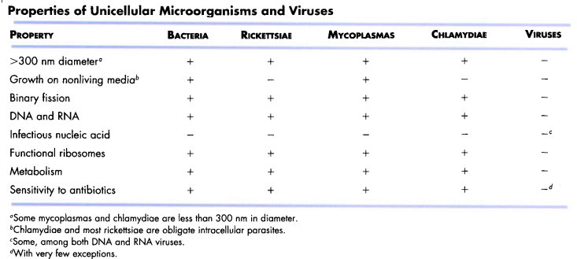

Slide 10
Viral symmetry
Icosahedral/ cubical
Helical/ spiral
Complex
Binal symmetry

Slide 11
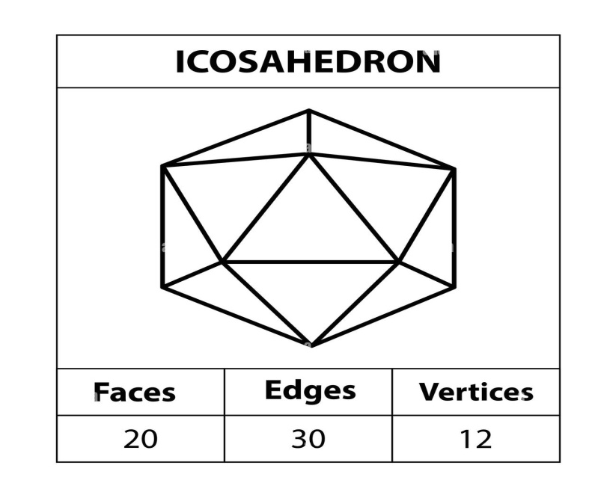
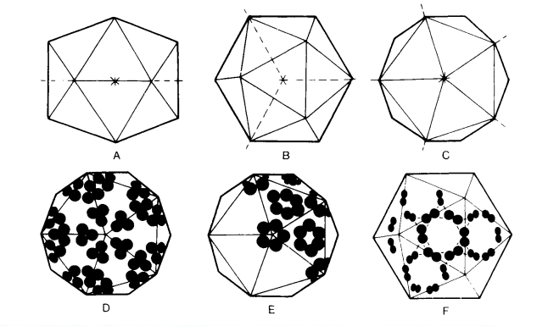
Icosahedral (cubical) symmetry:
An icosahedral is a polygon/ polyhedran with 12 vertices (corner), 20 facet (sides) and 30 edges
They have 5:3:2 rotational symmetry
The vertices have five fold axia of symmetry, each of the 20 faces has a three fold axis of symmetry and each of the 30 edges has a two fold axis of symmetry
Eg. Adenovirus, Picornavirus, Papovavirus, herpes virus etc
Edge
Face
Vertices
2 fold
(Edge)
3 fold
(Face)
5 fold (Vertices)

Slide 12
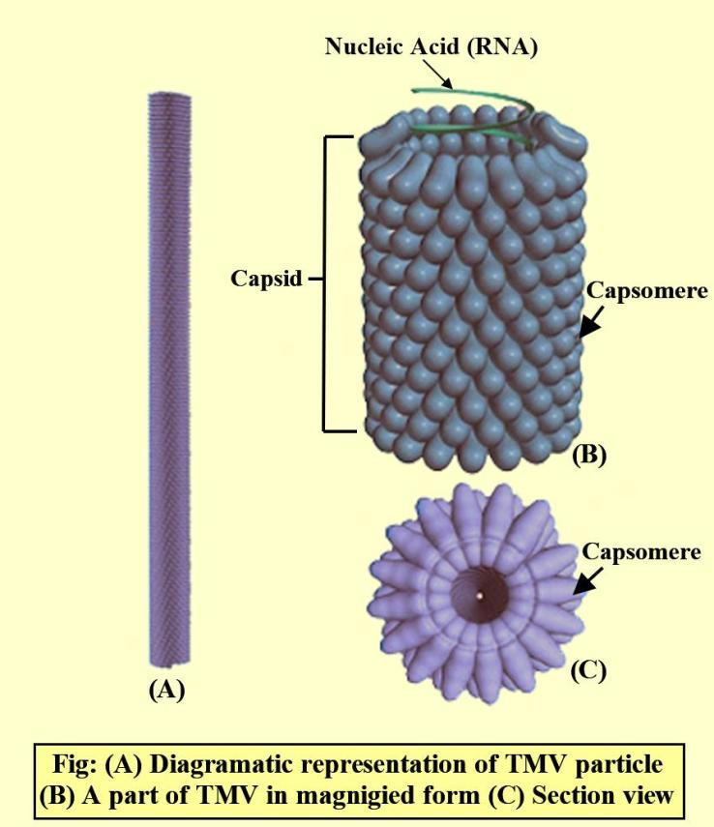
Helical (spiral) symmetry:
The capsomere and nucleic acid are wined together to form helical or spiral tube like structure
Most of the helical viruses are enveloped and all are RNA viruses
Eg. Rabies virus

Slide 13
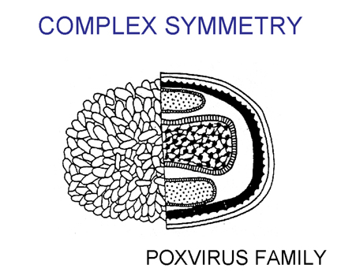
Complex symmetry
Some virus are more complex, being composed of several separate capsomere with separate shape and symmetry
They do not have either icosahedral or helical symmetry due to complexity of their capsid structure
Eg. Pox virus

Slide 14
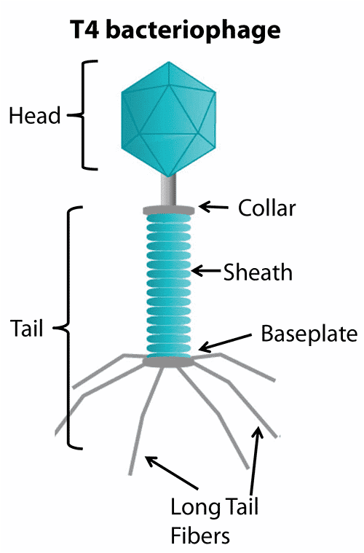
Binal symmetry
it is a type of complex symmerty
Some viruses such as T-phage (T2,T4 etc) have compex symmetry including head and tail
The most complicated virus in terms of structure are some bacteriophage which possess icosahedral head and helical tail
Such structure is called binal symmetry

Slide 15
Classification Of Viruses
Initially virus classifications were made based on the host normally infected and also based on trophism
Eg: neurotrophic virus ( having affinity for nerve tissue)
Later when the methods for studying the physical, chemical and biological properties of viruses were developed more information on viruses became available to develop a classification system on the basis of these properties
The main properties used are nature of
  Nucleic acid (DNA or RNA, single or double stranded, single or segmented nucleic acid, positive or negative sense and molecular weight)
  Structure of virion ( helical, icosahedral or complex symmetry, enveloped or non enveloped, complexity; number of capsomeres for icsahedral, diameter of nucleocapsids for helical virions)
  Site of replication ( nucleus or cytoplasm)
  The other properties used are host range, trophism, mode of transmission, surface structures ( eg: antigenic properties).

Slide 16
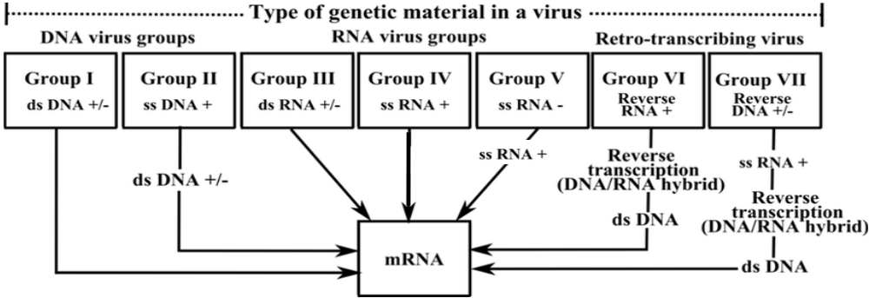
Baltimore Classification Of Virus
In 1971, David Baltimore proposed a virus classification based on how the viral genome is replicated and expressed
Viruses were grouped into six classes based on their method of transcription (mRNA synthesis)
This grouping is based primarily on whether the genome is single or double stranded and whether the genome is converted to an intermediate form or not before the m RNA is produced

Slide 17
Baltimore Classification Of Virus
  Class I ds DNA viruses
  Class II ss DNA viruses
  Class III ds RNA viruses
  Class IV ss positive RNA viruses
  Class V ss negative RNA viruses
  Class VI reverse transcriptase containing RNA virus
  Class VI reverse transcriptase containing DNA virus

Slide 18
ICTV Classification
An International Committee on Nomenclature of Viruses (ICNV) was formed at the ninth International Congress for Microbiology in 1966
This committee is now called International Committee on Taxonomy of Viruses (ICTV)

Slide 19
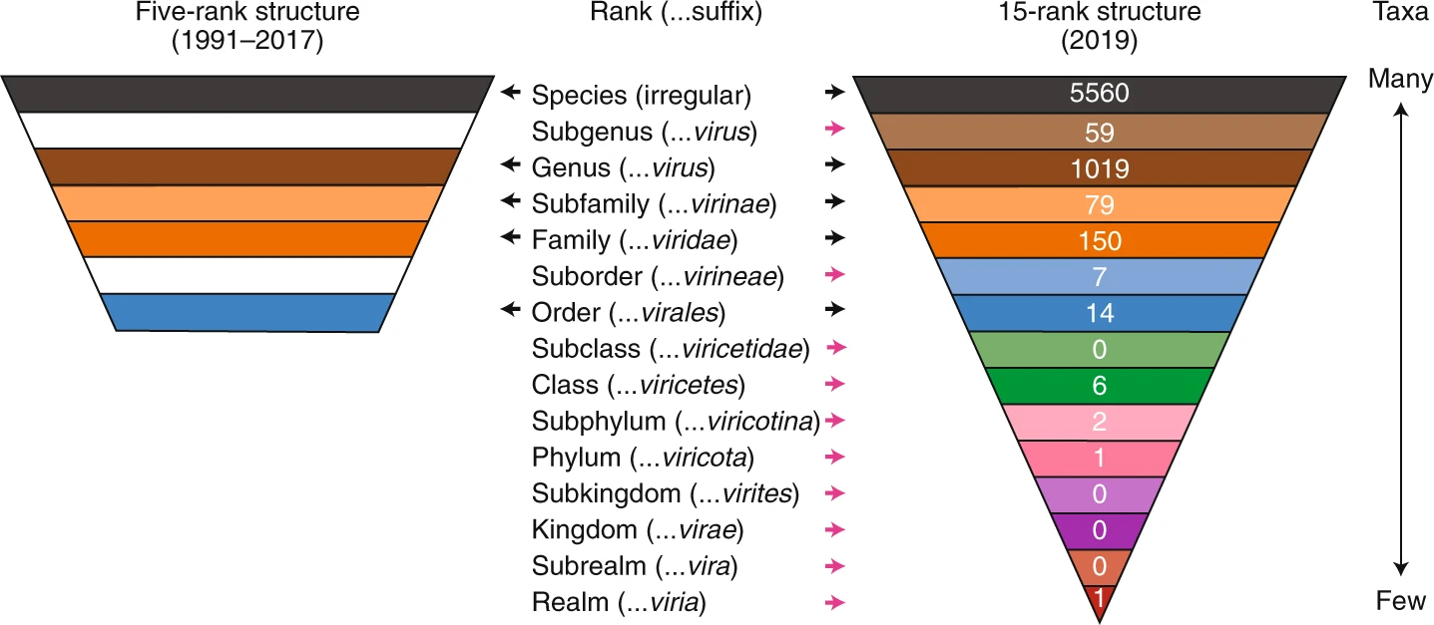
ICTV Classification

Slide 20
DNA VIRUSES
Viruses with ds DNA genome
Family: Adenoviridae
  Non enveloped, icosahedral with fibre protein at each vertex, ds stranded linear DNA, replication in nucleus
Family: Asfarviridae
  Enveloped,200 nm icosahedral particle with 70 nm isometric core, linear ds DNA, cytoplasmic replication.
  African swine fever virus
Family: Herpesviridae
  Enveloped 200 nm particle with spikes,enclosing a tegument and an icosahedral nucleocapsid of 100 nm. Linear ds DNA, replication in nucleus. Large family, latency common, some are oncogenic.
  Three subfamilies – alphaherpesvirinae, betaherpesvirinae and gammaherpesvirinae.
Family: Papilomaviridae
  Non enveloped, 55 nm icosahedral, covalently closed circular ds DNA genome, replication in nucleus, some are oncogenic.
Family: Polyomaviridae
  Nonenveloped, 40-45 nm icosahedral, covalently closed circular ds DNA , replication in nuceus oncogenic.
  Simian virus 40 (SV 40)
Family: Poxviridae
  Brick shaped or ovoid virions of 220-450 nm x 140-260 nm wide, some enveloped. Complex structure enclosing two lateral bodies and a biconcave core. Linear ds DNA genome, cytoplasmic replication.
  Two subfamilies – Chordopoxvirinae (viruses of vertebrates) and Entomopoxvirinae (viruses of insects).

Slide 21
DNA VIRUSES
Viruses with ss DNA genomes
Family: Circoviridae
  Nonenveloped small icosahedral, circular ss DNA genome
  Porcine circovirus 1 and chicken anaemia virus
Family: Parvoviridae
  Nonenveloped icosahedral 18-26 nm, linear ss DNA genome replication in nuceus.
  Two sub families – Parvovirinae (viruses of vertebrates) and Densovirinae (viruses of mainly insects)
Viruses with DNA genome that replicate through RNA intermediate
Family: Hepadnaviride
  42-50 nm enveloped particle with projections, isometric nucleocapsid with DNA polymerase and protein kinase activities, partially ds DNA that is not covalently closed. Complete negative sense strand of 3000 nt and a variable length positive sense strand of 1700 – 2800 nt, contains reverse transcriptase.
  Hepatitis B virus of humans, duck hepatitis B virus

Slide 22
RNA VIRUSES
Viruses with ds RNA genome
Family: Birnaviridae
  Nonenveloped icosahdral 60 nm particles, two segments of linear ds RNA genome, replication in cytoplasm.
  Infectious bursal disease virus
Family: Reoviridae
  Nonenveloped 60-80 nm icosahedral capsid, 11,12 or 13 segments of linear ds RNA , cytoplasmic replication.
  Bluetongue virus

Slide 23
RNA VIRUSES
Viruses with positive sense ssRNA
Family: Arteriviridae
  Enveloped (45-60 nm)particle containing icosahedral nucleocapsid, linear positive sense ss RNA genome, cytoplasmic replication
  Equine arteritis virus
Family: Caliciviridae
  Nonenveloped icosahedral 27-40 nm particle with calyx like (cup shaped) depressions. Linear ss RNA, cytoplasmic replication.
  Vesicular exanthema of swine virus
Family: Coronaviridae
  Enveloped 120-160 nm with club shaped sparse protein spikes, helical nucleocapsid with linear ss RNA genome, cytoplasmic replication.
  Avian infectious bronchitis virus
Family: Flaviviridae
  Enveloped 40-60 nm with isometric nuclecapsid of 25-30 nm linear ss RNA, cytoplasmic replication
  Yellow fever virus, classical swine fever virus, hepatitis C virus
Family: Picornaviridae
  Nonenveloped icosahedral 30 nm, linear ss RNA, cytoplasmic replication
  Poliovirus, foot-and-mouth disease virus
Family:Togaviridae
  Enveloped 70 nm particles with icosahedral nucleocapsid, linear ss RNA, cytoplasmic replication
  Semliki forest virus, Rubella virus

Slide 24
RNA VIRUSES
Viruses with negative sense ssRNA
Family: Arenaviridae
  Enveloped isometric particles (usually 120 nm) with club shaped spikes. Genome present two helical nucleocapsids, larger one with 75,000 nt negative sense ss RNA, smaller one with 3500 nt ambisense RNA
  Lymphocytic choriomeningitis virus
Family: Bunyaviridae
  Enveloped isometric 100 nm with 10 nm spikes, three nucleocapsids present each with one molecule of negative sense ss RNA, cytoplasmic replication
  Nairobi sheep disease virus, rift valley fever virus
Family: Filoviridae
  Enveloped bacilliform or filamentous and sometimes branched particles 800 – 900 (sometimes 14000) x 80 nm with helical nucleocapsid of 50 nm diameter, negative sense ss RNA,
  Ebola virus, Marburg virus
Family: Orthomyxoviridae
  Enveloped pleomorphic 120 nm particles with a dense layer of protein spikes, 6-8 helical nucleocapsids , 9 nm diameter with transcriptase activity, each contains a linear, negative sense ss RNA, RNA synthesis nuclear.
  Influenza viruses
Family: Paramyxoviridae
  Enveloped pleomorphic particles usually 150- 200 nm diameter with dense layer of protein spikes. One helical nucleocapsid 12-17 nm diameter with one molecule of linear negative sense ss RNA, cytoplasmic replication
  Newcastle disease virus of poultry, rinderpest virus, canine distemper virus, peste des petits ruminants virus
Family: Rhabdoviridae
  Enveloped bullet shaped particles 100-430 nm x 45-100 nm with 5-10 nm spikes, helicle necleocapsid with linear, negative sense ss RNA, cytoplasmic replication.
  Rabies virus

Slide 25
RNA VIRUSES
Viruses with RNA genomes that replicate through DNA intermediate
Family: Retroviridae
  Enveloped 80-100 nm particles with spikes, nucleocapsid is isometric or truncated cone, contains two identical copies of positive sense ss RNA, virions contain reverse transcriptase and integrase enzymes.
  Subfamilies – Orthoretrovirinae and Spumavirina
  Avian leukosis virus, bovine leukemia virus, humal immunodeficiency viruses

Slide 26
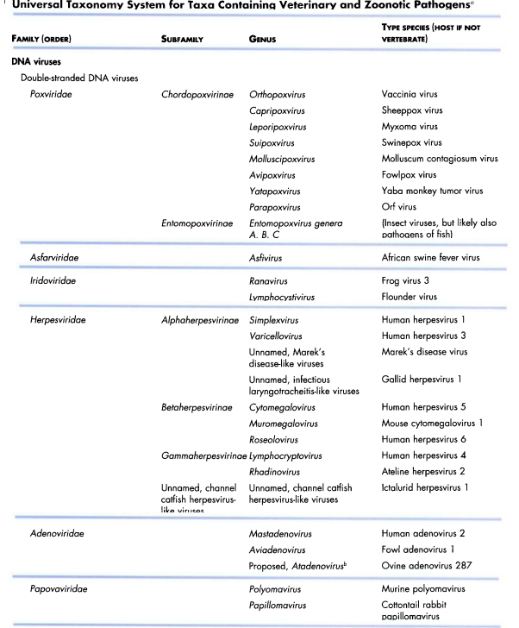


Slide 27
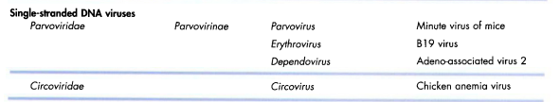
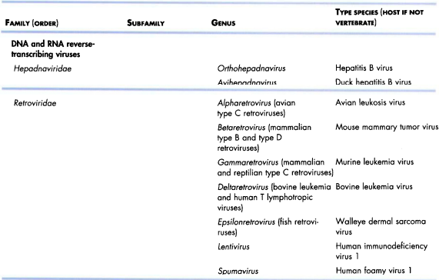

Slide 28
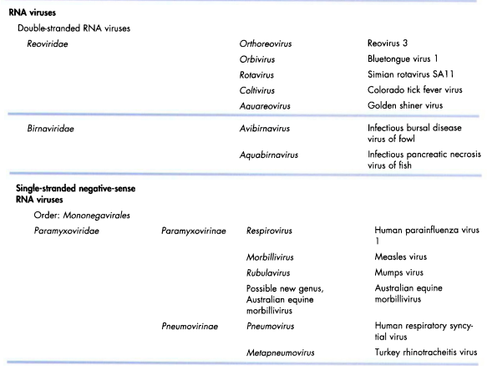

Slide 29
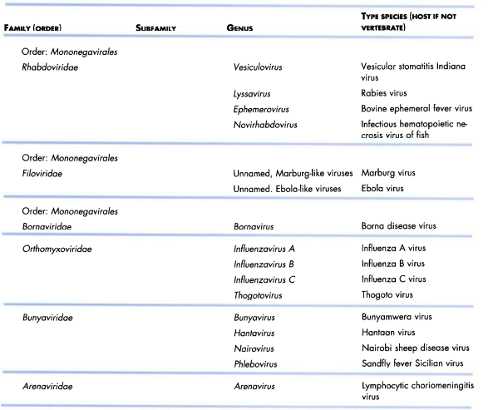

Slide 30
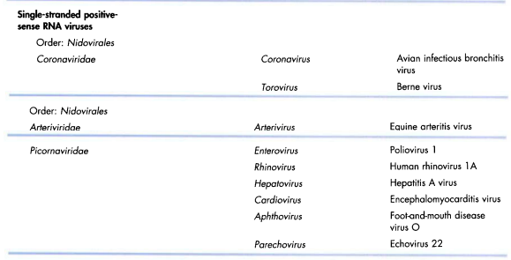

Slide 31
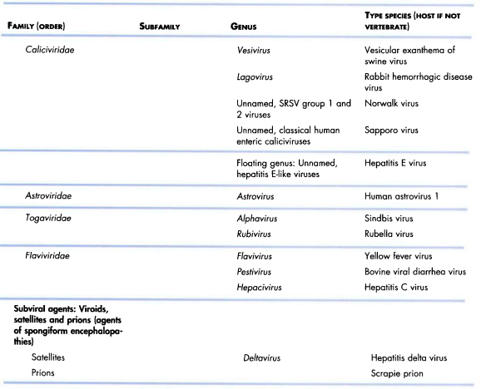

Slide 32
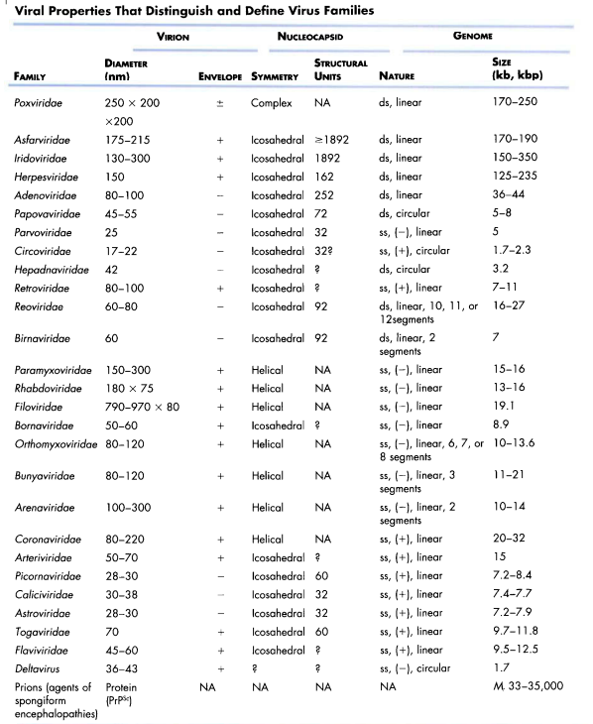

Slide 33
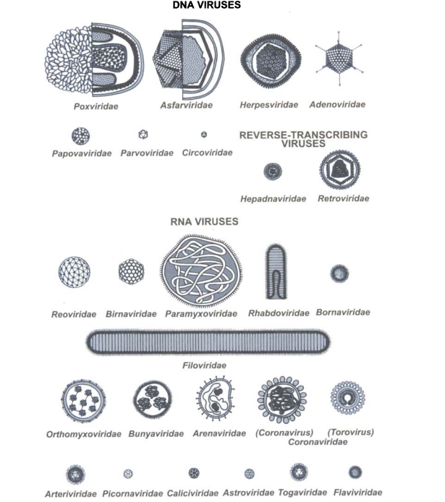

Slide 34
Virus replication
Attachment of the virion to the cell
Entry in to the cell
Uncoating of the genome
Transcription of early mRNAs
Translation of early viral proteins
Genome replication
Transcription of late mRNAs
Translation of late viral proteins
Assembly of genome surronded by late proteins
Maturation and release of virions from cell

Slide 35
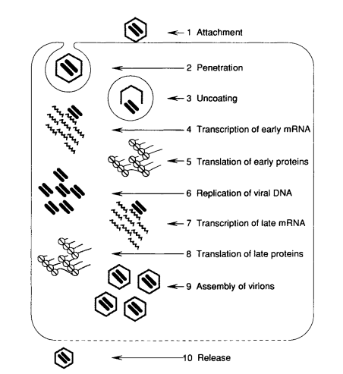
Virus replication process can be divided into seven steps

Slide 36
1. ATTACHMENT
Attachment occurs via one or more of virus surface proteins to specific molecules of host cell
These cellular molecules are known as receptors
  The recognition of the receptor by the virion is highly specific
  Some viruses have to to bind to a second type of cell surface molecule called coreceptor in order to infect a cell
  In some viruses binding to the receptor causes conformational changes in the virus protein that enables it to bind to the coreceptor
  Receptors and coreceptors are cell surface molecules usually glycoproteins
  Eg: intrcellular adhesion molecule–I (ICAM-I),CD 155, CD 4, sialic acid containg glycoproteins, signaling lymphocyte activation molecule (SLAM)
For some viruses attachment occurs through specialized structure such as fibres and knobs of adeno virus and the spikes of rotavirus
For enveloped viruses the attachment sites are on the surface glycoproteins present on the envelope
Initially a virion is weakly bound to a cell at only one or few receptors. At this stage the attachment is reversible. Subsequently binding to many receptors occurs and the attachment becomes irreversible

Slide 37
2. ENTRY
Viruses can deliver their genomes directly in to the cell through a pore in plasma membrane
Many naked viruses enter through endocytosis
The plasma membrane flows around the virus
More receptors bind and eventually the virion is completely enclosed in the membrane which pinches off as an endosome
In the case of enveloped viruses entry is by fusion of the viral envelope with plasma membrane or endocytosis followed by fusion of virus envelope with the endosome membrane

Slide 38
3. GENOME UNCOATING
Genome uncoating is the complete or partial removal of the capsid to release the virus genome
Depending on the virus the process can take place
  At the cell surface with the capsid remaining at the exterior surface of the cell
  Within cytoplasm
  At nuclear pore
  Within nucleus
From the stage of penetration till the appearance of mature progeny virions the virions cannot be demonstrated inside the host cell
This period during which the virus seems to disappear is known as eclipse phase

Slide 39
4. TRANSCRIPTION
Viruses with positive RNA genomes(class IV&VI) have the same sequence as the virus m RNA
However only in class IV the genomes can function as m RNA
They are called as plus strand or positive sense RNA viruses
The class V are referred as minus strand or negative sense RNA viruses
Class VI viruses must first reverse transcribe their ss genomes to ds DNA before m RNA can be transcribed
Because they carry out transcription in reverse (RNA to DNA) they are known as retro viruses
Later some DNA viruses were also found to have the ability to carry out reverse transcription
These viruses are known as pararetroviruses and class VII was formed to accommodate them
Some single stranded viruses have a mixture of positive and negative polarity within the strand
Genomes of this type are known as ambisense
Eg: ss DNA – geminiviruses (plant virus), ss RNA – arenaviruses (animal virus)
Viruses carrying out trnacription in the nucleus use cell RNA polymerase II. These viruses include retro and many DNA viruses. DNA viruses replicating in cytoplasm use virus encoded transcriptase.
In RNA viruses each virus in class III,IV and V encode its own enzyme. All viruses that carry out transcription except the positive sense RNA viruses have the transcriptase in the virion.
The enzyme is immediately available to transcribe the virus genome when the cell is infected. Before starting transcription the positive RNA viruses must translate copies of the from the genome RNA.

Slide 40
4. TRANSCRIPTION
Capping
Most eukaryotic and viral m RNA have a cap at their 5’ end. The cell enzymes that carry out the capping activities are guanylyl transferases (add guanosine 5’ triphosphate) and methyl transferases (add methyl groups)
Most viruses carrying out transcription in the nucleus use the cell enzymes. Some of the viruses replicating in cytoplasm
  eg: pox,reo and corona viruses encode their own capping and methylating enzymes.
Negative sense RNA viruses with segmented genomes “ snatch” caps from cell m RNAs eg: influenza
In this case the viral RNA polymerase binds to the cellular capped m RNA and cleaves the RNA 10-20 nucleotides from the 5’ end
The capped oligonucleotide acts as primers to initiate transcription of viral m RNA. Not all m RNAs are capped
  For example picorna viruses donot cap their m RNAs.
Polyadenylation
Series of adenosine residues are to 3’ end of most m RNAs of eukaryotes and viruses
This probably increase stability of m RNA and plays a role in the initiation of translation
Some viruses (eg: reoviruses) do not polyadenylate their m RNA

Slide 41
5. GENOME REPLICATION
Most DNA virus genomes are replicated in the nucleus but some ds DNA virus genomes are replicated in cytoplasm
Genomes of most RNA viruses are replicated in the cytoplasm but those of the minus strand RNA viruses with segmented genomes are replicated in the nucleus
In retro and pararetro viruses RNA to DNA replication occurs in the cytoplasm and DNA to RNA replication occurs in the nucleus
In the case of many RNA viruses the first nucleotide of the new strand base pairs with a nucleotide in the viral RNA
This initial nucleotide effectively acts as a primer for RNA replication
Some ss DNA viruses (parvoviruses) use self priming. There are regions at their 3’ end with complementarity sequences that can base pair
The hydroxyl group of the nucleotide at the 3’ end forms a linkage with the first nucleotide
Some DNA viruses (polyoma viruses) use cellular enzyme primase to synthesise their RNA primers
Others viruses such as herpes viruses encode their own primers
Retroviruses use the cellular t RNA to prime DNA synthesis and then use the 3’ –OH in a partly degraded positive RNA template to prime positive DNA synthesis
RNA primer synthesized by cell primase is used for RNA synthesis from proviral DNA
Some viruses use hydroxyl group of a serine or tyrosine in a protein as a primer
  Eg: DNA – adeno, RNA – picorna
Hepadna viruses use protein to initiate negative DNA replication and use RNA primer to initiate positive DNA.

Slide 42
6. Assembly
After synthesis of genomes and viral proteins they are assembled into virus particles in the nucleus and/or cytoplasm of the infected cell
DNA viruses (except poxviruses – assembled in cytoplasm) are assembled in the nucleus. RNA viruses are generally assembled in the cytoplasm
Maturation step may follow the initial assembly process
7. Release
It is the final step in virus replication. Naked virions are released by lysis of the cell
Enveloped animal viruses are released by budding through the host cell membranes
In a few viruses the host cells are not destroyed
The virions leave the cells through cytoplasmic channels over an extended period of time

Slide 43
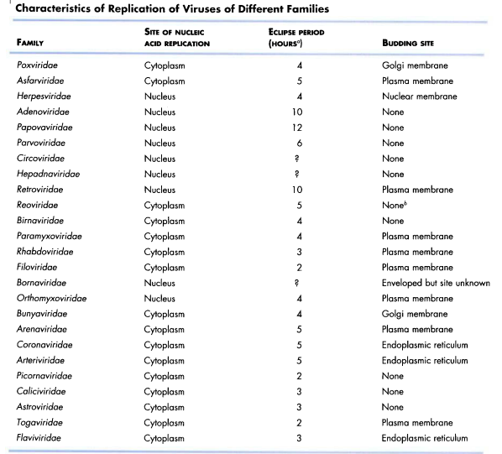

Slide 44
INTERFERENCE
It is the prevention of virus multiplication
It is due to defective interfering particles or interferons
Interferons are proteins secreted by cells in response to virus infection
The trigger for interferon production is double stranded RNA produced during RNA virus replication
Inferferons protect adjacent cells from infection and activate T cell mediated immunity
There are number of types of interferons
Alpha and beta are produced by most cells when infeted with viruses
The secreted interferon diffuses to nearby cells and bind to interferon receptors and trigger antiviral activities

Slide 45
MODE OF INTERFERON ACTION
The antiviral activities of interferon are
  Activation of genes that encode double stranded RNA dependent protein kinase R and RNase L.
  Stimulation of MHC I production and proteosome proteins
  These enhance the presentation of viral peptides on infected cell surface to T cells
  Activation of NK cells
  Induction of apoptosi.
Another type of interferon called gamma interferon is produced mainly by T cells and NK cells when trigerred by certain molecules released during immune responses(eg:IL-2)
It has number of effects including stimulation of antigen presentation and activation of phagocytes and NK cells

Slide 46
CYTOPATHIC EFFECTS(CPE)
Virus growth in cell culture can be detected by CPE
The CPE produced by some viruses are cell death, formation of giant cells, inclusion bodies etc
Inclusion bodies are aggregates of unassembled virus subunits or intact virus
They may be intracytoplamic or intranuclear and may be acidophilic or basophilic
Eg: Negri bodies in rabies - intracytoplasmic acidophilic inclusion bodies.
Plaque: Infected area surrounded by normal cells in monolayer cell cultures
Pock: Infected area surrounded by normal area in chorioallantoic membrane

Slide 47
MUTATION
Spontaneous mutations
  These mutations occur naturally during virus replication.
  DNA viruses are stable genetically than RNA viruses
  This may be due to the lack of error correction mechanisms in RNA replication
Induced mutations
  Chemicals
  Nitrous acid – direct action on bases
  Base analogues – indirect action, mispairing thus generating mutations
  Physical
  UV and X rays

Slide 48
TYPES OF MUTATIONS
Point mutations or insertion deletion mutations
Phenotypic changes seen are
  Conditional lethal mutants
    The mutant multiplies under certain conditions but not others where as the wild type grows at both conditions
    Eg : temperature sensitive mutant – grows at low temperature 31C but not at 39C
    The reason is the altered protein can not maintain functional conformation at the high temperature.
  Host range mutant - grows only in a subset of cell types
  Plaque size - plaques may be larger or smaller than the wild type
  Drug resistant mutants
  Enzyme deficient mutants
  Hot mutants – grow better at elevated temperature than wild type
  Attenuated mutants – cause much milder symptoms or no symptoms compared to parental virus

Slide 49
RECOMBINATION
Genetic recombination
Exchange of genetic information by breaking and joing nucleic acid bonds is seen in DNA and retroviruses
Recombination systems for DNA are available in the cell
This type of recombination is very rare in RNA viruses
Picornaviruses have a type of very low efficiency recombination
This is not like the standard DNA recombination
It is probably a copy choice type
In that the polymerase switches templates when copying the RNA
Recombination is also common in the coronaviruses
In this also the mechanism is different from that of DNA recombination
In the negative stranded RNA viruses recombination leading to viable progeny not reported
Genetic reassortment
It is a non-classical type of recombination
When dual infection occurs in a cell by two variants of a virus having segmented genome (eg.Orthomyxovirus) , progeny virions can be produced with some segments from one parent and some from the other

Slide 50
COMPLEMENTATION
It is interaction at a functional level
There is no exchange of genetic material
If we infect two mutants with a ts (temperature-sensitive) lesion in different genes in a cell each mutant provides the missing function of the other and hence both can replicate
But the progeny virions will still contain ts mutations and will be temperature-sensitive.

Slide 51
MULTIPLICITY REACTIVATION
When UV inactivated double stranded DNA viruses are infected at a very high multiplicity of infection production of live virus progeny is noticed
This happens because the inactivated viruses cooperate as genes inactivated in one virion may still be active in one of the others.

Slide 52
PHENOTYPIC MIXING
When two viruses infect a cell the progeny viruses may contain coat components derived from both parents and will have coat properties of both the parents, this is called phenotypic mixing
It involves no alteration in the genetic material
The progeny of such virion is determined by which parental genome is packaged and not by the nature of the coat proteins
Phenotypic mixing can occur between related or between unrelated viruses
Some times the coat is entirely that of another virus
  Eg: retrovirus nucleocapsid in a rhabdo virus envelope
This type is also called pseudotype (pseudovirion) formation
The pseudotype described has adsorption –penetration – surface antigenicity characteristics of rhabdo virus but after infection behaves as a retro virus and produce progeny retro viruses

Slide 53
DEFECTIVE VIRUSES
Defective viruses lack the full complement of genes
They need another virus to provide the missing functions- helper virus
Defective interfereing (DI)particles
The defective virus particles compete with the helper virus for the functions the helper provides
This may lead to decrease in the replication of the helper virus
This phenomenon is known as interference and such defective particles are called defective interfrering (DI) particles
Not all defective particles cause interference
DI particles can modulate natural infection

