Slide 1
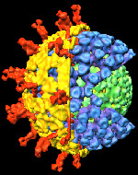
REOVIRidae
reo: respiratory enteric orphan
Baltimore group III ds segmented RNA virus

Slide 2
Characteristics
First recognized in 1959 ‑
  previously classified as echoviruses
>150 species in the family Reoviridae.
Infect invertebrates, vertebrates and plants,
Genera are serologically unrelated.
The Reoviridae family has 15 recognized genera divided into two subfamilies:
Spinareovirinae (with virions having 12 “spikes” (turrets) protruding from the core through the outer capsid, hence “turreted” viruses) and
Sedoreovirinae (with virions having a smooth, unspiked appearance and three capsid shells, hence “nonturreted” viruses)

Slide 3
The Spinareovirinae comprises nine genera including Orthoreoviruses, Aquareoviruses, and Coltiviruses that infect a variety of animal species.
The Sedoreovirinae comprises six genera that include important pathogens of domestic animals and humans. Included genera Orbivirus, Rotavirus, and Seadornavirus

Slide 4
Family Reoviridae
Genus | Segments | Host | Vector
Orthoreovirus | 10 | Mammals | None
Orbivirus | 11 | Mammals | Mosquitoes, flies
Rotavirus | 11 | Mammals | None
Coltivirus | 12 | Mammals | Ticks
Seadornavirus | 12 | Mammals | Ticks
Aquareovirus | 11 | Fish | None
Hypexreovirus | 10 | Mammals | None
Cypovirus | 10 | Insect | None
Fijivirus | 10 | Plant | Planthopper
Phytoreovirus | 12 | Plant | Leafhopper
Oryzavirus | 10 | Plant | Planthopper
Mycoreovirus | 11 or 12 | Fungi | None

Slide 5
Structure
These are non-enveloped.
Two or three capsid layers (double or triple layer capsids).
Genome- linear double stranded RNA 10-12 segments.
Proteins are encoded on one strand only of each duplex (the mRNA species)
The genome size may vary from 16 -27 kbp.
Positive strand has 5’ terminal cap.
Negative strand has 5’ terminal phosphorylation.
3’ end has poly A tail.

Slide 6
Replication
Reoviruses have three highly interesting and characteristic features regarding replication.
They are dsRNA viruses which replicate in the cytoplasm in the viroplasms or viral inclusion bodies.
They do not fully uncoat during the process of replication as the coat is resistant to protease digestion, which prevents them from being completely destroyed by the infected cell.
The mRNA used in translation is synthesized from the negative strand of the dsRNA. Each negative strand produces many positive strands using particle-associated transcriptase.
Neither of the strands of dsRNA appear among the transcription products, and both strands remain in the uncoated core particle.
Conservative replication

Slide 7
Following entry into the cells, the viral outer capsid is proteolytically cleaved in the late endosomes to form transcriptionally active cores.
These particles are released into the cytoplasm and synthesize full-length, positive-sense, capped, and non-polyadenylated single-stranded RNAs (ssRNAs) corresponding to each viral genome segment
Reovirus ssRNAs are translated to synthesize new viral proteins and also serve as templates for negative-sense ssRNA synthesis within the replicase particles to produce nascent genomic dsRNA

Slide 8
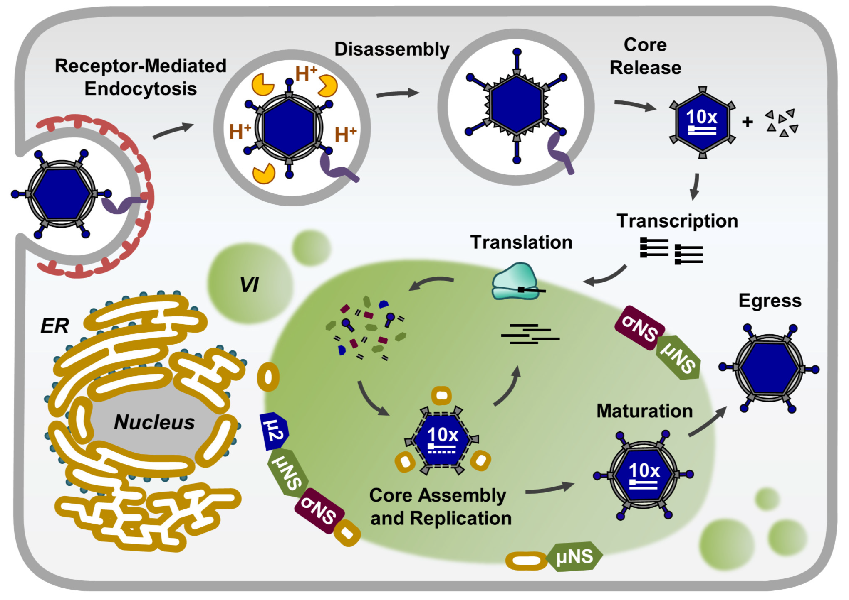

Slide 9
Blue-tongue
Sore Muzzle, Pseudo Foot-and-mouth Disease, And Muzzle Disease.
Notes:
Bluetongue is also known as

Slide 10
Bluetongue Virus
  Genus Orbivirus- 28 serotypes
  10 segments of ds RNA
Non-contagious
Insect-borne viral disease. Outbreaks are highly seasonal, occur during the late summer and autumn.
Ruminants: Primary host is sheep
Others infected: Cattle, goats, deer (asymptomatic infection)
Not zoonotic
BT endemic in India with 23 serotypes
Notes:
Bluetongue is a non-contagious, insect-borne, viral disease of ruminants. Bluetongue virus (BTV) belongs to the genus Orbivirus in the family Reoviridae. There are 24 serotypes identified worldwide, six of which have been isolated in the U.S. Bluetongue primarily affects sheep and wild ruminants, with asymptomatic infections occurring in cattle, goats, deer, and carnivores. This disease can result in significant morbidity.

Slide 11
Morbidity/Mortality: Sheep
Sheep
  Severity of disease varies
    Breed
    Strain of virus
    Environmental stress
  Morbidity
    As high as 100%
  Mortality
    Usually 0 to 30%
    but can reach up to 70% in highly susceptible sheep.
Notes:
In sheep, the severity of disease varies with the breed of sheep, strain of virus, and environmental stress. Morbidity can be as high as 100%. Mortality is usually 0 to 30%, but can reach up to 70% in highly susceptible sheep.
[Photo: A flock of sheep. Source: USDA ARS]

Slide 12
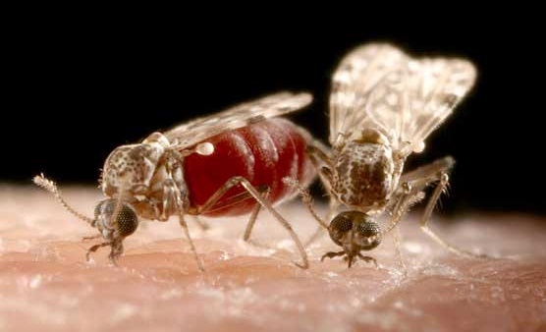
Animal Transmission
Biting midges -Genus Culicoides
Ticks, sheep keds
In utero to the fetus
Mechanical
Venereal- rare
Notes:
BTV is transmitted by biting midges in the genus Culicoides (shown above), with Culicoides variipennis var sonorensis the principal vector in the U.S. Ticks or sheep keds can be mechanical vectors but are probably of minor importance in disease transmission. While bluetongue is not a contagious disease, the virus can be transmitted to the fetus in utero or spread mechanically on surgical equipment and needles. Although BTV can be found in semen, venereal spread does not appear to be a major route of infection.
[Photo: Two Culicoides biting midges. Source: www.culicoides.net]

Slide 13
Pathogenesis
After insect bite virus first replicates in the cells near to the insect bite
There is primary viremia.
Virus enters haematopoetic cells and endothelial cells of blood vessels.
BTV induced lesions are due to direct injury to the endothelial cells of microvasculature resulting in increased vascular permeability, haemorrhages, fluid exudations, thrombosis, and tissue infarction
Adult remain viraemic for 14 to 28 days.

Slide 14
Clinical signs of BT
Fever, serous to bloody nasal discharge, later on mucopurulent,
Hyperaemia and oedema of lips, face, ears and sub-maxillary region (‘monkey-face’ appearance),
Oral erosions and ulcers, cyanosis of tongue,
Lameness with coronitis,
Respiratory distress and muscular necrosis to culminate in debility and death

Slide 15
Clinical Signs: Sheep
Incubation period: 5 to 10 days
Most asymptomatic
Severe disease may occur in some infected sheep and other ruminants
Oral erosions and ulcerations
Tongue
  Swollen, protruding
  Cyanotic
  = “blue-tongue”
Reproductive failure- abortions
Notes:
The incubation period for bluetongue is 5 to 10 days. The vast majority of infections with bluetongue are clinically inapparent. In a percentage of infected sheep and occasionally other ruminants, more severe disease can occur The tongue is occasionally cyanotic (“blue-tongue”) (middle photo, www.fao.org), swollen, and protrudes from the mouth (top photo, www.usda.org). Erosions and ulcerations are often found in the mouth; these lesions may become extensive and the mucous membranes may become necrotic. Pregnant ewes may abort their fetuses, or give birth to “dummy” lambs.
[Photo: Sheep, mouth. Most of the dental pad is eroded; the remaining pale mucosa is necrotic. Armed Forces Institute of Pathology/CFSPH]

Slide 16
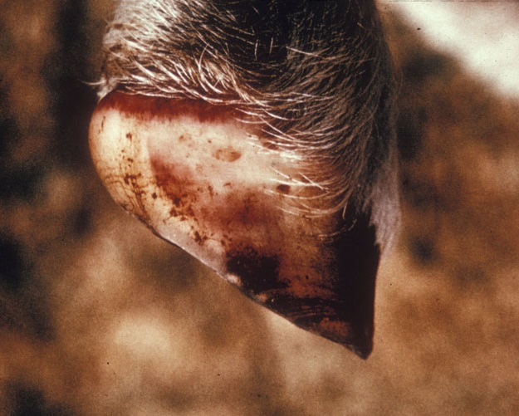
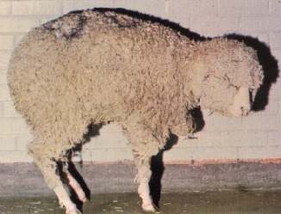
Clinical Signs: Sheep
Coronitis
  Inflammation of coronary band
Lameness
  Painful hooves
  Sloughing of hooves
Notes:
In sheep, the coronary bands on the hooves are often inflamed and the hooves painful. Lameness is common and animals may slough their hooves if they are driven.
[Photos: (Left) Sheep, foot. There are multiple petechiae in the hoof wall, and there is marked hyperemia of the coronary band. Source: Armed Forces Institute of Pathology/CFSPH; (Right) A lame sheep holding up its painful front leg. Source: USAHA Foreign Animal Disease “The Gray Book” at www.usaha.org/Portals/6/Publications/FAD.pdf]

Slide 17
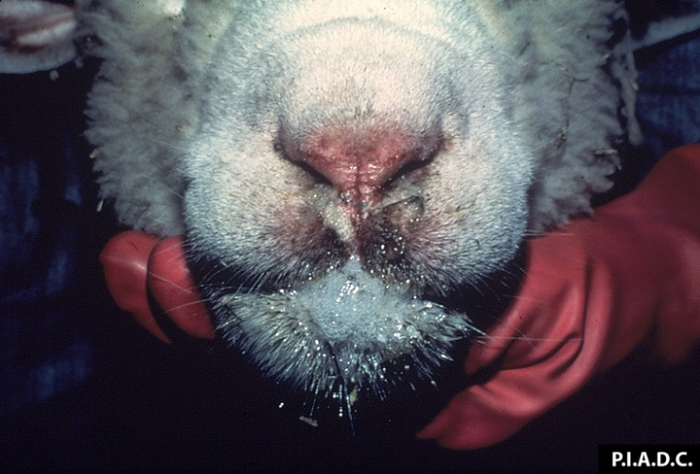
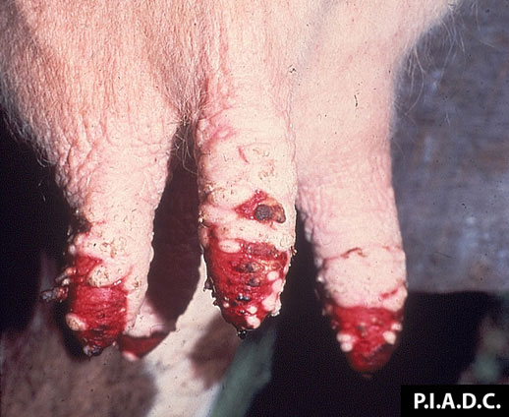
Clinical Signs
Cattle and goats
  Usually subclinical
  Erosions, crusts
  around nose
  and teats
  Coronitis
  Reproductive failure
  In cattle, constant changing of position of the feet gives bluetongue the nickname the dancing disease.
Notes:
Cattle can become viremic starting at 4 days post-infection but rarely develop symptoms; often, the only signs of disease are changes in the leukocyte count and a fluctuation in rectal temperature. Rarely, cattle have mild hyperemia, vesicles or ulcers in the mouth, erosion and crusting around the nose (top photo), hyperemia around the coronary band, or lesions around the teats of lactating cows (bottom photo). Temporary sterility may be seen in bulls, and infected cows may give birth to “dummy” calves with hydranencephaly or cerebral cysts. Cattle that have clinically apparent disease may develop severe breaks in the hooves several weeks after infection; such breaks are usually followed by foot rot. In pronghorn antelope and whitetail deer, the most common symptoms are hemorrhages and sudden death. Infections in goats are usually subclinical and resemble disease in cattle.
[Photos: (Top) Sheep. There is bilateral nasal exudate, erosion of the nasal planum, and excessive salivation. Source: Plum Island Animal Disease Center/CFSPH; (Bottom) Bovine, mammary gland. There is extensive coalescing ulceration of the teat skin. Source: Plum Island Animal Disease Center/CFSPH]

Slide 18
Post Mortem Lesions
Haemorrhage and ulcers in the oral cavity and upper gastrointestinal tract;
necrosis of skeletal and cardiac muscle;
coronitis;
subintimal haemorrhage in the pulmonary artery;
oedema of the lungs, ventral subcutis, and fascia of the muscles of the neck and abdominal wall;
and pericardial, pleural and abdominal effusions.

Slide 19
Diagnosis
Clinical signs
History
  Insect activity
  Wasting or foot rot
Laboratory
  Virus isolation
  ELISA, IFA, VN
  PCR
  Serology, complement fixation
  Examination of proteins
Notes:
Bluetongue should be suspected when typical clinical signs are seen during seasons when insects are active. A recent history of wasting and foot rot in the herd supports the diagnosis. Bluetongue can be diagnosed by isolating the virus in cell cultures or embryonated chicken eggs. It can also be isolated by inoculation into sheep, and sometimes suckling mice or hamsters. Virus identity is confirmed by antigen-capture ELISA, immunofluorescence (IFA), immunoperoxidase, virus neutralization (VN), or polymerase chain reaction (PCR) tests. These techniques allow for rapid diagnosis and can identify the virus serogroup and serotype. Serology and complement fixation tests are also used, and recently a method has been developed to examine bluetongue virus proteins and genes, which helps to differentiate between BTV and related viruses that cause epizootic hemorrhagic disease (EHD).

Slide 20
Isolation of the virus requires collection of the blood during viremia.
It can be done in embryonated eggs via I/V route or in BHK cell line.
For isolation buffy coat of the infected blood is used.
Serotype specific vaccine used

Slide 21
Vaccination
Available
  Serotype specific
Adverse effects
  Fetal malformations
  Recombination
    New strains of virus
Notes:
Vaccines are available but are specific for each serotype. There are also adverse effects to the use of vaccines; they can cause fetal malformations during the first 100 days of gestation in ewes, and may be able to recombine with field strains to produce new strains of virus. We all need to do our part to keep our sheep healthy and free from foreign animal diseases, such as bluetongue.

Slide 22
AFRICAN HORSE SICKNESS
Or Equine plague

Slide 23
Etiology
Orbivirus
Transmitted by midges (Culicoides spp.).
Horses and mules are the most severely affected.
Nine different serotypes of virus
Viscerotropic virus
AHSV naturally infects zebras, which are considered a natural reservoir for the virus as they rarely exhibit clinical signs of infection.

Slide 24
Serotypes
All serotypes of AHS virus occur in eastern and southern Africa; this distribution reflects the geographic pattern of zebra, which cycle the virus asymptomatically and probably serve as a reservoir for the virus
Only African Horse Sickness virus serotype 9 is found in West Africa where zebra do not occur.
Types 4 and 9 are responsible for most outbreaks outside sub-Saharan Africa.
Types 5 and 9 are neurotropic.
Cross-protection occurs between serotypes.
Notes:
From AVIS

Slide 25
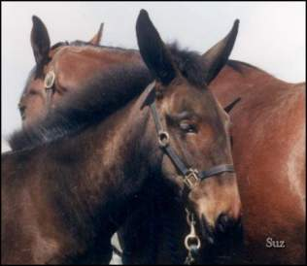
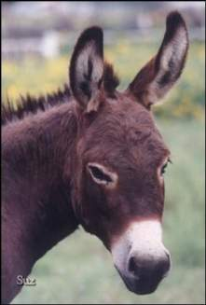
Host Range
In order of decreasing severity of disease:
Horses
Mules
Donkeys
Zebras
Approximately 70-95 % of all horses developing the disease will die while mortality % for mules is 50% and donkeys 10%

Slide 26
Host Range
Dogs can also become infected by eating infected meat.
1987-90 outbreak in Spain:
  Dogs that did not consume infected meat were found to be seropositive, suggesting infection by arthropod bites.
  Dogs infected with this virus may have the pulmonary form of the disease.
  There is no evidence that humans can be infected by field strains of the disease.
  However, intranasal exposure to neurotropic vaccine strains has caused encephalitis and retinitis in humans.

Slide 27
Transmission
AHSv is spread primarily by Culicoides (ex: biting flies and mosquitoes) by transfer of blood
  Culicoides are biological vectors because the virus can replicate in the midge
  In U.S., Culicoides that can transmit bluetongue virus most likely can transmit African Horse Sickness
  Culicoides are most active at sunset and about sunrise

Slide 28
Transmission
African Horse Sickness is non-contagious, but the horse is an amplifier of AHS virus and source of virus for arthropods.
Arthropods other than Culicoides may spread the virus as mechanical vectors

Slide 29
Pathogenesis
After bite of arthropods virus replicates in local lymph nodes.
Primary viremia.
Infection of other tissues and organs of RE system.
Secondary viremia.
There is generalized hyperemic reaction leading to inflammation and edema.
Vasculitis of small and medium blood vessels causing increased vascular permeability, edema, and hemorrhage, particularly in the lungs and heart

Slide 30
Clinical Signs
Infected horses remain viremic for approximately 18 days, although the fever may be present for another 4 to 8 days, if the animal should live that long.
Despite their reduced mortality, the viremic stage in donkeys may last for up to 28 days.
The pulmonary form has a shorter incubation period than the cardiac form.

Slide 31
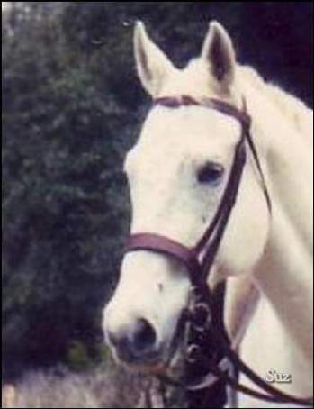
Clinical Signs
First Sign:
  Fever of 102°F to 106°F,
  (38.9°C - 41.1°C)
Notes:
Image courtesy of Dr Suzanne Burnham

Slide 32
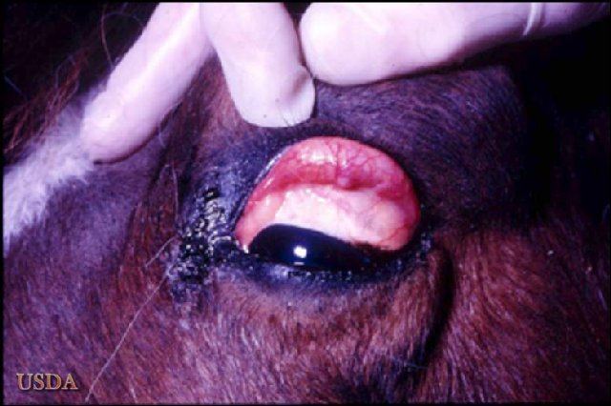
Clinical Signs
  Most Common Sign
  Congestion of the conjunctivae
  Severity of congestion is good indication of severity of infection
Notes:
Image courtesy of Dr Corrie Brown

Slide 33
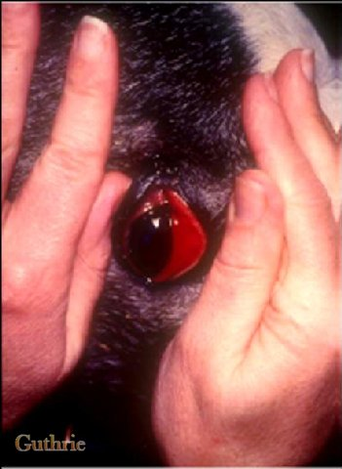
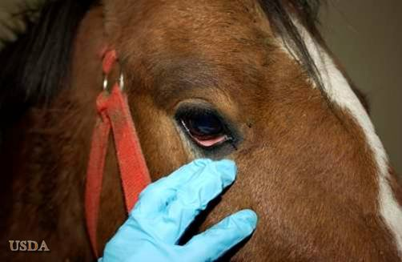
Clinical Signs
Lower Eyelid Conjunctivitis
Notes:
Image 1 from Dr. Alan Guthrie, Pretoria University; Image 2 from Plum Island collection

Slide 34
Clinical Signs
After initial signs, the disease can progress in one of four ways:
Peripheral (Cardiac) or sub acute called “Dikkop” (thick head) in S. Africa
Central (Pulmonary) or peracute called “Dunkop” (thin head) in S. Africa
Mixed Form (Acute) most common
Mild Form (horse sickness Fever)
Notes:
http://www.vet.uga.edu/vpp/IVM/ENG/Modes/definition03.htm
Clinical disease
Respiratory distress
Supraorbital edema
Colic
Death

Slide 35
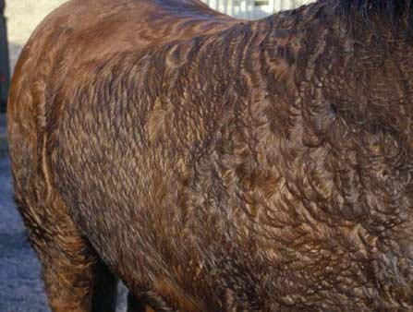
Clinical Signs: Pulmonary or Dunkop form
Fever up to 104°F to 106°F
Increasingly more rapid respiration and abdominal expiration
  Respiratory rate may reach 60-70 per minute
Coughing and Sweating
http://www.vet.ed.ac.uk/animalpain/Pages/images/Optimised%20Images/optphotos/EQsweating.jpg
Notes:
Image: http://www.vet.ed.ac.uk/animalpain/Pages/images/Optimised%20Images/optphotos/EQsweating.jpg
http://www.vet.ed.ac.uk/animalpain/
This website may be reproduced or altered for personal or academic use only provided acknowledgement is made to the original authors of the site, the sponsors and the University of Edinburgh who are the holders of the copyright.

Slide 36
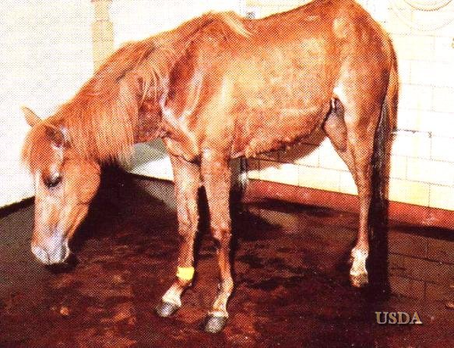
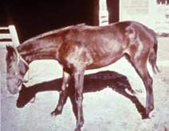
Clinical Signs: Pulmonary
Horse may appear colicky (getting up and down, and rolling)
As pulmonary distress increases:
  Animal stands with forelegs apart
  Head extended
  Nostrils dilated

Slide 37
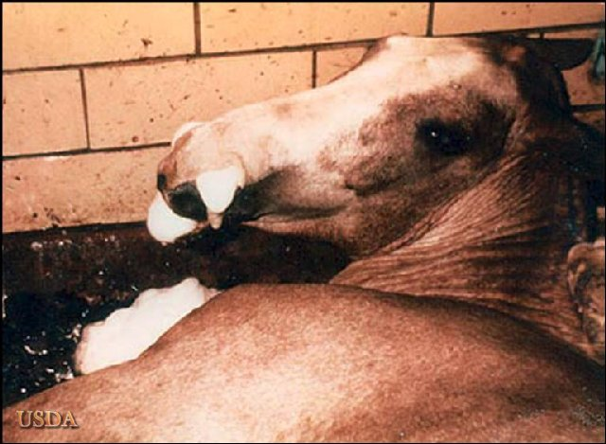
Clinical Signs: Pulmonary
Once foam appears
in nostrils, death
follows rapidly.
Animal may drink and eat, even in terminal stages.
Notes:
Image courtesy of Plum Island Animal Diagnostic Center

Slide 38
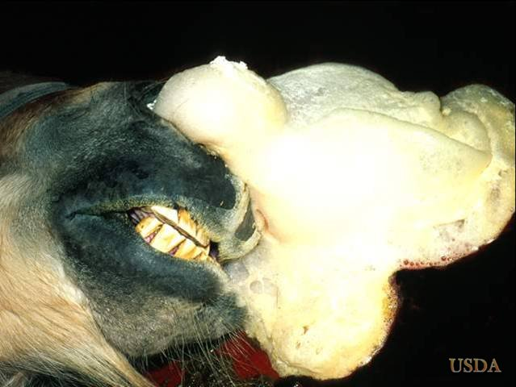
Clinical Signs: Pulmonary
Photo courtesy of Plum Island
Notes:
Photo courtesy of Plum Island Animal Diagnostic Center

Slide 39
Clinical Signs: Cardiac or Dikkop form
Incubation is usually longer (7-14 days)
Fever of 102-106°F usually lasts 3-6 days

Slide 40
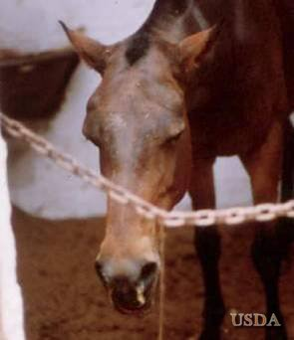
Clinical Signs: Cardiac
At the end of the febrile period, marked swelling of the head and neck may occur
Notes:
http://www.vet.uga.edu/vpp/IVM/ENG/Horse/index.htm

Slide 41
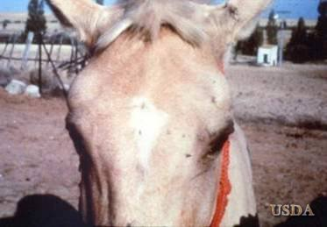
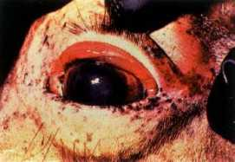
Clinical Signs: Cardiac
Classic areas for swelling are:
    Supraorbital fossa
    Conjunctiva
    Lips, cheeks, tongue
    Intermandibular space
    Laryngeal area
    Neck, brisket, ventral thorax
http://www.spc.int/rahs/Manual/images/AfrHorsSick-09.jpg
Notes:
Image 1 IFADD course 2005
Image 2 http://www.spc.int/rahs/Manual/images/AfrHorsSick-09.jpg

Slide 42
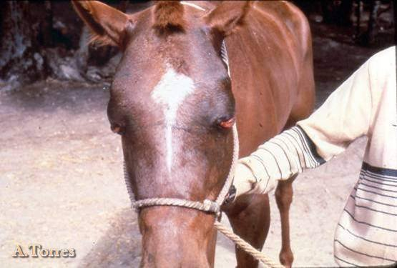
Clinical Signs: Cardiac
Peri-orbital swelling
Notes:
IFADD course 2005, Alfonso Torres, Peste Equina Africana ppt.

Slide 43
Clinical Signs: Cardiac
No edema of the lower parts of the legs occurs
Petechial hemorrhages on the ventral surface of the tongue and in conjunctiva may occur
As edema progresses, there may be restlessness and signs of abdominal pain and pulmonary edema

Slide 44
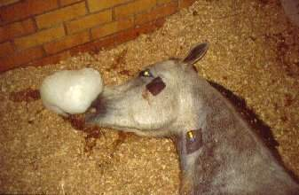
Clinical Signs: Cardiac
Finally, animal becomes prostrate, and dies
Again, animal may eat and drink, even in terminal stages
http://www.usyd.edu.au/su/rirdc/articles/disease/ahs.jpg
Notes:
http://www.usyd.edu.au/su/rirdc/articles/disease/ahs.jpg

Slide 45
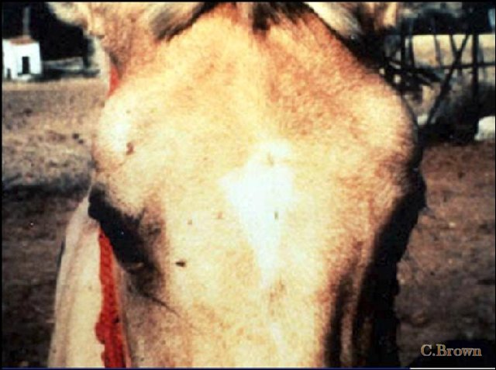
Recovery: Cardiac
If the disease is not fatal, the edema will subside over 3 to 8 days.
Notes:
Image courtesy Dr Corrie Brown

Slide 46
Clinical Signs: Mixed Form (acute)
Mixture of pulmonary and cardiac forms
Signs of one may predominate
The mixed form is more frequently seen at necropsy

Slide 47
Clinical Signs:
Mixed Form (fever)
Mildest form
Can be subclinical or inapparent
Occurs in zebras, donkeys, and horses with heterologous immunity.
Fever is usually intermittent—usually normal temperature in the morning, but is febrile in the afternoon
Fever may reach 104°F in 1 or 2 days

Slide 48
Clinical Signs:
Mixed Form (fever)
Other Clinical Signs:
  Increased respiratory rate
  Mild conjunctival congestion
  Accelerated pulse
  Loss of appetite is rare and mild
After 1 or 2 days, there is a rapid recovery

Slide 49
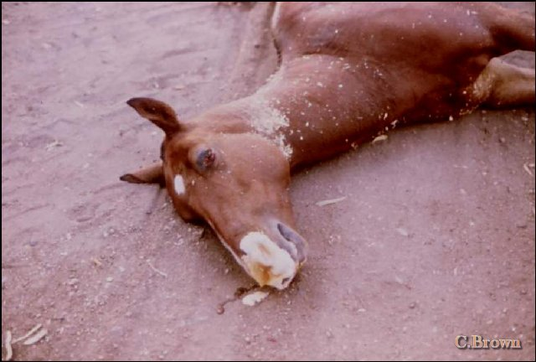
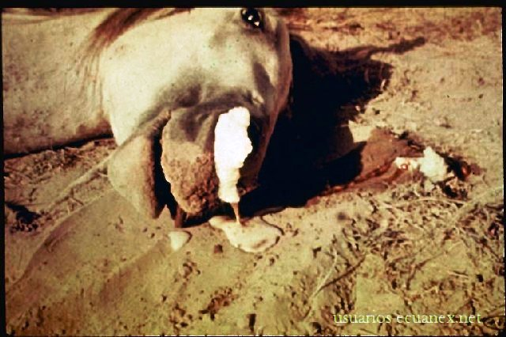
Post Mortem Lesions
Sudden Death
Notes:
Image courtesy of Dr Corrie Brown

Slide 50
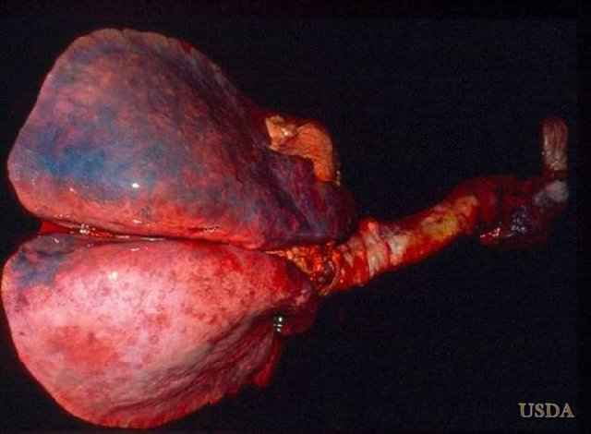
Pulmonary Edema
Notes:
Courtesy of Corrie Brown

Slide 51
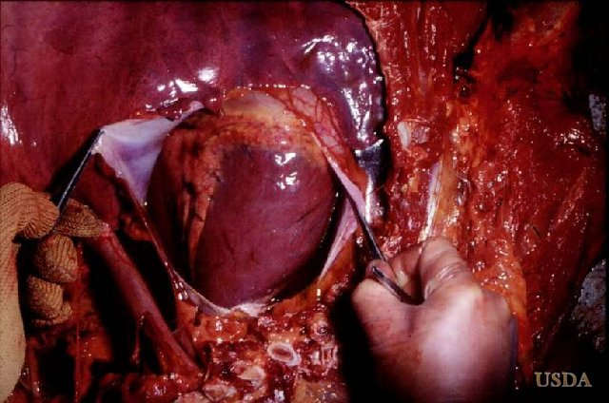
Hydropericardium
Notes:
Courtesy of Corrie Brown

Slide 52
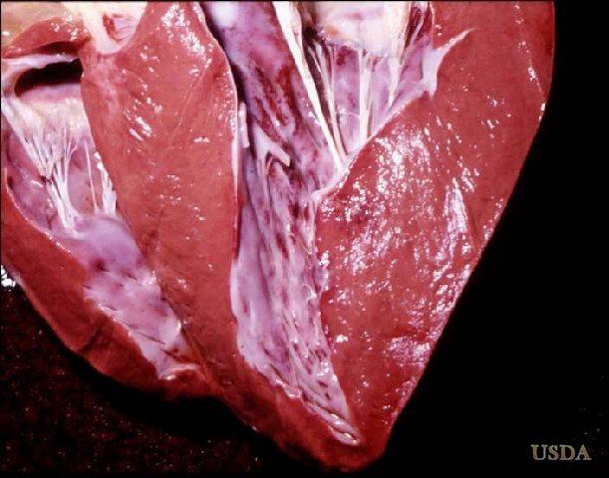
Myocardial necrosis
Notes:
Courtesy of Corrie Brown

Slide 53
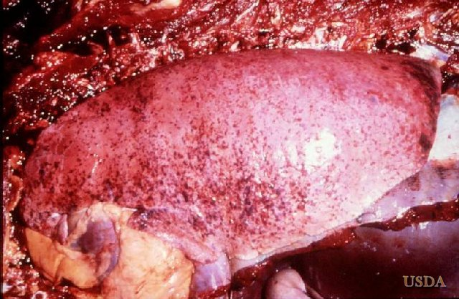
Hemorrhages
Notes:
Courtesy of Corrie Brown

Slide 54
Diagnosis
AHS is difficult to pinpoint in early febrile stages
Suspect the disease during the season when there are insect vectors
Suspect when horses develop the following:
  Fever
  Dyspnea
  Edema of the supraorbital fossa
  Subcutaneous edema of head/neck areas
  Pulmonary edema
  Death

Slide 55
Laboratory diagnosis
Virus isolation – blood from live animal; spleen from dead animal
    Vero cells, embryonated eggs, suckling mouse brain
Serology – CF test, ELISA
PCR
Virus is closely associated with erythrocytes
Notes:
Corrie Brown
The virus may be isolated for identification with ELISA or PCR;
however, there is no effective treatment. However, there is
prevention with several types of vaccine, from monovalent to
polyvalent. And certainly elimination of vector exposure is an aid in
control. - Mod.TG] Promed

Slide 56
Bovine Rota Virus
virions have a wheel-like appearance from which the genus derives its name (Latin rota, “wheel”).

Slide 57
Viral causes of diarrhoea in neonates
Rotavirus
Coronavirus
BVD
Bredavirus
Calicivirus
Parvovirus
Astrovirus
except for BVD and parvo - cause localized gut infections
Notes:
.
complicated by mixed infections and possible synergy between agents (rota and BVD - Kelling 2002, AJVR 63:1179-86)

Slide 58
Susceptibility of Neonates
Rotaviruses 4 to 14 days
Coronavirus 4 to 30
0
4 days
Colostral
Antibodies in gut
Susceptible period
Notes:
newborn animals protected only if there is neutralizing antibody in gut - systemic antibody not much use
after 4 days relatively little antibody in gut unless high levels in milk
susceptibility decreases after a month - changes in gut physiology, gut flora and increase in rate of replacement of enterocytes

Slide 59
Prevention of viral diarrhea in calves
Vaccination of pregnant animals
Colostrum for 2 weeks
Management

Slide 60
Rotaviruses
Main viral cause of neonatal diarrhea
Younger animals highly infected with Rota virus infection, mostly within the first 4 weeks
Transmitted by fecal-oral route or by direct contact.
11 dsRNA segments and is very stable over a wide pH range with heat liability.
There are six structural proteins (VP1 to VP4, VP6, and VP7) and six nonstructural proteins (NSP1 to NSP6).
Each of the 11 segments of dsRNA encodes a single viral protein except segment 11 which encodes two proteins

Slide 61
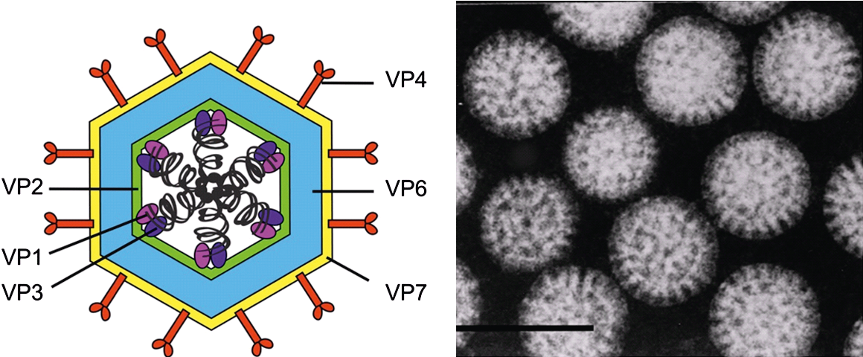
Triple-layered particle.

Slide 62
Rotaviruses
The genus has 9 species (A to D; F to J) or sometimes called groups based on antigenic and genetic similarities of the intermediate capsid protein of VP6.
Group A rotaviruses are the major cause of rotavirus infection in domestic animals.
Group A rotaviruses (RVA) can be further classified into P or G sero types based on genetic and antigenic similarities of VP4 and VP7.

Slide 63
VP4 (P protein for “protease-sensitive” due to its trypsin mediated cleavage required for virus adsorption into cells) determines the P serotypes.
VP7 (G protein for “glycoprotein” forming the matrix of the capsid) defines G serotypes

Slide 64
Rotavirus A, Rotavirus B, Rotavirus C and Rotavirus H viruses can infect humans, with Rotavirus A viruses being responsible for the majority of seasonal endemic diarrheal disease in young children.
Members of Rotavirus A can also infect other mammals (e.g., pig, cattle, horse, rat, mouse and bat) in which they cause diarrhea, and birds (e.g., chicken, turkey and pigeon) in which they cause enteric signs and Runting and Stunting syndrome.

Slide 65
Pathogenesis
Virus replication is typically restricted to the terminally-differentiated enterocytes lining the tips of the microvilli and enzyme producing enterocytes in the small intestine.
At the cellular level, the infection is characterized by vacuolization, blunting, and shortening of the villi.
Rotavirus also produces the enterotoxin NSP4.
Destruction of mature enterocotes in the villi leads to rupture and sloughing of the enterocytes with release of virus to infect adjacent cells.

Slide 66
Pathogenesis
Rotavirus may cause diarrhoea by three different mechanisms.
First, within 12–24 hours after infection, enterocytes are intact but the levels of the brush-border disaccharidases (sucrase, maltase, and lactase) are greatly reduced.
As a result, disaccharides in the diet cannot be hydrolysed to monosaccharides and thus cannot be absorbed, leading to osmotic diarrhoea.

Slide 67
Second, NSP4 has an effect in opening calcium channels in the enterocytes. This causes an efflux of sodium and water, producing secretory diarrhea .
Finally, the higher intra-enterocyte calcium concentration causes enterocytes to die by oncosis.
The rate of death of the mature villous tip enterocytes exceeds the rate of growth of immature enterocytes that are regenerated from the stem cells in the crypt, causing villous blunting and thus malabsorption

Slide 68
Maintenance of rotaviruses in populations
stable in environment
mucosal antibody more important than systemic antibody
persistence and periodic shedding
Rotavirus is not only a significant cause of diarrhea in calves but also has zoonotic potential

Slide 69
Diagnosis
Detection of virus in fecal smears by FAT
  FAT for GrA
    feces,
    jejunum, ileum,
EM and immune EM
antigen capture ELISAs (human test for Gr A rotaviruses)
  80 to 95% sensitivity and specificity compared to RT-PCR

Slide 70
EMERGING INFECTIOUS DISEASES
These are infections that have recently appeared within a population or those whose incidence or geographic range is rapidly increasing or threatens to increase in the near future.
Causes:
Previously undetected or unknown infectious agents
Known agents that have spread to new geographic locations or new populations
Previously known agents whose role in specific diseases has previously gone unrecognized.
Newly identified & previously unknown infectious agents that cause public health problems either locally or internationally are called emerging infectious disease

Slide 71
Factors in the Emergence or Re-emergence of Infectious Diseases
For an emerging disease to become established at least two events have to occur –
(1) the infectious agent has to be introduced into a vulnerable population and
(2) the agent has to have the ability to spread readily from person-to-person and cause disease.
Mutations
Development of resistance to drugs
Resistance of vectors to pesticides

Slide 72
Climate change is increasingly becoming a concern as a factor in the emergence of infectious diseases.
As Earth's climate warms and habitats are altered, diseases can spread into new geographic areas.
For example, warming temperatures allow mosquitoes - and the diseases they transmit - to expand their range into regions where they previously have not been found

Slide 73
Human Factors:
Population growth,
Urbanization, globalization, and
changes in human behavior can all contribute to the spread of infectious diseases
Public Health Infrastructure:
Weak surveillance systems,
lack of access to healthcare, and
inadequate infection control measures

Slide 74
Zoonotic potential of animal pathogens
Many emerging diseases arise when infectious agents in animals are passed to humans
60% of human pathogens are zoonotic
80% of animal pathogens are multi-host
75% of emerging diseases are zoonotic
80% of agents having a potential bioterrorist use are zoonotic pathogens
Nearly all emerging (new) human diseases originate from animal reservoirs
Diseases can now spread faster across the world than the average incubation period of most diseases

Slide 75
RE‐EMERGING INFECTIOUS DISEASE
Infectious agents that have been known for some time, had fallen to such low levels that they were no longer considered public health problems & are now showing upward trends in incidence or prevalence worldwide or have appeared in areas where they were not previously found.
Re-emergence of agents whose incidence of disease had significantly declined in the past, but whose incidence of disease has reappeared.

Slide 76
Emerging Virus
Re-emerging Virus
2001 - Nipah Virus(Bangladesh, India)
2003 - SARS Coronavirus
2004 - Avian Influenza(H5N1), Thailand, Vietnam
2006 - Influenza H5N1(Egypt, Iraq) - New Human Rhinovirus(USA)
2007 - Nipah Virus(Bangladesh) - LCM like Virus(Australia) - Polyoma like virus(Australia)
2009 - Influenza H1N1
2011 - Crimean Congo Hemorrhagic Fever (India)
Covid -19
Ebola
Marburg
Dengue
Yellow fever
Chikungunya
Chandipura
West Nile Virus
Rift Valley Fever
Human Monkey Pox

Slide 77
Emerging Bacteria
Re-emerging Bacteria
Drug resistant MTB- Both MDR and XDR
Lyme disease
MRSA
VRE (Vancomycin-resistant enterococcus)
E. coli O104: H4
Stenotrophomonas spp.
Extended spectrum betalactamase producing pathogens
TB
Pertussis
Cholera,
H. pylori,
Neonatal tetanus
Yersinia pestis
Rickettsia
Cl. difficile
Cl. botulinum
Bacillus anthracis (due to bioterrorim)
Fransciella

Slide 78
Emerging Fungi
Re-emerging fungi
Non albicans Candida
• Penicillium marneffi
• Apophysomyces spp.
• Fusarium
• Trichosporon
• Curvularia,
Alternaria
Zygomycosis
• Aspergillosis
• Penicilliosis
• Histoplasmosis

Slide 79
TRANSBOUNDARY DISEASES
The diseases that have very high probability of easily spreading across national, regional and international borders, they are often highly contagious in nature affecting domestic animals, wildlife and humans leading to enormous socioeconomic and public health challenge, significant economic, trade and/or food security issues

Slide 80
FMD
CBPP
BSE
Rift valley fever
PPR
African swine fever
Newcastle disease
Avian Influenza
Rabies
Botulism

