Slide 1
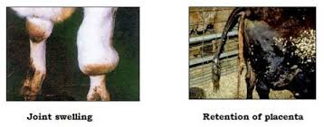
Brucellosis
Dr. Bincy Joseph
Assitant Professor
PGIVER , Jaipur

Slide 2
Brucellosis is caused by bacteria of the genus Brucella and is characterized by abortion, retained placenta, and to a lesser extent, orchitis and infection of the accessory sex glands in males.
Diagnosis depends on the isolation of Brucella from aborted materials, udder secretions or from tissues removed at post- mortem.
Presumptive diagnosis can be made by assessing specific cell-mediated or serological responses to Brucella antigens.
The disease is prevalent in most countries of the world.
It primarily affects cattle, buffalo, bison, pigs, sheep, goats, dogs, elk, and occasionally horses.
The disease in man, sometimes referred to as undulant fever, is a serious public health problem, especially when caused by B melitensis

Slide 3
Classification
All members of the Brucella genus are closely related.
There are six classical species: Brucella abortus, B. melitensis, B. suis, B. neotomae, B. ovis and B. canis.
The first three of these are subdivided into biovars based on cultural and serological properties.
Two species B. cetaceae and B. pinnipediae have been isolated from marine organisms.
Important diseases - Brucellosis, Bang’s disease, Malta fever, Undulant Fever, Fistulous withers, Poll evil

Slide 4
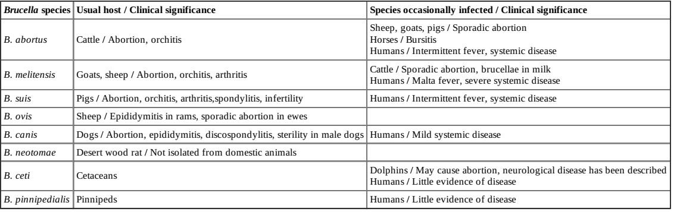

Slide 5
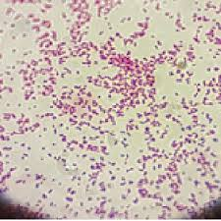
morphology
Brucella are coccobacilli or short rods
They are usually arranged singly, and less frequently in pairs or small groups
The organisms appear in pleomorphic forms in old cultures.
Brucella are nonmotile.
They do not form spores, and do not have flagella, pili, or true capsules.
Brucella are Gram negative and usually do not show bipolar staining.
Although they are not acid-fast organisms, they withstand decolourisation of 0.5 per cent acetic acid. (Modified Zeihl Neelsen Staining positive)
The Brucella genome is unusual among veterinary pathogenic
bacteria as it is composed of two circular chromosomes, with the exception of B. suis biovar 3, which
has a single chromosome.

Slide 6
Resistance
The organisms are killed by heating them to 60ºC for 10 minutes
In Milk readily killed by pasteurisation.
They are susceptible to acidic pH, disinfectants and sunlight.
They can survive for a long time foetus that is not exposed to sunlight.
They can remain for a long time in cold temperatures.

Slide 7
Antigens and Toxins:
Brucella produce two types of colonies smooth and rough that are associated with virulence, auto-agglutination etc.
Virulent organisms produce smooth colonies and avirulent organisms produce rough colonies.
Certain organisms produce intermediate colonies.
B.abortus, B.melitensis and B.suis produce two antigens called A and M.
Amount of these antigens in these species varies widely.
The A and M antigens occur in ration of 20:1 in B.abortus and still lower in B.suis.
Where as it occurs in the ratio of 1:20 B.melitensis.
The R antigen, a feature of the rough brucellae B. ovis and B. canis, can be detected by anti-R serum
The LPS (endotoxin) is the important virulence factor.
The organisms produce no exotoxins.

Slide 8
Cultural characters
They are aerobic organisms.
However, certain organisms like B.abortus and B.suis require 5-10% CO₂ tension.
Brucella species are aerobic, capnophilic and catalase-positive.
Apart from B. ovis and B. neotomae, they are oxidase-positive.
Brucella ovis and some biotypes of B. abortus require 5 to 10% CO2 for primary isolation
They are slow growing organisms and growth is visible after 48 hours at a temperature of 37ºC.
Numbers of media are used for the cultivation of organisms like nutrient agar, serum agar, liver infusion serum agar, tryptose agar, and dextrose potato and glycerol potato agar.
Media enriched with blood or serum are required for culturing B. abortus biotype 2 and B. ovis
On nutrient agar the colonies are small, round, convex, translucent with a smooth glistening surface.
In broth cultures they produce fine granular deposit.
Other media used include serum–dextrose agar (SDA) or glycerol dextrose agar.
A nonselective, biphasic medium, known as Castañeda’s medium, is used for the isolation of Brucella from blood and other body fluids or milk.
In contrast, primary isolates of B. ovis and B. canis always occur in rough
forms. Others produce smooth colonies
B. abortus are lysed by a specific bacteri-ophage (Tbilisi phage)

Slide 9
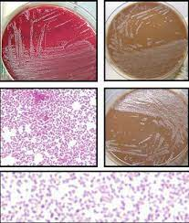

Slide 10
Biochemical characters
They utilise carbohydrates but produce very little or no acid and gas.
H₂S production is variable and this character is useful to differentiate brucella species.
All Brucella species are urease-positive except B.
ovis.
Inhibition of growth in the presence of different concentration of dyes like thionin, basic fuchsin, methyl violet and pyronin is also useful character in differentiation of various brucella species.
In general requirement of CO₂ for growth, hydrogen sulphide production, urease production and sensitivity to various dyes are the characters that are used to differentiate different Brucella species.

Slide 11
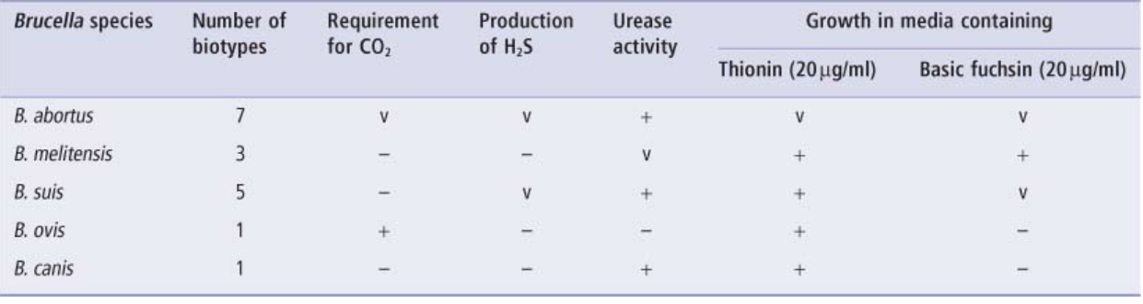

Slide 12
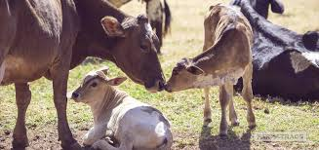
Brucellosis in cattle
The disease in cattle, water buffalo, and bison is mostly caused by Brucella abortus. However, B suis or B melitensis occasionally cause infection in cattle.

Slide 13
pathogenesis
Brucella infection in a herd is through introduction of infected animals.
The main sources of infection are aborted foetuses, placentae and genital discharge, milk and semen of infected bulls.
Natural transmission occurs by ingestion of organisms, which are present in large numbers in aborted fetuses, fetal membranes, and uterine discharges.
Cattle may ingest contaminated feed and water, or lick contaminated genitals of other animals.
Venereal transmission by infected bulls to susceptible cows appears to be rare.
Transmission may occur by artificial insemination when Brucella -contaminated semen is deposited in the uterus but, reportedly, not when deposited in the midcervix.
Brucellae may enter the body through mucous membranes, conjunctivae, wounds, or even intact skin.

Slide 14
Calves are relatively insusceptible and excrete the organisms in faeces and serve as source of infection for other animals.
B. abortus organisms are excreted in the colostrum and milk after parturition for many months up to 2 years.
Mechanical vectors (eg, other animals, including man) may spread infection.
The organisms pass from point of entry to the lymphatics to lymph node and multiply in thoracic duct.
From there it reaches the paranchymatous organs and other tissues.
They have the capacity to survive inside phagocytic cells.
In the paranchmatous organs, they develop granulomatous lesions.
They have an affinity for gravid uterus and foetal tissues.
The affinity of brucella organisms for foetal tissue is due to erythritol – a saccharide alcohol that is present in placenta of cattle, sheep, goat and pigs.
In male animals the organisms multiply in testicles, seminal vesicles and epididymis.

Slide 15
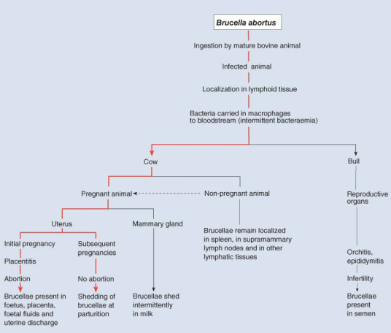

Slide 16
symptoms
Symptoms: Abortion during last stages of pregnancy is the important symptom (seventh or eighth month of pregnancy in cattle, third or fourth month in sheep, 50th day in dogs).
In cattle abortion is associated with retention of placenta.
Infections may also cause stillborn or weak calves, retained placenta, and reduced milk yield.
Usually, general health is not impaired in uncomplicated abortions.
Seminal vesicles, ampullae, testicles, and epididymides are infected in bulls.
Testicular abscesses may occur.
Long-standing infections may result in arthritic joints in some cattle.

Slide 17
lesions
Necrotic placentitis, swollen, hyperaemic cotyledons surrounded by brown exudates, thickened intercotyledonary spaces with leathery appearance are the common lesions.
Udder may look normal but cellular infiltration; degeneration and necrosis are also seen.
Orchitis and necrosis of the testicular tissues surrounded by fibrous tissue are the common lesions in male animals.

Slide 18
BRUCELLOSIS IN GOATS
In goats B.melitensis is the causative agent
The signs of brucellosis in goats are similar to those in cattle. B.melitensis organisms have a preference for udder tissue than gravid uterus.
Infection occurs primarily through ingestion of the organisms.
The disease causes abortion about the fourth month of pregnancy.
Arthritis, epididymitis and orchitis also occur.

Slide 19
BRUCELLOSIS IN SHEEP
In sheep B ovis is the causative agent, in which epididymitis and orchitis are observed.
Occasionally, placentitis and abortion are also seen.
Pathogenesis: The disease can be transmitted among rams by direct contact.
Infection in ewes occurs after mating with naturally infected rams.
Contaminated pastures do not appear to be important in spread of the disease.
Infection frequently persists in rams, and a high percentage shed B ovis intermittently.
Symptoms & Lesions: In sheep apart from abortion, lameness, mastitis, pyrexia and diarrhoea are also seen.
Lesions develop rapidly.
In rams, the first detectable abnormality is the marked deterioration in semen quality associated with the presence of inflammatory cells and organisms. The epididymal enlargement is unilateral or bilateral.
The most prominent lesion is spermatoceles of variable size containing partially inspissated spermatic fluid.
The tunics frequently become thickened and fibrous, and extensive adhesions develop between them. The testes show fibrous atrophy. In few cases the organisms are present in semen over long periods without clinically detectable lesions.

Slide 20
BRUCELLOSIS IN HORSES
The causative agent is B. abortus.
The organisms produce chronic inflammatory conditions referred as fistulous withers, poll evil and joint infections
Fistulous wither and poll evil are clinically same conditions occurring in supraspinous and supra-atlantal bursae respectively.
The inflammation of bursae leads to considerable thickening of the wall and the supraspinous bursa distends with a clear, straw-colored, viscid exudates and rupture later.
In more chronic, advanced cases, the ligament and the dorsal vertebral spines are also affected become necrosed.

Slide 21
BRUCELLOSIS IN PIGS
B.suis is the causative organism for abortion in swine
In pigs’ abortion, birth of weak piglets, lameness, paralysis, affection of spinal column and infertility in male and female animals are the common symptoms.
BRUCELLOSIS IN DOGS
B.canis is the causative organism in dogs. In dogs’ abortion, early embryonic deaths, dermatitis of scrotum and testicular atrophy are common symptoms.

Slide 22
BRUCELLOSIS IN HUMANS
Infection known as Undulant fever or Malta fever in humans occurs as a result of coming in contact with animals or animal products that are contaminated with these bacteria.
Humans are generally infected in one of three ways: eating or drinking something that is contaminated with Brucella, breathing in the organism (inhalation), or having the bacteria enter the body through skin wounds.
Direct person-to-person spread of brucellosis is extremely rare.
Mothers who are breast-feeding may transmit the infection to their infants.
Sexual transmission has also been reported.
Veterinarians treating the animals are in risk group along with butchers and animal attendants.
The symptoms of brucellosis are similar to the flu and include fever, sweats, headaches, back pains, and physical weakness.
Severe infections of the central nervous systems or lining of the heart may occur.
Brucellosis can also cause long- lasting or chronic symptoms that include recurrent fevers, joint pain, and fatigue.

Slide 23
Diagnosis
Based on symptoms and lesion and history of abortion in a herd.
Microscopical examination: Smears prepared from chorionic tissues, foetal stomach contents and uterine discharges stained by modification of Macchiavello’s method or Koster’s method will reveal brucella organisms.
Brucella are Gram negative and usually do not show bipolar staining.
They are not truly acid-fast, but are resistant to decolorisation by weak acids and thus stain red by the Stamp’s modification of the Ziehl–Neelsen method.
This is the usual procedure for the examination of smears of organs or biological fluids that have been previously fixed with heat or ethanol,
and by this method, Brucella organisms stain red against a blue background.
A fluorochrome or peroxidase-labelled antibody conjugate based technique is also used.

Slide 24
Bacteriological examination:
For the diagnosis of animal brucellosis by cultural examination, the choice of samples usually depends on the clinical signs observed.
The important samples are aborted fetuses (stomach contents, spleen and lung), fetal membranes, vaginal secretions (swabs), milk, semen and arthritis or hygroma fluids.
From animal carcasses, the preferred tissues for culture are those of the reticulo-endothelial system (mammary and genital lymph nodes and spleen), the late pregnant or early post-parturient uterus, and the udder.
When milk products are checked for contamination, they have to be enriched since the milk prouducts contain minimal number of organisms.
Albimi agar is the medium of choice.
Columbia agar, supplemented with 5% serum and appropriate
antimicrobial agents, is used for isolation
Other media include nutrient agar, serum agar, liver infusion serum agar, tryptose agar, and dextrose potato and glycerol potato agar.
The colonies are small, round, convex, and translucent with a smooth glistening surface.
In broth cultures they produce fine granular deposit.
Growth normally appears after 2–3 days, but cultures should not be discarded as negative until 8–10 days have elapsed.

Slide 25
Nucleic acid recognition methods: Polymerase chain reaction is used to differentiate causative organisms from vaccine organisms.
One of the first PCR methods developed was the AMOS-PCR (Bricker and
Halling, 1994), so named because it could differentiate between B. abortus biovars, 1, 2 and 4, B.
melitensis, B. ovis and B. suis. This method has been refined over time and can now differentiate other biovars and species in addition to B. abortus vaccine strains.
A new multiplex PCR assay (Bruce-ladder) described in the OIE Terrestrial Manual (Anon., 2009a) identifies most Brucella species in a single step, including the newly described species from marine mammals and B.
abortus and B. melitensis vaccine strains.
Animal inoculation:
  Guinea pigs are the laboratory animals of choice for brucella identification. Clinical materials are inoculated intra muscularly or sub-cutaneously. Two animals are inoculated and one animal is killed after 3 week and another after 6 weeks. Typical lesions include miliary necrotic foci in spleen, liver and lymphatic glands.
Strauss reaction: Development of orchitis after intraperitoneal injection of infective material

Slide 26
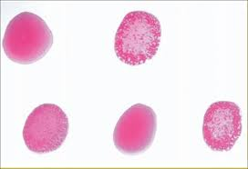
Serum agglutination tests
Serum agglutination tests: These tests are performed to identify antibodies against brucella in animals. Two types of tests a rapid plate test called Rose Bengal plate test (RBPT), which is a qualitative test
and stanadard tube agglutination test (STAT), which is a quantitative test are performed to identify animals infected with brucella.
In RBPT, the brucella antigen is stained with Rose Bengal dye. 0.3 ml of antigen and 0.3 ml of antibody are mixed and development of agglutination within one minute is positive reaction. It is a rapid method.
In STAT, the serum sample is diluted and brucella antigen without any dye is added.
Development of 50% agglutination at dilutions 1:40 and above is considered as positive and 1:20 is considered as suspected.
The test is of useful in unvaccinated cattle and in farms where calfhood vaccination is practiced

Slide 27
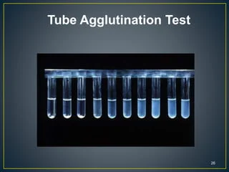
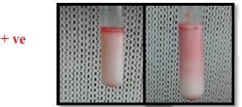

Slide 28
Milk ring test (MRT) or Abortus Bang’s ring (ABR) test: This test is performed to identify brucella in herds. It is based on detection of antibodies in milk against stained antigen.
Milk samples from herd are mixed with stained antigen and incubated.
Development of a ring above cream layer is a positive reaction.
Whey agglutination test:
Coombs test:
ELISA: It is a prescribed tests for international trade.
Complement fixation test: It is also a prescribed test for international trade.
The CFT is a widely used and accepted confirmatory test although it is complex to perform, requiring good laboratory facilities and adequately trained staff to accurately titrate and maintain the reagents.
There are numerous variations of the CFT in use, but this test is most conveniently carried out in a microtitre format.
Fluorescence polarisation assay: It is also a prescribed test for international trade.
FPA is a simple technique for measuring antigen/antibody interaction and may be performed in a laboratory setting or in the field.
It is a homogeneous assay in which analytes are not separated and it is therefore very rapid. For FPA antigen is labelled with a fluorochrome and added to serum or other fluid to be tested for the presence of antibody. If antibody is present, attachment to the labelled antigen will cause its rotational rate to decrease and this decrease can be measured.
Brucellin skin test: It is used for screening unvaccinated herds. A purified (free of sLPS) and standardised antigen preparation (e.g. brucellin) is used.

Slide 29
Control and Prevention:
Vaccination of calves with strain 19 (avirulent strain) at an age of 3-6 months offer high level of immunity. One dose gives immunity up to fifth pregnancy. Now RB51 strain is used instead of strain 19 vaccine.
An adjuvanted 45/20 bacterin, although less effective, has been used in some national eradication schemes in the past
The
modified live B. melitensis Rev. 1 strain, administered by the subcutaneous or conjunctival routes, is
used for vaccination of kids and lambs up to 6 months of age.
Periodical testing of herds by SAT and elimination of reactors.
Pasteurisation of milk and milk products.
Clean animal husbandry procedures.
Proper disposal of aborted foetuses.
Elimination of male animals from breeding programme

