Slide 1
Poxviridae
Group I viruses
Large enveloped ds DNA viruses with Complex symmetry

Slide 2
Baltimore classification-7 groups
dsDNA viruses
ssDNA viruses
dsRNA viruses
(+)-sense ssRNA viruses
(-)-sense ssRNA viruses
RNA reverse transcribing viruses
DNA reverse transcribing viruses

Slide 3
Classification
Subfamily Chordopoxvirinae (8 genera)
  Genus Orthopoxvirus; type species: Vaccinia virus; diseases: cowpox, vaccinia, smallpox
  Genus Parapoxvirus; type species: Orf virus
  Genus Avipoxvirus; type species: Fowlpox virus
  Genus Capripoxvirus; type species: Sheeppox virus
  Genus Leporipoxvirus; type species: Myxoma virus
  Genus Suipoxvirus; type species: Swinepox virus
  Genus Molluscipoxvirus; type species: Molluscum contagiosum virus
  Genus Yatapoxvirus; type species: Yaba monkey tumor virus
Subfamily Entomopoxvirinae –insect poxviruses
  Genus Entomopoxvirus A; B and C

Slide 4
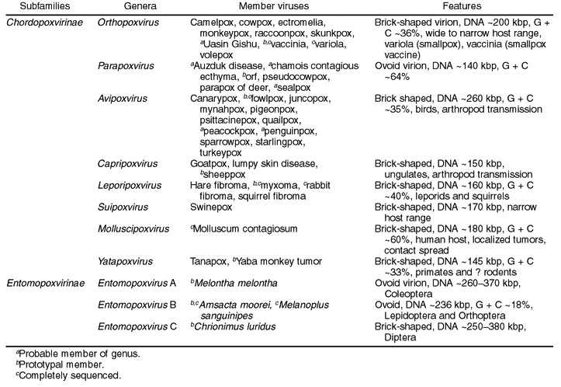
Family Poxviridae
.

Slide 5
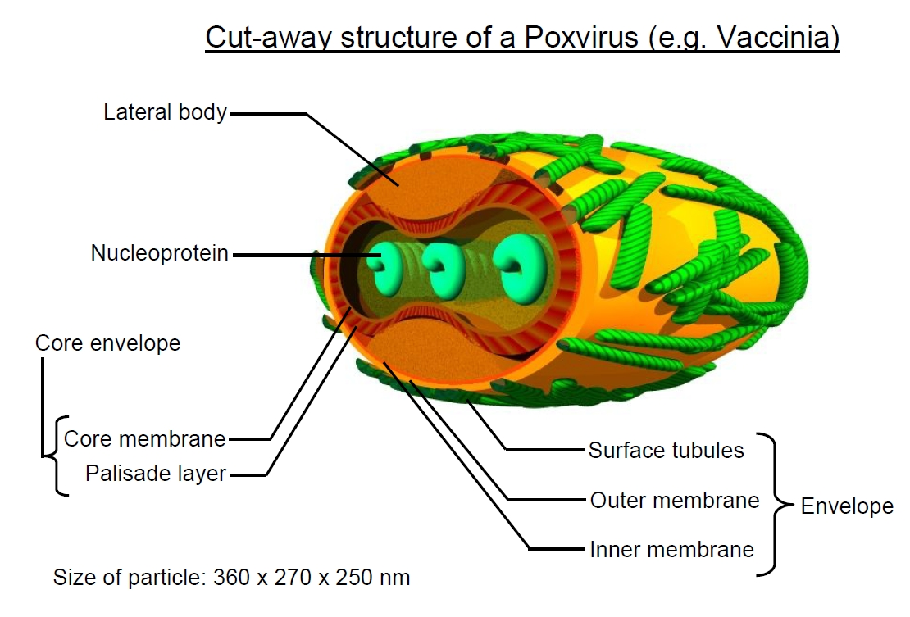
Virus Morphology
Pox viruses do not have helical or icosahedral symmetry. It is called as “Complex Symmetry”.
The outer envelope of the virus consists of two layers:
The thick outer layer contains surface tubules or short filaments of helically wound protein subunits (with a hollow channel running through the centre of each tubule)
The thinner inner layer (which is possibly a lipid bilayer )

Slide 6
Virions in most genera are brick-shaped, 250 x 200 x 200 nm, with an irregular arrangement of surface tubules.
Virions of members of the genus Parapoxvirus are ovoid,260 x 160 nm, with regular spiral arrangement of surface tubules wound around the virus giving a shape of “Ball of Yarn” or cocoon shaped.
In some poxviruses the tubules are replaced by globular protein structures.
Inside the envelope is the Dumbbell shaped core and two lateral bodies.
The core consists of the core wall - an outer thick palisade
layer, 17 nm thick (so called because it is striated, giving the appearance of many tiny columns) and the thinner,
smooth inner layer or core membrane, 8 nm thick.

Slide 7
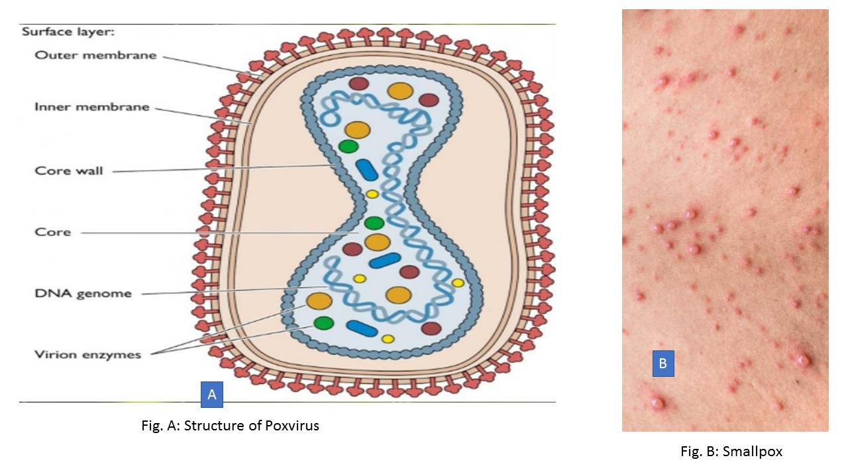

Slide 8
Viral Genome
The nucleoprotein consists of the tightly-packed linear double-stranded DNA genome coated by at least 4 different types of proteins, maintaining the DNA in a superhelical state.
A DNA-dependent RNA polymerase is also present in the nucleoprotein or core.
Genomes have the capacity to encode about 200 proteins, as many as 100 of which are contained in virions.

Slide 9
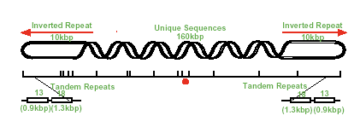

Slide 10
It contains no introns and contains more than 150 open reading frames that do not overlap.
The genome ends are palindromic tandem repeats and is covalently closed at each end; the ends are hairpin-like telomeres.
Unlike other DNA viruses, poxviruses encode all of the enzymes required for transcription and replication, many of which are carried in the virion
Cytoplasmic replication
Enveloped virions released by exocytosis;
Non-enveloped virions released by cell lysis.

Slide 11
Replication
After fusion of the virion with the plasma membrane or after endocytosis, the viral core is released into the cytoplasm.
Transcription is characterized by a cascade in which the transcription of each temporal class of genes ("early, intermediate," and "late" genes) requires the presence of specific transcription factors that are made by the preceding temporal class of genes.
Intermediate gene transcription factors are encoded by early genes, whereas late transcription factors are encoded by intermediate genes.
Transcription is initiated by the viral transcriptase and other factors carried in the core of the virion that enable the production of mRNAs within minutes after infection.

Slide 12
Proteins produced by these mRNAs complete the uncoating of the core and transcription of about 100 early genes; all this occurs before viral DNA synthesis begins.
Early proteins include DNA polymerase, thymidine kinase, and several other enzymes required for replication of the genome.
Poxvirus DNA replication involves the synthesis of long concatemeric intermediates, which are subsequently cut into unit-length genomes.
With the onset of DNA replication there is a dramatic shift in gene expression.
Transcription of "intermediate" and "late" genes is controlled by binding of specific viral proteins to promoter sequences in the viral genome.
Some early gene transcription factors are made late in infection, packaged in virions, and used in the subsequent round of infection.

Slide 13
The pox viral genes are expressed in Three phases.
Early Phase: Genes that encode the non-structural protein, including proteins necessary for replication of the viral genome, and are expressed before the genome is replicated.
Intermediate Phase: The intermediate genes are switched-on, triggering replication of the viral DNA genome. Viral synthesis occurs inside virally-induced double-membrane bound vesicles (derived from the host endoplasmic reticulum) called virosomes. DNA replication occurs inside these virosomes, which later disassemble prior to virion assembly in the late phase.
Late Phase: Late phase genes are expressed after the genome has been replicated and encode the structural proteins to make the virus particle.

Slide 14
Virion formation involves coalescence of DNA within crescent shaped immature core structures, which then mature by the addition of outer coat layers.
Replication and assembly occur in discrete sites within the cytoplasm (called viroplasm or viral factories), and virions are released by budding (enveloped virions) or by exocytosis, or cell lysis (nonenveloped virions).
Both enveloped and non-enveloped virions are infectious, but enveloped virions are taken up by cells more readily and appear to be more important in the spread of virions through the body of the animal

Slide 15
Two major forms of infectious virions:
The mature virion (MV) contains more than 80 proteins and consists of a nucleoprotein core surrounded by a lipid membrane with about 20 proteins. Approximately 20 proteins within the core are devoted by synthesis and modification of mRNA.
The enveloped virion (EV) consists essentially of a MV with an additional membrane containing about 6 proteins distinct from those in the MV membrane.

Slide 16
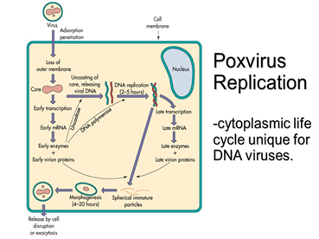

Slide 17
Transmission
By aerosol and droplets (variola virus),
By introduction of virus into small skin abrasions after direct or indirect contact with an infected animal (orf virus, milker’s nodule virus), and
In the case of some animal poxviruses mechanically by biting arthropods. .
The viruses generally have narrow host ranges.
Poxviruses are resistant in the environment under ambient temperatures and may survive for many years in dried scabs or other virus-laden material.

Slide 18
Skin lesions
Skin lesions are the principal feature.
Several viral encoded proteins are released from infected cells including a homologue of epidermal growth factor (virokines) which stimulates cell proliferation.
Typically pox lesions begins as macules and progress through papules, vesicles and pustules to scabs which detach leaving a scar

Slide 19
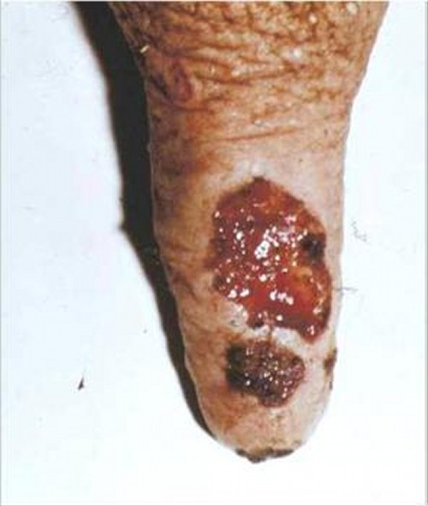
Cow/Buffalo Pox
Orthopox virus
It is a mild eruptive disease of dairy cows and buffaloes localized on the udder and teats.
The disease spreads by contact during milking.
After an incubation period of 3–7 days, during which cows may be mildly febrile, papules appear on the teats and udder.
Vesicles may not be evident or may rupture readily, leaving raw, ulcerated areas that form scabs.
Lesions heal within 1 month.
Most cows in a milking herd may become affected.
Milkers may develop fever and have lesions on the hands, arms, or face.
Occasionally, cowpox in people can cause generalized disease, and fatalities have been recorded

Slide 20
Pseudocowpox
Parapox virus.
They don't produce pock on the CAM.
It is a mild infection of the udder and teats of cows.
Lesions begin as small, red papules on the teats or udder.
These may be followed rapidly by scabbing, or small vesicles or pustules may develop before scabs form.
Granulation occurs beneath the scabs, resulting in a raised lesion that heals from the center and leaves a characteristic horseshoe or circular ring of small scabs. Similar lesions can occur on the muzzles and within the mouths of nursing calves
The infection spreads slowly throughout milking herds, and a variable percentage of cows shows lesions at any time.

Slide 21
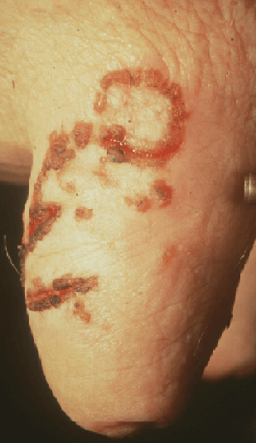
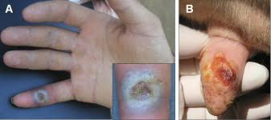
This virus can also infect humans and the condition is commonly referred to as milker's nodule
Horseshoe or circular ring of small scabs

Slide 22
Orf (Contagious Pustular dermatitis, Contagious Ecthyma, Scabby Mouth)
The disease is primarily of sheep and goat caused by Parapox virus.
There is development of pustular and scabby lesions on muzzle and lips.
The incidence in the flock may reach upto 90%.
The disease is common in lambs 2-3years of age.
The lesions develop as papules, pustules and then thick scabs and spread from oral commisures to muzzle and nostrils.
The scabs are often friable and mild trauma causes the lesions to bleed

Slide 23
Systemic invasion may lead to lesions on coronet, ears, anus and vulva. May extend to alimentary tract and trachea.
Spread of infection can be by direct contact or through exposure to contaminated feeding troughs and similar fomites, including wheat stubble and thorny plants.
Ewes can be vaccinated several weeks before lambing.
Vaccine is live virus derived from scabs collected from sheep.
Orf virus is zoonotic

Slide 24
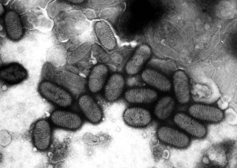
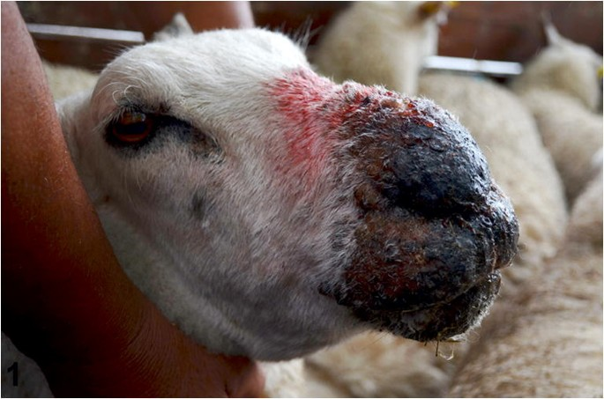
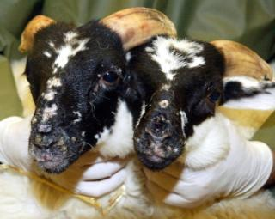
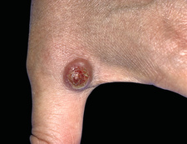

Slide 25
Lumpy skin disease (LSD)
Infectious, eruptive, occasionally fatal disease of cattle characterized by nodules on the skin and other parts of the body.
The Lumpy skin disease virus is related to capripox virus. Also called as Neethling virus
Vector borne -transmitted mechanically between cattle by biting insects.
The virus can be transmitted through blood, nasal discharge, lacrimal secretions, semen and saliva. The disease can also be transmitted through infected milk to suckling calves.
It is characterized by fever, reduced milk production and skin nodules. Mastitis, swelling of peripheral lymph nodes, loss of appetite, increased nasal discharge and watery eyes are also common.
Temporary or permanent infertility occur among infected cows and bulls. Recovery is slow and affected cattle often remain debilitated for several months.
Morbidity is high but mortality is low.

Slide 26
LSD
LSDV attacks the circulatory system of an animal and causes vasculitis or inflammation of blood vessels and lesions in organs like liver, lungs, spleen, lymph nodes
The epidermis, the outer surface of the skin, gets separated from the dermis or inner layer, leading to the formation of lumps or nodules on an animal’s body.
PM lesions- necrotising vasculitis, or the death of tissues, and fibrosis in various organs of the infected cattle, leading to their death.
Vaccines- Lumpi-ProVacInd (ICAR)
Due to cross-protection within the Capripoxvirus genus, sheep pox virus (SPPV) or goat pox virus vaccines have been widely used for cattle against lumpy skin disease virus (LSDV).

Slide 27
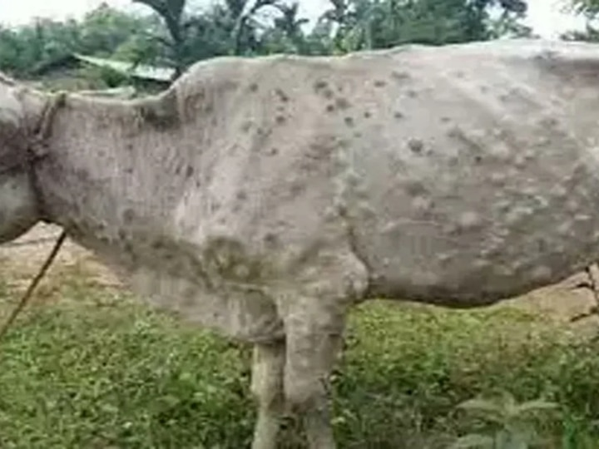
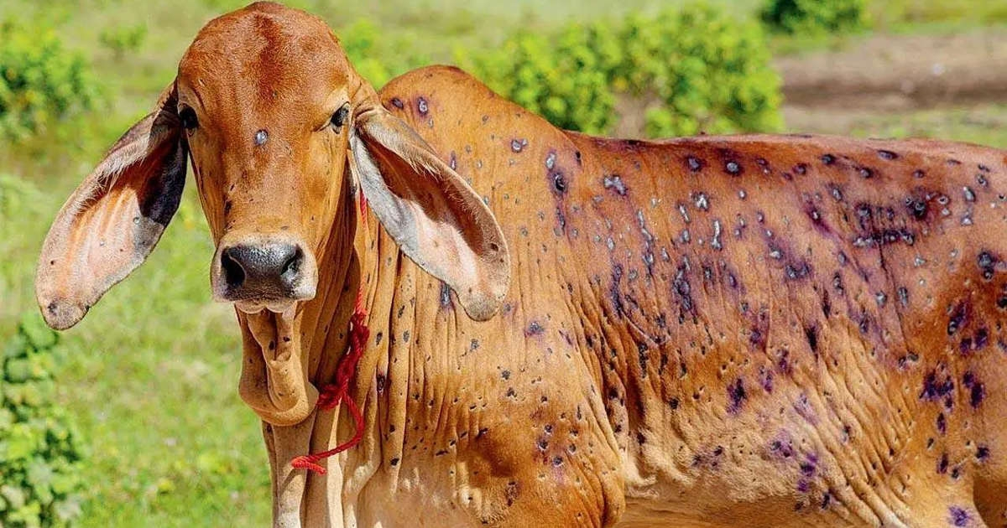

Slide 28
Sheep & goat Pox
Often fatal, diseases characterized by widespread skin eruptions.
The incubation period of sheeppox is 4–8 days and that of goatpox 5–14 days.
Sheep and goats of all ages may be affected, but the disease is generally more severe in young animals.
Clinical cases vary from mild to severe:
  fever, depression, polypnoea
  conjunctivitis, lacrimation, rhinitis, oedema of eyelids, photophobia
  cutaneous eruption beginning with erythematous areas especially noticeable in hair or wool-free parts of the body, such as the perineum, inguinal area, scrotum, udder, muzzle, eyelids and axillae
  lesions evolve into papules

Slide 29
Papulo-vesicular form
  Papules become a white-grey colour, desiccate and form crusts that are easy to remove
  Rarely, papules may transform into vesicles. After rupture of vesicles, a thick crust covers the lesions
Nodular form ('stone pox')
  Papules give rise to nodules involving all the layers of the skin and the subcutaneous tissue
  Necrosis and sloughing of the nodules leaves a hairless scar
In both forms, nodules develop in the lungs causing bronchopneumonia with cough, abundant nasal discharge, depression, anorexia and emaciation
Animals may recover within 20-30 days
Death is frequent when complications occur (abortion, which is rare, secondary infections, fly strike, septicaemia)

Slide 30
Lesions
Skin lesions: congestion, haemorrhage, oedema, vasculitis and necrosis. All the layers of epidermis, dermis and sometimes musculature are involved
Lymph nodes draining infected areas: enlargement (up to eight times normal size), lymphoid proliferation, oedema, congestion, haemorrhage
Pox lesions: on mucous membranes of the eyes, mouth, nose, pharynx, epiglottis, trachea, on the rumenal and abomasal mucosae, and on the muzzle, nares, in the vulva, prepuce, testicles, udder, and teats. Lesions may coalesce in severe cases
Lung lesions: severe and extensive pox lesions, focal and uniformly distributed throughout the lungs; congestion, oedema, focal areas of proliferation with necrosis, lobular atelectasis. Enlargement, congestion, oedema and haemorrhages of mediastinal lymph nodes

Slide 31
Prevention
Non-endemic areas – keep free with import restrictions and proper quarantine
Prevent introduction of infected animal products
  Meat, hair, wool, hides must be subjected to suitable decontamination procedures before entry into non-endemic areas
Notes:
The most likely manner for sheep pox or goat pox to enter a new area is by introduction of infected animals. Restrictions on the movement of animals and animal products (meat, hair, wool, and hides) are essential to prevent introduction of the disease. Wool, hair, and hides must be subjected to suitable decontamination procedures before entry into non-endemic areas.

Slide 32
Control and Eradication
Endemic areas
  Vaccinate
  The most widely employed vaccine is probably the Romanian strain that has been used effectively for many years .
  The Kenya O 180 strain is possibly the vaccine with the best safety and efficacy.
Outbreak in endemic area -small scale
  Quarantine, slaughter infected and exposed, clean and disinfect
  Ring vaccination
Outbreak in endemic area –large scale
  Massive vaccination
  Movement restrictions
Notes:
The most effective means of controlling losses in an endemic area is vaccination. However, even with vaccination, consideration still should be given to eliminating infected and exposed herds by slaughter, proper disposal of animals and contaminated material, and by cleaning and disinfecting contaminated premises, equipment, and facilities. If the disease has spread extensively in an endemic area, massive vaccination followed by cessation of vaccination and control of animal movements from the area represent a strong strategy to control and eradicate sheep and goat pox.

Slide 33
Control and Eradication
Outbreak in non-endemic areas
  Quarantine, slaughter infected and exposed, clean and disinfect
  Ring vaccination
A carrier state has not been shown for SGPV
Isolate infected herds and sick animals for at least 45 days after recovery
Notes:
If a small scale outbreak of sheep or goat pox occurs in an area usually free of it, place a quarantine around the infected area, slaughter infected and exposed animals and clean and disinfect the premises. Consider ring vaccination. A carrier state has not been shown for SGPV. However, the virus may persist for many months on contaminated premises. Quarantine of areas and premises containing infected or exposed animals is required to prevent disease spread. Isolate infected herds and sick animals for at least 45 days after recovery.

Slide 34
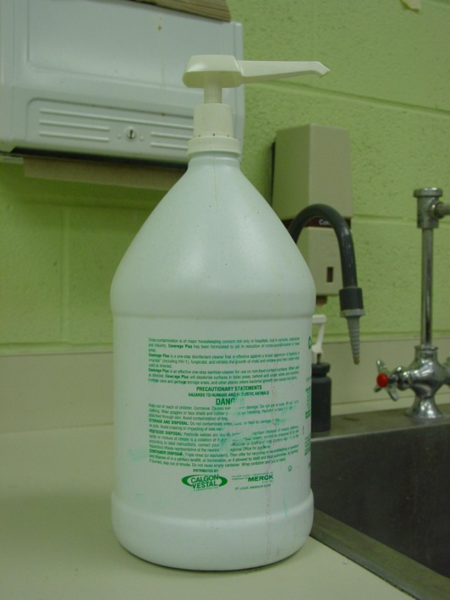
Disinfection
Sodium hypochlorite
Phenol 2% in 15 minutes
Detergents (SDS)
Virus can survive
  For 2 months in wool
  For 6 months in the environment
  for many years in dried scabs
Notes:
Sodium hypochlorite is an effective disinfectant. Inactivated by phenol (2%) in 15 minutes. Sensitive to detergents, such as those containing sodium dodecyl sulfate. The above photo depicts a strong disinfectant. The virus can survive for many years in dried scabs at ambient temperatures. Virus remains viable in wool for 2 months and on premises for as long as 6 months.

Slide 35
Vaccination
Vaccination can provide effective control in endemic areas
Killed vaccines do not provide long lasting immunity
Attenuated virus vaccines give immunity up to 2 years
Sheep Pox vaccine can protect against lumpy skin disease and vice versa.
Goat pox vaccine gives protection against sheep pox but not vice versa.
Eg Raksha-SP vaccine
Notes:
In endemic areas, vaccination is an effective means of controlling losses from SGP. Killed vaccines have not proved to be practical under field conditions because they do not provide solid lasting immunity. There are numerous attenuated virus vaccines. Immunity lasts up to 2 years.

Slide 36
Fowl Pox
A common disease of domestic and wild birds caused by Avipox virus
Avipoxvirus is highly host specific; therefore, infection with one type of poxvirus does not protect against others.
Poxviruses are named according to the susceptible host species (i.e., Fowlpox virus, Canarypox virus, Pigeonpox virus, Psittacinepox virus, Turkeypox virus, etc.
Disease course generally 3 to 4 weeks.
Avipoxvirus is transmitted by means of desquamation of skin lesions or by the biting of insects that sting the unfeathered skin areas, producing the characteristic papular, vesicular, and crusty lesions visible in the nares, eyelids, and legs.
Birds can also ingest or inhale viral particles, producing diphtheritic lesions in the oral cavity, pharynx, larynx, and trachea

Slide 37
Clinical Signs
Two forms of the disease:
Skin or cutaneous or Dry form - development of proliferative lesions, ranging from small nodules to spherical wart-like masses on the skin of the comb, wattle and other unfeathered areas
Diphtheritic or 'Wet' form- slightly elevated white opaque nodules develop on the mucous membranes. They rapidly increase in size to become a yellowish diphtheritic membrane. Lesions occur on the mucous membranes of the mouth, oesophagus, larynx or trachea.
The mortality rate is higher in the diphtheritic form than in the cutaneous form, sometimes nearing 50% particularly in young birds
Birds have difficulty breathing.
Weight loss, reduced egg production

Slide 38
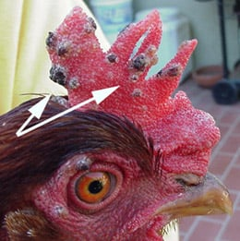
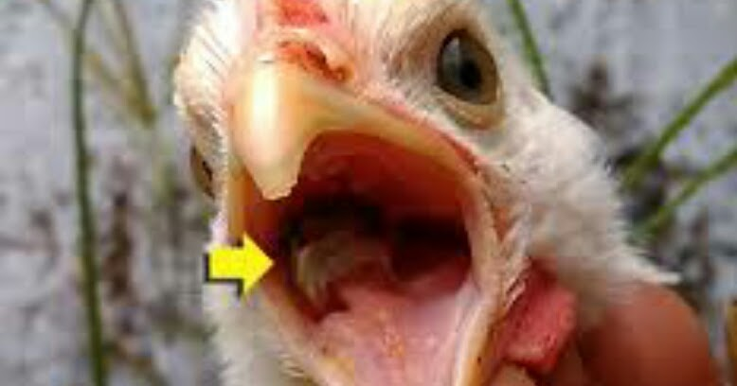
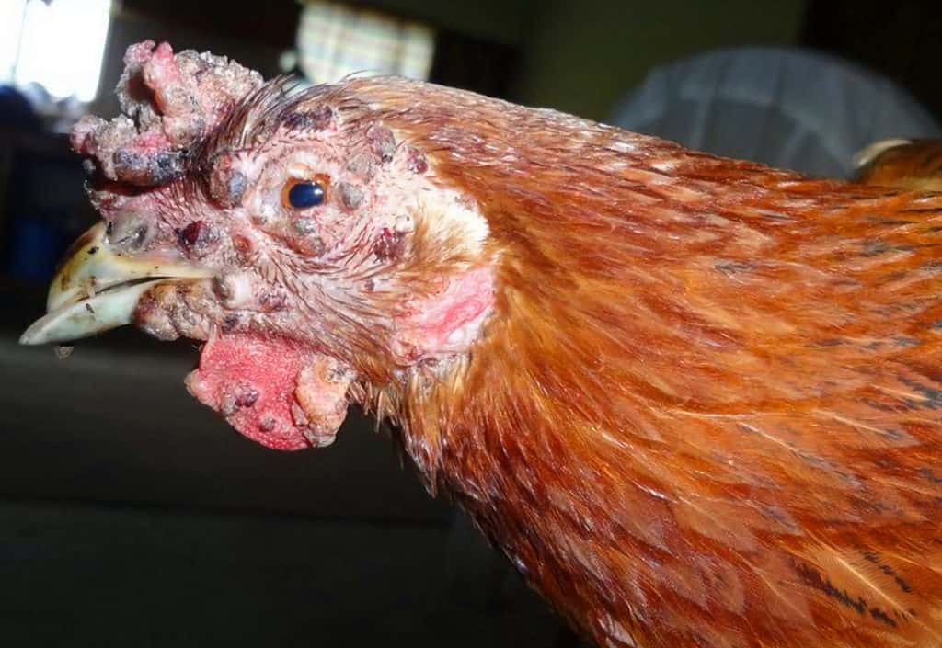

Slide 39
Post Mortem Lesions
Skin form: small whitish or yellowish areas, nodules or scabs
Diphtheritic form: raised white or opaque nodules which may join to form yellow, cheesy, necrotic lesion

Slide 40
Diagnosis
Characteristic gross and microscopic lesions and PCR
Fowlpox virus multiplies in the cytoplasm of epithelial cells with the formation of large intracytoplasmic inclusion bodies (Bollinger bodies) that contain smaller elementary bodies (Borrel bodies). The inclusions can be demonstrated in sections of cutaneous and diphtheritic lesions
Viral particles with typical poxvirus morphology can be demonstrated by negative-staining electron microscopy
The virus can be isolated by inoculating chorioallantoic membrane of developing chicken embryos, susceptible birds, or cell cultures of avian origin.

Slide 41
Prevention and Control
Management – do not introduce new birds with lesions
Virus survives in dried scabs for months or years.
Burn infected chicken houses and dispose of all infected birds.
Burn or bury all parts of the birds that are unused.
After all infected birds have been removed and no new cases occur, build another chicken house on a new site.
Fowlpox and pigeonpox virus vaccines of chicken embryo or cell culture origin are available.
The vaccines are used in susceptible flocks where the disease has been endemic or has been diagnosed in previous flocks
No zoonotic risk.

