Slide 1
FLAVIVIRIDAE
Baltimore group IV (+) SSRNA viruses.
(Group B Arboviruses)
Typical member- Flavivirus or Yellow fever virus

Slide 2
BVD, Hog cholera, Border disease
Pestiviruses
Hepaciviruses
Hepatitis C virus
Flaviviridae
Ortho Flaviviruses
Pegiviruses
Yellow fever
Japanese encephalitis
St. Louis encephalitis
Dengue
West Nile virus
(arthropods, biological vectors)

Slide 3
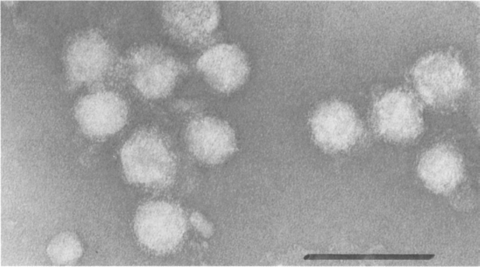
Morphology
Virion are icosahedral in symmetry and 50 nm in diameter.
Tightly adherent envelop with indistinct peplomers
Virions have a smooth, golf-ball-type appearance due to the arrangement of the surface glycoproteins that lie flat on the envelope.
Structural proteins are:
C - A nucleocapsid protein
M - A transmembrane protein
E - The peplomer glycoprotein (E1 and E2)

Slide 4
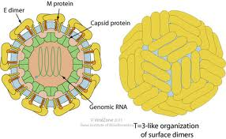

Slide 5
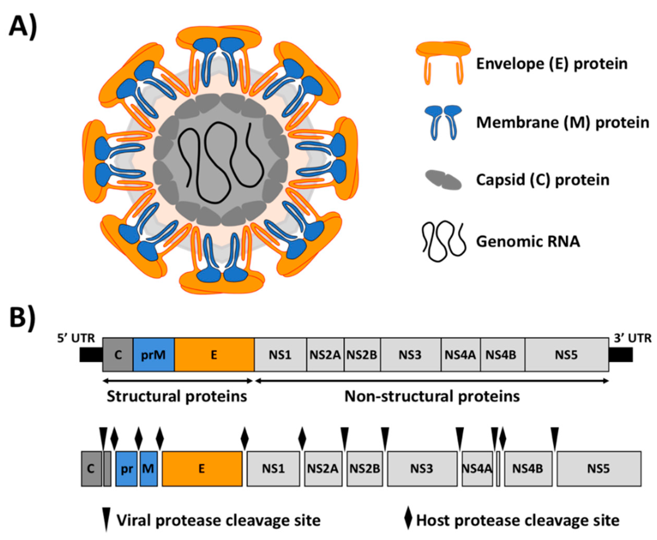

Slide 6
GENOME
Single molecule of linear positive sense, SS RNA 9.5 – 12.5 Kbp in size.
Flaviviruses have a 5′-terminal cap structure, whereas pestiviruses, hepaciviruses, and pegiviruses do not.
Instead of the 5′ cap, the hepaci-, pesti-, and pegiviruses have an internal ribosomal entry site in the 5′ non translated region.
All members lack a poly-A tail at the 3′-end of the genome.
There is single ORF which codes for 10 or more proteins.
At 5’ end structural proteins are coded and at 3’ end nonstructural proteins are coded.

Slide 7
There are seven or eight nonstructural Proteins.
NS5: The RNA-dependent RNA polymerase.
NS3: A helicase and protease and as part of the RNA polymerase complex.
Viral NS2B and NS3 and cellular proteases are responsible for cleavage of the polyprotein,
Flaviviruses encode only the NS3 protease, and the hepaci- and pestiviruses encode a second protease in the NS2 region that cleaves between NS2 and NS3.

Slide 8
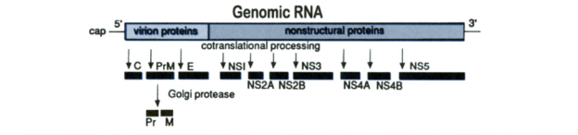
Structural proteins of flaviviruses include: C, the nucleocapsid protein; prM, a precursor glycoprotein that is cleaved during virus maturation to yield M, the transmembrane protein; E, the major spike glycoprotein, which also is the major target for neutralizing antibodies.
Pestiviruses have four structural proteins, including C (nucleocapsid protein) and the Erns, E1, and E2 envelope glycoproteins.

Slide 9
Replication
Virus attaches via E glycoprotein
Uncoating and +sense RNA released in the cytoplasm
Replication takes place at the surface of endoplasmic reticulum in cytoplasmic viral factories.
The dsRNA genome is transcribed/replicated thereby providing viral mRNAs/new ssRNA(+) genomes.
Virus assembly occurs at the endoplasmic reticulum and seems to be facilitated by the viral ionic channel. The virion buds at the endoplasmic reticulum and is transported to the Golgi apparatus.
Release of new virions by exocytosis.

Slide 10
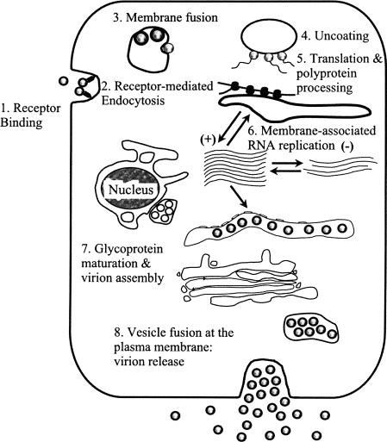

Slide 11
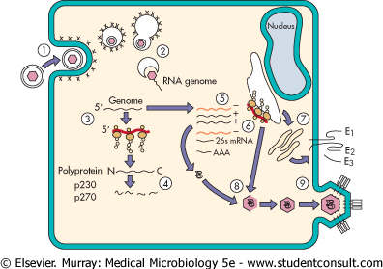

Slide 12
Stability
The viruses are not very stable in the environment and are inactivated easily by heat and by common disinfectants.
The lipid envelope is susceptible to organic solvents.
However, the stability of hog cholera virus in meat products and offal for weeks or even months has contributed importantly to its spread and reintroduction

Slide 13
Bovine viral diarrhoea (BVD) and Mucosal disease complex
Bovine viral diarrhea and mucosal disease are clinically dissimilar disease syndromes caused by same virus.
The acute disease is called bovine viral diarrhea
The chronic disease associated with persistent infection is called mucosal disease.
By genus Pestivirus
There are two distinct serotypes of BVDV
(BVDV1 and BVDV2)
Two distinct biotypes –cytopathic (CP) and non-cytopathic (NCP)
The NCP biotype predominates in the cattle population

Slide 14
Clinical Signs
The clinical and pathologic manifestations of infection in individual cattle vary with age and pregnancy status.
Three situations are considered:
Postnatal infection in non-pregnant cattle.
Infection in pregnant cows.
Persistent infection in calves and Mucosal disease.

Slide 15
Post natal infection in non pregnant cattle
Cattle of all ages are susceptible, but Common between 8- 24 months of age.
After incubation period of 5- 7 days there is fever, diarrhoea, nasal discharge, ocular discharge, stomatitis, leucopenia and in dairy cows decreased milk yield.

Slide 16
Infection of pregnant cows
Infection in early pregnancy results in embryonic death and reabsorption.
Infection at 80 to 125 days of gestation results in destructive fetal lesions, like monsters, low birth weight (weal calf syndrome) or foetal death.
Surviving calves remain infected for life and are persistently infected with no immune response.
Virus is shed by such animals in large amounts in all body secretions and source of virus to other animals in the herd.
Fetuses infected after about 125 days of gestation usually survive, whether manifesting pathologic damage or not, and usually develop neutralizing antibody and eliminate the virus.

Slide 17
Persistent infection in calves
Results from infection with non-cytopathic virus during the first 125 days of gestation.
The infected fetus develops an immune tolerance to the virus and sheds virus throughout its subsequent lifetime.
Mucosal disease only occurs when two biotypes of bovine viral diarrhea virus are present
The clinical features of mucosal disease mirror bovine viral diarrhea,but with much greater severity.

Slide 18
Mucosal disease (MD)
Mucosal disease, a severe and often fatal form, typically arises in persistently infected animals characterized by low morbidity and 100% mortality.
Clinical signs include severe and bloody diarrhea, sores in the mouth, and rapid wasting.
MD occurs in animals born persistently infected with a noncytopathic BVDV that are subsequently superinfected with a cytopathic bovine viral diarrhea virus (BVDV).
While similar in clinical presentation to hemorrhagic syndrome it differs in that it only occurs in persistently infected animals, two biotypes of virus are present, and it is 100% fatal.

Slide 19
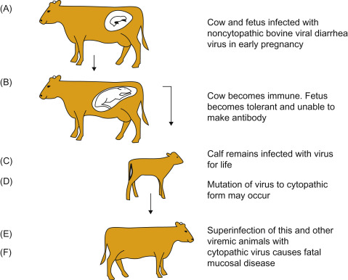

Slide 20
Hemorrhagic syndrome
Form of severe acute bovine viral diarrhea (BVD) characterized by high morbidity and mortality as high as 50%.
Clinical signs include hemorrhages throughout digestive system, high fevers and bloody diarrhea.
While similar in clinical presentation to mucosal disease it differs in that it is the result of an uncomplicated acute infection, only one biotype is present (noncytopathic) and it is not 100% fatal.

Slide 21
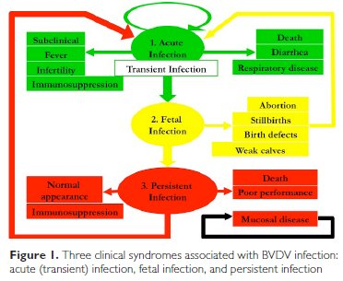

Slide 22
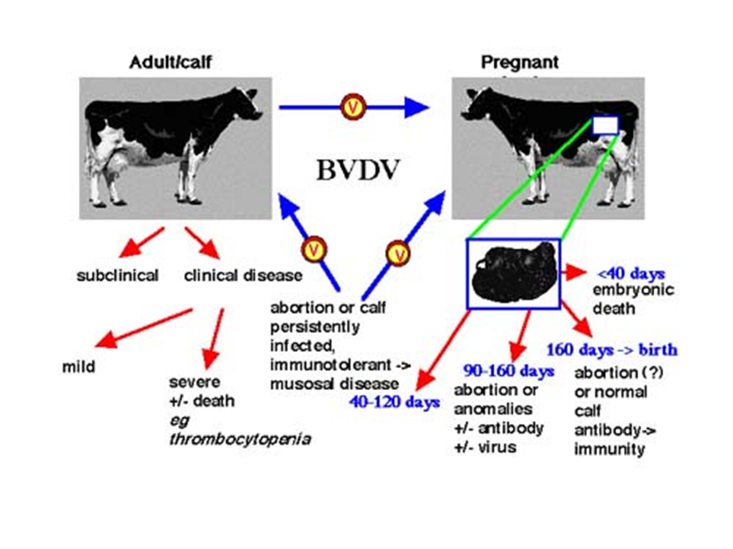

Slide 23
Pathogenesis
Features that govern the pathogenesis are:
Ability of the virus to cause viraemia
Ability of the virus to cause immunosuppression as virus impairs neutrophil functions and antibody secretion from the B cells.
Ability of the virus to infect the foetus transplacentally.

Slide 24
Diagnostic procedures
Virus isolation
  Small numbers
  Herd screening - microtitre
Antigen capture ELISA
  Herd screening
Serology
  VN
  ELISA
PCR
  genotyping
  pooled samples

Slide 25
Vaccines
Inactivated or attenuated
Most (all) contain CP BVDV
Vaccination between 6-8 months
Vaccination of persistently infected immunotolerant calves with vaccine results in severe mucosal disease.

Slide 26
HOG CHOLERA or CLASSICAL SWINE FEVER (CSF)

Slide 27
Introduction
By Pestivirus.
Wild boars and domestic pigs are the only natural reservoirs of CSF.
Humans are not infected or affected by the CSF virus.
The OIE has placed CSF on List A.
CSF is endemic in parts of Africa, Asia, Europe, and Central and South America.

Slide 28
Morbidity and Mortality
Age and immune status important
Varies with viral strain
  Acute
    High mortality (up to 100%)
  Subacute
    Lower morbidity and mortality rates
  Chronic
    Few animals affected – always fatal
  Some cases are asymptomatic
Notes:
The severity of classical swine fever varies. The age and immune status of the animals also affects the disease outcome. Younger animals often have higher mortality rates than adult pigs. Disease from highly virulent strains most commonly result in acute infection with high morbidity and mortality rates; the case fatality rate can approach 100%. Subacute disease usually has lower case-fatality rates compared to acute cases; mild cases of illness have lower mortality rates. Less virulent strains may be more difficult to detect as can chronic infections of CSF. Only a few animals in the herd may show signs of illness and these signs can resemble other swine diseases. Some infections of CSF can by asymptomatic; these animals may serve as carriers for further dissemination of the disease.

Slide 29
Animal Transmission
Highly contagious
  Blood, saliva, urine, feces, tissues of sick and dead animals
Transmission
  Ingestion of contaminated garbage or meat products
  Direct or indirect contact (fomites)
  Less common: aerosol, semen, vectors
Infected pigs are the only reservoir
Notes:
Classical swine fever virus is highly contagious. Sources of virus include blood and all tissues, secretions and excretion (saliva, urine, feces, semen) of sick and dead animals. Transmission primarily occurs from ingestion of the virus. This can occur following feeding of contaminated garbage or meat products. Transfer of the virus can also occur through direct contact of pigs with infected animals; this can occur through the mucous membranes, conjunctiva, and skin abrasions. Transfer of the virus by contaminated objects (fomites), such as boots, vehicles, equipment is also possible. Aerosol spread can occur in confined spaces; however the virus does not travel long distances in the air. This is a less common route of transmission as is transfer by insect vectors. Infected pigs are the only reservoir of virus.

Slide 30
Pathogenesis
Ingestion followed by primary replication of virus in tonsils causing Primary viraemia
Infection and replication of virus in endothelial cells, lymph nodes, bone marrow causing leukopenia, thrombocytopenia severe immunosuppression
Damage to endothelial cells and thrombocytopenia can lead to hemorrhages in various tissues, resulting in petechiae and ecchymoses
In pregnant sows, the virus can cross the placenta, potentially causing abortions, mummified fetuses, stillbirths, or persistently infected piglets.

Slide 31
Clinical signs in acute cases
IP=2-7 days
Fever, Vomiting, Diarrhoea, pneumonia
Infected piglets frequently develop neurologic signs, including tremors and convulsions.
Hyperemia and cynosis of skin of abdomen and ear
Leukopenea
Morbidity 100%

Slide 32
Clinical Signs:
Subacute/Chronic Disease
Subacute
  Similar to acute form, but symptoms less severe
  Pigs may survive
Chronic
  Anorexia, depression, fever, diarrhea
  Poor reproductive performance including abortions, stillbirths, and deformities
  Persistently infected piglets
  The most prominent lesion in swine dying from chronic hog cholera is a general exhaustion of the lymphoid system--complete atrophy of the thymus and germinal centers in the spleen and lymph nodes.
Notes:
The subacute disease form may resemble acute disease, but symptoms are usually less sever. Infected pigs may also survive. Chronic disease symptoms include fever, anorexia, stunted growth, and alopecia; these symptoms may wax and wane for months. Chronic infections are almost always fatal. Reproductive symptoms may also be seen with any level of virulence. Infected sows may give birth to persistently infected piglets; they typically die before one year of age.

Slide 33
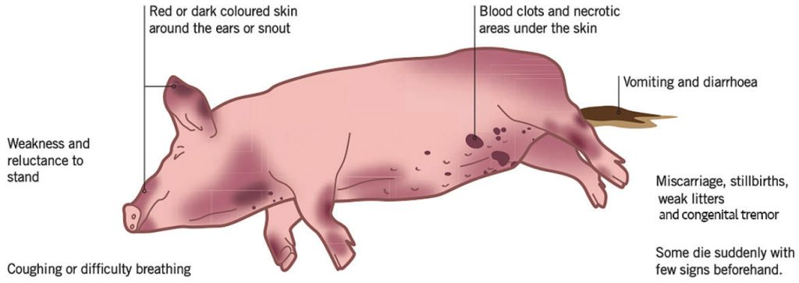

Slide 34
Post Mortem Lesions:
Acute Disease
Leucopoenia and thrombocytopenia
Enlarged hemorrhagic lymph nodes are common
Widespread petechiae and ecchymoses, especially in the skin, lymph nodes, epiglottis, bladder, kidney and rectum
Severe tonsillitis with necrotic foci sometimes occurs
Multifocal infarction of the margin of the spleen is characteristic: nearly pathognomonic but occurs infrequently with currently circulating strains
Lungs may be congested and hemorrhagic
Encephalomyelitis with perivascular cuffing is common

Slide 35
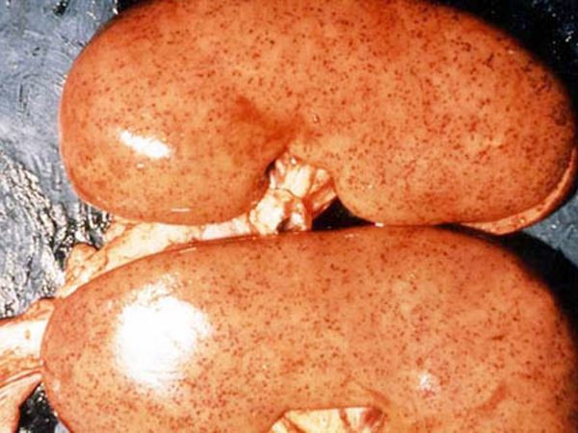
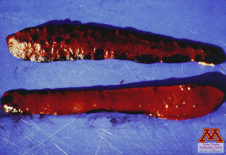
TURKEY EGG KIDNEY

Slide 36
Post Mortem Lesions:
Chronic Disease
‘Button’ ulcers in the cecum and large intestine mucosa
The "turkey-egg" kidney is a classic lesion
Generalised depletion of lymphoid tissue
Transverse striations of unmodelled growth cartilage at costochondral junctions in growing pigs
Hemorrhagic and inflammatory lesions are often absent

Slide 37
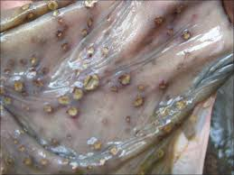
Button ulcers – chronic cases

Slide 38
Diagnosis
Suspect CSF in pigs with
  Septicemia and high fever
  History of garbage/scrap feeding
Diagnosis impossible without
laboratory confirmation
Tonsil samples - preferred
Notes:
CSF should be suspected in pigs with septicemia and a high fever. Other previously described clinical signs may be noted. History of the pigs or recent traffic onto the farm is also important. Potential introduction should be considered if the history includes feeding uncooked or undercooked scraps or garbage, particularly meat products, addition of new or returning animals to the herd, recent international travel of personnel on the farm, the presence of foreign visitors or workers, and/or lack of response by ill pigs to routine treatments. Diagnosis is impossible without laboratory confirmation, and tonsil is the preferred sample.

Slide 39
Diagnostic Tests
Detect virus, antigens, nucleic acids
  Tissue samples (tonsils, spleen, kidneys, distal ileum)
  Whole blood
  ELISA or direct immunofluorescence
Serology
  ELISA or virus neutralization
  Comparative neutralization test
Notes:
Differentiation of classical swine fever from other diseases (especially African swine fever, from which CSF is clinically indistinguishable) requires laboratory testing. CSF can be distinguished by detecting the virus or its antigens in whole blood or tissue samples. CSF surveillance most commonly uses rRT-PCR (real-time reverse transcriptase polymerase chain reaction) testing on tonsils and nasal swabs. Virus antigens in tissue may also be detected by direct immunofluorescence or ELISAs. Serology can also be used for diagnosis; the most commonly used serological tests are virus neutralization tests and ELISAs. The definitive test for differentiation is the comparative neutralization test.

Slide 40
Treatment
No treatment is possible.
Affected pigs must be slaughtered and the carcasses buried or incinerated.

Slide 41
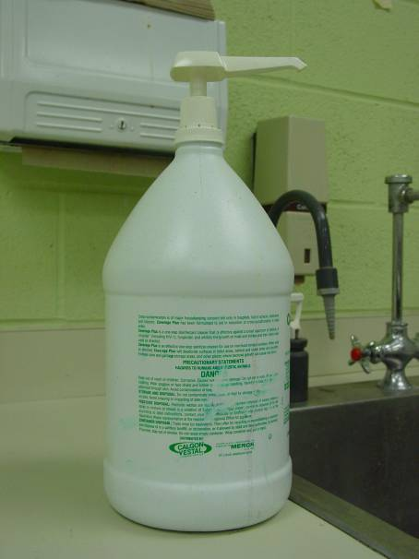
Disease Control
Disinfectants
  Sodium hypochlorite
  Phenolic compounds
Virus sensitive to
  Drying
  Ultraviolet light
  pH <3 or >11
Killed at high temperatures
  150ºF for 30 minutes; 160ºF 1 minute
Notes:
CSFV is moderately fragile in the environment. The virus is sensitive to drying and ultraviolet light. It is rapidly inactivated by pH 3 or less or pH greater than 11. The virus is stable at pH 5 to 10. Sodium hypochlorite and phenolic compounds are effective disinfectants. The virus can be destroyed by cooking at temperatures of 65.5 ºC (150 ºF) for greater than 30 minutes or 71 ºC (160 ºF) for one minute.

Slide 42
Prevention
Do not feed uncooked garbage or meat products to swine
Minimize visitors on the farm
  Especially those who have traveled internationally in the last 5 days
Implement biosecurity measures
  Clean/disinfect boots
  Clean coveralls
Notes:
To prevent the introduction of CSF into the U.S., pigs should not be fed uncooked or undercooked garbage (swill) or meat products. Since the CSFV is stable in the tissues of infected animals, feeding these materials may transfer the virus to susceptible swine. Additionally, visitors onto the farm should be minimized. This is especially important for those who have traveled internationally within the last 5 days. Some visitors are essential to the continued operation of the farm. These individuals should check in with farm personnel upon arrival and follow biosecurity measures while on the farm (e.g., wear clean coveralls and clean and disinfect boots before entering and after leaving animal areas).

Slide 43
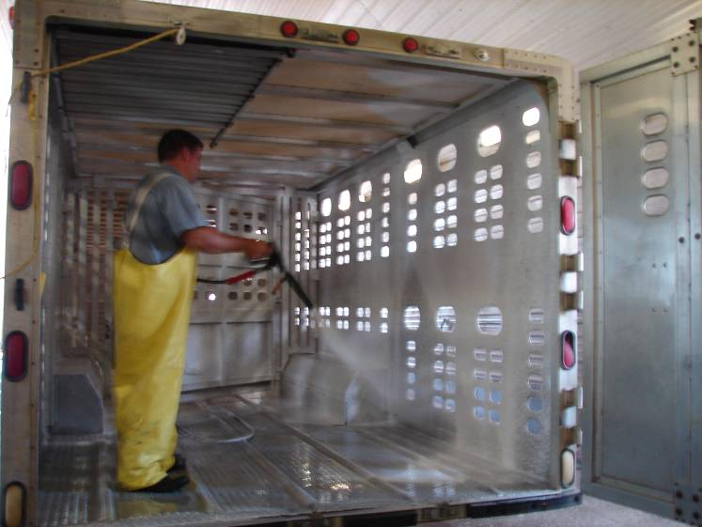
Prevention
Monitor animals for illness or signs of disease
  Inspect animals daily
  Report sick animals
Clean and disinfect
  Vehicles
  Equipment
  Boots and clothing
Notes:
Prompt recognition of the disease is essential to minimize spread. Monitor and inspect animals daily for signs of illness or disease. Farm personnel should be familiar with signs to look for and who to contact when signs are noted. Vehicles and equipment can serve as fomites for the spread of the virus. They should be cleaned after each use. Additionally, boots should be disinfected, and clean clothing should always be worn when coming in contact with pigs.

Slide 44
Prevention
Isolate ill animals immediately
Quarantine newly introduced animals
  Minimum of 30 days
  New purchases, returning animals
Keep health records on every animal
Notes:
Animals infected with CSF can rapidly spread the virus to other susceptible pigs. Therefore, any animals showing signs of illness should be isolated immediately. Additionally, because pigs can be asymptomatic or can shed the virus before clinical signs are seen, newly purchased or returning animals should be quarantined a minimum of 30 days prior to introduction into the herd. Keeping health records on every animal is equally important, as it will help in the history and possible trace back (if needed) for animals in the herd.

Slide 45
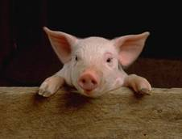
Vaccination
Available in endemic countries
  Protects from disease
  Does not eliminate infection
Helpful in outbreak control
Notes:
Vaccines are available in endemic countries. While vaccination can protect animals from clinical disease, it does not eliminate infection, and therefore may be inappropriate in countries with an eradication policy. In countries free of CSF, periodic surveillance is necessary to confirm freedom from infection.

