Slide 1
FAMILY PARAMYXOVIRIDAE
Order Mononegavirales- four families- Bornaviridae, Rhabdoviridae, Filoviridae and Paramyxoviridae

Slide 2
Introduction
The name paramyxovirus is derived from two Greek words, para meaning by the side of and myxa meaning mucus
Belongs to order Mononegavirales- All the viruses are enveloped, covered with peplomers, and all have genomes consisting of a single molecule of negative-sense, single-stranded RNA
Baltimore group V

Slide 3
Includes important agents of disease, causing age-old diseases of humans and animals (measles, rinderpest, PPR, canine distemper, New Castle disease, mumps, respiratory syncytial virus (RSV), the parainfluenza viruses), and newly recognized emerging diseases (Nipah, Hendra, morbilliviruses of aquatic mammals)
Most viruses have a narrow host range in nature, many are host-specific
The transmission of paramyxoviruses is horizontal, mainly through airborne routes; no vectors are known

Slide 4
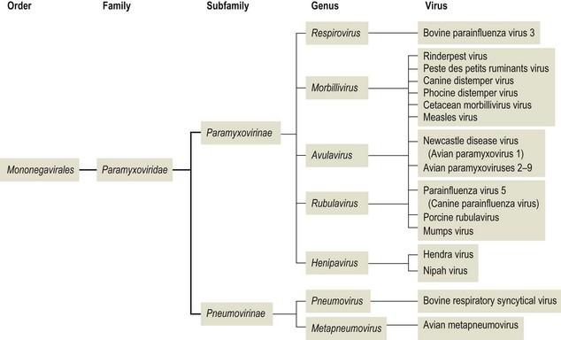
Classification

Slide 5
International Committee on Taxonomy of Viruses (ICTV) Report on the family Paramyxoviridae by Rima et al. (2019)
Currently, Paramyxoviridae has four subfamilies, 17 genera, and 77 species.
Subfamily: Avulavirinae, which contains three genera (Meta, ortho and Para avulavirus)and 21 species
Subfamily: Metaparamyxovirinae, which contains one genus and one species
Subfamily: Orthoparamyxovirinae, which contains eight genera and 34 species
Subfamily: Rubulavirinae, which contains two genera (Ortho and para rubulavirus) and 18 species

Slide 6
Virion Properties
Pleomorphic in shape (spherical as well as filamentous forms occur), 150-300 nm in diameter and enveloped.
The lipid envelope is covered in glycoprotein spikes (peplomers) of two types, an attachment protein (G or H or HN) which is a tetramer and a trimer or tetramer of fusion protein (F).
Proteins are designated H (hemagglutinin) for morbilliviruses as they possess haemagglutination activity, (ability to cause red blood cells to clump in laboratory tests).

Slide 7
HN (Hemagglutinin-neuraminidase) attachment proteins occur in respiroviruses, rubulaviruses and avulaviruses. These possess both haemagglutination and neuraminidase activity, which cleaves sialic acid on the cell surface, preventing viral particles from reattaching to previously infected cells.
Attachment proteins with neither haemagglutination nor neuraminidase activity are designated G (glycoprotein). These occur in henipaviruses.

Slide 8
Cell attachment is mediated via the hemagglutinin-neuraminidase (HN) protein.
This glycoprotein elicits neutralizing antibodies that inhibit adsorption of virus to cellular receptors.
The fusion protein is present on newly formed virions in an inactive precursor form (F₀ ) that is activated by proteolytic cleavage by a cellular protease which is essential for viral infectivity.
A neutral pH for fusogenic activity is also a requirement.

Slide 9
Because the fusion protein is essential for viral infectivity and for direct cell-to-cell spread via fusion between the viral envelope and the cell membrane, it plays a key role in the pathogenesis of paramyxovirus infections, including persistent infections.
There is also an envelope-associated non-glycosylated matrix (M) protein between the envelope and the nucleocapsid core.

Slide 10
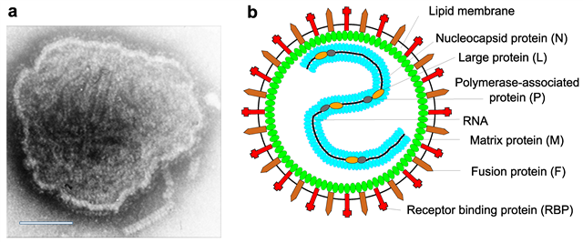

Slide 11
The nucleocapsid has helical symmetry, 13 to 18 nm in diameter, has a characteristic ‘herringbone’ appearance
A single molecule of linear, non-segmented, negative-sense, single-stranded RNA present
Three nucleocapsid-associated proteins, i.e., an RNA-binding nucleocapsid protein (N) protects the RNA from nuclease digestion
a polymerase-associated phosphoprotein (P) that binds to N and L proteins and forms part of the RNA polymerase complex
and a large protein (L), is the catalytic subunit of RNA-directed RNA polymerase (RdRP) (capping and cap methylation activities)

Slide 12

Herring bone - named for the resemblance to the bone structure of the herring fish skeleton

Slide 13
Virions are labile, being sensitive to heat, desiccation, lipid solvents, non-ionic detergents and many disinfectants.
Paramyxoviruses can possess haemagglutinating, haemolytic and neuraminidase activities.
Infection of cultured cells is generally lytic, but temperate or persistent infections are common in this family in vitro and in vivo.
Also there is the formation of inclusion bodies and syncytia in infected cells.

Slide 14
Viral replication
Site- cell cytoplasm
Even though their replication is entirely cytoplasmic, Morbilliviruses produce acidophilic intranuclear inclusion bodies
Virions attach via their hemagglutinin- neuraminidase protein to cellular sialoglycoprotein or glycolipid receptors.
The fusion protein then mediates fusion of the viral envelope with the plasma membrane, at physiologic pH.

Slide 15
The liberated nucleocapsid remains intact, with all three of its associated proteins (N, P, and L) being required for transcription by the virion- associated, RNA-dependent RNA polymerase (transcriptase).
The viral genome is transcribed from the 3' end by viral polymerase (P-L) which generate mRNAs for secondary transcription.

Slide 16
Replication of the full-length genome occurs efficiently only after accumulation of viral proteins and involves production of positive sense anti-genomes which act as templates for the synthesis of new negative-sense genomic RNA.
Matrix proteins are considered the key organizers of virus particle assembly since they act as bridges between the envelope glycoproteins and the ribonucleoprotein complexes, can self-assemble into higher order structures, and bind cellular membranes as well as several cellular factors.

Slide 17
This new RNA associates with the NP and transcriptase to form the nucleocapsid and then the M, F, and HN proteins migrate to the surface of the plasma membrane.
Paramyxoviruses bud off of the cell membrane, leaving them enveloped.

Slide 18
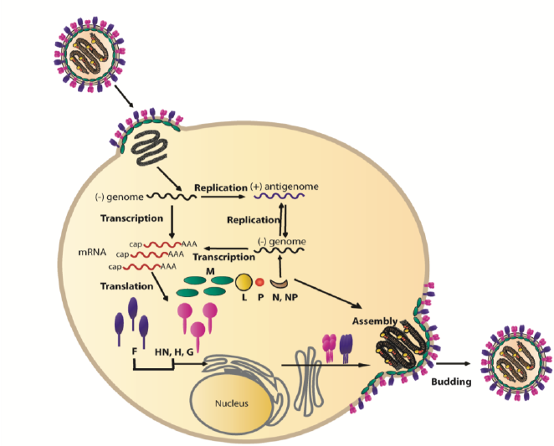

Slide 19
New Castle disease virus
The taxonomic name for Newcastle disease virus (NDV) has recently changed from Avian paramyxovirus 1 (APMV-1) to Avian Avulavirus 1 (AAvV-1).
Belongs to subfamily- Avulavirinae

Slide 20
Pathotypes of NDV
Five pathotypes based on clinical signs in infected chickens:
a) viscerotropic velogenic (Doyle's form) - hemorrhagic intestinal lesions
b) neurotropic velogenic (Beache's form)- respiratory and neurologic signs
c) mesogenic, (Beaudett's form).
d) lentogenic or respiratory (Hitchner form).
e) asymptomatic. .

Slide 21
Velogens and mesogens are now classified as virulent NDV (vNDV), the cause of Newcastle disease and reportable infection,
whereas infections with lentogens, the low virulence NDV (loNDV) widely used as live vaccines, are not reportable.
Members of all species of the subfamily Avulavirinae have hemagglutinin and neuraminidase activities.

Slide 22
New Castle disease
or Ranikhet disease or Avian Distemper
The disease was first observed in Java in 1926 and in the same year it spread to England, where it was first recognized in Newcastle, hence the name.
The disease is one of the most contagious of all viral diseases, spreading rapidly among susceptible birds
OIE list A disease
Zoonotic- Humans may become infected; manifested by unilateral or bilateral reddening, excessive lachrymation, oedema of the eyelids, conjunctivitis and sub-conjunctival haemorrhage

Slide 23
Transmission
By direct contact with diseased or carrier birds.
Infected birds may shed the virus in their feces, contaminating the environment.
Transmission can then occur by direct contact with feces and respiratory discharges or by contaminated food, water, equipment, and human clothing.
Newcastle disease viruses can survive for several weeks in the environment, especially in cool weather.

Slide 24
Generally, virus is shed during the incubation period and for a short time during recovery.
Birds in the pigeon family can shed the virus intermittently for a year or more.
The virus is present in all parts of the carcass of an infected bird.
When the virus is introduced into a susceptible flock, virtually all the birds will be infected within two to six days.

Slide 25
Pathogenesis
Initially the virus replicates in the mucosal epithelium of the upper respiratory and intestinal tracts; shortly after infection, virus spreads via the blood to the spleen and bone marrow, producing a secondary viremia.
This leads to infection of other target organs: lung, intestine, and central nervous system.
Respiratory distress and dysponea result from congestion of the lungs and damage to the respiratory center in the brain.
The most prominent histologic lesions are necrotic foci in the intestinal mucosa and the lymphatic tissue and hyperemic changes in most organs, including the brain.

Slide 26
In vivo Pathogenicity tests
Intravenous Pathogenicity Index (IVPI)-
6 wks susceptible chicks
Birds are examined at 24 hour intervals for 10 days and scored at each observation:
0 if normal,
1 if sick,
2 if paralysed and
3 if dead.
The IVPI is the mean score per bird per observation over the 10 day period. Lentogenic strains and some mesogenic strains will have IVPI values of 0, whereas the indices for virulent strains will approach 3.0.

Slide 27
2. Mean death time (MDT)- in 9 days embryonated eggs.
Each egg is examined twice daily for 7 days and the times of any embryo deaths recorded.
The minimum lethal dose is the highest virus dilution which causes all the embryos inoculated with that dilution to die.
The MDT is the mean time in hours for the minimum lethal dose to kill embryos.
The MDT has been used to classify NDV strains into velogenic, taking less than 60 hours to kill; mesogenic, taking between 60-90 hours; and lentogenic, taking more than 90 hours.

Slide 28
3. Intracerebral pathogenicity index (ICPI)-0.05ml of the diluted virus is injected intracerebrally into each of 10 one-day-old chicks hatched from an SPF flock. The birds are examined every 24 hours for 8 days.
At each observation the birds are scored: 0 if normal, 1 if sick, and 2 if dead.
The ICPI is the mean score per bird per observation over the 8-day period.
The most virulent viruses will give indices which approach the maximum score of 2.0, whereas lentogenic strains will give values close to 0.0.

Slide 29
Clinical signs
Dependent on factors such as: the virus/pathotype, host species, age of host, co-infection with other organisms, environmental stress and immune status.
Lentogenic strains Usually associated with subclinical disease marked by mild respiratory disease; coughing, gasping, sneezing and rales
Mortality is negligible
Mesogenic strains May cause acute respiratory disease and neurologic signs in some species
Mortality rate is usually low (<10%)
Velogenic strains Most commonly cause severe disease in chickens with 100% mortality; signs principally respiratory and/or nervous

Slide 30
Initial clinical signs vary but include: lethargy, inappetence, ruffled feathers, oedema and infection of conjunctiva.
As the disease progresses birds may develop: greenish or white watery diarrhoea, dyspnoea and inflammation of the head and neck often with cyanotic discoloration
In later stages of disease neurologic signs may be manifested as: tremors, tonic/clonic spasms, wing/leg paresis or paralysis, torticollis, and aberrant circling behaviour

Slide 31
Sharp drop in egg production; eggs contain a watery albumin and appear misshapen with abnormally coloured, rough or thin shells
These strains often result in sudden death, with few or no signs
Birds that survive serious infection may develop neurologic and partial or complete cessation of egg production

Slide 32
Lesions
Only velogenic strains produce significant gross lesions
Predominantly hemorrhagic lesions, in particular at the esophagus/proventriculus and proventriculus/gizzard junctions and in the posterior half of the duodenum, the jejunum, and ileum.
In severe cases, hemorrhages are also present in subcutaneous tissues, muscles, larynx, tracheal/esophageal tissues, serous membranes, trachea, lungs, airsacs, pericardium, and myocardium.
Spleen may appear enlarged, friable and dark red or mottled

Slide 33
In adult hens, hemorrhages are present in ovarian follicles.
Lesions can develop into diphtheroid inflammatory foci and later into necrotic foci.
In the central nervous system, lesions are those of encephalomyelitis--neuronal necrosis, perivascular cuffing, and interstitial inflammatory infiltration

Slide 34
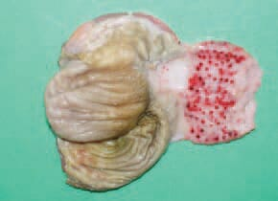
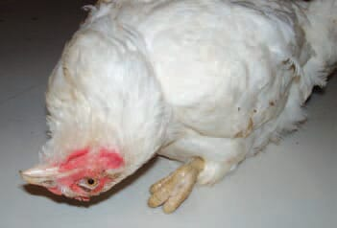
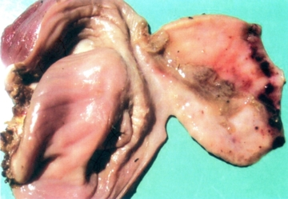
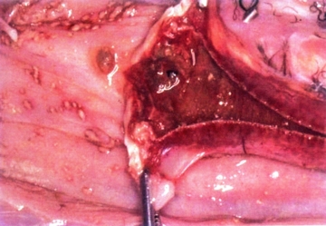
Opisthotonus in the neurotropic form
The haemorrhages of gizzard epithelium
The haemorrhagic necrotic and focal diphtheroid lesions in the mucosa of the buccal cavity
The mucous coat of gizzard is oedematous, covered with thick mucus

Slide 35
Diagnosis
Samples
Samples should be collected from recently dead birds or moribund birds that have been killed humanely.
Dead birds: oro-nasal swabs; lung, kidneys, intestine (including contents), caecal tonsils, spleen, brain, liver and heart tissues, separately or as a pool
Live birds: tracheal or oropharyngeal and cloacal swabs (visibly coated with faecal material) from live birds or from pools of organs and faeces from dead birds
Clotted blood samples or serum

Slide 36
Identification of the agent
Virus isolation : by allantoic inoculation of 10-day-old embryonated eggs, and tested for haemagglutination (HA) activity
Virus identification: use of specific antiserum in a haemagglutination inhibition (HI) test
Pathogenicity index determined by intracerebral pathogenecity test.
Molecular techniques- RT-PCR

Slide 37
Serological tests
Haemagglutination and haemagglutination inhibition tests: most widely used and detects antibody response to virus glycoprotein (predictor of protection against disease)
Enzyme-linked immunosorbent assay (ELISA): as whole virus is used as antigen, detects antibody to all of the virus proteins

Slide 38
Vaccination
Conventional live virus vaccines: 2 groups
lentogenic vaccines (e.g. Hitchner-B1, La Sota, V4, NDW, I2 and F)
mesogenic vaccines (e.g. Roakin, Mukteswar and Komarov)
Live virus vaccines administered to birds by incorporation in the drinking water, delivered as a coarse spray (aerosol), or by intranasal or conjunctival instillation; some mesogenic strains are given by wing-web intradermal inoculation

Slide 39
Inactivated vaccines- prepared from allantoic fluid that has had its infectivity inactivated by formaldehyde or beta-propiolactone incorporated into an emulsion with mineral oil or vegetable oil, and is administered intramuscularly or subcutaneously;
New recombinant vaccines: fowlpox virus, vaccinia virus, pigeonpox virus, turkey herpesvirus and avian cells in which the HN gene, the F gene, or both, of NDV are expressed

Slide 40
Prevention
When the disease appears in a previously disease free area, a stamping out policy is practiced in most countries. This includes:
strict isolation or quarantine of outbreaks;
humane destruction of all infected and exposed birds
thorough cleaning and disinfection of premises;
proper carcass disposal;
pest control in flocks;
depopulation followed by 21 days without poultry before restocking;
avoidance of contact with birds of unknown health status;
control of access to poultry farms.

Slide 41
Canine distemper virus
Canine distemper virus, or CDV, is a morbillivirus closely related to the viruses of measles and rinderpest.
Morbillivirus belongs to subfamily orthoparamyxovirinae and are able to infect a wide range of hosts to cause varied types of disease, many of which are severe.
Wild animals like raccoons, foxes, wolves, coyotes, skunks, ferrets, and mink can also get distemper.

Slide 42
Canine distemper
Syn. - Canine influenza; Carres; Hard pad disease; footpad disease
It is an acute highly contagious viral disease of carnivorous animals characterized by diphasic fever, ocular and nasal catarrh and frequent cutaneous eruptions.
Affects dogs most commonly aged between 3 and 6 months when maternal antibody level is declining, but can occur in older dogs that have been vaccinated infrequently or improperly, especially after stress, immunosuppression, or contact with other affected dogs.

Slide 43
CD is a multisystemic disease that can present with one or more of the following:
– Respiratory disease with severe pneumonia
– Gastrointestinal disease with vomiting and diarrhoea
– Neurological disease including seizures
– Severe immunosuppression leading to infection by normally innocuous bacteria and viruses
The mortality rate of all forms of the disease, taken together, ranges between 30 and 80%.

Slide 44
Transmission
Indigenous breeds are quite resistant.
In nature, the transmission of the virus takes place by inhalation (droplet or aerosol).
The disease may indirectly be transmitted through ingestion of contaminated food and water.

Slide 45
Sources of virus
The virus is discharged through secretions and excretions-conjunctival, nasal, and oral exudates, urine, feces, and skin dander.
The virus is present in all the excretions during the systemic reaction phase of the disease.
virus is sensitive to lipid solvents, such as ether, and most disinfectants, including phenols and quaternary ammonium compounds. It is relatively unstable outside the host.

Slide 46
Pathogenesis
CDV is considered a multi-cell pathogen that has the ability to infect three different types of host cells including epithelial, lymphoid, and neurological cells.
The pathogenesis is as follows:
Virus – inhalation – Pharynx – Palatine tonsil –Macrophages–Lymphoid vessels – Blood vessels – Bone marrow –Spleen – Lymphoid tissues – Leukopenia – Leukocytosis.

Slide 47
Infected cells carry the virus to the draining lymph node where the resident activated T-cells and B-cells are infected, resulting in virus amplification and the initiation of primary viremia.
The virus gets disseminated to secondary lymphoid organs, including the spleen, the thymus, the tonsils and subsequently a systemic spread through the entire immune system.

Slide 48
Clinical signs
In acute form- There is a high rise of temperature. This temperature reaction is characteristic and is known as biphasic reaction.
The temperature rises upto 103 to 104°F. In this stage, the nose of the animal will turn dry and hot and eyes will turn congested. The animal is markedly depressed and refuses to take food.
The first fever peak, often 3-6 days after infection, is accompanied by lymphoid depletion.

Slide 49
Within few days yellowish green discharge is voided from the eyes and nose.
This temperature usually come down in 96 hours to normal level and remains so till 11 to 12 days.
Afterwards, temperature rises to a second peak which remains continuous during the course of the systemic infection.
The second rise of temperature is accompanied by widespread viremia and dog shows rhinitis, conjunctivitis, gastroenteritis and broncho­pneumonia.

Slide 50
The pulmonary disease is characterized by catarrhal inflammation of the larynx and bronchi, tonsillitis, and a cough. Later, bronchitis or catarrhal bronchopneumonia develop, sometimes with pleuritis.
The gastrointestinal disease is characterized by severe vomiting and watery diarrhea.
Occular form -swollen eye lids, congestion of conjuctival mucosa (conjunctivitis), purulent discharge from the eyes. The pus may lead to ulceration of the cornea.

Slide 51
Nervous form –subacute form or follow any of the acute manifestation.
These are characterized by restlessness, excitement, chewing movements (“chewing-gum fits”) , excessive salivation and convulsion. The dog may fall and show epileptic form fits. Lymphopenia is the distinct feature of distemper
The nervous form may be characterized by chorea.
Chorea indicates jerky movements of group of muscles. The muscular spasms may be observed in the lips, cheeks, jaws, head, neck or limb muscles.
Paresis or paralysis, often beginning in the hind limbs and evident as ataxia, followed by ascending paresis and paralysis.

Slide 52
Cutaneous form
There is appearance of rash, vesicles and pustules, In some cases, the skin of the foot pads and nose may become hard due to hyper keratosis and the condition is ascribed as “hard pad disease”.
When the foot pads are thickened, the dog may experience some difficulty in walking on hard objects.
There may be vesicopustular eruptions on the ventral aspect of the abdomen and on the inner parts of the thighs of skin. This type of distemper eruptions are known as distemper exanthema.

Slide 53
There are two late forms of the disease seen in old dogs: old dog encephalitis and hard-pad disease
“Old dog encephalitis” in old dogs in which there is slow progressive loss of neurologic functions and characterized by mental disorders, motor deterioration and death

Slide 54
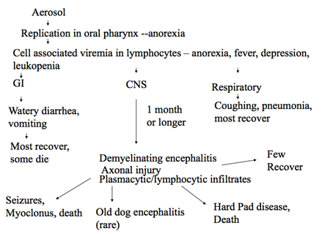

Slide 55
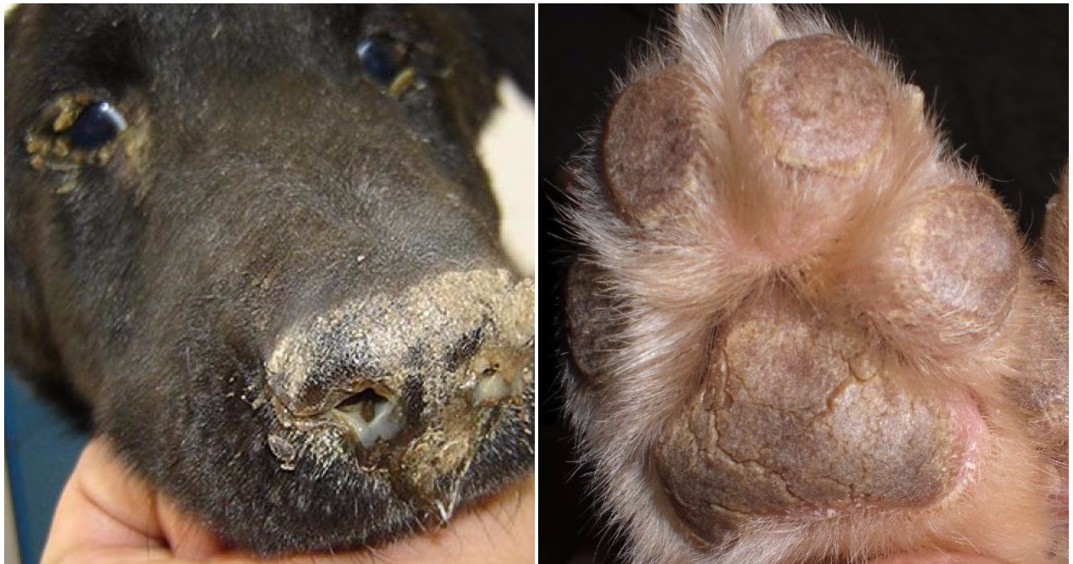
Hard pad disease

Slide 56
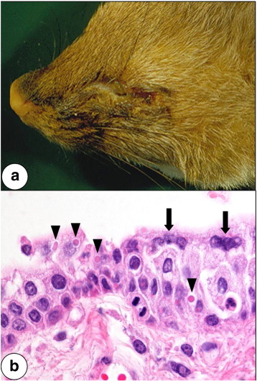
a)Severe muco-suppurative conjunctivitis; b) Conjunctiva with epithelial syncytial cells (arrows) and cytoplasmic eosinophilic viral inclusion bodies (arrowheads); hematoxylin–eosin

Slide 57
Lesions
Hyperkeratosis of the nose and footpads
Thymic atrophy is a consistent pm finding in infected young puppies.
Necrosis of lymphatic tissues, interstitial pneumonia, and cytoplasmic and intranuclear inclusion bodies in respiratory, urinary, and GI epithelium.
Lesions found in the brains of dogs with neurologic complications include:
neuronal degeneration, gliosis
Non-inflammatory demyelination
perivascular cuffing
Non-suppurative leptomeningitis, and
Intranuclear inclusion bodies predominately within glial cells

Slide 58
Diagnosis
Reverse-transcriptase polymerase chain reaction (RT-PCR)
Virus isolation
Immuno-histochemistry
Fluorescent antibody staining
Faecal enzyme-linked immunosorbent assay (ELISA)
Electron microscopy
Histopathology
Serological tests
Indirect fluorescent antibody tests
Haemagglutination inhibition
ELISA

Slide 59
Vaccination
A dog after recovery from an attack of distemper generally acquire a long lasting immunity
Vaccination is very effective at preventing distemper.
Young dogs require 2 vaccinations with modified-live virus (MLV) vaccine which can be given from 6 weeks of age, with the second being given 3-4 weeks after the first vaccination.
Vaccination against distemper is then repeated one year later and thereafter is given as part of the booster vaccination regime.

Slide 60
Peste des Petits Ruminants or PPR
Syn- goat plague, kata, syndrome of stomatitis-pneumoenteritis, and ovine rinderpest
French name for "plague of small ruminants".
Highly contagious disease of goats and sheep characterized by fever, sores in the mouth, diarrhea, pneumonia, and sometimes death.
It is caused by a morbillivirus that is related to rinderpest, measles and canine distemper. The official name of this virus was changed in 2016 to Small ruminant morbillivirus (SRM)

Slide 61
Cattle and several wild ruminants have been infected most often experimentally, but goats and sheep are the usual targets.
PPR is WOAH list A disease
The disease occurs in a band that spreads across Africa between the equator and the Sahara, through the Arabian Peninsula, the Middle East, south-west Asia.
Reported in 1989 in India from Tamil Nadu.

Slide 62
Transmission
The virus is secreted in tears, nasal discharge, secretions from coughing, and in the faeces of infected animals.
Close contact between animals, especially through inhalation of fine droplets that are released into the air when affected animals cough and sneeze will spread the disease.
Water, feed troughs, and bedding can also be contaminated with secretions and become additional sources of infection, however the virus does not survive for a long time outside the body of a host animal.

Slide 63
Since animals excrete the virus before showing signs of the disease, it can spread by movement of infected animals.
Morbidity rate in susceptible populations can reach 90–100%
Mortality rates vary among susceptible animals but can reach 50–100% in more severe instances
Both morbidity and mortality rates are lower in endemic areas and in adult animals when compared to young.

Slide 64
Pathogenesis
PPR virus, like other morbilliviruses, is lymphotropic and epitheliotropic
It induces the most severe lesions in organ systems rich in lymphoid and epithelial tissues.
After the entry of the virus through the respiratory tract system, it localizes first replicating in the pharyngeal and mandibular lymph nodes as well as tonsil.
Viremia may develop 2-3 days after infection and 1-2 days before the first clinical sign appears.
Subsequently viremia results in dissemination of the virus to spleen, bone marrow and mucosa of the gastro-intestinal tract and the respiratory system

Slide 65
Clinical signs
Disease severity depends on various factors: PPRV strain, host species and breed, and the health status of host animals.
The disease is particularly seen in young animals
The incubation period is 4–6 days
High fever (41°C/106F), erosive stomatitis, conjunctivitis, gastroenteritis, and pneumonia, dry muzzle, oculo-nasal discharges,
Watery blood-stained diarrhea.

Slide 66
Erosions-small pin-point red-greyish areas on the gums, dental pad, palate, lips, inner aspects of the cheeks and upper surface of the tongue.
Eye, nose and mouth discharges with scabs or nodules around the mouth
Death usually occurs 4–6 days after the onset of fever.

Slide 67
Lesions
The carcass of an affected animal is usually emaciated, the hindquarters soiled with soft/watery faeces and the eyeballs sunken. The eyes and nose contain dried-up discharges.
Prominent crusty scabs along the outer lips and severe interstitial pneumonia frequently occur with PPR
Erosive lesions may extend from the mouth to the reticulo–rumen junction
Erosive or haemorrhagic enteritis

Slide 68
Peyer’s patches may be necrotic.
Lymph nodes are enlarged, and the spleen and liver may show necrotic lesions.
The large intestine is usually more severely affected, with congestion around the ileo-cecal valve, at the ceco-colic junction and in the rectum.
In the posterior part of the colon and the rectum, discontinuous streaks of congestion “zebra stripes” form on the crests of the mucosal folds

Slide 69
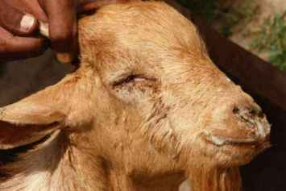
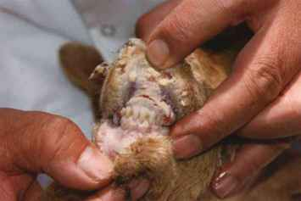
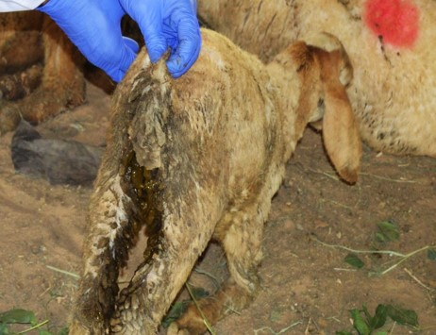
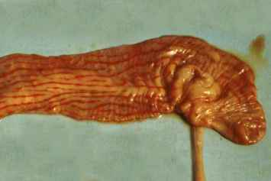

Slide 70
Diagnosis
A tentative diagnosis of PPR infection can be made based on characteristic signs like mucopurulent nasal discharge, pneumonia, diarrhea, scaby lesions on tongue, around mouth and death of many animals in flock should be suspected of PPR.
Swabs of the eyes, nasal, mouth, tongue and rectal discharges.
Nucleic acid detection and identification- Reverse-transcription PCR (RT-PCR)
Immunocapture enzyme-linked immunosorbent assay, AGID, CIE, virus neutralization test

Slide 71
Prevention and control
Farm Disinfection: PPR virus can be killed by most common Disinfectants-Phenols, Sodium hydroxide 2%
Vaccination: • Live attenuated PPR vaccine is available.
Names: PPR vaccine, Raksha PPR.
Dose: 1 ml by s/c
Age group: 3 months’ kids.
Immunity: 3 years.

Slide 72
Rinderpest or cattle plague
Rinderpest was declared as eradicated worldwide by the WOAH and FAO in May and June 2011.
India was declared rinderpest-free in May 2006 by WOAH.

