Slide 1
Genotype prediction for a structural variant in Brown Swiss cattle (BSW) using Illumina Beadchip data
Seefried, F., von Rohr P., Drögemüller C.,
University of Bern,
1st October 2019

Slide 2
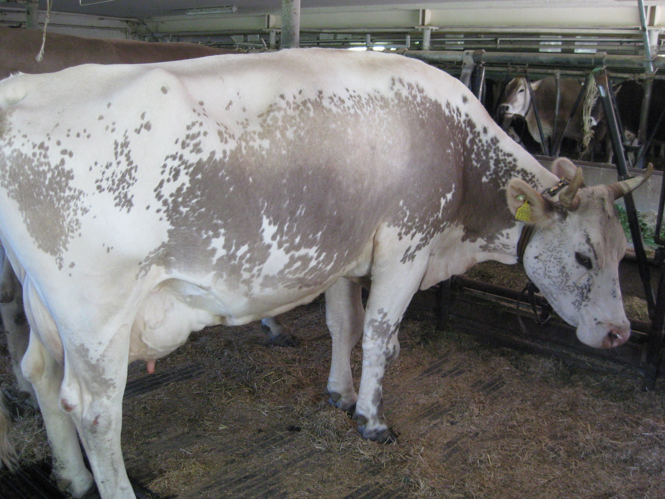
Colour sidedness in Brown Swiss
Usually Brown Swiss (BSW) cattle is characterized by solid brown colour
2 hypopigemented colour phenotypes exist at low frequency
Belt
Colour sidedness (Cs)

Slide 3
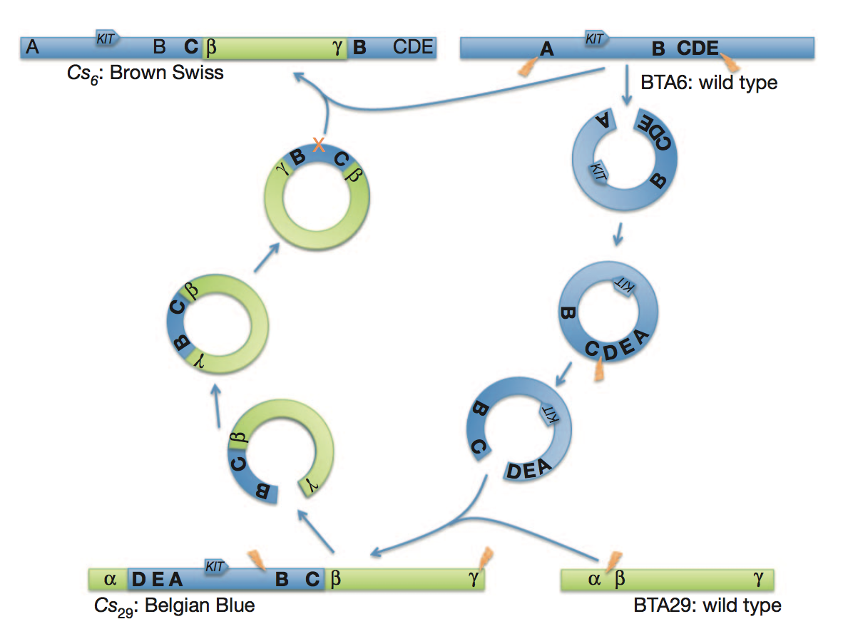
Genetics of Cs
Complex structural variant
Serial translocation of chromosome segments between BTA6 and BTA29 (Durkin et al. 2012)
Dominant inheritance
Illumina Infinium assay data provide normalised signal intensities (Log R Ratio)

Slide 4
Log R Ratio
BTA29 signal intensities for Wild-type (black) and heterozygous (red) Cs6 animals

Slide 5
Log R ratio - Computation
R intensity values result from polar transformation of signal intensity readouts
R stands for copy number
Theta represents the angle => Genotype
Log R ratio
Ratio between observed and expected intensities
Logs because distribution properties better

Slide 6
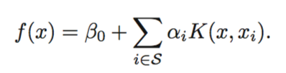
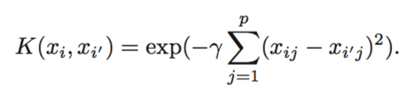
Support Vector Machines
Supervised classification model
Classification of geno- / phenotypes
True Cs6 were available
Log R Ratios from SNPs within translocated region
Genotype data
Linear kernel
Radial kernel
Notes:
SVM = supervised statistical learning (see R book page 26)
Response variable = qualitative
Methods are logistic regression, K-nearest neighbours, gemeralized additive models, boosting and SVM
The support vector machine (SVM) is an extension of the support vector classifier that results from enlarging the feature space in a specific way, using kernels. (see R book page 360)
A kernel is a function that quantifies the similarity of two observations.
SVM maps the vecotr of signal intensities into a higher dimensional feature space and constructs a linear / nonlinear decision boundary.

Slide 7
Software
R
Packages:
e1071
grDevices, stats, MASS
Principal:
Set up prediction model using reference samples
Predict other sample using selected model
Run time: 20’ for BSW (60’000 genotyped samples)

Slide 8
Classification - Example
f(x) non-linear
f(x) linear

Slide 9
Classification
Distribute data plane into different regions according to data classes
Example
Two classes red and black
Separate plan into red and black region
Function f(x) describes boundary, can either be linear or non-linear
Linear f(x) => Regression
Non-linear f(x) => one possibility SVM

Slide 10
Data & Prediction accuracy
Chip densities: Illumina 777K / 150K / GGPLD
Validation strategy: leave-one-out CV
Accuracy criteria:
Proportion of number of correct predictions over no. of total sample size
True positive proportion
Coat Phenotype | Cs - Genotype | No. of reference animals
Solid brown | wt/wt | 2003
Colour-sided | wt/Cs | 87
Colour-sided | Cs/Cs | 19

Slide 11
Results
Proportion (%) of correct predictions using Log R Ratio (imputed genotypes)
Chip | Cs-Genotype prediction |  | Phenotype Prediction
SVM Kernel | Linear | Radial | Linear | Radial
777K | 99.8 (99.3) | 99.7 (99.6) | 100 | 99.9
150K | 99.8 (99.9) | 99.8 (99.1) | 99.9 | 99.8
LD | 95.8 | 97.2 | 97.1 | 97.7
True positive proportion (%) using Log R Ratio (imputed genotypes)
777K | 94.6 (91.6) | 92.5 (93.0) | 100 | 100
150K | 96.6 (98.9) | 92.7 (80.6) | 100 | 96.2
LD | 3.5 | 66.7 | 43.5 | 66.3
Notes:
No of SNPs
HD 107
150K 22
LD 4

Slide 12
Implementation
Routinely implemented into Qualitas SNP pipeline
Data: SNP genotypes
Ease of implementation
Leave-One-Out Crossvalidation has been implemented depending on a given parameter
SVP used also used to predict carriers or simple recessive defects (SNPs): SMA, Weaver, HH1, …
Obstacle: reference population needed
Difficult in case of missing homozygous samples for classical recessive defects

Slide 13
Additional Results
Breed | Variant | Size of reference population | p (Aim-Allele) reference (%) | No. of homozygous reference samples | Proportion of correct genotype-predictions
BSW | POLLED202BPINDEL | 1240 | 2.0 | 17 | 99.3%
BSW | SMA | 2100 | .8 | 0 | 99.0% ⁽¹⁾
BSW | BELT | 1700 | 2.6 | 8 | 99.8%
BSW | FH2 | 14600 | .5 | 8 | 99.9%
HOL | Mulefoot | 9200 | .1 | 0 | 100%
HOL | Brachyspina⁽²⁾ | 1000 | 1.6 | 0 | 99.4%
1) Not implemented, very poor true positive proportion
2) Not implemented due to patent protection

Slide 14
Summary
SVM seem to perform well for calling structural variants using signal intensities / genotype data
Benefits in prediction accuracy were detected using genotypes compared to using Log R ratio
Linear kernel outperformed radial kernel in accuracy
Effect of chip density
No. of SNPs
Benefits / Limitations using Log R ratio data:
No pedigree / imputation
Complete callingrate required
No. of SNPs / size of the structural variant

Slide 15


Thank you!

Slide 16
Log R ratio - Diagram

