Slide 1

Players to Watchout
IOB Staff Club
- SportOptima

Slide 2
Batsman

Slide 3
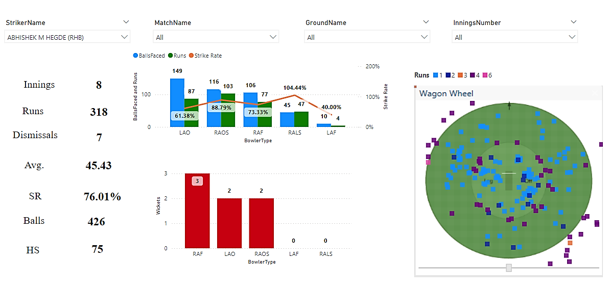
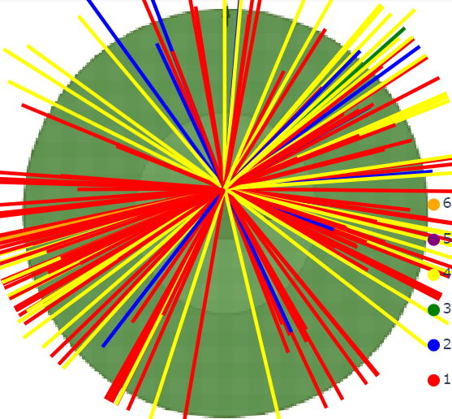
Abhishek M. Hedge – Right Hand Bat
powered by SportOptima

Slide 4
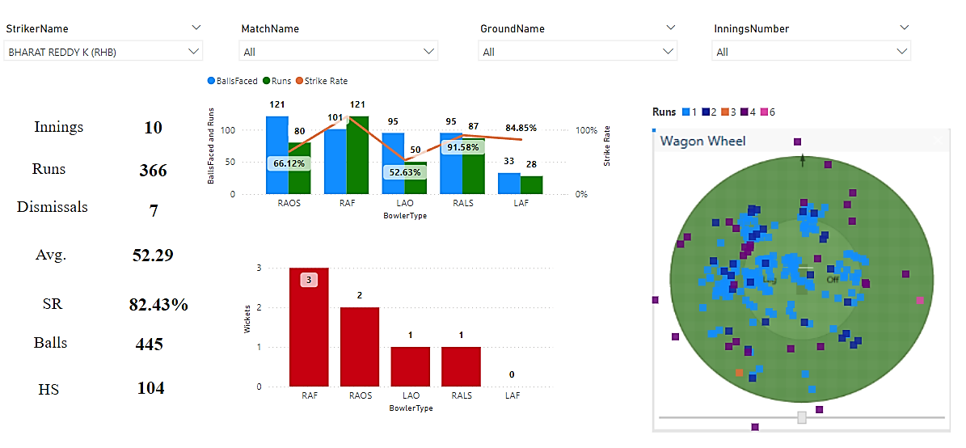
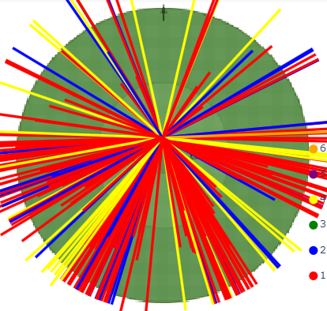
Bharat Reddy K – Right Hand Bat
powered by SportOptima

Slide 5
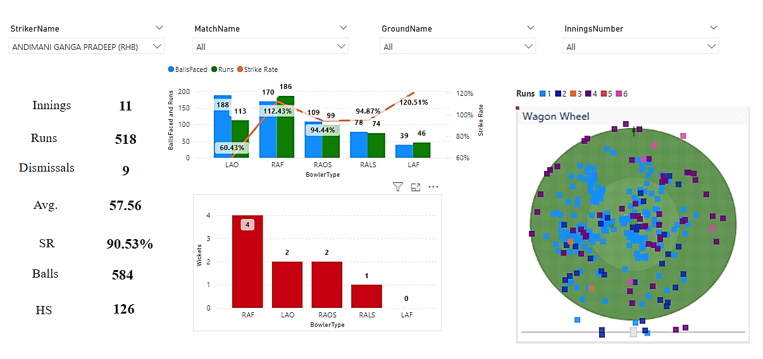
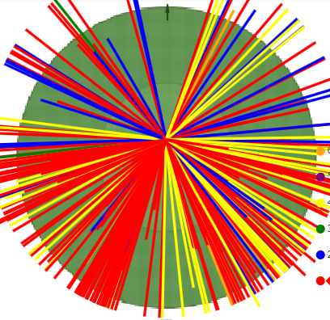
Andimani Ganga Pradeep– Right Hand Bat
powered by SportOptima

Slide 6
Bowlers

Slide 7
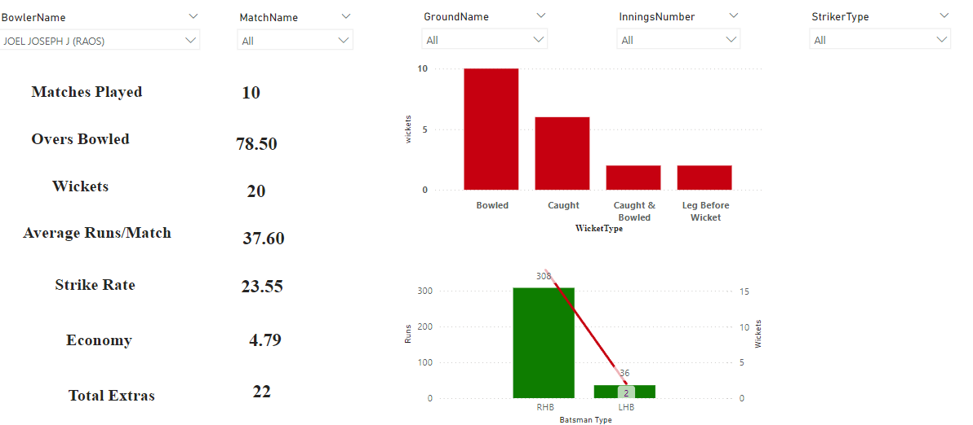
Joel Joseph– Right Arm Off Spinner
Inference:
Takes a lot of wicket Bowled, must be attacking the stumps more often than not
powered by SportOptima

Slide 8
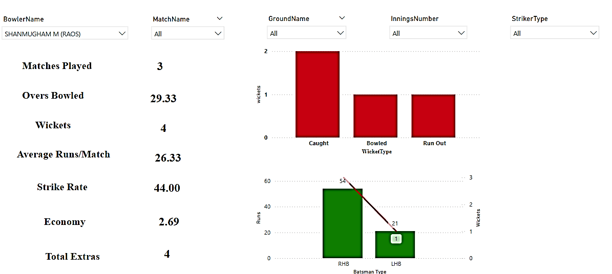
Shanmugham M – Right Arm Off Spinner
powered by SportOptima

Slide 9
Thank you
powered by SportOptima

