Slide 1

Players to Watchout
Nungambakkam Cricket Club
- SportOptima

Slide 2
Batsman

Slide 3
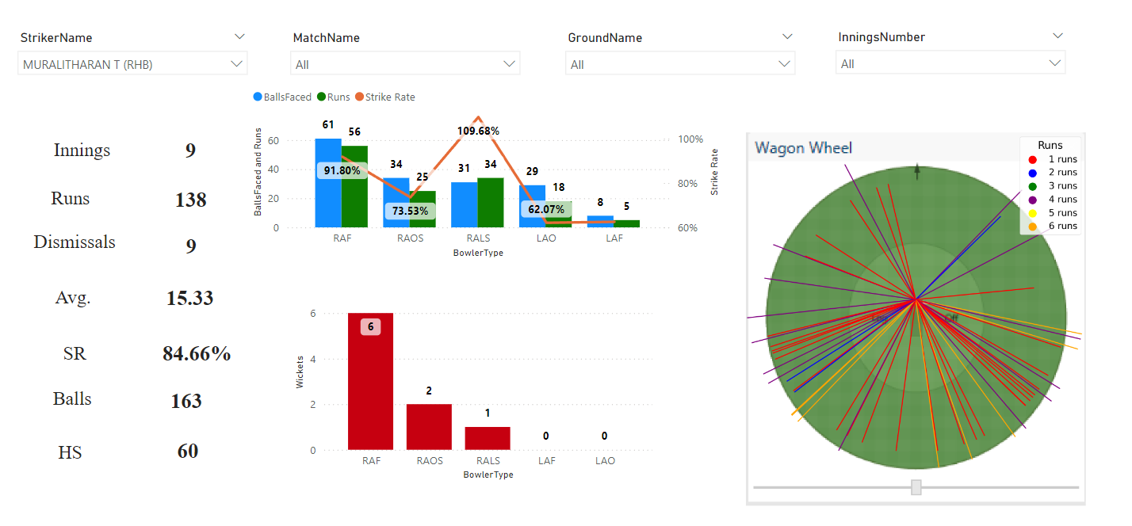
Muralitharan– Right Hand Bat
powered by SportOptima

Slide 4
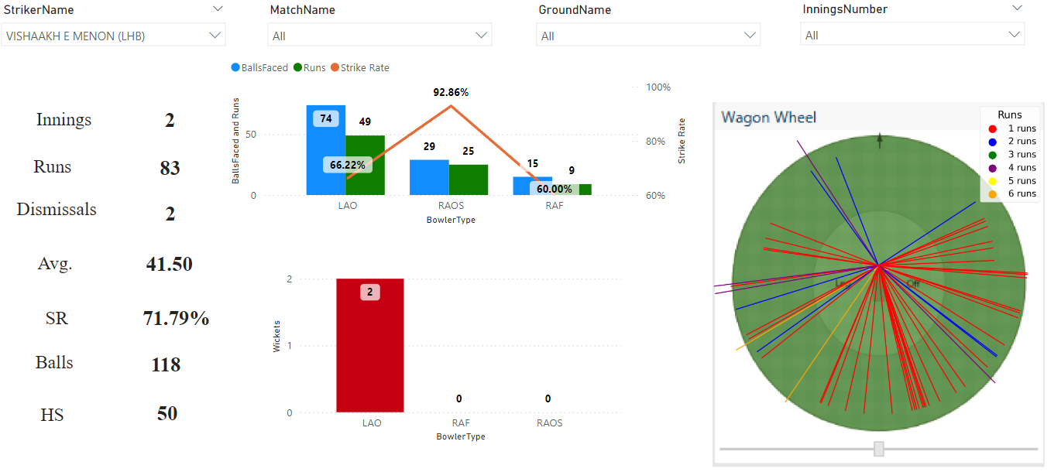
Vishaak E Menon– Left Hand Bat
powered by SportOptima

Slide 5
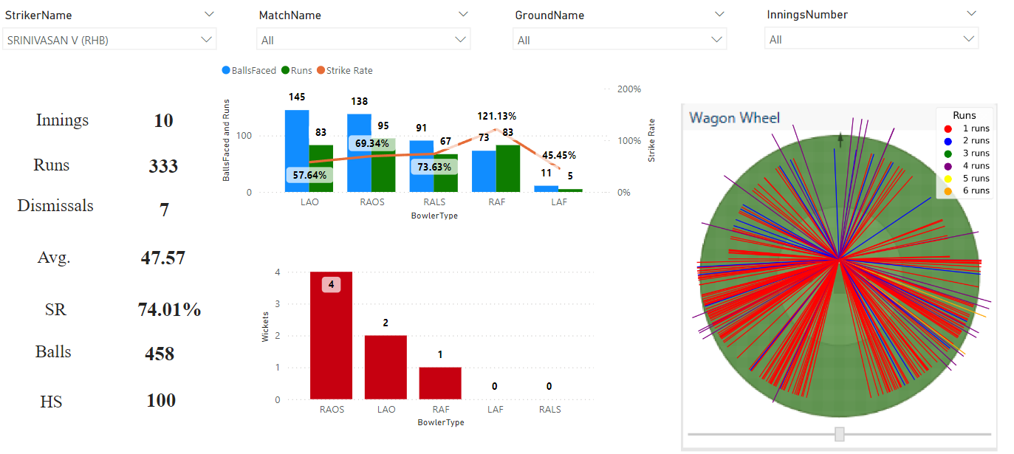
Srinivasan V– Right Hand Bat
powered by SportOptima

Slide 6
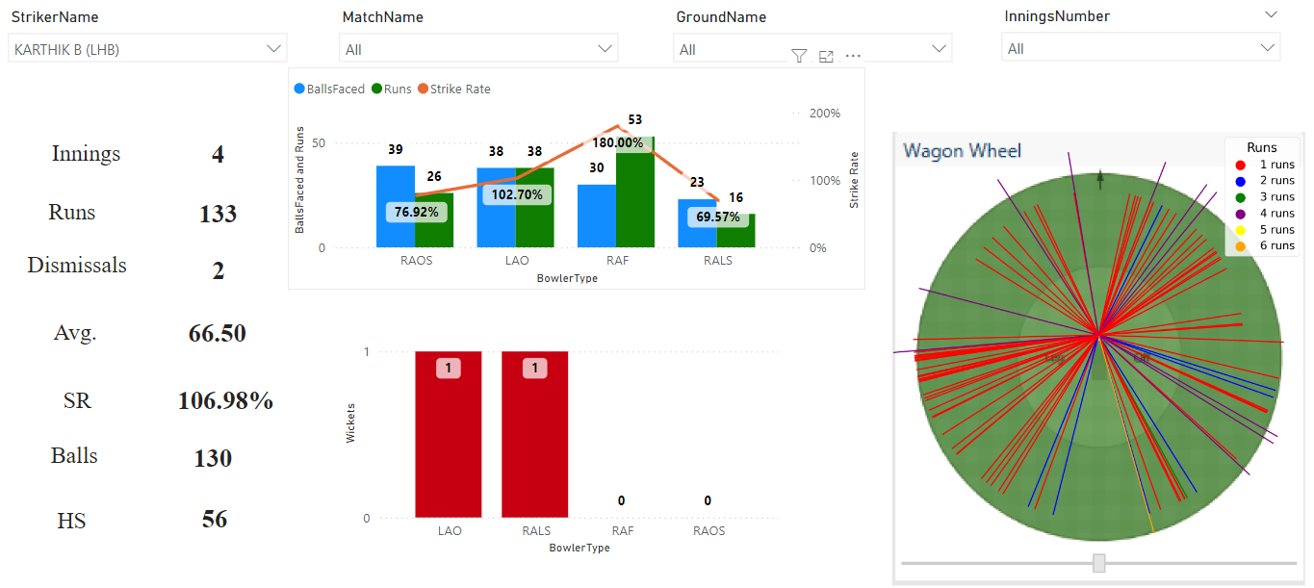
Karthik B– Left Hand Bat
powered by SportOptima

Slide 7
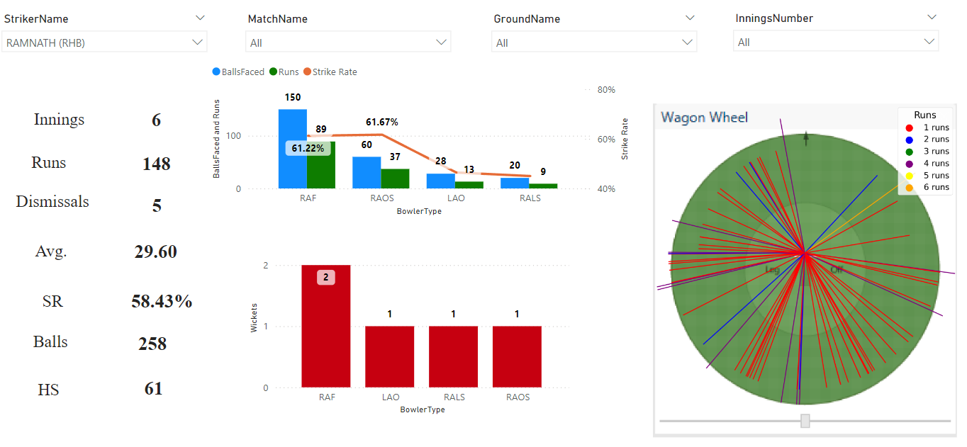
Ramnath– Right Hand Bat
powered by SportOptima

Slide 8
Bowlers

Slide 9
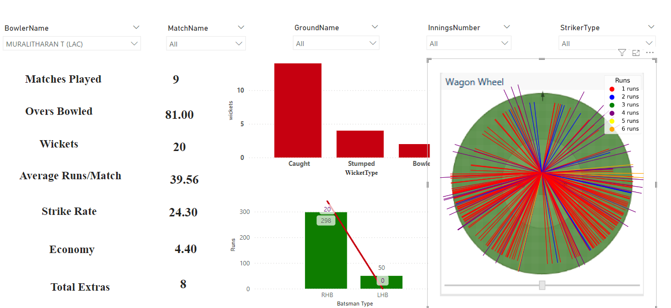
Muralitharan– Right Arm Leg Spinner
powered by SportOptima

Slide 10
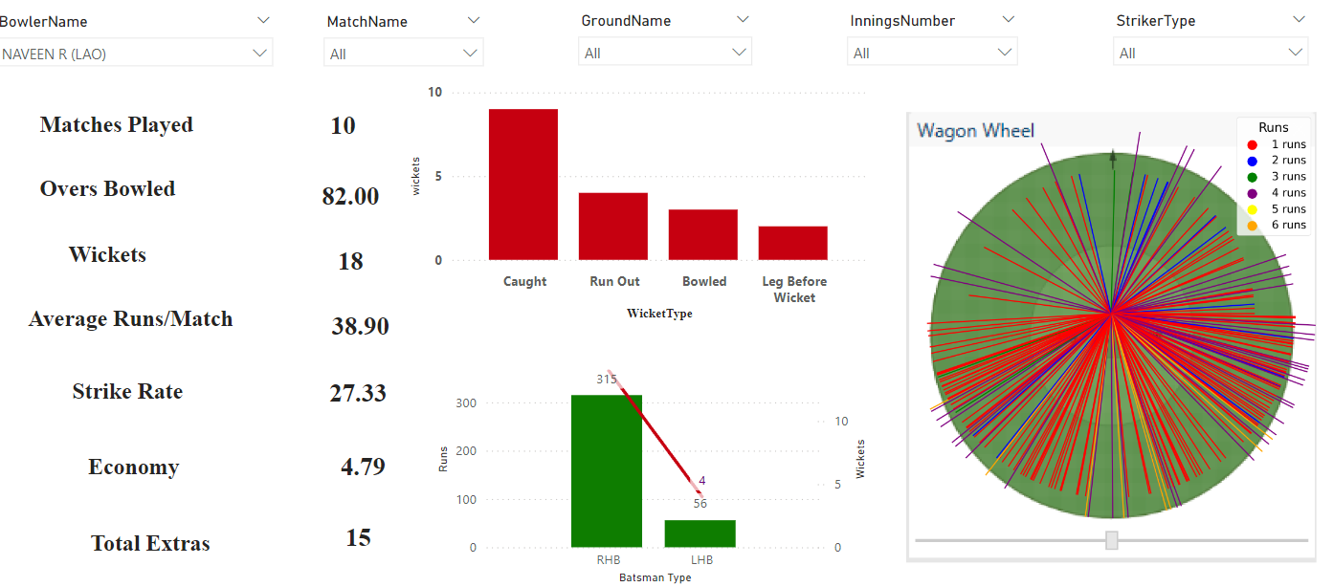
Naveen R– Left Arm Off Spinner
powered by SportOptima

Slide 11
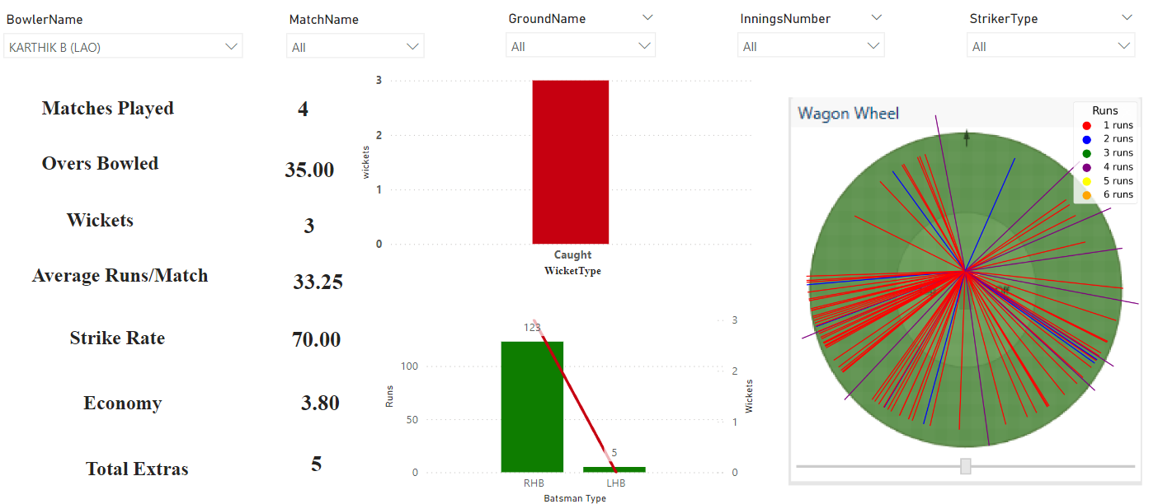
Karthik B– Left Arm Off Spinner
powered by SportOptima

Slide 12
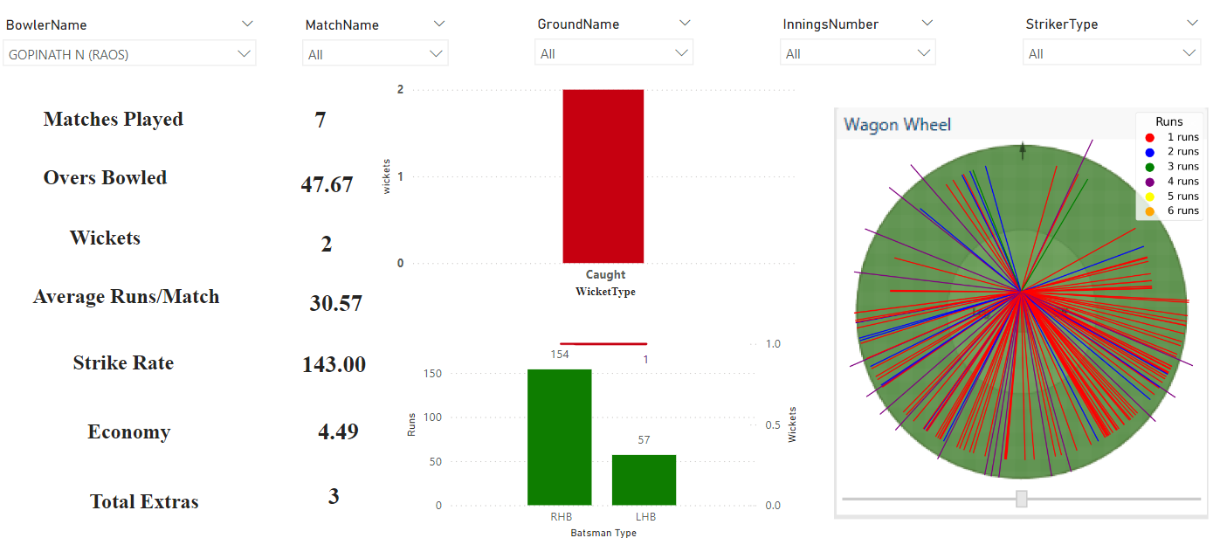
Gopinath– Right Arm Off Spinner
powered by SportOptima

Slide 13
Thank you
powered by SportOptima

