Slide 1
Biosafety in the WHO AFRO Laboratory Accreditation scheme

Slide 2
Role of Biosafety and Accreditation Efforts
Laboratory safety weighted the highest with 43 points among other QSEs
ISO developed a standard particular to laboratory safety
ISO 15190
This makes safety the core of laboratory processes

Slide 3
Step-wise approach to implementing a WHO/AFRO Accreditation scheme for laboratories
5 Star
4 Star
End Point
CAP
ISO15189
SANAS
--Etc
3 Star
2 Star
1 Star
> 95 %
85-94 %
75-84 %
Score on onsite evaluation
65-74 %
55-64 %
Incremental Process

Slide 4
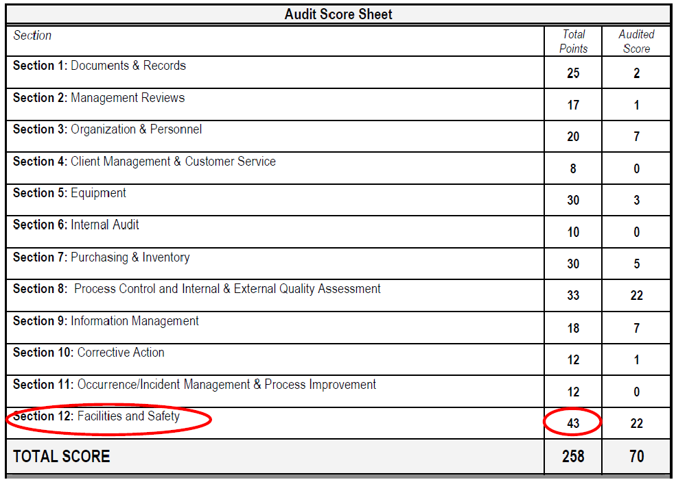
Relationship with ISO 15189 standard

Slide 5
National Biosafety/ Biosecurity guidelines
These guidelines provides measures to-
Establish and maintain a safe work environment
Prevent and prepare for emergencies
Neglect of the guidelines leads to accidents which are
loss of reputation
loss of customers / loss of income
negative effect on staff retention
Increased costs—litigation, insurance

Slide 6
Biosafety Program Elements
There are 14 core biosafety program elements, namely;
Management’s Responsibility; discussed in 1.4.4
Safety Business & Administrative Programs
Review Laboratory Biosafety Programs (Risk Assessment) as discussed in Module 3
Equipment evaluation (PPE & Lab Equipment) as discussed in module 5
Review Building & Facility Systems as discussed in module 5
Occupational Health Program as discussed in module 4
Chemical Management & Industrial Hygiene Programs as discussed in module 2

Slide 7
Biosafety Program Elements cont.
Waste Management & Environmental Safety Programs as discussed in module 2
Emergency Preparedness & Response Programs as discussed in module 5
Agent Biosecurity as discussed in unit 2 of module 1 below
Transport of Biological Agents as discussed in module 2
Field Activities (Clinical & Research)
Training & Outreach Activities
Radiation Safety Programs

Slide 8
Management Responsibilities in biosafety programme
Discussion
In your facilities who is responsible for biosafety?
What can you do to ensure biosafety in your facility?
Director responsibilities
Laboratory Supervisor responsibilities
Personnel responsibilities
Who is responsible for biosafety??

Slide 9
Safety is therefore ‘EVERYONES RESPONSIBILITY’

Slide 10
Biosafety manuals and standard operation procedures
For effective implementation of a biosafety programme
develop specific/ institution procedures
explain what is expected and required of laboratory personnel

Slide 11
Biosafety management programme
Have written procedures (SOPs)
Training and exercises on safety practices and techniques
risk assessments
laboratory safety audits to look for potential safety problems
Waste management

Slide 12
Thank You.

