Slide 1
WASTE MANAGEMENT TRAINING Occupation Health and Safety

Slide 2
At the end of this session, participants should be able to;
Define occupational health and safety
Explain responsibilities and obligations of occupation health
Describe occupational health control procedures
Apply health and safety techniques (conducting waste segregation, conducting first aid procedures, appropriate utilisation of PPE)
Understand attitude and perception on use of appropriate PPE

Slide 3
Introduction
It is the responsibility of health care institutions to provide a safe and healthy workplace for all
The management of waste presents a number of potential hazards to employees requiring the appropriate measures of risk identification, risk assessment, and risk control
Employees have an obligation to follow instructions regarding safe work practices

Slide 4
Occupational health and safety
Definition
The promotion and maintenance of the highest degree of physical, mental and social wellbeing of workers in all occupations
Occupational health with regard to waste mgt deals with handling or exposure to waste

Slide 5
Guiding principles
Health care waste management policies and plans should cater for continuous monitoring of workers, health and safety
Correct handling, treatment, storage and disposal procedures should be followed by all workers

Slide 6
Guiding principles
To prevent and control risk of exposure of health care personnel and workers handling waste, the following health and safety measures should be considered;
Develop a standardized set of management rules and operating procedures for health-care waste
Inform and train waste workers so that they perform their duties properly and safely
Involve waste workers in the identification of hazards and recommendations for prevention and control
Provide equipment and clothing for personal protection
Establish an occupational health programme that includes information, training and medical measures when necessary, such as immunization, post-exposure prophylactic treatment and regular medical surveillance.

Slide 7
Responsibilities on occupation health & Safety
Employer Responsibilities
Health care institution is responsible for providing appropriate information, education and training
Ensuring that safe systems of work are developed and maintained
Promote utilisation and documentation of approved work practices
Ensure multilingual translations are provided to personnel as required

Slide 8
Responsibilities on occupation health & Safety
Employees Responsibilities
Employees should comply with health care waste management policies, procedures and instructions given for the protection of their own health and safety and health and safety of others
This includes the correct use of safety and protective equipment
Report all incidents using the provided structure

Slide 9
Responsibilities on occupation health & Safety
Employee Vaccination Programs
Each health care institution should have an employee vaccination program.
Maintain and keep long- term records to ensure booster injections are given as required.

Slide 10
Occupational health risks
Health care waste handlers are at greatest risk from infection hazards especially sharps not disposed off appropriately
Types of occupational exposure include;
Sharps injuries from bloodborne pathogens e.g HIV, Hep B, C
Other biologicals, e.g SARS, TB, Influenza
Chemical exposures, e.g chemotherapeutic drugs, disinfectants
Physical harzards, e.g ionising radiation
Ergonomics e.g manual lifting and transporting heavy waste loads

Slide 11
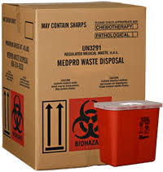
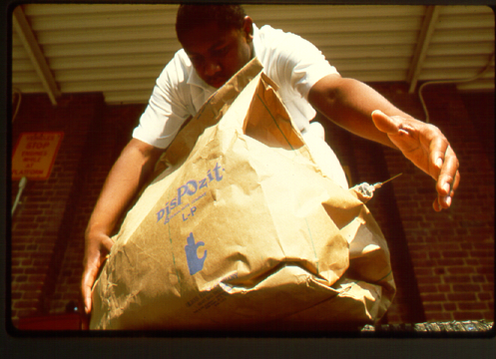
Control measures
Sharps injuries
Immunisation against hep B virus
Appropriate disposal of sharps
Use of engineered needles that automatically retract
Exhaust ventilation
Biologicals
Exhaust ventilation (natural or mechanical)
Respiratory protection with N95, etc
Autoclaving waste in lab before disposal

Slide 12
Protective equipment
The most effective PPE in reducing risk of injury are gloves to protect from exposure to blood and other materials
Particulate mask and respirators protect from respiratory infections harzard and particulate from burning waste
Boots for waste handlers to protect from sharps injuries to the foot
Access to soap and water, alcohol for hand rub, for hand hygiene

Slide 13
Protective equipment
The following should be made available to personnel who collect or handle waste
Obligatory
Disposable gloves or heavy duty gloves
Industrial aprons
Overalls
Leg protection and or industrial boots
Depending on type of operation
Eye protection
Face mask
Helmets

Slide 14
Controls framework
Elimination of hazardous waste
Most preferred method should be used whenever possible
Remove hazards completely from work area if possible
Avoid unnecessary injuries
Reduce usage of hazardous chemicals
Substitutions
Substitute hazardous chemicals with less hazardous chemical
Jet injectors may substitute needles
Engineering controls – controls that isolate a hazard from a workplace
Puncture resistant containers to isolate sharps
Retractable needle syringes

Slide 15
Controls framework
Administrative control - policies to limit exposure e.g universal precautions
Resources on PPE, exposure control plan, medical surveillance program, immunisation, Post Exposure Prophylaxis, training
Work practice controls
Good work practices, no recapping of needles
Personal protective equipment

Slide 16
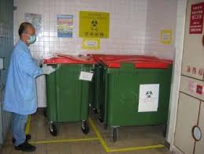
Other considerations for health & Safety
Periodic medical check-up tailored according to organisms employees are exposed to
Monitoring accidents and injuries by appropriate documentation (Incident reporting and reviewing incidents)
Need for availability of first aid kit
What first aid material should be in the waste management area (eye wash, emergency, first aid box, spill kit)
Availability of first aid material in the waste management area
Inventory system of first aid box contents, PPE, spill kit contents
Display warning signs
Medical surveillance plan for employees
Availability of PPE
Appropriate use of PPE
Proper organisation and exist in the waste management area in case of emergency
Exists should not be blocked
Appropriate containers for transportation of waste should be available

Slide 17
Reporting accidents and incidents
All waste-management staff should be trained in emergency response and made aware of the correct procedure for prompt reporting
Accidents or incidents, including near misses, spillages, damaged containers, inappropriate segregation and any incidents involving sharps
These should be reported to the waste-management officer (if waste is involved) or to another designated person

Slide 18
Reporting accidents and incidents
The report should include details of:
the nature of the accident or incident
the place and time of the accident or incident
the staff who were directly involved
any other relevant circumstances
The cause of the accident or incident should be investigated by the waste-management officer (in case of waste) or other responsible officer, who should also take action to prevent recurrence
Records of the investigation and subsequent remedial measures should be kept

Slide 19
Occupational post-exposure prophylaxis
Post-exposure prophylaxis (PEP) is short-term antiretroviral treatment (for HIV) or immunization (for hepatitis B) to reduce the likelihood of infection after potential exposure
PEP should be provided as part of a comprehensive universal precautions package that reduces staff exposure to infectious hazards at work
PEP for HIV comprises a set of services to prevent development of the infection in the exposed person. These include first-aid care;
counselling and risk assessment
HIV blood testing
depending on the risk assessment, the provision of short-term (28 days) antiretroviral drugs, with follow-up and support
Most incidents linked to occupational exposure to bloodborne pathogens occur in health-care facilities

Slide 20
Occupational post-exposure prophylaxis
The World Health Organization (WHO) and the International Labour Organization guidelines on PEP
PEP should be provided as part of a package of prevention measures that reduce staff exposure to infectious hazards
PEP should be available to health-care workers and patients
Occupational PEP should also be available to all workers who could be exposed while performing their duties (such as social workers, law enforcement personnel, rescue workers, refuse collectors)
Countries should include occupational PEP in national health-care plans

Slide 21
Occupational post-exposure prophylaxis
The World Health Organization (WHO) and the International Labour Organization guidelines on PEP
Appropriate training to service providers should ensure the effective management and follow-up of PEP
PEP should be initiated as soon as possible within the first few hours and no later than 72 hours after exposure to potentially infected blood or body fluids
PEP should not be prescribed to a person already known to be infected with HIV
Risk evaluation, and counselling on side effects, and benefits of adherence and psychosocial support is needed
Any occupational exposure to HIV should lead to evaluation and, where relevant, strengthening of safety and working conditions

Slide 22

Minimum approaches to health and safety practices
The minimum approach to health and safety practices for health-care personnel and waste workers includes:
Implementation of standardized management procedures
Hepatitis B vaccination (in addition to compulsory vaccinations) for all personnel who are at risk of exposure to blood (cleaners and waste handlers)
Provision of sharps boxes where injections are taking place
Implementation of standard precautions, e.g no recapping of needles after use

Slide 23
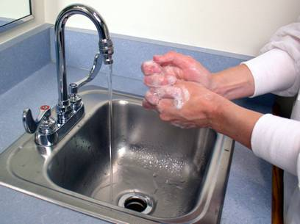
Minimum approaches to health and safety practices
Promotion of proper hand hygiene
Availability, as a minimum, of gloves to provide personal protection from patients’ body fluids
Allocation of an additional role (e.g. for an infection-control nurse) to assume responsibility for promoting better worker safety

Slide 24
Compensation of exposed workers staff
Facilities should develop guideline for workers compensation of workers in case of exposure

Slide 25
Application of health and safety techniques
Practical session
Hand washing technique
Putting on and removing gloves

Slide 26
References
WHO, ILO (International Labour Organization) (2007). Post-exposure prophylaxis to prevent HIV infection: joint WHO/ILO guidelines on post-exposure prophylaxis (PEP) to prevent HIV infection. Geneva, World Health Organization and International Labour Organization
WHO (2009c). WHO policy on TB infection control in health-care facilities, congregate settings and households. Geneva, World Health Organization
WHO (2010). WHO best practices for injections and related procedures toolkit. Geneva, World Health Organization

