Slide 1
Safety Signs

Slide 2





Slide 4



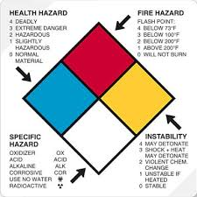

Slide 5







