Slide 1



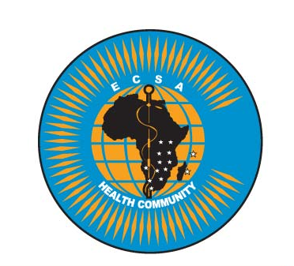


BIORISK PERFORMANCE

Slide 2
Learning Outcomes
At the end of this topic you should be able to
Explain the role of performance in Biorisk management
Identify key elements of performance
Apply performance concepts to Biorisk scenarios
Evaluate how performance can improve Biorisk management
To describe how Biorisk management program is organized and the roles of different players in a Biorisk management program

Slide 3
Contents
Description of performance management
Components of performance: Controls, Assurance (audits and inspections), Improvement based on feedback
Application of performance in validation of sustainability of assessment and mitigation measures
Codes, Regulations, Standards, policies and guidelines for Biorisk management
The Plan, Do, Check, Act concept and how it relates to the AMP model
Roles of management, administration, biosafety officers and personnel in Biorisk management

Slide 4
Performance
Performance is the way in which someone or something functions
Performance is the result of all the efforts of a company or organization
Performance improves biorisk management:: You know that your system works and the risk is controlled

Slide 5
BIORISK PERFORMANCE
The implementation of the entire biorisk management system, including evaluating and ensuring that the system is working the way it was designed. Another aspect of performance is the process of continually improving the system.

Slide 6
Biorisk Management Performance
Control:
Processes, procedures, structures, and responsibilities to manage biorisk
Assurance:
Systematic process of checking the system through audits and inspections
Improvement:
Setting and achieving goals based on internal and external feedback to further improve the system

Slide 7
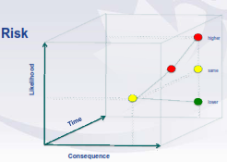
Performance: The relevance of time

Slide 8
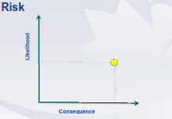

Slide 9
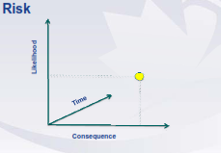

Slide 11
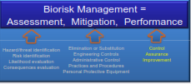

Slide 12
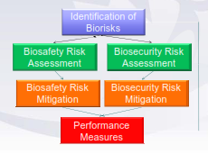
Identification of Biorisks

Slide 13
Laboratory Biorisk Management Standards
CWA 15793:2008
A framework that integrates best practices and procedures
Ensures that an organization can effectively achieve all of its objectives
Frequently built around the plan, do check act cycle
Consistent with other international standards such as ISO 9001/14001 and OSHAS 18001
Performance based
Voluntary
PDCA based

Slide 14


Systematic Approach
PLAN
Identification of potential for improvement
Analysis of current situation
Development of new concepts
DO
Testing and optimization of new concepts
by basic means at one working place
ACT
Full implementation as a standard
which is periodically checked by audits
CHECK
Careful checking of process and obtained results
If successful – full approval as a standard

Slide 15
How performance improves risk management system
It gives idea of the following:
If your system will work (control)
If your system is sustainable (assure)
If the risk is assessable (improve)

Slide 16
The AMP Model
Assessment = Plan, Do, Check, Act
Mitigation = Plan, Do, Check, Act
Performance = Plan, Do, Check, Act
Mitigation is improved and sustained when performance measures are included
PDCA = Tool of quality control

Slide 17
Role of management in Biorisk Managment
Management shall be designated with overall responsibility for overseeing the system for management of biorisk by;
a. Providing appropriate resources i.e personnel, facilities and other resources deemed necessary for the safe and secure operation of the facility;
b. Reporting to top management on the performance of the biorisk management system and any need for improvement;
c. Ensuring promotion of the Biorisk management system throughout the organisation;
d. Instituting review, audit and reporting measures to provide assurance that the necessary requirements are being implemented and maintained effectively

Slide 18
Role of biosafety officer
Provides guidance and oversight to the biorisk management program. This person has delegated authority from senior management to audit, review, and, where needed, to stop work in the event the work does not comply with the organizational policies and guidance defined to ensure biosafety and biosecurity.

Slide 19
Key Messages
Biorisk management is about assessment of the risk, mitigation and monitor performance for improved biorisk management
the risk is controlled can only if your system works thus performance of biorisk management is vital
For your system to work (control) it should be sustainable (assure) and the risk is assessable (improve)

