Slide 1



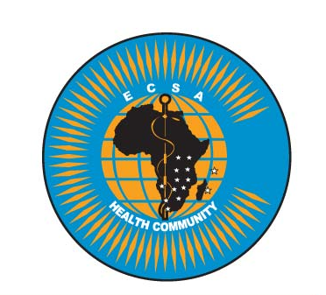


Introduction to Biorisk Management

Slide 2
Learning Outcome
At the end of this topic you should be able to
To describe biorisk management as a concept
To outline the key components of biorisk management
To demonstrate the application of AMP model in risk management

Slide 3
Contents
An overview of the risks of working in a clinical or public health laboratory
An overview of laboratory associated infections
Definition of Biorisk management, biosafety and biosecurity
Overview of how risk is identified and managed and how risk management is monitored/evaluated
The key components of Biorisk management: Assessment, Mitigation and Performance

Slide 4
The risk posed by laboratories:
Clinical and biomedical research laboratories handle infectious agents, multiply drug resistant organisms, altered genomes or organisms and potential agents of bioterrorism
These labs therefore pose a potential hazard to their personnel, the community and the environment

Slide 5
Examples of some of the major hazardous agents handled by labs:
Various bacterial, fungal, viral and parasitic agents are capable of causing viral infections
The agents could be acquired by:
Inhalation (aerosols) e.g. M. tuberculosis, Brucella spp, Neisseria menigitidis, Dimorphic fungi
Ingestion e.g. Salmonella spp, Vibrio cholerae,
Contact e.g. Methicillin Resistant Staphylococcus aureus (MRSA)
Parenterally (Contact with blood/body fluids, needle stick injury): Hepatitis B and C viruses, HIV, Hemorrhagic fever viruses,

Slide 6
Burden:
Data on burden of lab acquired infections is not readily available in developing countries due to lack of systematic reporting
In the USA, the highest risk has been noted for:

Slide 7
Measures to control the risk:
The laboratories must therefore put in place adequate measures to minimize the risk of accidental or malicious spread of these hazards.
Systems or processes to control safety and security risks associated with the handling, storage and disposal of biological agents and toxins in laboratories are referred to as - Laboratory Biorisk Management

Slide 8
Laboratory Biorisk management: Biosafety and Biosecurity
Laboratory Biorisk Management has 2 major aspects:
Laboratory biosafety:
containment principles, technologies, and practices implemented to prevent unintentional exposure to pathogens and toxins, or their unintentional release
Laboratory biosecurity:
Protection, control and accountability for valuable
biological materials within laboratories, in order to prevent their unauthorized access, loss, theft, misuse, diversion, or intentional release

Slide 9

Laboratory Biorisk management: The AMP model
There are 3 key steps (components) in Biorisk management:
Assessment
Mitigation ‘The AMP Model’
Performance

Slide 10
Biorisk assessment:
Biorisk Assessment identifies the risk by:
Defining the hazards in a particular laboratory (e.g. the infectious agents the lab is handling)
Evaluating the likelihood that the hazards will result into an event that has consequences (e.g. the likelihood that the infectious agent can be transmitted to the laboratory personnel)
Evaluating the gravity or seriousness of the consequences (e.g. whether infection with a particular organism leads to serious disease and the availability of measures to manage and control the disease in question)

Slide 11
Biorisk mitigation:
Biorisk mitigation refers measures implemented to eliminate or minimize the risk
The measures are broadly grouped into:
Elimination or Substitution (A laboratory ceases handling of a particular infectious agent)
Engineering Controls (Laboratory physical infrastructure design and equipment aimed at containing the risk)
Administrative Controls (Policies, standards and guidelines that help control of risks)
Practices and Procedures (Processes and activities that have been shown in practice to be effective in reducing risks)
Personal Protective Equipment (Devices worn by the personnel to protect against hazards in the laboratory)

Slide 12
Biorisk performance:
Performance defines the controls as well as the assurance and improvement procedures required in implementation of biorisk management.
Controls: These include the processes, procedures, organizational structures, and responsibilities to manage biorisk
Assurance: This is the systematic process of checking adherence to and effectiveness of the system through audits and inspections
Improvement: Setting and achieving biorisk management goals based on internal and external feedback

Slide 13
Reference materials:
Clinical Infectious Diseases 2009; 49: 142 – 7

