Slide 1
Bioethics and Dual Use Part 2

Slide 2

Dual-Use Dilemma
An ethical dilemma
Results from potentially conflicting values of promoting good (scientific progress and public health) and protecting public security

Slide 3
Key Ethical Questions
What are the responsibilities of the scientific community to society?
How do you weigh the potential benefits of scientific work against the risks for misuse?
Who should make these decisions?
How can tensions between the science community and security experts best be managed?

Slide 4
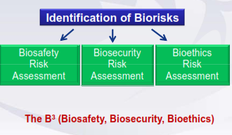

Slide 5
Key Messages II
Perceptions of risk may differ from one group to another
All risks need to be considered equally
The dual-use dilemma results from potentially conflicting values for security and values for development
When assessing risk ethical considerations need to be taken into account

Slide 6
MITIGATING THE RISK OF DUAL-USE

Slide 7
Key Mitigation Options
Research oversight mechanism
Policies of funding agencies, publishers and editors
Laws and regulations
Codes of ‘Conduct and Ethics’
Awareness-raising and educational initiatives

Slide 8
Dual-Use Mitigation Options for the Lab
Promote ethics education and training for staff
Encourage discussion and reflection on laboratory practices
Implement ‘Codes of Conduct and Ethics’
Ensure your institution and staff are aware of their responsibilities

Slide 9
Dual-Use Mitigation Options for the Lab
Ensure your institution and staff are aware of relevant legislation and regulations at national, regional and international level
Conduct biosafety and laboratory biosecurity risk assessments and apply appropriate risk reduction measures
Key principles include: Awareness, Safety and Security, Education, Accountability and Oversight

Slide 10
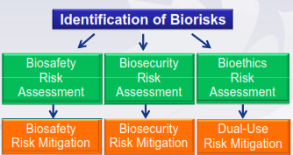

Slide 11
BIOETHICS AND PERFORMANCE

Slide 12
Dual-Use Performance Measures
Assess staff's :
– Perception and understanding of what is meant by dual-use
– Attitudes towards the community
– Awareness of the political environment
– Understanding of their social responsibilities
– Awareness of relevant legislation and regulations at national, regional and international level
Use of biosafety and laboratory biosecurity risk assessments
Evaluate awareness and compliance with Codes of Conduct
Level of institutional engagement with stakeholders

Slide 13
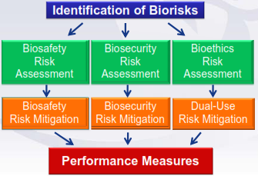

Slide 14
Key Messages III
A range of complimentary mitigation options have been put forward by stakeholders to manage dual-use risks.
Dual-use risk mitigation strengthens biosafety and laboratory biosecurity mitigation measures.
Including bioethics and dual-use into biorisk management will strengthen laboratory performance.

Slide 15
Summary I
Life Science can be used for both peaceful and harmful purposes.
Life science is a multi-stakeholder issue and is influenced by external social and political factors
Perceptions of risk may differ from one group to another.
All risks need to be considered equally.
Security and development are two key values at stake when assessing dual-use risk.

Slide 16
The identification of Biorisks requires ethical consideration
Awareness, Safety and Security, Education, Accountability and Oversight are key dual-use risk mitigation principles
Bioethics and dual-use risk assessment, mitigation and performance strengthens Biorisk Management

Slide 17
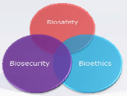
Biorisk Management is all about B³

Slide 18
Resources
World Health Organization. 2010. Responsible life sciences research for global health security: A guidance document. Geneva.
University of Bradford. Educational Module Resource. Available at: http://www.brad.ac.uk/bioethics/EducationalModuleResource/

