Slide 1
Analysis and Formulation of Problem Statement
Robert M. Karanja, PhD

Slide 2
Problem identification
prioritizing problems
Analysis justification studied?
What is the problem and why should it be studied?
Selection, analysis and statement of the research problemstudied?
What information is available?
Literature review
Literature and other available information studied?
Why do we want to carry out the research? What do we hope to achieve?
Formulation of research objectives
General and specific Objectives
hypotheses
What additional data do we need to meet our research objectives? How are we going to collect this information?
Research methodology
variables
types of study
data collection techniques
sampling
plan for data collection
plan for data processing
and analysis
ethical considerations
pre-test or pilot study
Who will do what, and when?
Work plan
Material support and equipment
Money
How will the project be administered? How will
utilisation of results be ensured?
Plan for project administration and utilisation
of results
administration
monitoring
identification of potential
users
How will we present our proposal to relevant authorities, community and the funding agencies?
Proposal summary
Briefing sessions and lobbying

Slide 3
Objectives
To analyze a selected problem and the factors influencing it
To establish scope and focus of the research problem
To formulate the statement of the problem for the research proposal outline you will be developing during the course

Slide 4
Analysis of Research Problem
Analysis is a very crucial step in designing the research through:
enabling those concerned to pool their knowledge of the problem
clarifying the problem and the possible factors that may be contributing to it, and
facilitating decisions concerning the focus and scope of the research
Requires a systematic analysis of the problem, completed jointly by the researchers, health workers, managers and community representatives

Slide 5
Overview of Problem Analysis Process
List all perceived concerns in selected problem area
Clarify/restate the various inputs for better understanding i.e.
what is the discrepancy between reality and desired ideal?
Identify the core problem, i.e. articulate in 1 sentence:
Nature of problem i.e the discrepancy
Distribution of problem i.e. who is affected, when, where?
Magnitude and intensity of problem i.e how widespread, severe and consequences e.g. mortality, DALYs etc

Slide 6
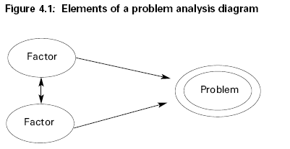
Overview of Problem Analysis Process
Conduct iterative brainstorming sessions to identify causes of problem, how they relate to each other and to the problem depicted diagrammatically e.g.

Slide 7
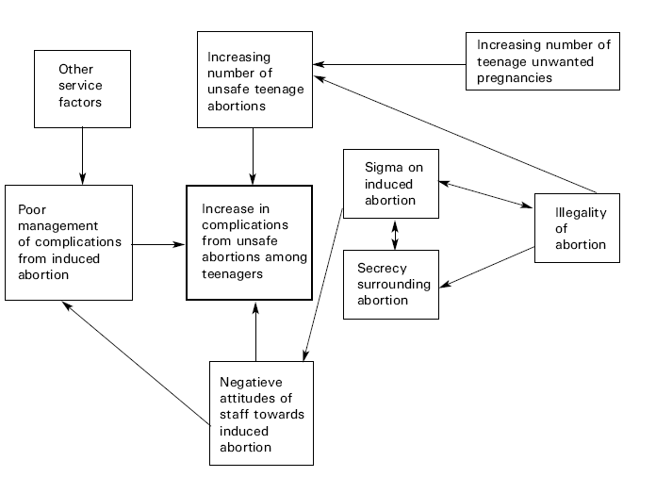
Example: Fig 4.2 – Initial problem diagram on complications from unsafe abortions among teenagers

Slide 8
Characteristics of Good Research Questions
There is perceived difference/discrepancy between reality vs. ideal or planned situation
Reasons for the discrepancy are poorly understood
There exists more than one possible answer to a question or more than one solution to the problem

Slide 9
Practical example: TB non compliance
??

Slide 10
Prioritization of Research Problems
Criteria for selecting of research problem:
Relevance – magnitude, distribution, severity
Avoidance of duplication
Urgency of data needed (timeliness)
Political acceptability of study – early policy makers involvement/feedback
Feasibility of study – HR, $$, complexity
Applicability of results
Ethical acceptability
Rating of 1 to 3 for each criteria

Slide 11
Problem statement
Refer to yesterday’s exercise on community insurance scheme and suicides

