Slide 1
EXPERIMENTAL STUDY DESIGNS
Erastus K. Njeru
School of Public Health &
Clinical Epidemiology Unit
University of Nairobi

Slide 2
Learning Objectives
By the end of the session, participants will be able to:
Define experimental studies
State conditions for use of experimental studies
State the characteristics, indications, strengths, and limitations of experimental studies

Slide 3
Progress in the research priorities and conducting health research

Slide 4
Problem identification
prioritizing problems
Analysis justification studied?
What is the problem and why should it be studied?
Selection, analysis and statement of the research problemstudied?
What information is available?
Literature review
Literature and other available information studied?
Why do we want to carry out the research? What do we hope to achieve?
Formulation of research objectives
General and specific Objectives
hypotheses
What additional data do we need to meet our research objectives? How are we going to collect this information?
Research methodology
variables
types of study
data collection techniques
sampling
plan for data collection
plan for data processing
and analysis
ethical considerations
pre-test or pilot study
Who will do what, and when?
Work plan
Material support and equipment
Money
How will the project be administered? How will
utilisation of results be ensured?
Plan for project administration and utilisation
of results
administration
monitoring
identification of potential
users
How will we present our proposal to relevant authorities, community and the funding agencies?
Proposal summary
Briefing sessions and lobbying

Slide 5
Quantitative Research Designs
Broadly:
Observational
Researcher does not manipulate study factor (no intervention) – observes!
Experimental
Study factor (intervention) is manipulated
True Experiment (Researcher allocates subjects to groups)
Quasi-experiment (subjects not allocated by researcher)

Slide 6
Experimental study
Definition:
Prospective study comparing the effect and value of intervention technique(s) against a control in human subjects
Also known as Interventions or Trials
Clinical
Field

Slide 7
EXPERIMENTAL STUDIES
Two main categories of intervention studies:
Experimental (true)
Quasi-experimental

Slide 8
EXPERIMENTAL STUDIES
Subjects randomly assigned to ‘intervention’ or ‘non-intervention’ groups by researcher
Non-intervention should include ‘standard’
Gold standard (most reliable) for proof of causality

Slide 10
Important characteristics
Randomization:
eliminates the effect of confounding variables through the equal distribution of confounders (both known and unknown) in the experimental and control groups.
Control group(s):
Greater confidence that outcomes / outcome levels observed in experimental group are due to factor manipulated.

Slide 11
Important characteristics
Masking (Blinding used previously, not sensitive to visually impaired) - Reduces bias
Single Blind - Only the investigator is aware of which intervention each subject is receiving.
Double Blind - Neither the subjects nor the investigators responsible for following the subjects know the identity of the intervention assignment.
Triple-Blind - An extension of the double-blind design; the committee monitoring response variables is not told the identity of the groups.
Notes:
Even if the study participants and study personnel can’t be blinded, the people analysing the results should be.

Slide 12
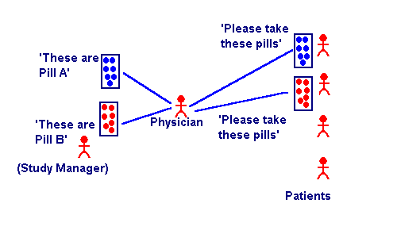
The Double Blind Method

Slide 13
DESIGN STRATEGIES
Randomized Controlled Trial – Study with intervention and a control groups; the assignment of the subject to a group is determined by formal procedure of randomization
Crossover Design - Special case of a RCT; allows each subject to serve as his/her own control the order in which the intervention and the control treatments are given is randomized

Slide 14
DESIGN STRATEGIES
Withdrawal studies - subjects on a particular treatment are taken off or have the dosage reduced
Factorial design - evaluates two interventions compared to control in a single experiment.

Slide 15
DESIGN STRATEGIES
Equivalency studies / trials with positive control - objective is to test whether a new intervention is as good as an established one
Group allocation/ Cluster randomization design - group of individuals, a clinic, or a community is randomized to a particular intervention or control.

Slide 16
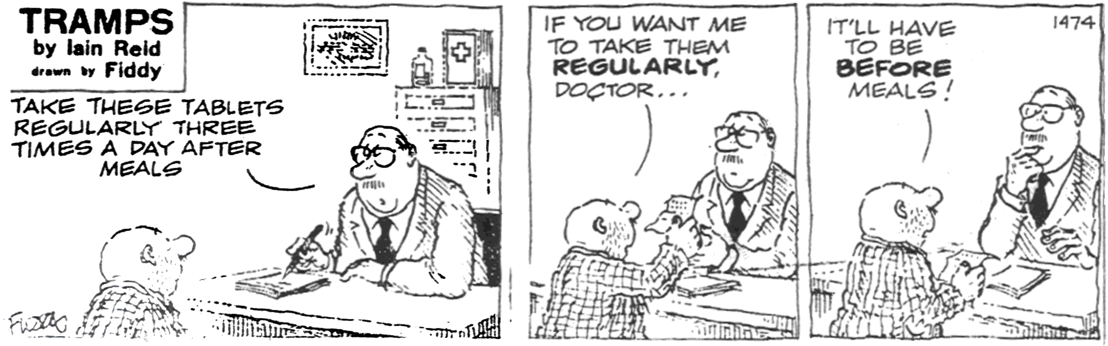
BE CAUTIOUS ABOUT YOUR SETTING

