Slide 1
CASE CONTROL STUDY DESIGN
Erastus K. Njeru
School of Public Health &
Clinical Epidemiology Unit
University of Nairobi

Slide 2
Learning Objectives
By the end of the session, participants will be able to:
Define conditions for use of case control studies
State conditions for use of case control studies
State the characteristics, indications, strengths, and limitations of case control studies

Slide 3
Quantitative Research Designs
Broadly:
Observational
Researcher does not manipulate study factor (no intervention) – observes!
Experimental
Study factor (intervention) is manipulated
True Experiment (Researcher allocates subjects to groups)
Quasi-experiment (subjects not allocated by researcher)

Slide 4
OBSERVATIONAL STUDIES
Descriptive Analytical (Comparative)
• Case reports • Case-control
• Case series • Cohort
• Correlational (ecological)
• Cross-sectional

Slide 5
Case-Control studies
Question answered: “What happened?”
Matching needed for controls
Might be difficult to differentiate from Case Series (Both are after the fact)
Ask if the goal was to describe a phenomenon, if description is the goal → Case Series

Slide 6
Case Control Studies
At least two groups – cases, controls
Strongest design for questions of cause (etiology) “What could have caused this situation?”
Retrospective
In analysis, compare the prevalence of risk factor between cases and controls

Slide 7
Case Control studies
Subjects with characteristic of interest matched with “controls:”
Identical subjects without that characteristic
Identical subjects with a different disease
General population
Data collected by recall surveys or records
Must be careful on mis-classification

Slide 8
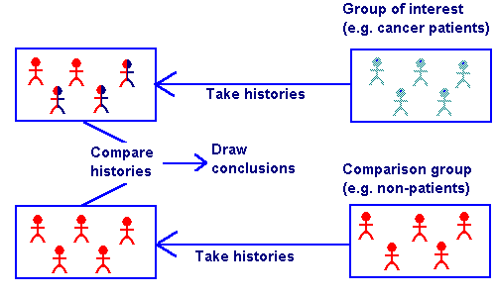
Case Control Studies

Slide 9
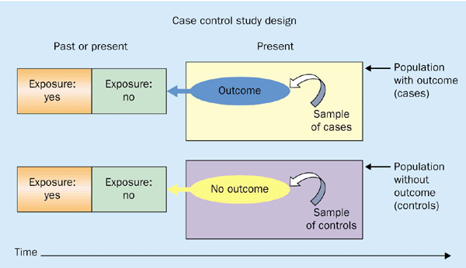
Case-control Studies: research in reverse

Slide 10
Example
Association between smoking and lung cancer
People with lung cancer are enrolled to form the case group, and people without lung cancer are identified as controls
Researchers then look back in time to ascertain each person's exposure status (smoking history), (retrospective design).
Analysis done by comparing frequency of smoking exposure in the case group with that in the control group, and calculating a measure of association.

