Slide 1
COHORT STUDY DESIGN
Erastus K. Njeru
School of Public Health &
Clinical Epidemiology Unit
University of Nairobi

Slide 2
Learning Objectives
By the end of the session, participants will be able to:
Define conditions for use of cohort studies
State conditions for use of cohort studies
State the characteristics, indications, strengths, and limitations of cohort studies

Slide 3
Quantitative Research Designs
Broadly:
Observational
Researcher does not manipulate study factor (no intervention) – observes!
Experimental
Study factor (intervention) is manipulated
True Experiment (Researcher allocates subjects to groups)
Quasi-experiment (subjects not allocated by researcher)

Slide 4
OBSERVATIONAL STUDIES
Descriptive Analytical (Comparative)
• Case reports • Case-control
• Case series • Cohort
• Correlational (ecological)
• Cross-sectional

Slide 5
Cohort Studies
Used to answer the question “What will happen?”
Prospective/forward
May also be retrospective cohort (Historical Cohort) – uses prospective records
used to establish causation of a disease or to evaluate the outcome/impact of treatment, when randomized controlled clinical trials are not possible

Slide 6
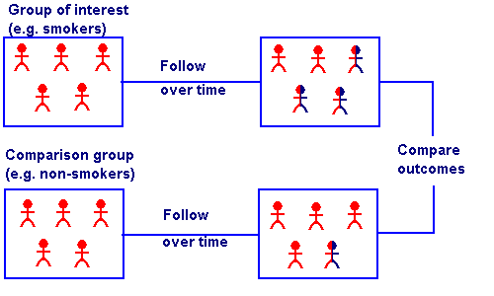
Cohort Studies

Slide 7
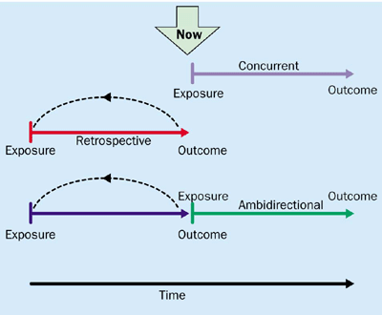
Cohort studies: marching towards outcomes
Lancet 2002; 359: 341-45
The defining characteristic of all cohort studies is that they track people forward in time from exposure to outcome. Data collection may be prospective or retrospective. Ex. Contraceptives and DVT.

