Slide 1
Laboratory Management of a Quality System
Module 2:
Overview of Quality Systems

Slide 2
ACKNOWLEDGEMENTS
Ministry of Health and Social Welfare – Tanzania
Muhimbili University of Health and Allied Science
World Bank
ECSA- HC

Slide 3
Learning Objectives
Describe the importance of quality systems
List four components of a total quality management system
Identify twelve quality system essentials
Describe the laboratory’s path of workflow

Slide 4
Today’s Agenda
Systems Overview
Total Quality Management
Quality Systems Essentials
QSE Activities
Quality Organization
Module Summary

Slide 5
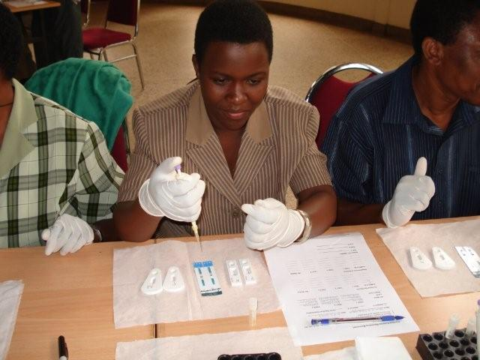
Systems Overview
The laboratory is a system
The laboratory is also an
important part of the entire
patient care system
The outputs of one system
are often the inputs of another
system

Slide 6
Patient Care System
        Hospital system
Laboratory
System
Blood Bank
System
Medical
Staff
Patient
Registration
Radiology
System
Pharmacy
System
Patient
Care Unit
Outpatient
Services

Slide 7
What is a Quality System?
Organizational structures, resources, processes, and procedures needed to implement a quality product or service
Systems approach ensures the quality of the entire laboratory system of processes
Doing the right thing right, the first time and every time

Slide 8
Quality Systems Approaches
Purpose is to provide quality system models for healthcare and laboratories
ISO 15189 – International Organization for Standardization
  Provides guidance for quality in laboratories; can be used for laboratory accreditation
CLSI GP26-A3– Clinical Laboratory Standards Institute
  Provides guidance on quality systems for laboratory services

Slide 9

What questions do you have so far?

Slide 10
Today’s Agenda
Systems Overview
Total Quality Management
Quality Systems Essentials
QSE Activities
Quality Organization
Module Summary

Slide 11
Total Quality Management (TQM)
ISO 9001 Definition:
“Coordinated activities to direct and control an organization with regard to quality”
NCCLS (CLSI) Definition:
“A management approach centered on sustained high quality by focusing on long-term success through customer satisfaction”
ISO 15189 contains many of the requirements of ISO 9001:2000 with sector-specific guidance for laboratories

Slide 12
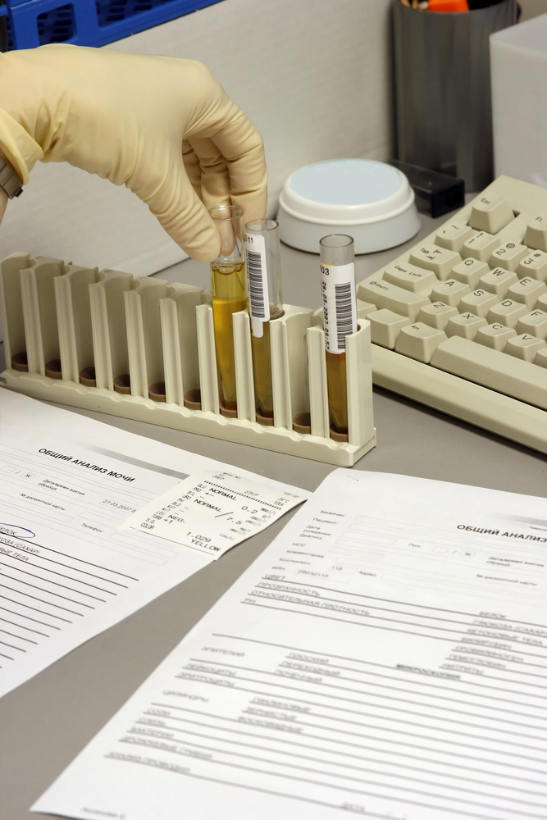
What is the Purpose of TQM?
It builds quality into every
work process and procedure
It prevents medical errors
that can harm patients
It saves money by preventing
failures

Slide 13
TQM Quality Hierarchy
TQM
Quality
Systems
Quality
Assurance
Quality
Control

Slide 14
Quality Control
Main focus is on analytical process control
Set of procedures for continuously assessing the quality of laboratory results using internal quality control samples
Operational techniques

Slide 15
Quality Assurance
Planned and systematic activities to assure quality and reliability of the entire testing process from test order to test interpretation
Includes pre-analytical, analytical, and post-analytical quality assurance monitors

Slide 16












The Quality Assurance Cycle
Pre-Analytic
Patient/Client Prep
Sample Collection
Personnel Competency
Test Evaluations
Reporting
Data and Lab Management
Safety
Customer Service
Post-Analytic
Sample Receipt and Accessioning
Record
Keeping
Quality
Control
Sample
Transport
Testing
Evaluation
Analytic

Slide 17

Laboratory Quality Systems
Organization
Personnel
Equipment
Process Control QC & Specimen Management
Information Management
Purchasing & Inventory
Documents & Records
Occurrence Management
Assessment
Process Improvement
Customer Service
Facilities & Safety

Slide 18

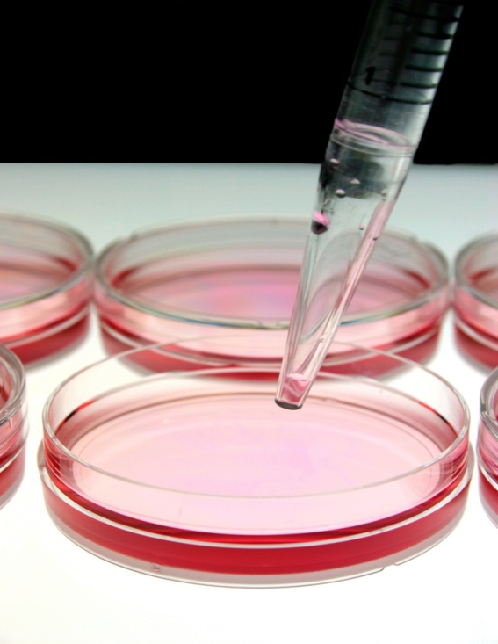

Total Quality Management
Coordinated activities to direct and control an organization with regard to quality

Slide 19
What questions do you have on
total quality management?

Slide 20
What questions do you have on
total quality management?

Slide 21
Today’s Agenda
Systems Overview
Total Quality Management
Quality Systems Essentials
QSE Activities
Quality Organization
Module Summary

Slide 22
Quality System Essentials (QSE)
Organization
Personnel
Equipment
Purchasing and Inventory
Process Control
Information Management
Document and Record Control

Slide 23
Quality System Essentials (Continued)
Occurrence Management
Assessment
Process Improvement
Customer Service
Facilities and Safety

Slide 24
Quality Systems Essentials
Apply to all processes in the laboratory workflow
Provide the building blocks of quality
Constitute the manager’s “procedure manual”

Slide 25
What questions do you have on quality systems essentials so far?

Slide 26
Today’s Agenda
Systems Overview
Total Quality Management
Quality Systems Essentials
QSE Activities
Quality Organization
Module Summary

Slide 27
QSE - Specimen Management Process
Organization
Personnel
Equipment
Process Control
Purchasing and Inventory
Information Management
Document and Record Control
Occurrence Management
Internal Assessment
Process Improvement
Service and Satisfaction
Facilities and Safety

Slide 28
QSE Example:
Specimen Management Workflow
Organization – Define the organizational structure within the specimen procurement department. Define qualifications, roles and job descriptions for the phlebotomist and supervisor.
Personnel – Create orientation and training programs that focus on the core competencies for phlebotomy.

Slide 29
QSE Example: (Continued)
Specimen Management Workflow
Equipment – Provide specimen collection equipment that meets the quality standards of the organization such as blood draw tubes/needles, and sharps disposal containers.
Purchasing/Inventory – Develop a system to track and store supplies.

Slide 30
QSE Example: (Continued)
Specimen Management Workflow
Process Control – Use standardized patient identification and labeling SOPs; define collection tube handling procedures; measure phlebotomy performance against standards and procedures through observation of the process; define reasons for specimen rejection and redraw.
Occurrence Management – Document and investigate all specimen errors and phlebotomy incidents with corrective actions taken.

Slide 31
QSE Example: (Continued)
Specimen Management Workflow
Information Management – Develop policies that address patient confidentiality and privacy issues. Develop a system that tracks the specimen from order entry to result reporting.
Document and Record Control – Develop a procedure that outlines the storage, retrieval and destruction of specimen collection forms.

Slide 32
QSE Example: (Continued)
Specimen Management Workflow
Internal Assessment – Define criteria that are used periodically to assess the quality of the specimen collection process. Collect the data and report the results to management.
Process Improvement – Evaluate the data from occurrence reports and modify identified procedures that will result in an improvement in specimen collection processes.

Slide 33
QSE Example: (Continued)
Specimen Management Workflow
Customer Service – Develop a customer survey that measures the patient’s satisfaction with the phlebotomy procedure.
Facilities and Safety – Establish a procedure to assure that the phlebotomy section meets safety and regulatory standards.

Slide 34
Activity: QSE Based Process
Work in groups of four
How do we apply QSE principles to the hematology analyzer process?

Slide 35
QSE for the Hematology Analyzer
Organization
Personnel
Equipment
Process Control
Purchasing and Inventory
Information Management
Document and Record Control
Occurrence Management
Internal Assessment
Process Improvement
Service and Satisfaction
Facilities and Safety

Slide 36
QSE Example:
Automated CBC Process
Organization – Define the roles in Hematology – particularly the quality assurance tech role and supervisor role
Personnel – Define the instrument orientation training checklist, core competencies, and competency assessment (for example: interpreting data, and calibrating instrument)
Equipment – Define a decision matrix for instrument selection; define SOPs for calibration and maintenance

Slide 37
QSE Example: Automated CBC Process (Continued)
Process Control – Define instrument validation procedures; write quality control policy and procedures; enroll in PT or other EQA; write and enforce criteria for specimen rejection
Supplies – Define a good vendor relationship and inventory management process. Monitor critical supply levels.

Slide 38
QSE Example: Automated CBC Process (Continued)
Information Management – Develop policies that address patient confidentiality and privacy issues to ensure results are reported to authorized individuals only. Develop a system for reporting lab results including critical hematology results.
Document and Record Control – Develop a procedure that outlines the storage, retrieval, and destruction of hematology reports. Maintain instrument maintenance and function check logs.

Slide 39
QSE Example: Automated CBC Process (Continued)
Occurrence Management – Document all instrument malfunctions/failures, complaints, and quality assurance problems in an occurrence log and have quality assurance tech and management investigate. Take corrective action.
Internal Assessment – Define quality control criteria used to regularly assess analyzer operations. Collect and review data. Report the results to management.

Slide 40
QSE Example: Automated CBC Process (Continued)
Process Improvement – Evaluate the data from occurrence reports. Modify procedures to decrease the number of erroneous hematology report results.

Slide 41
QSE Example: Automated CBC Process (Continued)
Customer Service – Develop a customer survey to measure the physician satisfaction with the turnaround time for receiving hematology results.
Facilities and Safety – Develop a procedure to properly dispose of analyzer biohazard waste.

Slide 42
What questions do you have on applying quality systems essentials to common lab processes?

Slide 43
Quality Organization
A written plan for quality defined
Leadership commitment – management commits to this approach and commits sufficient resources
Roles in quality are defined from quality coordinator to bench staff – all staff must commit to follow quality assurance/control procedures
All staff are trained on the quality plan

Slide 44
What questions do you have on developing a
quality organization?

Slide 45
Module Summary
Described the importance of quality systems
Listed the components of a total quality management system
Identified the quality system essentials
Described the laboratory’s path of workflow

Slide 46
What questions or suggestions do you have on the Overview of Quality Systems?

Slide 47
Thank you

