Slide 1
Laboratory Management of a Quality System
Module 3: Personal management

Slide 2
ACKNOWLEDGEMENTS
Ministry of Health and Social Welfare – Tanzania
Muhimbili University of Health and Allied Sciences
World Bank
ECSA- HC

Slide 3
Learning Objectives
After completing this module, you will be able to:
Describe each of the personnel management functions in a laboratory
Develop orientation and training checklists
Define key competencies for staff
Develop a competency assessment program for the laboratory
Develop staffing plans and schedules for the laboratory

Slide 4
Today’s Agenda
The Quality System
Personnel Management
  Recruitment & Selection
  Position & Job Description
  Training and Orientation
  Competency Assessment
  Performance Management
  Continuing Education
  Staffing and Scheduling
Module Summary

Slide 5

The Quality System
Organization
Personnel
Equipment
Process Control QC & Specimen Management
Information Management
Purchasing & Inventory
Documents & Records
Occurrence Management
Assessment
Process Improvement
Customer Service
Facilities & Safety

Slide 6
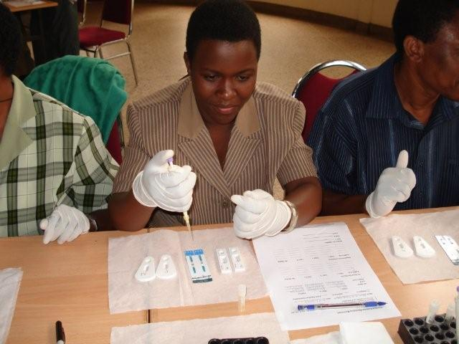
The Laboratory Staff
Well trained laboratory staff
are the most important part
of a quality system and are
the laboratory’s greatest asset
Success of a quality system is dependent on:
  Staff knowledge and skills
  Staff motivation and commitment to following the quality system process

Slide 7
Human Resource Planning
Within a quality system, management must assess the total job to be done to achieve the goals of the organization and determine:
  What knowledge and skills are needed?
  How many people with each skill set?
  When are they needed?
  How will they be scheduled?
  How will they be supervised?

Slide 8

Are there any questions?

Slide 9
Today’s Agenda
The Quality System
Personnel Management
  Recruitment & Selection
  Position & Job Description
  Training and Orientation
  Competency Assessment
  Performance Management
  Continuing Education
  Staffing and Scheduling
Module Summary

Slide 10
Personnel Management
Personnel Recruitment
and Selection
Position/Job Descriptions
Training and Orientation
Competency Assessment

Slide 11

Personnel Management (Continued)
Performance Management
  Performance Standards
  Coaching and Counseling
  Discipline
  Performance Review
Continuing Education
Staffing and Scheduling

Slide 12
Today’s Agenda
The Quality System
Personnel Management
  Recruitment & Selection
  Position & Job Description
  Training and Orientation
  Competency Assessment
  Performance Management
  Continuing Education
  Staffing and Scheduling
Module Summary

Slide 13
Personnel Recruitment
Schools
On-the-job training (certain skills)
Advertisements
Family and friends
Vendors
Other Laboratorians

Slide 14
Staffing Needs Assessment
Identify job to be done-gap in service delivery
Identify skill set needed
Determine hours needed to fulfill needs (part vs. full time/days or evening)

Slide 15
Personnel Selection
Process to determine employee fit and qualifications for the position
  Determine what they can do
  Determine how willing are they to do it
Tools - application/CV, job description, assessment tools, and interviews

Slide 16
Personnel Selection (Continued)
Obtain CV or application
Review for posted qualifications
  Level of education
  Training required by the MOH
Interview to verify what they can do and their motivation to do the job
Obtain references
  Previous employers, co-workers or instructors

Slide 17
Interview Process
Assess technical skills
  Problem-solving
  Manipulation skills (e.g.. pipetting)
  Mathematical
Assess non-technical skills such as:
  Communications
  (written and oral)
  Customer Service
  Commitment
  Color-blindness

Slide 18
Sample Interview Questions
Describe a QC problem that you solved independently.
Describe the last time you did more than was required by your job.
Describe a time when you were presented with a problem you could not solve.

Slide 19
Job Descriptions
Perform task analysis and define job duties for each job that needs to be accomplished in the laboratory
Then write a job description that will:
  Describe the job tasks to be done
  Define what will be done, not how well
  Define why the job exists in the job summary
  Define principal duties and accountabilities including QA / QC duties

Slide 20
Job Descriptions (Continued)
Job descriptions also need to define:
  Education and experience required (define minimum required for the job)
  Special physical and mental requirements
  The amount of authority and reporting structure
Job descriptions must be reviewed annually to keep current

Slide 21
Uses of Job Descriptions
Use
Purpose
Selection
Compensation
Used to evaluate if applicants meet basic requirements
Used in defining compensation level for each position

Slide 22
Uses of Job Descriptions (Continued)
use
Purpose
Performance management
Lab Organization
Sets expectations and helps employee understand their duties
Used to define roles and responsibilities in the organization

Slide 23
What questions do you have about job descriptions?

Slide 24
Today’s Agenda
The Quality System
Personnel Management
  Recruitment & Selection
  Position & Job Description
  Training and Orientation
  Competency Assessment
  Performance Management
  Continuing Education
  Staffing and Scheduling
Module Summary

Slide 25
Orientation Process
Orientation is the process of introducing a new staff member to the new work environment and tasks / duties
An Orientation Checklist is used to ensure every new staff member receives the same information
At the end of orientation, complete initial competency assessment to assess capability

Slide 26
Orientation Checklist
Explain the lab’s role in support of organizational goals
Review the job description
Review performance expectations such as customer service and others
Tour the work area and introduce to all management and staff
Show where all manuals and resources are kept

Slide 27
Orientation Checklist (Continued)
Review and sign for all procedures and policies including safety
Explain performance evaluation process
Review quality system essentials and QA responsibilities
Assign a trainer
Train on all methods and equipment including safety equipment

Slide 28
Employee Training – When?
During orientation
Based on defined needs
  Example: new instrument or method introduced
Based on competency issues
  Example: identified by competency assessment
Ongoing – continuing education

Slide 29
Quality Training
Training is an important element in a quality system
Quality training follows a systematic and prescribed process
Training guides, checklists, and just-in-time training modules ensure training is consistent

Slide 30
Discussion
What kind of training do you perform?
How do you train employees on a new procedure?

Slide 31
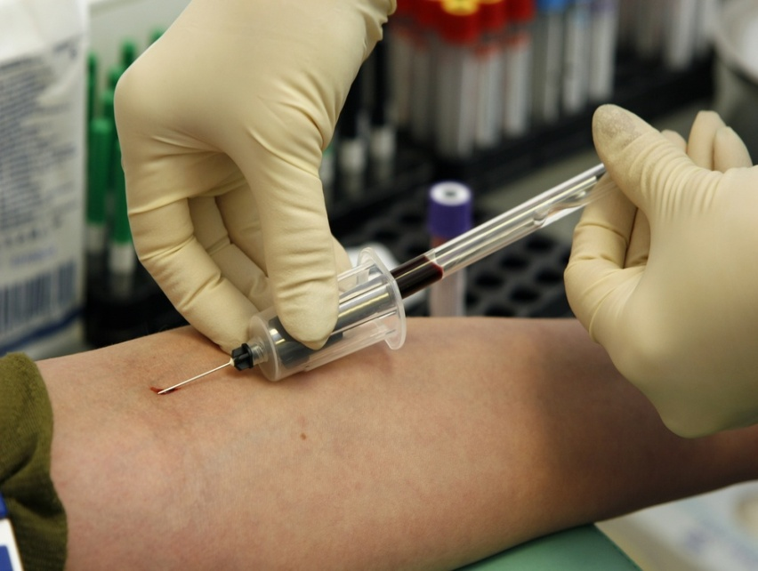
Competency Based Training
Designed to help employees
develop skills to perform specific
job tasks
Uses SOPs and job-
related documents
Measures training
outcomes using
competency assessment

Slide 32
What questions do you have about employee orientation, training, and competency-based training?

Slide 33
Today’s Agenda
The Quality System
Personnel Management
  Recruitment & Selection
  Position & Job Description
  Training and Orientation
  Competency Assessment
  Performance Management
  Continuing Education
  Staffing and Scheduling
Module Summary

Slide 34
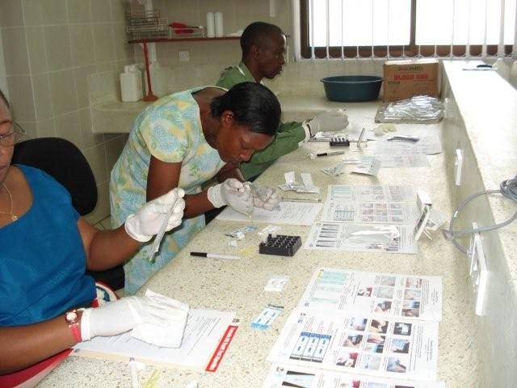
Competency
What is competency?
How is it measured?

Slide 35
What is Competency?
Competency – having the essential ability to perform specific tasks that are part of the total testing process
Important competencies – those competencies that are important to job performance and have an important impact on quality of care

Slide 36
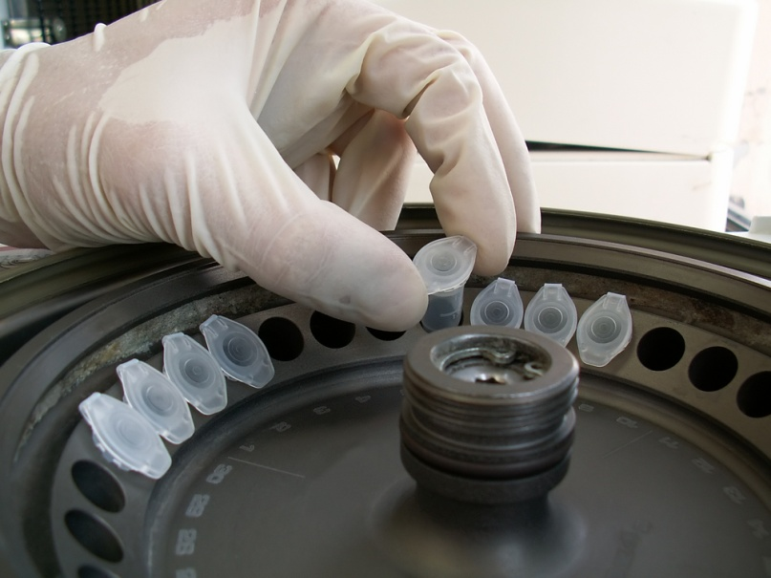
E.g.: Accessioning Competencies When Processing Specimens
Logs in all specimens and
assigns unique identifying
number (accession number)
to all specimens
Follows specimen
rejection policy and
rejects specimens appropriately
Spins specimens appropriately at correct time and speed of centrifugation

Slide 37
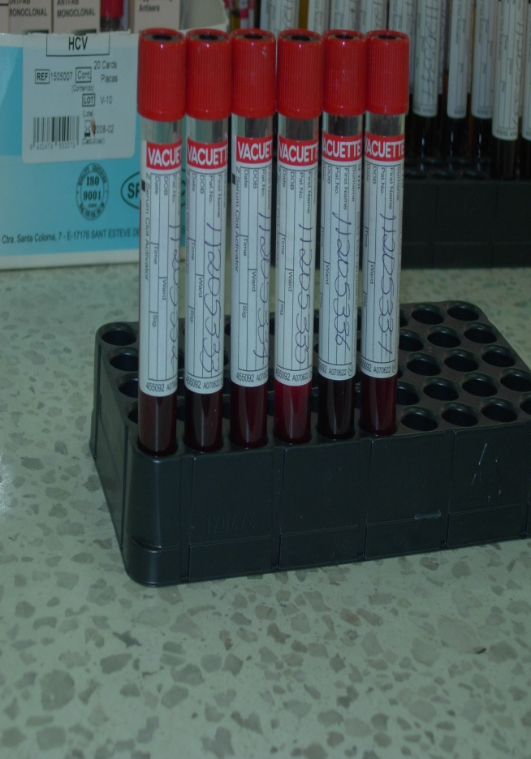
E.g.: Phlebotomy Competencies
Properly identify the patient:
use two identifiers
Label all specimens with
complete patient information
immediately after the specimen
is drawn

Slide 38

E.g.: Technologist Competencies
Notify clinician of critical
results/panic values
Keeps current on all
new and revised policies
and adheres to defined
procedures at all times

Slide 39

E.g.: Technologist Competencies
(Continued)
Ensures all quality control and
maintenance are performed on
schedule.
Assures QC data are within
acceptable limits
Identifies unsuitable specimens
and notifies the clinician for recollection.
Documents appropriately on laboratory reports

Slide 40
How is Competency Measured?
Competency Assessment – a process for determining and documenting the ability of personnel to perform specific key job duties

Slide 41
Competency Assessment Process
Develop a written policy on competency assessment that identifies when, what, and how competency will be assessed
Identify important competencies for each process in the laboratory
Develop competency assessment checklists
Review policy at least annually
Communicate the policy to all staff

Slide 42
Competency Assessment Policy
Example of when the assessment will occur?
  Initially after orientation on new staff and at least annually on current staff or with introduction of new methods
Example of what will be assessed?
  Every important job task and procedure performed (pre-analytical, analytical, and post-analytical)

Slide 43
Competency Assessment Policy
Example of how the assessment is done?
  Based on skill assessment of important competencies (those competencies important to the job and that have a direct impact on quality patient care)
  SOPs reviewed and knowledge assessed
  Direct observation of performance including trouble-shooting or problem solving capability

Slide 44
Competency Assessment Policy (Continued)
Example of how the assessment is done?
  Review of outcomes of performance such as proficiency testing, quality control, maintenance logs, and patient testing
  “Blind” testing of samples and slides
  Case studies and situation-based problem solving
  (written exercises)

Slide 45
Establishing a Competency Program
Prepare a schedule for assessing each employee
Prepare a checklist of the important
competencies
Determine assessment method
Document and evaluate results
Take remedial/corrective action
Have a plan for addressing competency problems

Slide 46
Group Work –
Competency Assessment
Work in pairs to identify at least 3 important competencies for chemistry QC
Develop how you would assess these competencies

Slide 47
What questions do you have about competency, or the competency assessment process?

Slide 48
Today’s Agenda
The Quality System
Personnel Management
  Recruitment & Selection
  Position & Job Description
  Training and Orientation
  Competency Assessment
  Performance Management
  Continuing Education
  Staffing and Scheduling
Module Summary

Slide 49
Causes of Performance Failure
Inadequate initial orientation
Inadequate training
Equipment or method problem
Sample problem
Poor documented procedures or failure to follow procedures
Difficulty changing behavior

Slide 50
Competency Based
Human Resources Strategy
Effective…
  Selection Process
  Orientation and Training
  Competency Assessment
  Performance Management
  Rewards Strategy
  Recognition Strategy
…enhances retention of
highly skilled laboratory staff

Slide 51

Performance Management
Set and communicate achievable, realistic performance expectations/standards
Define expected performance in the
areas of
  technical tasks
  communications
  work habits
  teamwork

Slide 52
Group Work – Performance
Work in pairs to define good performance in the following areas for your staff:
  technical
  communications
  work habits
  teamwork

Slide 53
Performance Management
Assess performance by observation and work sample
Provide effective feedback on areas that need improvement
Assure that poor performance is corrected
Reinforce and recognize good performance
Document all aspects of performance – positive and negative

Slide 54
Types of Feedback
Coaching – Feedback given to help an employee reach his/her maximum performance level (positive approach)
Counselling – Feedback given and often documented when employee must improve his/her performance (negative)

Slide 55
How to Give Feedback
Pick an appropriate time and
place (always in private)
Be specific and direct
Be descriptive, not judgmental
Point out positive aspects first
Direct feedback toward
improving behavior and stress impact of work on patient care, not toward person

Slide 56
Role Play – Giving Feedback
Supervisor discusses with a technologist a problem with his documentation of QC results.

Slide 57
Performance Appraisal
A system to assess overall performance on the standards (usually annually)
Evaluation is based on:
  Technical performance standards
  Customer service expectations
  Work habits
  Communication skills
  Organizational skills - safety

Slide 58
What questions do you have about performance management, giving feedback or the performance appraisal?

Slide 59
Today’s Agenda
The Quality System
Personnel Management
  Recruitment & Selection
  Position & Job Description
  Training and Orientation
  Competency Assessment
  Performance Management
  Continuing Education
  Staffing and Scheduling
Module Summary

Slide 60
Continuing Education
An educational program that brings staff up-to-date in a particular knowledge area
May be used to improve competency in certain problem areas
Important in maintaining laboratory quality and state of the art systems
Journal club, vendor support, or computer / online access
Make learning an expectation for everyone

Slide 61

Continuing Education and Competency Assessment
Focus continuing education
on staff needs based on
competency assessment.

Slide 62
Today’s Agenda
The Quality System
Personnel Management
  Recruitment & Selection
  Position & Job Description
  Training and Orientation
  Competency Assessment
  Performance Management
  Continuing Education
  Staffing and Scheduling
Module Summary

Slide 63
Do you have any questions about staffing and scheduling?

Slide 64

Staffing & Scheduling Model
Purpose – to define the
number and skill mix of
staff needed for the
workload
Skill mix defines the
proper mix of assistants,
technicians, and technologists
needed for efficient operation

Slide 65

Staffing & Scheduling Model (Continued)
Staffing model defines
the minimum number
of each type of
personnel needed for
each operating shift
Scheduling of each
shift of operation is
based on the staffing model

Slide 66

Staffing & Scheduling Model
(Continued)
Factors to consider:
  Daily workload
  Complexity
  Working hours of lab
  Space
  Urgent vs routine
  Manual vs automated
  Skill level
  Training: new employees, students

Slide 67
Group Work – Staffing
Work in pairs
Discuss a staffing challenge at your lab?
Discuss how you have tried to address it?

Slide 68
Case Study Scheduling
Your outpatient facility sees 60 patients from 0700 to 1700 hours per day.
Your lab is drawing the patients and running ART testing in Hematology, Chemistry, Flow Cytometry on automated instruments on each patient.
Prepare a staffing schedule for this laboratory for one week.

Slide 69
Today’s Agenda
The Quality System
Personnel Management
  Recruitment & Selection
  Job Description
  Training and Orientation
  Competency Assessment
  Performance Management
  Continuing Education
  Staffing and Scheduling
Module Summary

Slide 70
Summary: Personnel Management
Recruitment and Selection
Job Descriptions
Training and Orientation
Competency Assessment
Performance Management
Continuing Education
Staffing and Scheduling

Slide 71
Summary: Personnel Files
Employment record including CV and application
Orientation and Competency Records
Performance Documentation
Performance Appraisal
Personnel Actions
Job Description and Performance Standards
Continuing Education Records
Work Injury Records

Slide 72
What questions do you have on the Quality System and Personnel Management?

Slide 73
THANK YOU

