Slide 1
Laboratory Management of a Quality System
Module 5: Laboratory Process Management

Slide 2
ACKNOWLEDGEMENT
Ministry of Health and Social Welfare – Tanzania
Muhimbili University of Health and Allied Sciences
World Bank
ECSA- HC

Slide 3
Learning Objectives
Describe the major process control activities in the laboratory
Describe process control measures for specimen management
List the components of a method validation
Implement and manage a comprehensive quality control system in the laboratory

Slide 4
Learning Objectives (Continued)
List the components of a well-written Quality Control (QC) guidelines
Explain the advantages and disadvantages of the different options for QC rules
Evaluate and interpret a variety of QC problems
Design and implement an effective process improvement project

Slide 5
Today’s Agenda
The Quality System
Process Design
Process Control
  Specimen Management
  Method Validation
  Quality Control
Process Standardization and Audits
Process Improvement
Module Summary

Slide 6

The Quality System
Organization
Personnel
Equipment
Process Control QC & Specimen Management
Information Management
Purchasing & Inventory
Documents & Records
Occurrence Management
Assessment
Process Improvement
Customer Service
Facilities & Safety

Slide 7
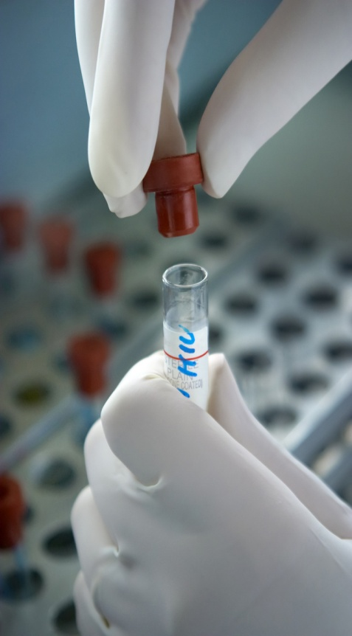
The Laboratory Processes
Processes within a quality system
are well defined and assure work
is performed the same way each time
Success of a quality system is
dependent on processes that:
  Make errors difficult to commit
  Make errors visible if committed

Slide 8
Managing Laboratory Processes
Design the process
Define process controls
  Specimen Management
  Method Validation
  Quality Control
Standardize the process
Audit the process periodically
Continuously improve the process

Slide 9

Any questions
so far?

Slide 10
Today’s Agenda
The Quality System
Process Design
Process Control
  Specimen Management
  Method Validation
  Quality Control
Process Standardization and Audits
Process Improvement
Module Summary

Slide 11
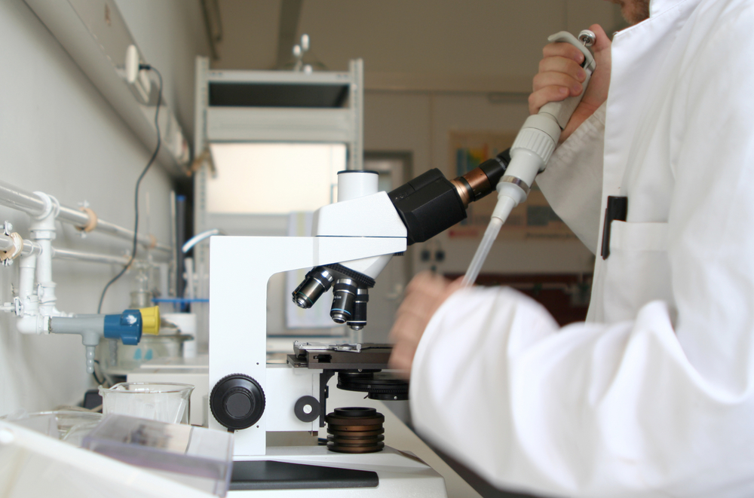
Process Design
Design good processes to
meet customer needs
Eliminate steps that do not
add value to the customer
Arrange equipment and
supplies close to staff to
eliminate time in motion

Slide 12

Process Design (Continued)
Plan workflow and
physical space to
enhance efficiency
Minimize number of
workstations
Mistake-proof processes
to minimize human error
Automate tasks where possible

Slide 13
Process Design Goals
Make errors difficult to commit
Make errors visible if committed

Slide 14
Mistake Proofing Phlebotomy
Double check patient identifiers with order form
Do NOT pre-label specimen container
Do NOT give an unlabeled specimen container to another individual to be labeled
Never leave the patient’s bedside without first checking to make sure all specimen containers are labeled
Each specimen label must legibly display:
  Initials of person who collected the specimen
  The date and time it was collected
  Patient Name and number

Slide 15
Exercise
Design a phlebotomy process that will insure quality for the customer and client.
Work in groups for 20 minutes followed by 10 minutes for discussion.

Slide 16
What questions do you have about process design?

Slide 17
Today’s Agenda
The Quality System
Process Design
Process Control
  Specimen Management
  Method Validation
  Quality Control
Process Standardization and Audits
Process Improvement
Module Summary

Slide 18
Process Control
Goal
  To assure work processes are performed the same way each time
Definition
  A set of control measures for the 3 phases
  of testing to assure quality of the entire
  laboratory process

Slide 19




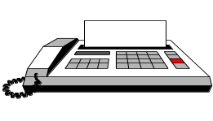







The Quality Assurance Cycle
Pre-Analytic
Patient/Client Prep
Sample Collection
Personnel Competency
Test Evaluations
Reporting
Data and Lab Management
Safety
Customer Service
Post-Analytic
Sample Receipt and Accessioning
Record
Keeping
Quality
Control
Sample
Transport
Testing
Evaluation
Analytic

Slide 20
Process Control Activities
Pre-analytic:
  Specimen collection and transport guidelines; criteria for acceptability of specimens
Analytic:
  Method evaluation and validation
  Calibration, calibration verification, periodic linearity checks

Slide 21
Process Control Activities (Continued)
Analytic (continued):
  Use of calibrator and control materials at defined frequencies for the method
  Quality control program with defined rules; performing and documenting corrective action
  Statistical evaluation of QC data; shifts and trends identified
  Repeat of questionable results

Slide 22
Process Control Activities (Continued)
Post-analytic
  Result review criteria and/or delta checks (limits set for significant change in results)
All Phases:
  Well written policies and procedures under document control
  Clear documentation of all steps

Slide 23

Major Process Control Activities
Specimen Management
Process/Method Validation
Quality Control
  Statistical Quality Control
  Reagent lot validation

Slide 24
What questions do you have on process controls so far?

Slide 25
Today’s Agenda
The Quality System
Process Design
Process Control
  Specimen Management
  Method Validation
  Quality Control
Process Standardization and Audits
Process Improvement
Module Summary

Slide 26
Specimen Management
Standardized patient identification procedures
Standardized specimen labeling procedure
Written specimen collection procedures with collection containers and handling procedures
Defined quality indicators for specimen collection and transport process
Written and enforced specimen rejection policies
Written procedures for situations requiring redraws

Slide 27
What questions do you have on specimen management?

Slide 28
Today’s Agenda
The Quality System
Process Design
Process Control
  Specimen Management
  Method Validation
  Quality Control
Process Standardization and Audits
Process Improvement
Module Summary
Notes:
Clinical laboratorians want some assurance that the results of tests they are reporting are” correct”.
Selection of a new method for any test in a clinical laboratory is a vital aspect for maintaining high –quality laboratory testing
The most difficult aspect of method evaluation is judging accuracy. Absolute accuracy is unknowable;however, in some instances, good estimates of truth are possible. For comparison studies a reference method or a well-accepted procedure exists that will serve as the anchor or comparative protocol for the new method.

Slide 29
Process/Method Validation
Process validation includes method evaluation and validation of pre-analytic and post-analytic processes
Prior to reporting test results, each method must have performance characteristics validated to assure the quality of the expected results

Slide 30
Process/Method Validation (Continued)
What is done?
  Precision Analysis
  Carryover Study
  Correlation Study
  Accuracy Assessment
  Linearity (Reportable range verification)
  Normal/Reference Range

Slide 31
Process/Method Validation (Continued)
How is it done?
  Laboratory can perform process validation but it is very time-consuming and requires special technical expertise
  Vendor may perform and document the performance aspects of the instrument during the evaluation
  Laboratory leaders must review and approve the method validation regardless of how it is done

Slide 32
What questions do you have on process validation?
Notes:
Note that some vendors aren’t very helpful even in the states to perform method validation during instrument set-up (noted at COLA meetings x 2 and Ethiopia) Vendor “may” perform?
Process Validation- a policy for process validation should include a written statement that new equipment, test methodologies, and computer system upgrades will undergo a validation process prior to performance of patient testing. Validation provides evidence and assurance that the process will perform to its predetermined specifications before patient testing is conducted. The quality procedure describes how a validation process is conducted and documented.

Slide 33
Today’s Agenda
The Quality System
Process Design
Process Control
  Specimen Management
  Method Validation
  Quality Control
Process Standardization and Audits
Process Improvement
Module Summary
Notes:
Quality Control guarantees the laboratory’s stated limits of precision with some reassurance of accuracy.
Quality control is a process of identification and documentation of analytical problems as they occur.

Slide 34
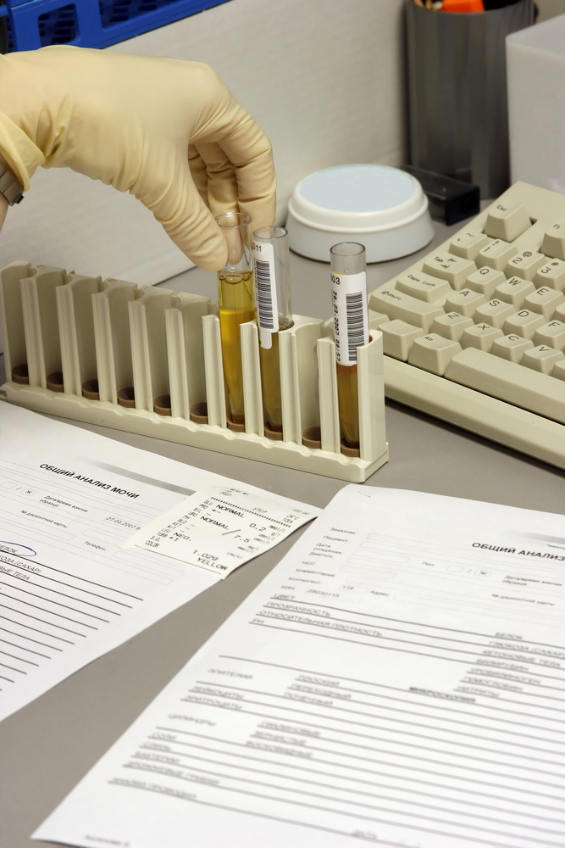
Quality Control
A set of procedures for
continuously assessing the
quality of laboratory results
Using quality control samples
Notes:
Questions what types of QC samples do you use?

Slide 35
Stable Control Materials
Commercial controls (assayed or unassayed)
Patient or employee controls (controls internally obtained)
Statistical measurement using patient data
Notes:
All test results call for a control procedure using test results from stable control materials, then plotting those qualitative or quantitative control observations on a control chart that has specified control limits to monitor over time to monitor for changes. If a qualitative or quantitative control fails to provide the expected result, the problem should be investigated and controls repeated before patient results are obtained. An occurrence log should be kept to document the incident and solution to the analytical problem.

Slide 36
Types of Quality Control
Qualitative – run at least one positive and negative control each day
Quantitative – run at least 2 controls (normal and abnormal) once per shift
Notes:
Qualitative test results need at least one positive and negative control analyzed and results recorded per day on a monthly chart.
Quantitative test results need at least two controls (normal and abnormal) analyzed and recorded once per shift on a monthly quantitative chart such as Levey-Jennings to monitor over time for precision and accuracy changes. The control results are monitored with data calculations using specified decision criteria or control rules.

Slide 37
Purpose for Quality Control
Why do it?
  Quality control is used to monitor the precision and the accuracy of the assay in order to provide reliable results
  Quality control statistics (i.e. Mean and SD) indicate whether observed results are within the expected limits of the analytical process

Slide 38
Precision
Reproducibility or closeness of results to each other
Notes:
The degree of fluctuation on repeated measurements is indicative of the “precision” of the assay.
Note these are not accurate as the closeness of measurements to the true value is indicative of the “accuracy” of the assay.
This is inaccurate, but is precise

Slide 39
Imprecision: Random Error
An unexpected and unpredictable error
For example, one control out of two control results exceeds 3 standard deviations from the mean

Slide 40
Accuracy
The closeness of the measured result to the true value
Notes:
This diagram is imprecise, but somewhat accurate. Comparison of bias from true value (z-score) helps to determine accuracy.

Slide 41
Inaccuracy: Systematic Error
Repeated error that occurs in a predictable manner
For example when two consecutive control values exceed the same mean +2s limit or the same mean -2s control limit
This rule is sensitive to shifts in the mean in which a sustained change either higher or lower would cause a new mean to be calculated if allowed to continue without resolving the problem
Notes:
Other quality control rules are set up to catch systematic errors, shifts or trends such as rejecting the 4th control result in a row that falls between 1 and 2s (4-1s) or the 10th result in a sustained direction between the mean and 2 s (10x).

Slide 42
Knowledge Check
A repeated error that occurs in a predictable way is an example of:
  Accuracy
  Inaccuracy
  Imprecision
  Precision
Notes:
ANSWER: INACCURACY

Slide 43
Knowledge Check
The closeness of a measured result to a true value is referred to as:
  Accuracy
  Standard Deviation
  Imprecision
  Precision
Notes:
Answer: Accuracy

Slide 44
Knowledge Check
An unexpected and unpredictable error is an example of:
  Accuracy
  Inaccuracy
  Random error
  Standard deviation
Notes:
Answer: Random error

Slide 45
Knowledge Check
Reproducibility or closeness of results to each other is referred to as:
  Accuracy
  Inaccuracy
  Imprecision
  Precision
Notes:
Answer: precision

Slide 46
Knowledge Check
What is the difference between a random
error and a systematic error?
Notes:
A random error is unexpected and unpredictable.
A systematic error repeats in a predictable way.

Slide 47
Knowledge Check
What is the difference between a random
error and a systematic error?
  A random error is unexpected and unpredictable
  A systematic error repeats in a predictable way.
Notes:
Correct Answer:
A random error is unexpected and unpredictable.
A systematic error repeats in a predictable way.

Slide 48
What questions do you have on Quality Control so far?

Slide 49
QC Program Management
Written quality control guidelines and procedures
Statistical evaluations to set quality control limits
Determination of QC rules to be used
Defined system for running, documenting, and charting QC data
Notes:
Helpful Hints: Check instrument manuals for their quality control procedures. Also the commercial quality control materials have product inserts that provide instructions.

Slide 50
QC Program Management (Continued)
Defined procedures for handling out-of-control situations
Procedures for troubleshooting of QC failures
Supervisory review of QC data and corrective actions

Slide 51
QC Program Management (Continued)
Written QC Guideline
Quality Control limits
QC Rules
QC Documentation
Out-Of-Control Procedures
QC Supervision

Slide 52
Written QC Guideline
Guidelines and procedures must be written to include:
Goals of the program
Type of quality control materials to be used
Internal or electronic QC allowed
Frequency of QC testing

Slide 53
Written QC Guideline (Continued)
Quality control rules for different assays
QC statistics and control limits
Tech review and acceptance of patient test results
Corrective action to be taken for out-of-control situations
Supervisor review of QC results

Slide 54
Quality Control Limits
Statistical evaluation process to set limits using mean and standard deviation
Manufacturers/supplier QC limits are determined from large groups of laboratories in order to provide information about the comparative performance between laboratories and between methods
These are cumulative control tolerance limits
Notes:
The standard deviation should be equal or larger than the standard deviation you would calculate from that control material, especially if your method was included in the cumulative results.

Slide 55
Calculate Quality Control Limits
  Given the mean and standard deviation (s) for a control material, control limits are calculated as the mean +/- a certain multiple of the standard deviation, such as 2s or 3s.
  For example: cholesterol Control 1 mean = 200 mg/dL, s = 4 mg/dL, 200 – (2x4) and 200 + (2x4); the 2s control limits would be 192 and 208 mg/dL.
  The 3s control limits would be 188 and 212 mg/dL as determined by 200 – (3x4) and 200 + (3x4).
  * Standard deviation may be abbreviated SD or s.
Notes:
Eliminate outliers and rejected results but include repeated results when calculating the next month’s control limits. Once the method is established, if the mean or standard deviation seems to be changing significantly each month, cumulative results (over the past 2 months or more) should be used to calculate the mean and SD for the quality control charts. This is commonly part of the QC programming in instruments such as the BD FASCOUNT.

Slide 56
QC Rules
Each analytic run is either accepted or rejected based on the control rules chosen to monitor quality control values
Control rules should be carefully selected to maximize error detection and minimize false rejection
Control rules will vary from method to method and will be based on the quality (allowable error) required by the test

Slide 57
QC Rules (Continued)
Options for QC rules:
  Simplest – if one control value is more than 3 SD from the mean value the run is rejected
  Complex – Multi-rule procedures developed by James Westgard
What rules are you currently using for your chemistry assays?
Notes:
These rules depend on well-proven mean and standard deviation results used to determine the limits.
Rejecting all results beyond the 2 SD limits will cause too many false rejections. Rejecting all results beyond the 3 SD limits may cause too many false acceptance so you should still look for shifts and trends (systematic errors in accuracy).

Slide 58
Rejection Rules
Multi-rule System
  Mean +/- 2s (95% limits) are commonly used quality control ranges to set limits for acceptance and rejection of analytical runs.
  Use of automation suggests the need for more rules to check for systematic errors like shifts or trends.
  A high level of false rejection occurs when rules are so stringent that analytical runs are rejected when they shouldn’t be.
  Rules should be set to minimize false acceptance and false rejection of analytical runs.

Slide 59
Warning Rules
Multi-rule System
  A warning rule may be set up to allow acceptance of results in one run but extra precaution to check for shifts and trends in this and the next consecutive runs.
  When one control exceeds 2s but not 3s (either high or low) and no shifts or trends occur, the Westgard Multi-rule system calls this a warning.
Notes:
The use of 95% control limits gives an expected high level of false rejections.
However, most labs use one control between 2s and 3s as a warning but not an actual indication of analytical errors on this day especially if the first time occurrence in a QC cycle.

Slide 60
QC Documentation
Running and Documenting QC
  Quality control results obtained for each quantitative or qualitative test should be recorded and documented by plotting the values onto the control charts
  Documentation of the quality control results will provide evidence of routine monitoring of the system
  Quality control measurements from out-of-control runs must be documented
  Corrective actions to bring the test system back into control must be documented
Notes:
Ask How are your currently documenting QC results? Corrective actions?
EG . Manual or Instrument QC

Slide 61
Out-of-Control Situations
Procedures for out-of-control situations
  The patient run with out-of-control quality control values must be rejected
  Rerun the control using a new control vial
  Identify the problem using instrument or method troubleshooting process
  Resolve the problem and implement appropriate corrective action
  Rerun QC and if control is within limits, rerun and report patient samples from rejected run

Slide 62
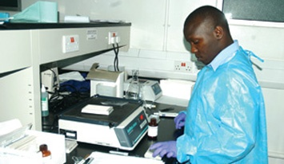
Quality Control Supervisor
A well-documented and
managed QC program is
the laboratory supervisor’s
responsibility!

Slide 63
What questions do you have on quality control management policies and rules?

Slide 64
Reagent Lot Validation
Qualitative Tests
  New lots must be checked by running one known positive and one known negative patient before using the lot to assure there is not a problem with the new lot.
  New lots of reagents must give the same results as obtained with the old lot.
  QC material may be used as an alternative.

Slide 65
Reagent Lot Validation (Continued)
Quantitative Tests
  Changes in lot numbers of reagents may cause the need to recalibrate the system and then rerun the controls to verify proper calibration.
  The assayed control mean and standard deviation often takes into consideration changes in reagent lot numbers since the values are calculated as lot-to-date.

Slide 66
What questions do you have on Quality Control case studies?

Slide 67
Today’s Agenda
The Quality System
Process Design
Process Control
  Specimen Management
  Method Validation
  Quality Control
Process Standardization / Audits
Process Improvement
Module Summary

Slide 68
Process Standardization
Standard Work
  Processes must be standardized to create standard work – one way of doing things!
Process standardization is achieved through well-written standard operating guidelines and procedures
Hold staff accountable for following SOPs
Notes:
Facilitator: Ask the participants the following questions:
What SOPs are used in your Lab? Does everyone in your lab pipette in the same way? Does everyone label specimen containers in same way?

Slide 69
Process Audits
Process control can be assessed through internal assessment/audit of the various processes for example:
  Audits of calibration records
  Audits of preventative maintenance records
  Audits of daily QC records
  Audits of procedure manuals for out-of-date documents
  Audits of logs and records for complete information
Notes:
Do you audit process records? Note- small numbers of records e.g. % will be pulled in audit. However, Files must be organized for audit to occur. Discussion of how to store, keep, and organize records in Information module

Slide 70
What questions do you have on process standardization and audits?

Slide 71
Today’s Agenda
The Quality System
Process Design
Process Control
  Specimen Management
  Method Validation
  Quality Control
Process Standardization / Audits
Process Improvement
Module Summary

Slide 72
Process Improvement
Identify opportunities for improvement based on occurrence reports, internal and external audits, complaints, customer feedback, and employee input
Select problems to work on that have significant impact on patient care, finance, or customer satisfaction
Define the process that you will use
(Ex. PI team, FOCUS(find, organize, clarify, understand, select)-PDCA (plan, do, check, act)
Prioritize the problems you wish to solve

Slide 73
Activity: Process Improvement
Define the problem “What happened?”
Assemble the right team to solve the problem
  Those close to the issue
Assess the current state
  Team flowcharts how the process currently works
Gather data on what happened
Perform root cause analysis to identify root cause of the problem

Slide 74
Activity: Process Improvement (Continued)
Brainstorm solutions
Develop the implementation plan
Communicate the process changes to all staff
Evaluate results by collecting data
  Were the objectives achieved?
Create a standard process that can be performed in one standard way
Do quality checks periodically on the process

Slide 75

Process Improvement Project
F- Finding a process to improve
  Panic Results Reporting

Slide 76
PLAN -Set Project Goals/Objectives
100% of results audited will reflect that documentation of notification was performed for all results
At least 90% of results audited will reflect that lab to clinician/nursing notification occurred within 30 minutes of result availability
At least 90% of results audited will reflect that clinician notification (if applicable) occurred within 60 minutes of result availability

Slide 77
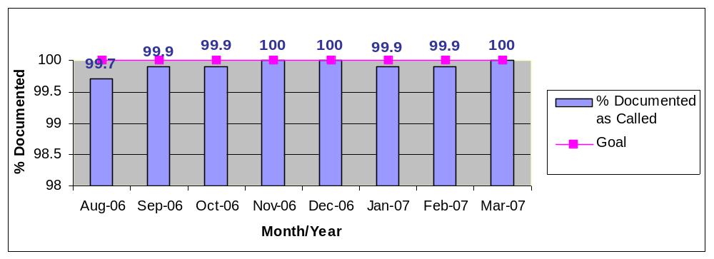
DO- Gather Data
Panic Values – Documentation of Notification

Slide 78
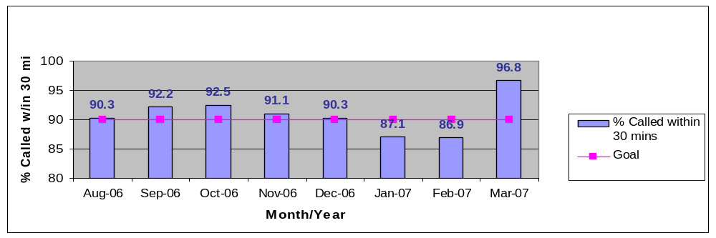
DO- Gather Data (Continued)
Turn around time (TAT) for Notification of Panic Values – Lab to Clinician

Slide 79
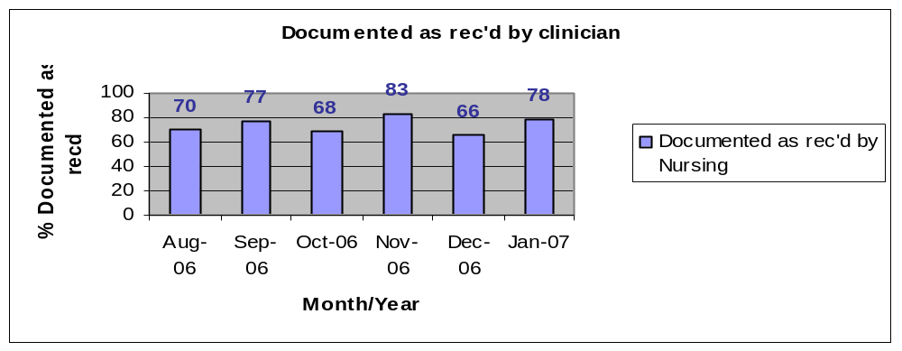
DO- Gather Data (Continued)
Clinician Review –
Documentation of receipt by Clinician/Nurse

Slide 80
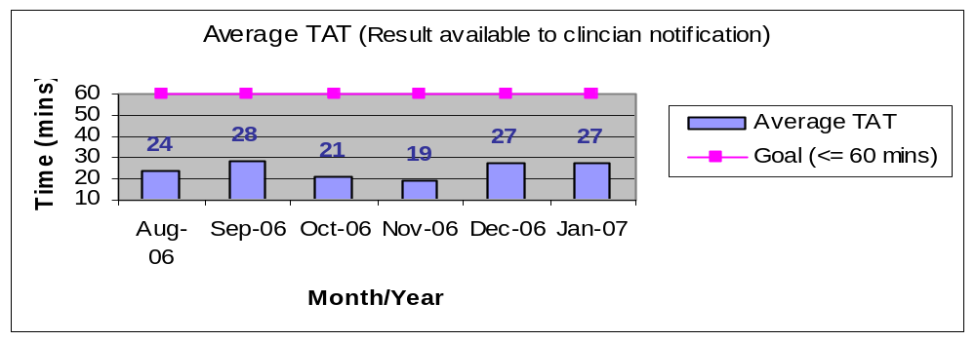
DO-Gather Data (Continued)
TAT for receipt by clinician of panic values (Based on Clinician Audit)

Slide 81

CHECK -Assess Data
Lab
  Downward trend:
    Documentation: Jan and Feb 2007
    TAT for Notification: Jan and Feb 2007
Clinical Area
  Not all Panic values called by lab to clinicians were documented as received
  Read back was not always documented

Slide 82

ACT- Develop Action Plan – Generate Ideas
Reviewed variances and limitations. Looked at time of day, department workflow, instrumentation, interfaces, location of patient etc.
No documentation of notification
  Tech sent result without calling
  Panic value called but not documented in Computer

Slide 83
ACT- Develop Action Plan – Generate
Ideas (Continued)
Timeliness of Notification
  Long delay to report Panic Values/tech unable to reach clinician
  Multiple results on instrument interface; no autoverification of normal results on hematology analyzer
  Results left on interface of instruments with autoverification

Slide 84


ACT – Implement
Patient Safety Review Checklist
Interface screen snapshots
Document delays in reporting results
Reminders posted on computers and instruments
  Check interfaces frequently

Slide 85
Check
A review of the data collected for March 2007 showed an improvement!
  [100%] Critical Values were documented as called
  [96.8%] Critical Values audited were called within 30 minutes. The highest % ever attained.

Slide 86
Assess
Continue to review
  Monthly audits
  Variances
  Make midcourse corrections as needed!
For the safety of our patients!

Slide 87
Case Study
In reviewing Your quality monitors you note that there were three occurrences of corrected rapid HIV test results your threshold is 0. Therefore the laboratory has an unacceptably high number of corrected rapid HIV reports.
Describe the PI process you would use to solve this problem
Notes:
Apply information from previous PI activities
Remember PDCA- Gather, Evaluate Data, etc.

Slide 88
Module Summary
Described the major process control activities in the laboratory
Described process control measures for specimen management
Listed the components of a method validation
Implemented and managed a comprehensive quality control system in the laboratory

Slide 89
What questions do you have on process improvement?

Slide 90
Module Summary (Continued)
Listed the components of a well-written QC guideline
Explained the advantages and disadvantages of the different options for QC rules
Evaluated and interpreted a variety of QC problems
Designed and implemented an effective process improvement project

Slide 91
What questions do you have on Laboratory Process Management?

Slide 92
Thank you

