Slide 1
Laboratory Management of a Quality System
Module 6: Document Control and
Record Management

Slide 2
ACKNOWLEDGEMENT
Ministry of Health and Social Welfare – Tanzania
Muhimbili University of Health and Allied Sciences
World Bank
ECSA- HC

Slide 3

The Lab Quality System
Organization
Personnel
Equipment
Process Control Quality Control & Specimen Management
Purchasing & Inventory
Information Management
Documents & Records
Occurrence Management
Assessment
Process Improvement
Customer Service
Facilities & Safety

Slide 4
Learning Objectives
At the end of this module, you will be able to:
Tell the difference between a document and a record
Explain the rationale for maintaining documents and records
Provide examples of documents and records kept at a test site
Identify features and components of SOPs
Describe how to properly keep and maintain test site documents and records

Slide 5
Document Control
The Lab Quality Manual includes:
  - Policies
  - Processes
  - Procedures
All are controlled
documents and must
be approved by the
head of Lab.
Policies
Processes
Procedures

Slide 6
Document Control: Policies
Policies define “What to do”
Defined in broad terms usually written in compliance with standards of laboratory practice

Slide 7
Document Control: Processes
Processes describe
“How it happens”
Sets of interrelated activities
that transform inputs into
outputs such as
  Specimen collection
  Instrument calibration

Slide 8
Document Control: Procedures
Standard Operating Procedures
(SOPs) define “How to do it”
Provide step-by-step
instructions that
laboratory staff must
follow carefully

Slide 9
Content Overview
What are documents and records?
Documents
  Why are they important?
  What documents should you keep?
  Why is it important to follow SOPs?
  What is the proper way to keep and maintain documents?
Records
  Why are they important?
  What records should you keep?
  What is the proper way to keep and maintain records?

Slide 10
Why Do Labs Need Documents?
Policies - communicate to customers
Quality Manual for monitoring the total testing process
Procedure manuals – consistent methods
References - available to share or access
Required to meet formal laboratory standards

Slide 11

What Are Documents and Records?
Documents
  WRITTEN policies, process descriptions, procedures, and blank forms
  Used to communicate information
Records
  Information captured on worksheets, forms, and charts
RECORDS

Slide 12
Exercise: Differentiate Between Documents and Records
Country testing algorithm
Safety manual
Client test results
Standard operation procedures (SOPs) for an approved HIV rapid test
Manufacturer test kit inserts
Summary of findings form on-site evaluation visit
Report of corrective actions
Temperature log (blank form)
Quality control record (blank form)
Daily maintenance log (completed)
Stock cards and stock book (completed)
EQA specimen transfer log (completed)

Slide 13
Exercise: Differentiate Between Documents and Records
Country testing algorithm
Safety manual
Client test results
Standard operation procedures (SOPs) for an approved HIV rapid test
Manufacturer test kit inserts
Summary of findings form on-site evaluation visit
Report of corrective actions
Temperature log (blank form)
Quality control record (blank form)
Daily maintenance log (completed)
Stock cards and stock book (completed)
EQA specimen transfer log (completed)

Slide 14
Documents Are the Backbone of the Quality System
Verbal instructions often are:
Not heard
Misunderstood
Quickly forgotten
Ignored
Policies, standards, processes, and procedures must be written down, approved, and communicated to all concerned.

Slide 15
Standard operating Procedures
The standard operating procedures are the most important documents in a laboratory
They describe in detail the complete techniques for tests performance
Lab staff must fully understand and follow rigorously

Slide 16
Standard Operating Procedures (SOPs) Are Documents that…
Describe how to perform various operations in a testing site
Provide step-by-step instructions
Assure:
  Consistency
  Accuracy
  Quality

Slide 17
Important features of SOPS
Applicable and achievable in the laboratory in which they will be used
Clearly written and easy to understand and follow
Kept up to date using appropriate technologies.

Slide 18
Avoid Drowning in Detail…..
BAD EXAMPLE: “The purpose of this procedure is to document the aforementioned activities, herin after referred to as the prescribed tasks in terms that preclude their execution in an inconsistent manner, wherin such inconsistency may potentially result in the prescribed tasks delivering a result that is not repeatable or reproducible”

Slide 19
And Poorly Written Procedures
Why use ten words when one will do?
  “The items hereinunder referenced in some cases fell excessively outside normal parameters.”
  “The procedures contained herin are applicable to all operations in the following departments within their functional ambit”

Slide 20
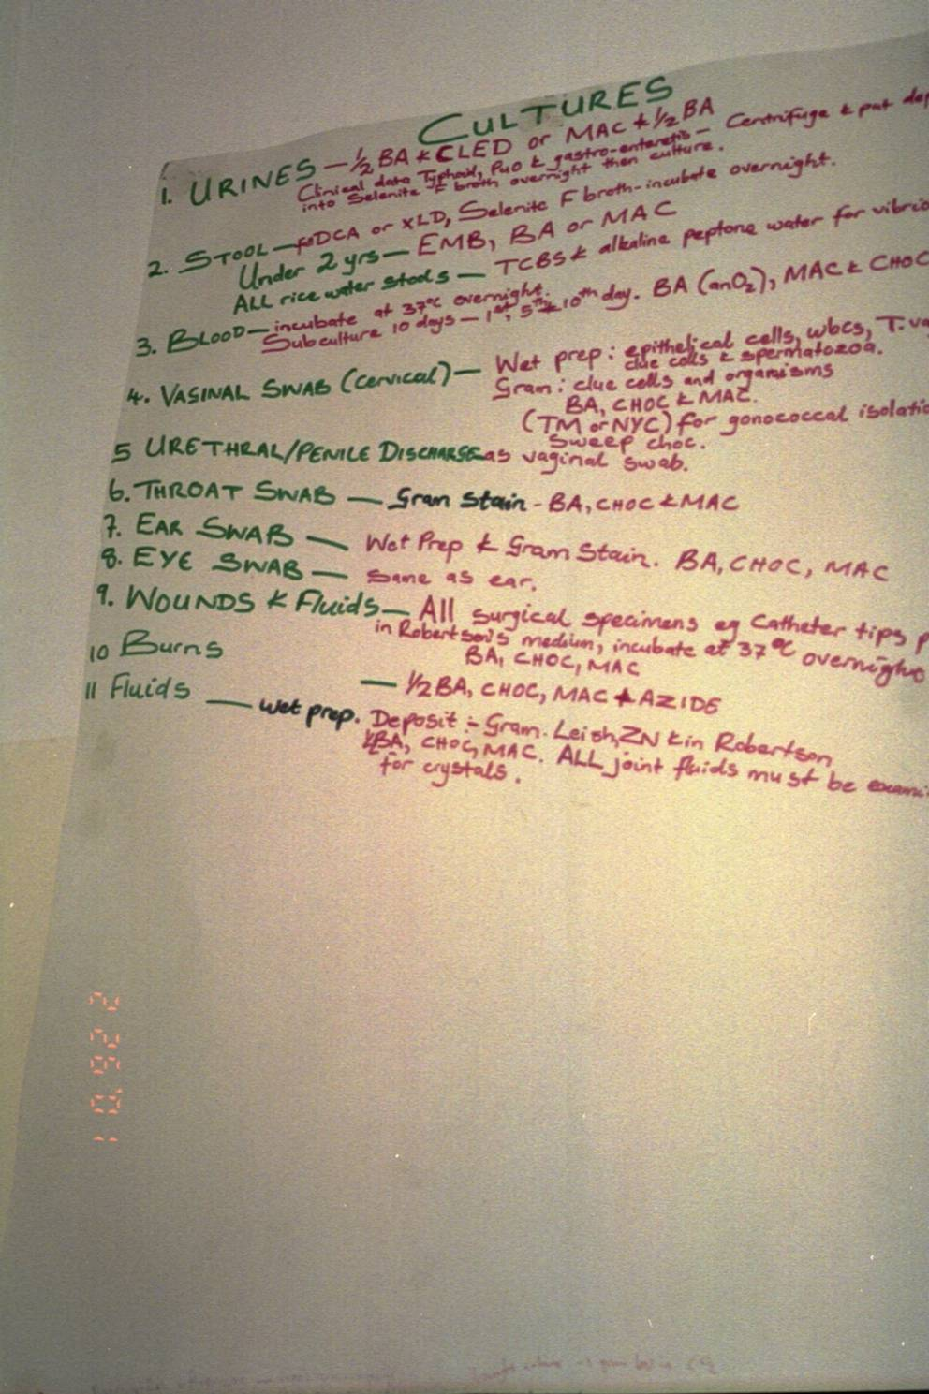
Job Aid

Slide 21
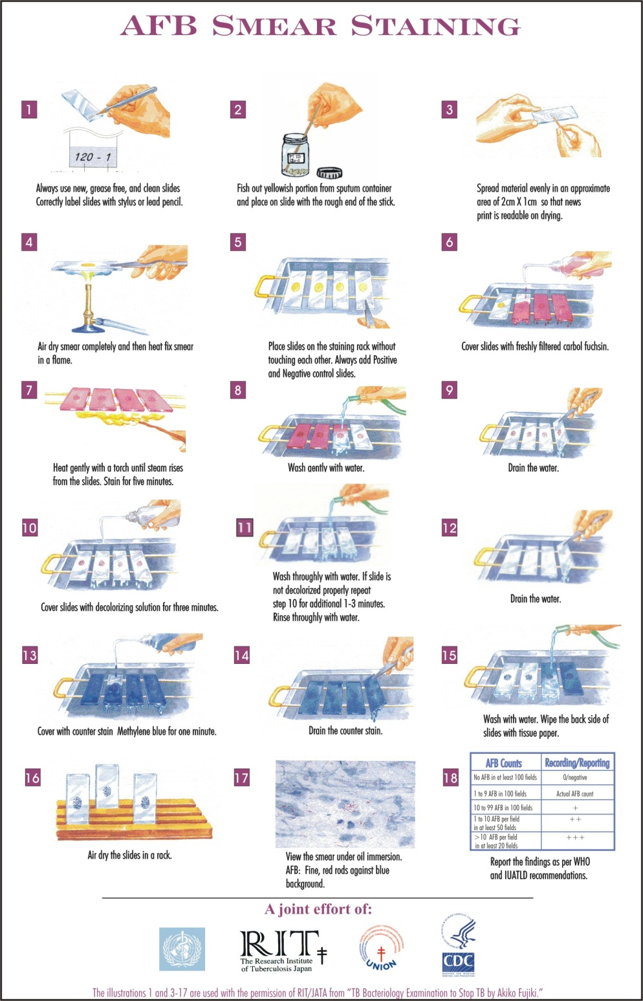

Slide 22
SOPs content:
- Principle of test
- Specimen
- Equipment
- Reagent
- Control
- Method of test
- Sources of error

Slide 23
Preparing sops
COVER SHEET
- Name of Lab
-Title of SOP
-Authorized signature and date
-Prepared by and date
-Revised by and date
-Approved by and date

Slide 24
Principle of Test
Brief description of each test principle
Roche COBAS taqman. This method amplifies part of the HIV-1 gag gene by RT-PCR followed by a real-time PCR detection by fluorescent probe hydrolysis and quantified using an external standard curve

Slide 25
Specimen
Type of specimen (e.g anticoagulant used)
Volume required
Collection of specimen
Time of collection
Transportation time
How container should be labeled
Arrival time in the laboratory
Criteria of specimen rejection.

Slide 26
Equipment
Material needed ( Pipette, incubator, water bath…).
Daily-start up Machine
Daily maintenance
Weekly maintenance
Monthly maintenance
Temperature monitoring

Slide 27
Controls
For chemistry Zymotrol control and calibration for GPT/ALAT, GOT/ASAT…
QC everyday
Hematology QC everyday
Serology Positive and Negative controls every test run
Record control results and sources of control

Slide 28
Reagents
How to store reagents
Monitoring (temperature, precipitation etc.)
How to prepare the reagent
Check expiry date
Shelf life of reagent (opened/unopened)
Reagent consumable/test (Master reagent)

Slide 29
Methodology
Describes performance of the test.
Detail of control
Detail of calibration
Used factor
Safety
Daily Start Up machine

Slide 30
Reported results
Validate the test (controls in the correct range?)
Unit
Normal range
Panic Value

Slide 31
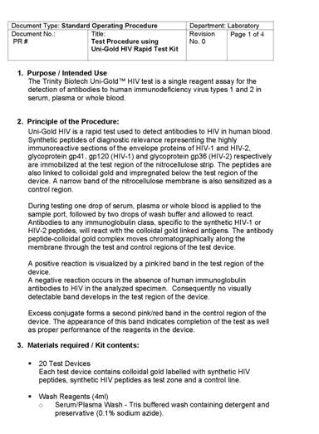
SOPs Are Controlled Documents
Must be approved for use in-country
Must have document control features
Must be kept up-to-date
Insert sample page
of in-country
test procedure
SOP

Slide 32
What SOPs Should You Keep at a Test Site?
Daily routine schedule
Country policies and algorithm
Safety manuals
  Safety Precautions
  Preparation of 10% bleach solution
  Post-HIV exposure prophylaxis management and treatment guidelines
Blood collection:
  Fingerprick, venipuncture, DBS

Slide 33
What SOPs Should You Keep at a Test Site?– Cont’d
Test procedures
EQA
  Submission of EQA specimens to reference lab
  Internal assessments
Reordering of supplies and kits
Equipment use and maintenance

Slide 34
SOPs Must Be Followed
Why is it important to follow SOPs?
What are the consequences if you don’t?

Slide 35
Do Not Rely Solely on Manufacturer Product Inserts
Manufacturer product inserts do not provide specific information for test sites
Examples include:
  Materials required, but not in kit
  Specific safety requirements
  Sequence of tests in country algorithm
  External quality control requirements
Notes:
Might tell what you need, but not where to get it, Ex QC material.
Reference to lab policy – frequency of running QC

Slide 36
Implementation of SOPs
Why don’t personnel follow SOPs?
  SOPs do not exist
  Too complex and detailed
  Not readily available in user-friendly format
  SOP developed at a higher level or at another lab
  Old SOP versions are in use
  Adherence to SOPs is not a job requirement
  Poor or absent supervision of compliance
  Difficulty in dealing with change
    “We have always done it this way” attitude

Slide 37
Implementation of SOPs (Continued)
Organization and management must have a commitment to implement SOPs
Perform a needs assessment
Establish central QA unit to develop, disseminate, and update analyte based SOPs
Provide orientation, training and continuing education programs on contents

Slide 38
Implementation of SOPs (Continued)
Have sufficient qualified personnel with documented training and experience to carry out laboratory work to the required standard
Make knowledge and adherence to SOPs a job requirement and include in the standard performance appraisal system

Slide 39
Records

Slide 40
Why are Records Essential?
For continuous monitoring of quality system
For specimen tracking throughout process
To identify failures in equipment
To revisit information; reference
For use as a management tool

Slide 41
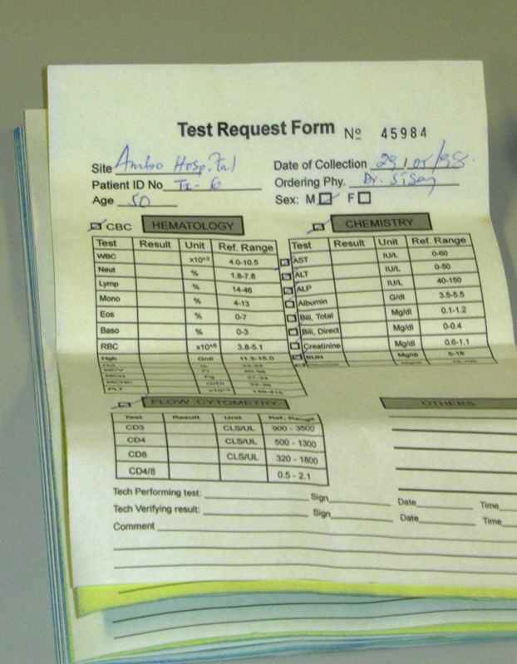
Important Laboratory Records
Records are any data or information recorded by the laboratory including:
  Test requisition forms
  Patient result forms (may be the same as requisition) initial and corrected/amended
  Accession logs
  Instrument print-outs (function checks etc.)

Slide 42

Important Laboratory Records (Continued)
Records are any data or
information recorded by
the laboratory including:
  Maintenance logs
  Temperature checks
  QC and QA records
  Specimen rejection logs
  Result worksheets
  with calculations

Slide 43
Things You Might Forget to Record!
Disposition of rejected specimens
Referral of specimens to another laboratory
Records of adverse occurrences or problems
Inventory and storage records
Instrument purchase data, preventive maintenance, troubleshooting

Slide 44
Test Report Contents
Date and time
Any patient identifiers
Date and time of sample collection
Date and time sample received in the lab
Person performing test
Biological reference intervals
Interpretative comments
Laboratory name
Name of person authorizing the report
Name and lot number of kit or reagent
QC for the test run

Slide 45
Format of Records
Forms should include at minimum:
  Title
  Date
  Results
  Tolerance limits/acceptable range
  Comments
  Performing staff initials/date

Slide 46
Exercise – Record Design Review
Review Record Design (pick one for each group)
  Investigation Request
  Accession book/log
  Result register
  Temperature chart
  TAT data collection sheet

Slide 47
Proper Record-Keeping Makes Quality Management Possible
Record-keeping allows a test site to:
Communicate accurately and effectively
Minimize error
Monitor quality system
Assist management in:
  Developing policy & plans
  Monitoring and evaluating programs
RECORDS

Slide 48

Record Storage Systems
Record system must allow one to reconstruct the entire process from beginning to end
Paper Storage Systems
  Data entry on manual records must be accurate, legible, permanent ink, and complete
  File cabinets organized alphabetically and by month/year
  Bound books of records
Electronic Storage Systems

Slide 49
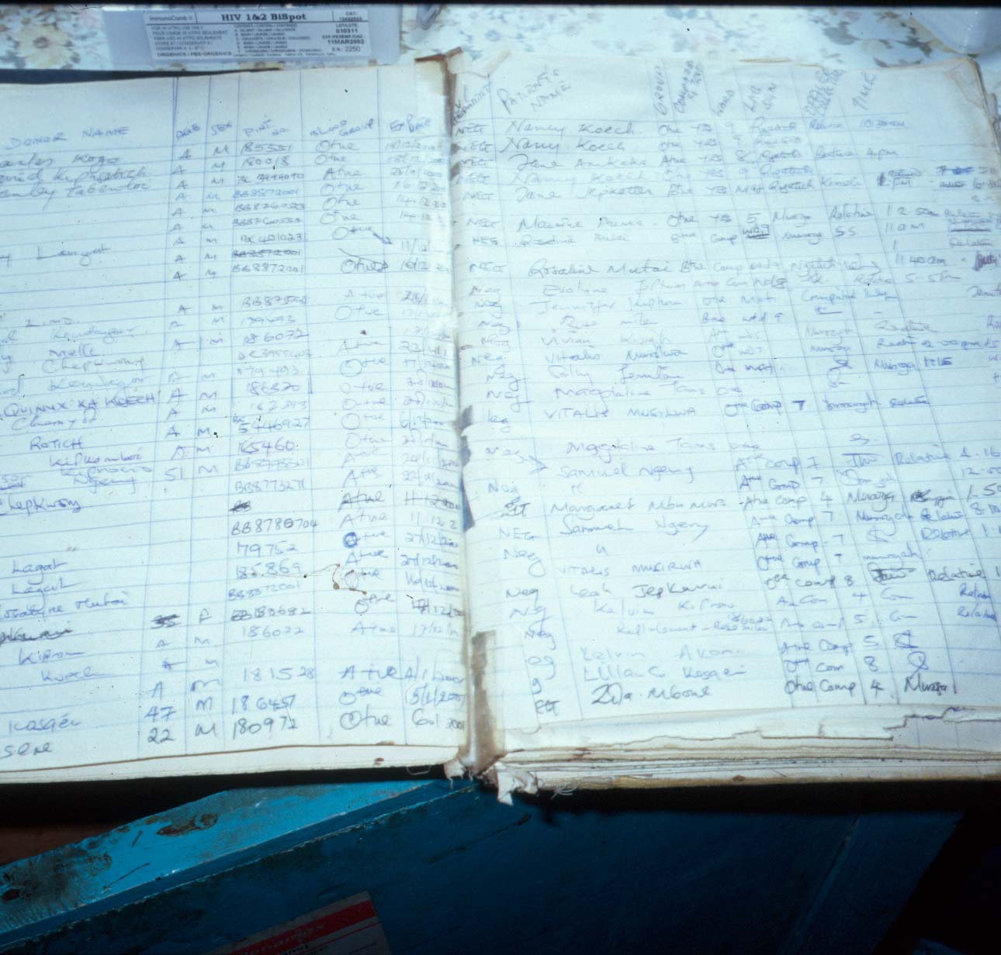

Slide 50
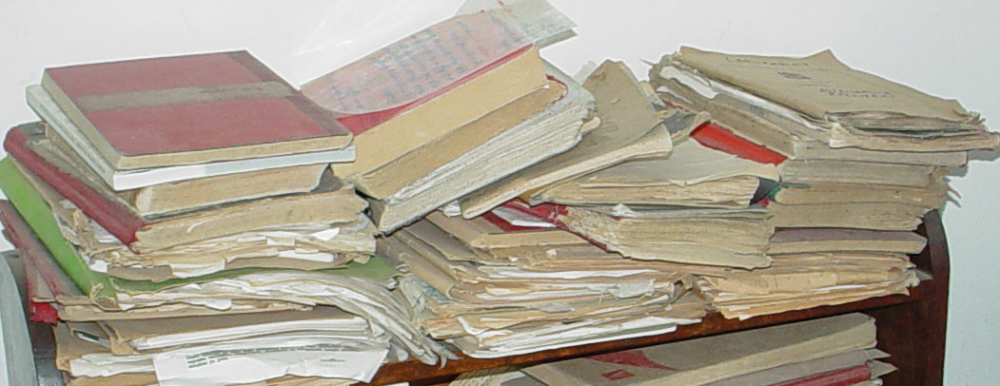

Slide 51

Electronic vs. Paper Systems
Electronic record-keeping provides the following advantages over paper systems:
  Permanence
  Security
  Ease of storage and retrieval
  Traceability
  Legibility

Slide 52
What Records Should You Keep at a Test Site?
Specimen transfer logs
HIV request / client test result
Lab / Test register
Temperature logs
Equipment maintenance logs
Inventory records
RECORDS

Slide 53
Tips for Good Record Keeping
Understand the information to be collected
Record the information every time
Record all the information
Record the information in the same way every time
RECORDS

Slide 54
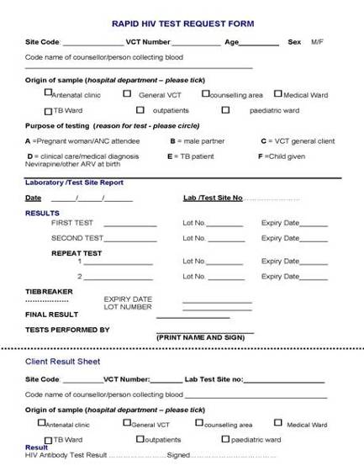
Client Test Records
Fill completely and accurately
Write legibly
Sign & date
Insert sample
in-country client
test record
RECORDS

Slide 55
How Long Should You Retain Client Test Records?
It depends on several factors:
National policies
Secure storage space at test site
RECORDS

Slide 56
Record Retention
Records should be maintained on-site if possible to provide easy retrieval for 5 years
Records must be organized, secure, and easily retrievable
Records must be traceable to performing staff and reviewing supervisor
Records should be retained in secure, water-resistant boxes according to date, type of record and disposal date

Slide 57
Record Retention (Continued)
Manual records of testing and QC should be retained for at least 5 years
The period of retention depends on:
  Clinical needs for retrieval of patient records
  Government or accrediting requirements
  Storage capacity
  Auditing and assessment needs

Slide 58
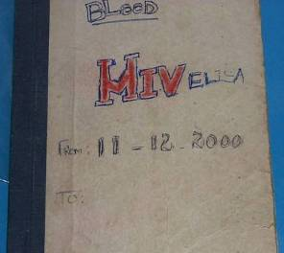
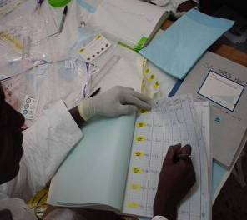
Logbooks Are Cumulative Records of Test Site Operations
RECORDS
Minimize deterioration
Index to allow for easy retrieval

Slide 59
Records Should be Permanent, Secure, Traceable
Permanent:
  Keep books bound
  Number pages
  Use permanent ink
  Control storage
Secure:
  Maintain confidentiality
  Limit access
  Protect from environmental hazards
Traceable:
  Sign and date every record
RECORDS

Slide 60
Information Recorded will Feed Into Monitoring and Evaluation Systems
Provide in-country information:
  When will what be reported?
  How will it be reported?
  Whom will it be reported to?
  How will the data be used?
RECORDS

Slide 61
Problem Scenario
You are the laboratory supervisor in a moderate-sized hospital. A physician calls you and says that he has a patient who had a potassium of 5.5 mmol/L yesterday and 3.5 today. The patient had not received any change of medication or diet.
What documents or records would you review to find the source of the problem?

Slide 62
Summary
What is the difference between a document and a record?
What are some examples of documents and records?
Name examples of information not found in a manufacturer product insert.
What are some key features of SOPs?
What are some tips for good record-keeping?
How should records be maintained?
How are test site records reported in your country?

Slide 63
Key Messages
Written policies and procedures are the backbone of the quality system
Complete quality assurance records make quality management possible
Keeping records facilitates meeting program reporting requirements

