Slide 1
Laboratory Management of a Quality System
Module 6: Document Control and
Record Management

Slide 2
ACKNOWLEDGEMENT
Ministry of Health and Social Welfare – Tanzania
Muhimbili University of Health and Allied Sciences
World Bank
ECSA- HC

Slide 3
Learning Objectives
Define document control and its purposes
Differentiate between documents and records
Define policies, processes, and procedures
List the features of a well-written standard operating procedure
Flowchart a laboratory process and create a process table and supporting procedures
Describe the elements of a record retention system for important laboratory records

Slide 4
Today’s Agenda
The Quality System
Document Control
  Standard Operating Procedures (SOPs)
  Process-Based SOPs
  Implementing SOPs
Records Management
Module Summary

Slide 5

The Quality System
Organization
Personnel
Equipment
Process Control QC & Specimen Management
Information Management
Purchasing & Inventory
Documents & Records
Occurrence Management
Assessment
Process Improvement
Customer Service
Facilities & Safety

Slide 6
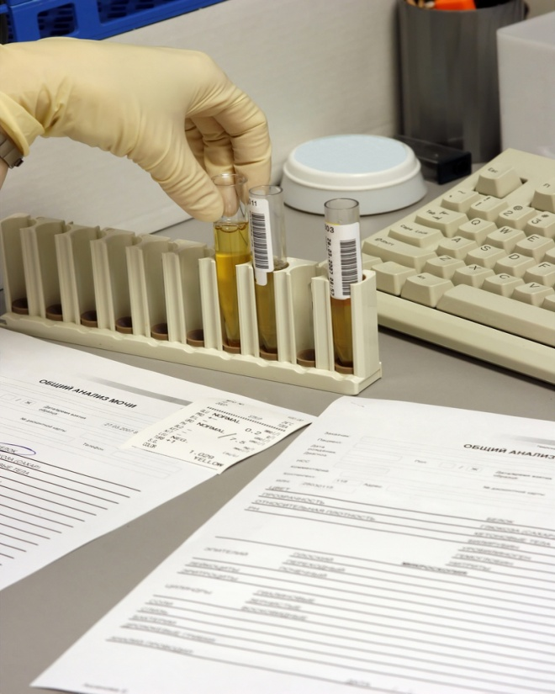
The Laboratory Documentation
Quality depends on having a
good document and record
control system in place for:
  Formatting and maintaining
  various versions of documents
  Assuring well written standard
  operating procedures
  Assuring proper record retention

Slide 7
Documents vs. Records
Documents describe what is to be done
Records describe the result of what was done
Document types
  Policies
  Procedures
  Forms
  Checklists
Documents must be created and controlled
Record types
  Any data or information recorded by the laboratory
  Instrument printouts
Records must be created and retained

Slide 8
Why Document and Record Control is Important to Quality?
Assures a standardized format for all documents and records (procedures, results, forms)
Establishes change controls for revising documents
Assures all departments have the most accurate, current, and approved documents

Slide 9
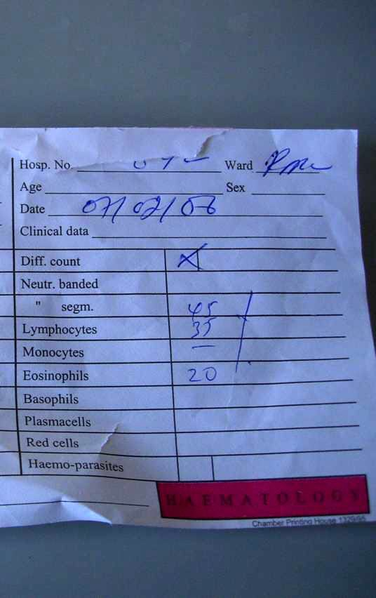
Why Document and Record Control is Important to Quality? (Continued)
Establishes a record retention
system for patient records and
other documents to assure
records are stored for defined
period
Assures easy retrieval of all
documents and patient records

Slide 10

Does anyone have a question?

Slide 11
Today’s Agenda
The Quality System
Document Control
  Standard Operating Procedures (SOPs)
  Process-Based SOPs
  Implementing SOPs
Records Management
Module Summary

Slide 12
Document Control
The Lab Quality Manual includes:
  - Policies
  - Processes
  - Procedures
All are controlled
documents and must
be approved by the
head of Lab.
Policies
Processes
Procedures

Slide 13
Document Control: Policies
Policies define “What to do”
Defined in broad terms usually written in compliance with standards of laboratory practice

Slide 14
Document Control: Processes
Processes describe
“How it happens”
Sets of interrelated activities
that transform inputs into
outputs such as
  Specimen collection
  Specimen accessioning
  Instrument calibration

Slide 15
Document Control: Procedures
Standard Operating Procedures
(SOPs) define “How to do it”
Provide step-by-step
instructions that
laboratory staff must
follow carefully

Slide 16
Document Control: Numbering
All controlled documents and corresponding forms must be numbered uniformly
A standard cover sheet must be used for reviews, approvals, and document control information
All pages must be numbered (1 of 3, etc.)

Slide 17
What questions do you have about controlled documents?

Slide 18
Today’s Agenda
The Quality System
Document Control
  Standard Operating Procedures (SOPs)
  Process-Based SOPs
  Implementing SOPs
Records Management
Module Summary

Slide 19
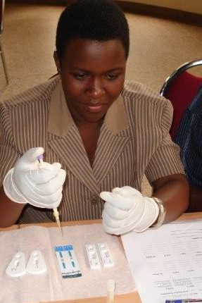
Standard Operating Procedures
Give management and
customers an assurance
of quality
Provide laboratory staff
with written instructions
on how to perform testing
Identify all reagents and
supplies needed for inventory

Slide 20
Standard Operating Procedures (Continued)
Serve as a guide for new staff training
Help to assess employee competence and identify retraining needs
Prevent unauthorized modifications to procedures

Slide 21
Standard Operating Procedures (Continued)
Good SOPs are:
  Clear and concise
  Accurate and updated
  Understood easily by staff
  Accessible to staff
Define the required elements in a template for consistency

Slide 22
Today’s Agenda
The Quality System
Document Control
  Standard Operating Procedures (SOPs)
  Process-Based SOPs
  Implementing SOPs
Records Management
Module Summary

Slide 23
Process-Based SOPs
Analyte Procedures
Process-Based Procedures
Detailed
Procedure manual
Very detailed
old CLSI format
Large binders on a shelf
Simple, new CLSI format
Process manuals for each process and instrument
Easy to read format for
each step in the process
Readily available at the bench or instrument

Slide 24
Why Process-Based SOPs?
All work is a process of interrelated activities that transform inputs into outputs
Processes may involve more than one person or area of the laboratory
Processes can be mapped to identify component procedures that need staff instructions for performance
Process-based procedures make training and
competency assessment much easier

Slide 25
How to Create Process-Based SOPs
Identify key processes in the lab workflow
Draw basic flowchart of each process
Create process table
Write the required procedures in the process
Create the Process Manual
Write the analyte procedures for a separate method-based manual

Slide 26
Step 1: Identify Key Processes
The laboratory workflow consists of:
  Pre-analytical, Analytical, and Post-analytical processes
SOPs must be defined for pre-analytical, analytical, and post-analytical processes in the laboratory workflow
Approximately 9 major processes exist in the laboratory workflow

Slide 27
Laboratory Workflow Processes
Pre-Analytic
Processes
Analytic
Processes
Post-Analytic
Processes
Test ordering
Specimen collection
Specimen transport
Specimen receipt and processing
Testing
Results review
& follow-up
Interpretation
Result reporting & archiving
Specimen management & follow-up

Slide 28
Step 2: Draw Basic Flowchart of
Each Process
A workflow can be drawn using 3-4 symbols
For example, each automated analyzer process can be flowcharted to identify the important procedures that must be written for the analyzer operation
Activity in
the process
Decision
Document
Or Result
Start Trigger
Or End

Slide 29



Automated
Analyzer
Flowchart
Samples received
analyzer
Sample
acceptability is
evaluated
Yes:
Samples are
loaded & tested
No:
Perform start-up,
daily maintenance
and QC
Is analyzer
functioning
properly?
No:
Perform
troubleshooting
If Yes
Yes:
Results are
evaluated
Repeat
examination
If No
Samples are
unloaded &
stored
End

Slide 30
What questions do you have about drawing process flowcharts?

Slide 31
Example: Accessioning Process Map
A process map for accessioning would include the following steps with written procedures:
  Specimen and request received and entered into specimen log
  Specimen and request are evaluated for adequate labeling and adequacy
  Inadequate specimens are rejected
  Specimens are centrifuged, aliquotted, or prepared for shipment out of the laboratory
  Specimens are distributed to the testing area

Slide 32
Step 3: Create Process Table
Define what happens at each step in
the process
Identify who is responsible
Identify what procedures are needed for
each step

Slide 33
Example Process Table for Automated Analyzer
What Happens? | Who’s Responsible | Procedures Needed
Sample evaluated for acceptability | Technologist | Evaluating Sample Acceptability for Abx Pentra Clot Checking Procedure
Analyzer ready procedures performed | Technologist | Checking required reagents Performing daily start-up Performing daily maintenance Performing daily function checks Performing and evaluating QC
Samples are loaded and run | Technologist | Programming samples on the analyzer Generating pending test list Loading routine and STAT tests on the analyzer
Troubleshooting performed for instrument problems | Technologist | Troubleshooting procedures

Slide 34
Example Process Table for
Automated Analyzer (Continued)
What Happens? | Who’s Responsible | Procedures Needed
Results are entered and evaluated | Technologist | Evaluating patient results Identifying and interpreting codes, flags, and histograms Correcting WBC for nRBC Entering and releasing results
Results are reported to wards and archived | Technologist | Reporting results on request form Notifying doctor on unusual or critical results Archiving/filing patient results
Samples are unloaded and stored | Technologist | Storing patient samples

Slide 35
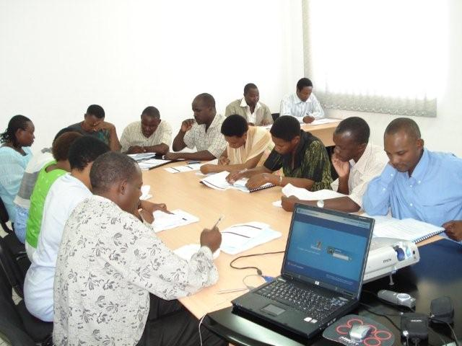
Step 4: Write Required Procedures
Write basic instructions
for components
of the process
Group procedures by
process
Ex. Specimen labeling

Slide 36
Example – Specimen Labeling Rejection Procedure
Specimens are rejected if inadequately labeled as follows:
  Unlabeled
    Any specimen is unlabeled if the container holding the specimen (evacuated tube, urine container, slide, etc.) does not have the patient’s last and first names, and identification number directly affixed to it.
    Labels must be placed on the container themselves rather than the lids

Slide 37
Example – Specimen Labeling
Rejection Procedure (Continued)
Specimens are rejected if inadequately labeled as follows:
  Mislabeled
    A specimen is mislabeled if its patient identification differs from the patient identification on the request form associated with it
    A specimen is mislabeled if the specimen does not belong to the patient on the label

Slide 38
Example – Specimen Labeling
Rejection Procedure (Continued)
Improperly/Incompletely Labeled
  The patient’s first name, last name, and the identification/file number are the minimum acceptable patient demographic data required on the specimen
  Certain types of specimens must also have an accurate date and time of collection on specimen labels
  Blood Bank specimens require a date drawn and first initial and last name of the blood collector clearly printed on the pilot tube

Slide 39
Example – Specimen Labeling
Rejection Procedure (Continued)
Specimen rejections will be documented on the laboratory request form and sent to the ward
The ward or clinician will be notified of the need to recollect

Slide 40
What questions do you have about creating process tables and writing procedures?

Slide 41
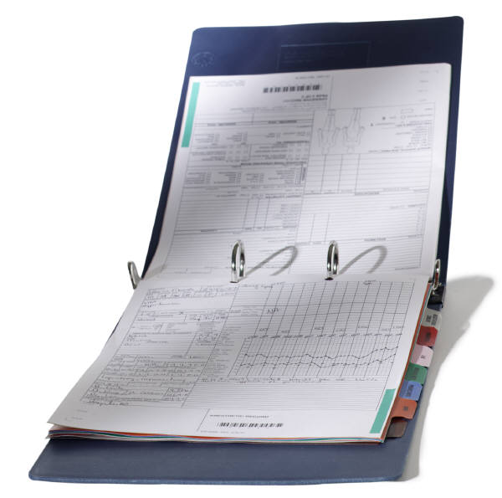
Step 5: Create Process Manuals
One manual for each process
and instrument
Process manual becomes
your training,
competency assessment,
and procedure manual.

Slide 42
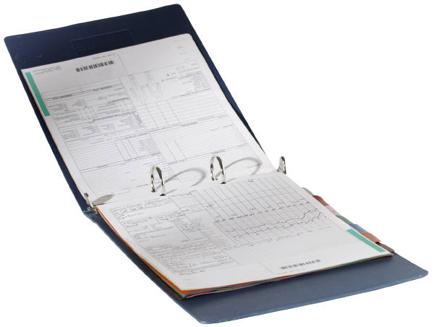
Step 5: Create Process Manuals
Process Manuals include:
  Flowchart of the processes
  Procedure instructions
  in order of performance
  Related documents
  References

Slide 43
Step 6: Write Analyte Procedures
In addition to process procedures from the process table, one single page procedure would exist for each analyte on the analyzer. These are included in a separate procedure manual by analyte and would include elements not needed for daily use.

Slide 44
Elements of Analyte Procedures
Principle and purpose of the test
Sample requirements
Equipment and materials
Reagent lists
Special safety precautions
Maintenance procedures
Quality control details
Calculations
Reference ranges
Interpretation of results
Linearity/dilutions

Slide 45
Elements of Analyte Procedures (Continued)
Interferences and procedural limitations
Any alert/critical values
References
Approval sheet with signatures
  Author(s)
  Persons reviewing and approving
  Employee review
  Implementation and revision dates

Slide 46
Today’s Agenda
The Quality System
Document Control
  Standard Operating Procedures (SOPs)
  Process-Based SOPs
  Implementing SOPs
Records Management
Module Summary

Slide 47
Implementation of SOPs
Why don’t personnel follow SOPs?
  SOPs do not exist
  Too complex and detailed
  Not readily available in user-friendly format
  SOP developed at a higher level or at another lab
  Old SOP versions are in use
  Adherence to SOPs is not a job requirement
  Poor or absent supervision of compliance
  Difficulty in dealing with change
    “We have always done it this way” attitude

Slide 48
Implementation of SOPs (Continued)
Organization and management must have a commitment to implement SOPs
Perform a needs assessment
  Prioritize simple process based procedures first for higher volume procedures at local site
Establish central QA unit to develop, disseminate, and update analyte based SOPs
Provide orientation, training and continuing education programs on contents

Slide 49
Implementation of SOPs (Continued)
Have sufficient qualified personnel with documented training and experience to carry out laboratory work to the required standard
Make knowledge and adherence to SOPs a job requirement and include in the standard performance appraisal system

Slide 50
What questions do you have about implementing standard operating procedures?

Slide 51
Today’s Agenda
The Quality System
Document Control
  Standard Operating Procedures (SOPs)
  Process-Based SOPs
  Implementing SOPs
Records Management
Module Summary

Slide 52
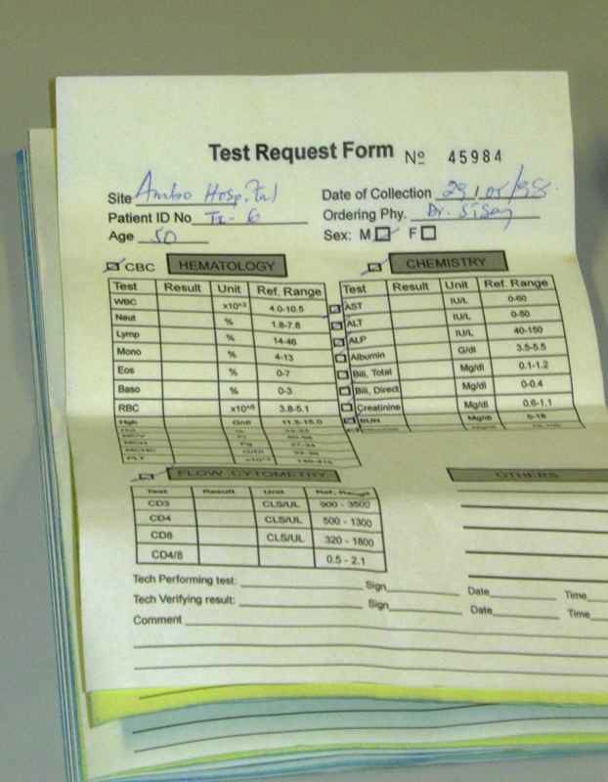
Important Laboratory Records
Records are any data or information recorded by the laboratory including:
  Test requisition forms
  Patient result forms (may be the same as requisition) initial and corrected/amended
  Accession logs
  Instrument print-outs (function checks etc.)

Slide 53

Important Laboratory Records (Continued)
Records are any data or
information recorded by
the laboratory including:
  Maintenance logs
  Temperature checks
  QC and QA records
  Specimen rejection logs
  Result worksheets
  with calculations

Slide 54
Format of Records
Forms should include at minimum:
  Title
  Date
  Results
  Tolerance limits/acceptable range
  Comments
  Performing staff initials/date

Slide 55
Exercise – Record Design Review
Review Record Design (pick one for each group)
  Investigation Request
  Accession book/log
  Result register
  Temperature chart

Slide 56
Exercise – Record Design Review
Review Record Design (pick one for each group)
  Investigation Request
  Accession book/log
  Result register
  Temperature chart

Slide 57

Record Storage Systems
Record system must allow one to reconstruct the entire process from beginning to end
Paper Storage Systems
  Data entry on manual records must be accurate, legible, permanent ink, and complete
  File cabinets organized alphabetically and by month/year
  Bound books of records
Electronic Storage Systems

Slide 58

Electronic vs. Paper Systems
Electronic record-keeping provides the following advantages over paper systems:
  Permanence
  Security
  Ease of storage and retrieval
  Traceability
  Legibility

Slide 59
Record Retention
Records should be maintained on-site if possible to provide easy retrieval for 5 years
Records must be organized, secure, and easily retrievable
Records must be traceable to performing staff and reviewing supervisor
Records should be retained in secure, water-resistant boxes according to date, type of record and disposal date

Slide 60
Record Retention (Continued)
Manual records of testing and QC should be retained for at least 5 years
The period of retention depends on:
  Clinical needs for retrieval of patient records
  Government or accrediting requirements
  Storage capacity
  Auditing and assessment needs

Slide 61
What questions do you have about laboratory records, storage systems, and record retention?

Slide 62
Today’s Agenda
The Quality System
Document Control
  Standard Operating Procedures (SOPs)
  Process-Based SOPs
  Implementing SOPs
Records Management
Module Summary

Slide 63
Summary: Documents vs. Records
Documents describe what is to be done
Document types
  Policies
  Procedures
  Forms
  Checklists
Documents must be created and controlled
Records describe the result of what was done
Record types
  Any data or information recorded by the laboratory
  Instrument printouts
Records must be created and retained

Slide 64
Summary: Controlled Documents
The Lab Quality Manual includes:
  - Policies
  - Processes
  - Procedures
All are controlled
documents and must
be approved by the
head of the Lab.
Policies
Processes
Procedures

Slide 65
What questions do you have about document and record control for the laboratory?

Slide 66
Thank you

