Slide 1
Laboratory Management of a Quality System
Module 7: Occurrence Management
Internal & External Assessments

Slide 2
ACKNOWLEDGEMENT
Ministry of Health and Social Welfare – Tanzania
Muhimbili University of Health and Allied Sciences
World Bank
ECSA- HC

Slide 3
Learning Objectives
Describe how to set up an effective occurrence management system
Provide operational and quality benchmarks
for monitoring lab operations
Develop audit tools for conducting internal audits
Describe the components and implementation of an effective external quality assurance program, including proficiency testing

Slide 4
Today’s Agenda
The Quality System
Occurrence Management
Assessment
  Internal Audits
  External Assessment
Module Summary

Slide 5

The Quality System
Organization
Personnel
Equipment
Process Control QC & Specimen Management
Information Management
Purchasing & Inventory
Documents & Records
Occurrence Management
Assessment
Process Improvement
Customer Service
Facilities & Safety
Notes:
The laboratory quality system provides the means to ensure that the laboratory does things right. Policies and procedures are in place, people are trained and competent, processes are assessed for weaknesses, and corrective action is taken when problems are identified.

Slide 6
Monitoring Laboratory Quality
Monitoring laboratory
operations on a routine basis
is essential in order to maintain control, and develop a high quality of service
  The effectiveness of a
  Quality Laboratory System
  is measured against benchmarks
Notes:
The importance of the laboratory’s quality program becomes aligning the laboratory’s quality efforts – such as accuracy and precision with the customer’s expectations for timeliness, courtesy, and consultation.

Slide 7
The Quality Manager’s (QM) Role
Plans and organizes the quality
processes and audit schedules
Assures the institution of
corrective and preventive actions
when deficiencies or opportunities
for improvement are noted
Verifies corrective and preventive
action is documented and carried out
Notes:
Ask the following questions:
Who is your Quality Assurance ( QA )Manager? Who is responsible for Quality Assurance (QA) in your laboratory?

Slide 8

What questions do you so far?

Slide 9
Today’s Agenda
The Quality System
Occurrence Management
Assessment
  Internal Audits
  External Assessment
Module Summary

Slide 10
What is an Occurrence?
An occurrence is any incident involving laboratory processes for any laboratory specimen
  Complaints
  Process deviations
  Errors and accidents
  Instrument problems
Occurrences are detected by:
  External customer complaints
  Employee reporting
  Management review
Notes:
Discussion
Describe some incidents you may have had involving a laboratory process?
Complaint?
Process Deviation?
Error or accident?
Instrument problems?
How did you detect it?
External customer complaint?
Employee reporting?
Management review?

Slide 11
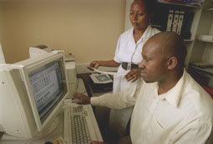
Occurrence Management System
A process for documenting
and addressing problems
that occur in the laboratory
  Log occurrence
  Investigate occurrence
  Take corrective action
  Report results / trends
  Prioritize problems and assign to a process improvement (PI) team
  Conduct focused audit to ensure resolution
Notes:
Discussion
Ask the following questions:
Do any of you use an occurrence management system?
What process do you use for documenting and addressing problems that occur in the laboratory?
Give some examples of an occurrence and how and where you documented the occurrence

Slide 12

Occurrence Logs
Occurrence logs are used
to capture:
  Who was involved?
  What occurred?
  When did it occur?
  Where in the laboratory process
  did the problem occur?

Slide 13

Occurrence Investigation
Management will:
  Review and evaluate the
  data on the occurrence
  Determine how the event
  occurred including any
  contributing factors
  Determine the root cause
  by evaluating system or
  people issues (knowledge and behavior)

Slide 14

Occurrence Corrective Action
Manager will document:
  Remedial actions taken to
  solve immediate problem
  Corrective actions to be
  taken to solve system or
  people issues identified
  Audit the system later in
  time to assure stability of the fix

Slide 15
Occurrence Reporting (Data)
Occurrence documentation is part of quality reporting system
Occurrence data and trends are used to identify problems for process improvement activities
  Management prioritizes the problems
  Management assigns the process improvement (PI) team to develop solutions

Slide 16

Occurrence Audits
Occurrence data must be
monitored with a focused
audit after intervention to
assure the fix is stable

Slide 17
Tips: Occurrence Management
Develop and promote a no-blame culture
Focus on the system and not the people
View every documented situation as an opportunity for improvement
Notes:
No-blame culture- we do not want to blame the individual for an occurrence but we want to look at the process and what we can do to prevent the occurrence form happening again. It is not about looking on who to punish but on what process that can be corrected and or improved upon.

Slide 18

Case Study
Doctor Cohen called and said
the WBC report on his patient was incorrect yesterday. It did not match the clinical picture.
How would you handle this occurrence?
Notes:
Give hint-obtain info from occurrence log, investigate occurrence, try to determine how it occurred by asking “why” questions.

Slide 19
What questions do you have on occurrence management?

Slide 20
Today’s Agenda
The Quality System
Occurrence Management
Assessment
  Internal Audits
  External Assessment
Module Summary

Slide 21
The Role of Assessments
Assessments are a major component of the Quality Laboratory Systems framework
Assessments are a systematic and ongoing examination of processes within the quality system

Slide 22
Assessments / Audits
Internal Audits
  Periodically conducted to assess if management has implemented adequate and effective controls of laboratory operations and quality systems
  Define and report on quality indicators/monitors with benchmarks
External Assessments
  Used to identify systematic error or methodological problems
  Usually performed by an outside organization

Slide 23
Today’s Agenda
The Quality System
Occurrence Management
Assessment
  Internal Audits
  External Assessment
Module Summary

Slide 24
Internal audits
What to Audit
High volume procedures
High risk procedures
Problem-prone processes
Issues highlighted in occurrence documentation
Notes:
Give examples for each.
High Volume procedure? e.g. CBC
High Risk Procedure? TB testing
Problem- prone processes?- e.g. accurate pipetting for CD4 testing

Slide 25
Internal Audit Methods
Tracer Methodology
  Follow the path of the workflow for an activity from the beginning to the end
Confirmation/Corroboration
  Asking employees or others to verify that collected information is accurate
Sampling
  Selecting a statistically valid smaller number of records to review

Slide 26
Example: Internal Audit
Process to be audited
  Blood collection for transfusion testing
Methodology
  Tracer Methodology

Slide 27
Example: Internal Audit (Continued)
Audit Steps
  Examine the request slip and tube labels for complete information
  Review the SOP for accuracy and completeness
  Compare the SOP with performance by observing blood drawn and labeled in multiple areas
  Check final labeled tubes for criteria defined in SOP
  Review data on specimen rejections in Blood Bank
  Examine training and competency assessment records on phlebotomists

Slide 28
Exercise
Create an internal audit (assessment) list for your laboratory
For every item on your audit list, identify what audit method you will use
Notes:
20-30 minutes to complete
Pick High volume High risk problem prone etc.
e.g. CD4 testing

Slide 29

Quality System Monitors
What is a monitor?
  The item that will be
  benchmarked and
  measured as an indicator
  of quality
  Good monitors involve
  information easy to collect
  and relevant to your lab operations
Why have monitors?
  If you don’t measure it, it will never improve
Notes:
Look at the picture on this slide:
What would be a good monitor to measure?
e.g. Importance of accurate pipetting when making up controls
or the Improtance of accurate pipetting when making dilutions

Slide 30
What questions do you have about internal audits
thus far?

Slide 31
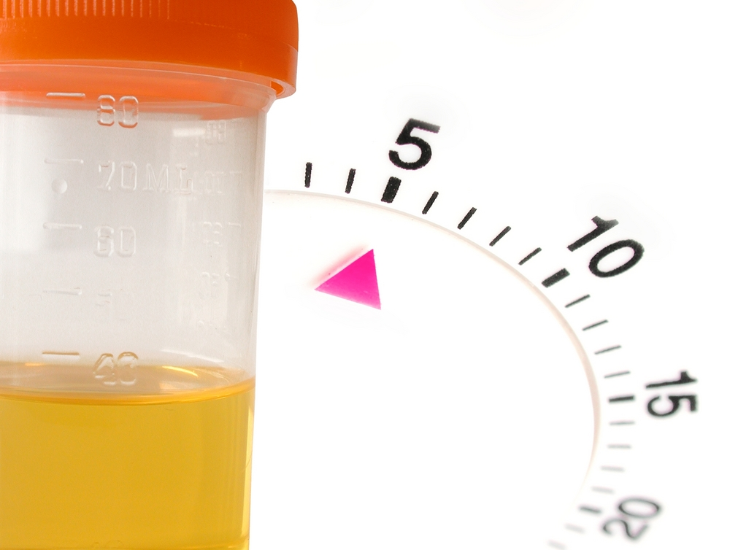
Example Quality System Monitors
Phlebotomy wait time
Specimen rejection rate
Phlebotomy competency
Turnaround time (TAT)
Technologist competency
Quality control failures
Corrected reports

Slide 32

Example Quality System Monitors (Continued)
Internal and external assessment findings
Critical result notification
Critical supply inventory levels

Slide 33
Exercise
Identify at least one monitor you could use for each item on the audit list your created earlier.
Notes:
Give 15 minutes
Some examples to work with
Can identify the laboratory operating system and have participants give an example of the quality indicator
Examples
LABORATORY OPERATING SYSTEM SAMPLE QUALITY INDICATOR
Test requests Number and sources of inadequately prepared test requests
Specimen Collection and Labelling Number and source of patients without proper identification at the time of specimen collections
Specimen transport Number and source of specimens that exceeded maximum transportation time
Results reporting Number and severity of reporting errors

Slide 34
What questions do you have on internal audits and monitors?

Slide 35
Today’s Agenda
The Quality System
Occurrence Management
Assessment
  Internal Audits
  External Assessment
Module Summary

Slide 36
External Quality Assessment (EQA)
A system for objectively checking the laboratory’s performance using an external agency or facility
Used to supplement internal audits to identify opportunities for process and quality improvement
Notes:
EXPLAIN several definitions of EQA exist, leading to confusion. EQA has often been used as a synonym of Proficiency Testing .. For example, CLSI definition is: “Evaluation of laboratory’s performance on examination of samples of external origin for the purposes of determining adequacy of the laboratory ‘s pre examination, examination and post examination activities. But this definition might be too restrictive, as it doesn’t include rechecking and on-site visit methodologies.
EQA ensures customers (physicians, patients and health authorities) that your laboratory can produce reliable results.

Slide 37
EQA / Inter-Lab Comparison Benefits
Allows inter-lab comparison of performance
Provides objective evidence of laboratory quality
Serves as an early warning system and an indicator for focusing improvement efforts
Identifies systematic reagent/kit problems
Identifies training needs
Source of continuing education
Source of material for practice
Notes:
EXPLAIN results may be compared between laboratories offering not only an opportunity for performances to be compared but also for systematic kit problems to be identified allowing market surveillance.
Benefits to public health programs, and individual laboratories:
Laboratory oriented objectives:
1. Identify possible insufficiencies in laboratory practices, and guide participants in corrective actions to be used for making these practices better;
2. Identify reliability characteristics of methods, materials and equipment in routine-use and suggest appropriate corrective actions;
3. Evaluate and monitor training impact; assist in preparation of future training;
4. Opportunity for continuous self-education
Public health oriented objectives:
5. Establish bases for results comparability during epidemiological surveillance and disease control;
6. Collect information on laboratory measurements (intra- and inter-laboratory) in order to alert professionals and/or governments on results, traceability and harmonisation problems, and establish appropriate acceptable limits for results in a given prospective;
7. Collect information on operating authorisations or laboratory accreditation.
8. Further education
9. Create a channel for communication and exchange of specimens. It is good tool to create the national laboratory network and keep it alive.

Slide 38
EQA Comparison Methods Overview
Re-checking /
Re-testing
samples exchange
Proficiency
Testing
3rd Party On-site
Evaluation
Notes:
STATE here 3 EQA methods are represented:
Proficiency testing: traditionally labs receive specimens from a Proficiency Testing provider
Inter-laboratory comparisons can also be achieved with network of labs within your/region, etc. The issues for inter-laboratory comparisons within a network of labs: sample exchange, data comparison, etc…
On-site evaluation with periodic visits to the laboratory.

Slide 39
EQA On-Site Evaluation Method
Re-checking /
Re-testing
samples exchange
Proficiency
Testing
3rd Party On-site
Evaluation
Notes:
STATE here 3 EQA methods are represented:
Proficiency testing: traditionally labs receive specimens from a Proficiency Testing provider
Inter-laboratory comparisons can also be achieved with network of labs within your/region, etc. The issues for inter-laboratory comparisons within a network of labs: sample exchange, data comparison, etc…
On-site evaluation with periodic visits to the laboratory.

Slide 40
On-Site Evaluations /Supervision
Define the standards to be used in evaluating the laboratory
  For example: facilities, quality control, procedure manual, specimen management, and personnel)
Develop checklist of items to check on the evaluation and define tracer method to use
Third-party quality officer evaluates the laboratory and produces an evaluation report
Evaluated laboratory must respond with documentation to all deficiencies
Notes:
This is different from the inspection process

Slide 41
On-Site Evaluations /Supervision
Uses:
Direct observation
Review QC & Documentation
Administer individual proficiency testing
Collect & compare data from multiple sites
Opportunity for mentoring and evaluation of other programs

Slide 42
On-Site Evaluations / Supervision
Limitations:
Evaluators must be trained in consistent observation
Checklists must be developed

Slide 43
Regulatory Inspection
Health Laboratory Board
All Labs subject to Law
  Standards
  Checklist
  Sanctions –Withdrawal of License
Notes:
Make sure relevant and up to date information is included

Slide 44
EQA Proficiency Testing Method
Re-checking /
Re-testing
samples exchange
Proficiency
Testing
3rd Party On-site
Evaluation
Notes:
STATE here 3 EQA methods are represented:
Proficiency testing: traditionally labs receive specimens from a Proficiency Testing provider
Inter-laboratory comparisons can also be achieved with network of labs within your/region, etc. The issues for inter-laboratory comparisons within a network of labs: sample exchange, data comparison, etc…
On-site evaluation with periodic visits to the laboratory.

Slide 45
EQA Proficiency Testing
ISO Definition (guide 2:1996)
  Determination of laboratory testing performance by means of inter-laboratory comparisons.
CLSI Definition
  A program in which multiple samples are periodically sent to members of a group of laboratories for analysis and/or identification; whereby each laboratory’s results are compared with those of other laboratories in the group and/or with an assigned value, and reported to the participating laboratories and others.

Slide 46
EQA Proficiency Testing (Continued)
External proficiency testing program
(e.g. EQAS, SANAS, CDC)
Internally stabilized PT samples
Alternative assessment mechanism – use previously analyzed specimen as blind sample or split sample analysis
Notes:
Question-
What EQA program do you participate in? For what test/assay? What frequency?

Slide 47
EQA Proficiency Testing Process
Central organization sends out challenge specimens for testing
Laboratories analyze specimens, return results to central organization
Results evaluated, laboratories sent scores, performance report
Laboratories take appropriate corrective actions and document

Slide 48
EQA Proficiency Testing
Uses
Limitations
  Most common form of EQA
  Development of specimen panels by the National/Zonal Reference Lab
  Easiest type of program to implement where serum-based tests are performed
  Usually involves only a few specimens
  Test results may not represent routine test performance
  Preparing and distributing samples significant effort

Slide 49
EQA Blinded Rechecking
Re-checking /
Re-testing
samples exchange
Proficiency
Testing
3rd Party On-site
Evaluation
Notes:
STATE here 3 EQA methods are represented:
Proficiency testing: traditionally labs receive specimens from a Proficiency Testing provider
Inter-laboratory comparisons can also be achieved with network of labs within your/region, etc. The issues for inter-laboratory comparisons within a network of labs: sample exchange, data comparison, etc…
On-site evaluation with periodic visits to the laboratory.

Slide 50
EQA Blinded Rechecking
Uses
  Forwarding a selected sample of tests for rechecking to assess the quality of testing
  Best utilized in high-volume settings
Limitations
  Must develop a systematic sampling method to avoid bias in selecting samples for referral
  Requires retesting to be done on a high percentage of samples
  Practicality limited by lack of capacity at NRL/Zonal and excessive delays

Slide 51
Evaluation of EQA Reports
Where are the problems?
  Pre-Analytic
    Specimen compromised during preparation, transport, or after receipt by improper storage or handling
  Analytic
    Reagents, instruments, methods, calibration
    Calculation
    Competency of Staff*
Notes:
The problems may lie anywhere along the path of workflow.
The integrity of the challenge may have been compromised during preparation, shipping or after receipt by improper storage or handling.
On the examination front great care should be taken to ensure that the EQA challenge materials do not exhibit a matrix effect in the examination system used by the participating laboratory. Analytical problems should be investigated to determine whether any error is random or systemic
My next slide speaks to competency of staff but before going there let me emphasise that post-examination problems occur frequently and that incorrect data capture by the EQA scheme organizer is certainly not unknown.

Slide 52
Evaluation of EQA Reports (Continued)
Where are the problems?
  Post-analytic
    Report format
    Interpretation
  Data
    Clerical/transcription error
Notes:
The problems may lie anywhere along the path of workflow.
The integrity of the challenge may have been compromised during preparation, shipping or after receipt by improper storage or handling.
On the examination front great care should be taken to ensure that the EQA challenge materials do not exhibit a matrix effect in the examination system used by the participating laboratory. Analytical problems should be investigated to determine whether any error is random or systemic
My next slide speaks to competency of staff but before going there let me emphasise that post-examination problems occur frequently and that incorrect data capture by the EQA scheme organizer is certainly not unknown.

Slide 53
EQA Documentation
Establish written procedures for:
  Handling of samples
  Analysis of sample
  Recording of results on report forms
  Verification of clerical accuracy
  Use of statistical tools
  Handling corrective actions

Slide 54
What questions do you have on external assessments?

Slide 55
Activity
Work in pairs
Identify possible inter-laboratory evaluations for your laboratory. Then:
  Define the EQA method you will use and the i standards to be used
  Develop a checklist of items to be checked on evaluation and define tracer method to used
  Identify what procedures need to be developed to support the evaluation
Notes:
This can be used if you do not currently have a written EQA process.
See and refer t on internal assessments Job aids.
This can be used be used for ongoing self evaluation (before the evaluators come to your lab)

Slide 56
Today’s Agenda
The Quality System
Occurrence Management
Assessment
  Internal Audits
  External Assessment
Module Summary

Slide 57
Module Summary
Describe how to set up an effective occurrence management system
Provide operational and quality benchmarks
for monitoring lab operations
Develop Internal Audits tools for
conducting audits
Describe the components and implementation of an effective external quality assurance program, including proficiency testing

Slide 58
Any questions on Occurrence Management or Internal and External Assessments?

Slide 59

Thank you

