Slide 1
Laboratory Management of a Quality System
Module 8: Information Management

Slide 2
ACKNOWLEDGEMENT
Ministry of Health and Social Welfare – Tanzania
Muhimbili University of Health and Allied Science
World Bank
ECSA- HC

Slide 3
Learning Objectives
Describe the basic elements of information management
Describe the laboratory information system hardware and software components
Provide the laboratory information system capabilities
Describe the benefits of using printed barcode labels generated from the LIS for specimen labeling

Slide 4
Learning Objectives (Continued)
Describe the difference between the types of reports that can be generated from the LIS
Describe the purpose of a documented audit trail within the LIS
Describe the purpose of performing a laboratory information system back-up process

Slide 5
Today’s Agenda
Quality Systems
Information Management Options
  Paper-based
  Automated
  Laboratory Information System (LIS)
LIS Components and Architecture
LIS Capabilities
Module Summary

Slide 6

The Quality System
Organization
Personnel
Equipment
Process Control QC & Specimen Management
Purchasing & Inventory
Information Management
Documents & Records
Occurrence Management
Assessment
Process Improvement
Customer Service
Facilities & Safety

Slide 7

The Laboratory Information
The product produced by
the laboratory is information
Laboratory information
within a quality system
produces increased knowledge
and better patient care
  The quality of incoming
  information has an impact on the quality of outgoing information

Slide 8
Examples of Laboratory Information
Test orders/investigation forms with patient information
Specimen receiving logs/specimen receipt information
Specimen Transfer Forms
Result and reception registers
Specimen collection lists/labels

Slide 9
Examples of Laboratory Information
Laboratory reports
Quality control data and charts
Maintenance and service records
Instrument function checks and calibration records
Occurrence forms/logs
QA logs

Slide 10
Incoming Laboratory Requests
Information on requests must be complete and standardized.
Requests must document the order and provide:
  What needs to be done; what tubes need to be drawn
  How fast it needs to be done (Urgent)
  Relevant patient and specimen information
  (patient on ART)
  Information the lab needs to provide
  proper patient care

Slide 11
Outgoing Patient Reports
Laboratory reports must:
  Contain patient and clinician demographics
  Contain test order information
  Have legible easily read results with correct units of measure
  Have an appropriate reference range reported by the results
  Have information on who released the report and when
  Contain comments on specimen quality or other important notes to the caregiver

Slide 12
Quarterly Laboratory Reports
Summary of patient investigations performed
Infrastructure
Staff
Equipment and Supplies
Other QA, occurrence information

Slide 13
Information Management Issues
  Missing reports, logs, or information
  Storage and archiving problems
  Inadequate control of documents and records
  No consistent numbering system
  Information lacks critical identifiers
  Information not standardized
  Lack of traceability
  Transcription errors; lack of readable records

Slide 14
Managing Laboratory Information
Design processes for managing incoming and outgoing laboratory information
Assure information management processes include:
  Confidentiality controls
  Quality controls for legibility and accuracy
  Permanent and secure storage
  Easy retrieval

Slide 15

What questions do you have on information management
so far?

Slide 16
Today’s Agenda
Quality Systems
Information Management Options
  Paper-Based
  Automated
  Laboratory Information System (LIS)
LIS Components and Architecture
LIS Capabilities
Module Summary

Slide 17
Information Management Options
Paper-based Systems
Automated Systems (non-LIS)
Laboratory Information Systems (LIS)

Slide 18
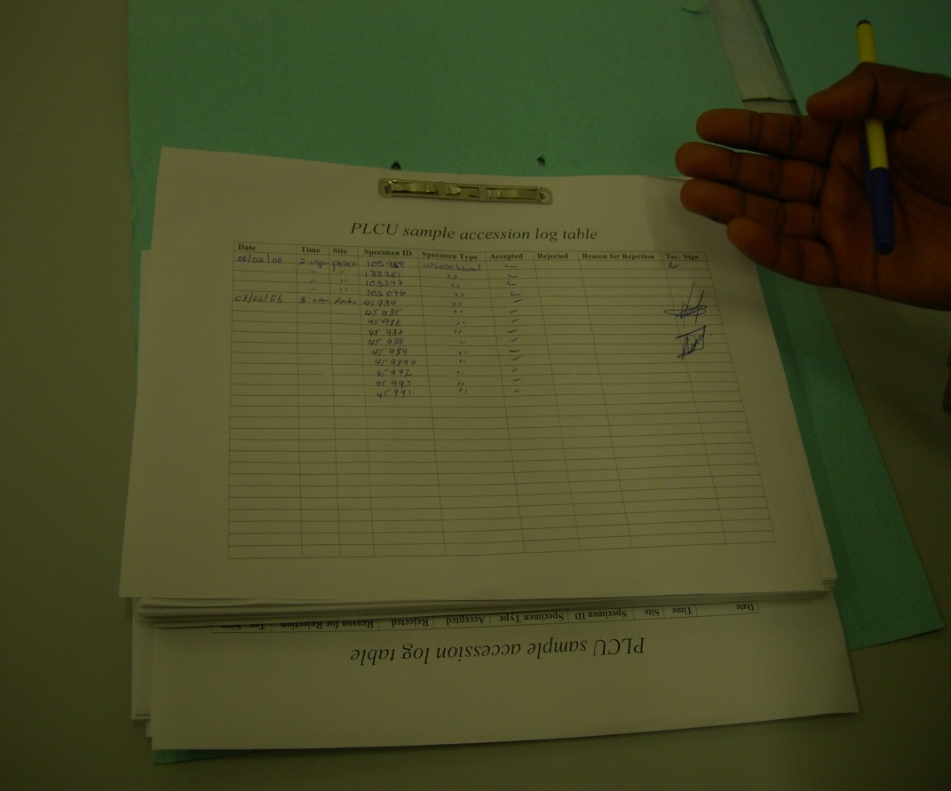
Paper-based Systems
Comprised of manual logs, worksheets, QC charts, occurrence reports, laboratory reports, laboratory investigation forms, and general lab administration reports and records.
Notes:
Standardized forms have been developed by MOH for documenting all of the above information. Systems must then exist for filing and storing the information.

Slide 19

Paper-based Systems (Continued)
Requirements for paper systems:
  Assure complete data entry
  Assure legibility by writing as
  little as possible
  Assure unique specimen ID number (accession logs, requests,
  and reports)
  Assure proper storage and retention for prescribed period
Notes:
Retention periods must be defined by MOH for record retention

Slide 20

Goal of Paper-based Systems
Able to trace/reconstruct
what occurred at each step during the testing process
Easily find laboratory
requests and reports
as needed
Assure confidentiality of laboratory information

Slide 21
Organization of Paper-based Systems
Labs must have an organized system to retain and readily access important paper information
Options include log books, file cabinets, and binders
Organize information sequentially by month, date, year or alphabetically by month, date, year (Laboratory Reports)
Need system for copying and archiving records

Slide 22
Organization of Paper-based Systems (Continued)
Determine what information is needed and where it is located
  Organize related information in the same location - QC with QC, laboratory reports with laboratory reports
  Organize the information so that related data can be reviewed together – for example, QC results and corrective actions

Slide 23
Today’s Agenda
Quality Systems
Information Management Options
  Manual
  Automated
  Laboratory Information System (LIS)
LIS Components and Architecture
LIS Capabilities
Module Summary

Slide 24
Automated Systems (Non-LIS)
Instrument software
  Information is stored on-line in instrument computers for QC functions
Personal computers/software programs
  Excel and other programs can be used for recording and charting QC
In-house developed system using commercial database software
Notes:
Avoid putting games, DVD and other media on these computers as files may get corrupted.

Slide 25
Exercise
In your laboratory, you have daily QC information for chemistry, hematology, and flow cytometry instruments.
How do you document and manage your QC information?

Slide 26
Advantages of Computerized System
Permanence, easy long-term storage
Security and confidentiality
Easy access to all patient results and data
Reduction in errors due to legibility issues
Rapid turnaround time for reporting
Access to large volume of QC data and statistics
Traceability

Slide 27
Disadvantages of Computerized System
Cost of equipment
Need for equipment maintenance
Consistent power requirements
Need for special skills and training
Time consuming to implement and train staff
Back-up system and disaster recovery plan must exist

Slide 28
Today’s Agenda
Quality Systems
Information Management Options
  Paper-based
  Automatic
  Laboratory Information System (LIS)
LIS Components and Architecture
LIS Capabilities
Module Summary

Slide 29
Laboratory Information System (LIS)
A laboratory information system (LIS) will enable laboratories to:
  Manage their data
  Maintain quality
  Improve efficiency while focusing limited labor resources
An LIS has tools and a database structure specific to the laboratory workflow.
  Manual entry procedures and errors are minimized and data flow is automated by LIS software.
Notes:
This automation centralizes laboratory information, reduces errors, and makes
the retrieval of testing information fast and easy from a centralized location.
More than just a tool for laboratories, LIS solutions can be configured to share
data with an institution’s central computer system, permitting a detailed track of
a patient’s activities and health status from the time he or she is admitted,
diagnosed, and treated.

Slide 30
Laboratory Information Systems (LIS)
Multiple sizes and functionality
General or specialized applications (i.e. clinical lab, blood banking)
Hardware and software components
Storage capacity requirements

Slide 31
What questions do you have on the various options for laboratory information management?

Slide 32
Today’s Agenda
Quality Systems
Information Management Options
  Paper-based
  Automatic
  Laboratory Information System (LIS)
LIS Components and Architecture
LIS Capabilities
Module Summary

Slide 33
Components of LIS
Network
Computer Hardware
  Servers
  Cables
  Workstations
  Printers
Computer Software
  Programs (applications)
  Databases

Slide 34
Computer Hardware
Servers
  Physical “boxes” that control operations of the system and house databases
Cables
  Lines that connect remote workstations to the servers or other hardware (i.e. printers, instruments)
Workstations
  Physical components generally considered to be the computers (local hard drives, monitors, and keyboards)

Slide 35

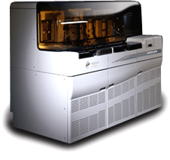
LIS System Architecture
Terminal Server
Server
Workstations
Instrument
Printer

Slide 36
LIS Computer Software
Programs (applications)
  Contain the system instructions for performing operations and functions
  Written in various programming “languages”
  Most often reside on the servers
Databases
  Usually stored on the servers
  Contain the data entered via the programs (i.e. patient data, test directories)

Slide 37
What questions do you have on components and architecture
of a laboratory information system?

Slide 38
Today’s Agenda
Quality Systems
Information Management Options
  Paper-based
  Automatic
  Laboratory Information System (LIS)
LIS Components and Architecture
LIS Capabilities
Module Summary

Slide 39
LIS Essential Capabilities
Ease of Use
Interfaces
  instruments, hospital system, other systems
Order entry, registration/accessioning, and receiving
Result processing and reporting
Data storage and retrieval
System security, back-up, maintenance
Audit trails and management reports

Slide 40
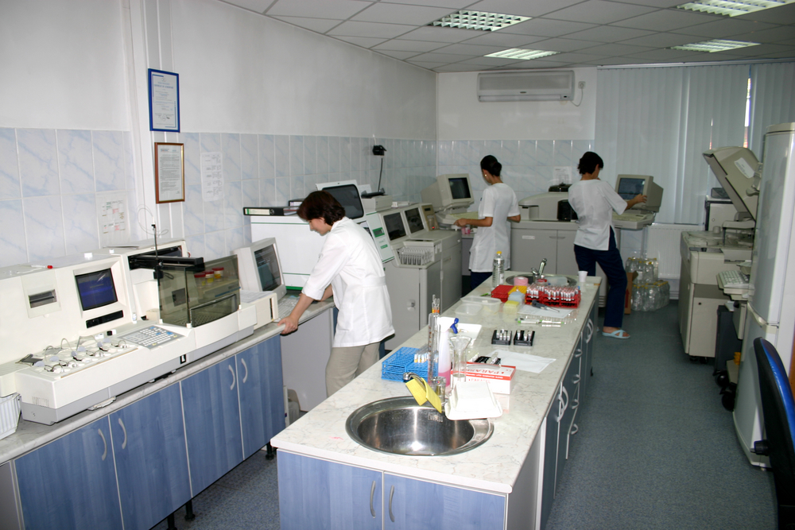
Ease of Use
Screens should be easy to read and allow for smooth movement between functions
Automatic abnormal result flagging
Sample identification number generation

Slide 41

Ease of Use (Continued)
Generation of bar codes
enhances workflow and
reduces chance of error
Previous test results on
a patient can be viewed
along with new results
Hospital computer download of patient data eliminates redundant typing and errors
Batch result (s) entry for quick accurate entry
Notes:
Add major components of bar code ;talk about scanning of barcodes

Slide 42
Interfaces
The LIS interfaces laboratory
analyzers, allowing laboratory
staff to order test data from
any workstation
When testing is completed,
results are uploaded to the
system automatically, or
manually entered through
data entry user interface

Slide 43
Interfaces (Continued)
A technologist evaluates the results and releases them for reporting
Need to understand interface requirements
  Connectivity
  Electronic message format

Slide 44
What questions do you have on ease of use and interfaces LIS capabilities?

Slide 45
LIS Essential Capabilities
Ease of use and interfaces
  instruments, hospital system, other systems
Order entry, registration/accessioning, and receiving
Result processing and reporting
Data storage and retrieval
System security, back-up, maintenance
Audit trails and management reports

Slide 46
Order Entry
An order is placed in the system usually by a clinician, nurse, lab assistant or technologist
The order contains the tests to be performed
Orders may be tracked with a unique identifier
The identifier (which is usually a number) is most commonly referred to as an accession, specimen, or sample number

Slide 47
Order Entry (Continued)
The barcode labels with the unique patient accession number for the draw tubes are printed by the LIS. This provides the ability to track the specimen from the point it is taken from the patient to the point that it gets discarded.
Using the barcode labels, a phlebotomist will collect the appropriate specimen(s) from the patient. Following collection, the specimens are labeled with the printed bar code labels and returned to the laboratory.

Slide 48
Order Entry (Continued)
Duplicate Order Checking
The LIS will cancel duplicate tests ordered on the same accession number
Depending on the LIS, the duplicate tests may show as cancelled on the final report, or may not show up at all

Slide 49
Specimen Receiving
After the specimen is collected, it is sent/brought to the lab for processing. This event is recorded in the LIS as specimen receipt.
Upon receipt, either manual or automated testing begins. Most LIS systems are configured to download the specimen data to an analyzer either after the order is placed or when a specimen is received in the lab.

Slide 50
Specimen Receiving (Continued)
When the specimen is placed on the instrument, the unique ID is read from the barcoded label and matched with the order previously downloaded to the instrument.

Slide 51
What questions do you have on order entry and specimen receiving LIS capabilities so far?

Slide 52
LIS Essential Capabilities
Ease of use and interfaces
  instruments, hospital system, other systems
Order entry, accessioning, and receiving
Result processing and reporting
Data storage and retrieval
System security, back-up, maintenance
Audit trails and management reports

Slide 53
Results Entry
When results of lab tests are available, they are entered into the system manually or automatically downloaded from an instrument
Once the results are double checked by the medical technologist, they are released to the patient record
Released results are often automatically printed on lab reports which are delivered to the attending physician

Slide 54
Results Processing
Auto verification of results within the defined normal ranges
Manual review of results outside of preset criteria
Result edit capability; edits recorded in audit trail
Automatic delta checking capability

Slide 55
Results Processing (Continued)
High, low and panic value flagging
Automatic display of previous results obtained within defined timeframe
Coded comments may be attached for consistency
Manual entry of offline results

Slide 56
Results Reporting
Lab reports containing patient results are the final output of all LIS systems, and in many cases, the primary LIS interaction with healthcare providers outside of the lab
Reports can be printed locally, printed remotely, autofaxed or delivered electronically
The degree to which an LIS supports customizable lab reports and flexibility in result delivery methods should be considered when purchasing a new laboratory information system

Slide 57
Results Reporting Formats
Types of report formats:
Individual reports per accession number or occurrence
Cumulative reports for multiple days or occurrences (i.e. all results for a hospital stay)
LIS may have ability to create user-defined patient report formats

Slide 58
Results Reporting Requirements
Calculation verification at periodic intervals
  Compare manual calculation to system calculation
Detection of unbelievable or illogical results
Reportable range limit flagging
Notes:
Detection of unbelievable results – discuss that these are values that would impossible for a human to have. May be due to specimen collection errors, instrument malfunction, calculation errors, etc.

Slide 59
Results Reporting Requirements (Continued)
Allows for comments on specimen quality that might compromise the accuracy of analytic results (i.e. hemolyzed, lipemic)
Manual and automated result entries are verified before final acceptance and reporting by the computer
Corrections to report are clearly identified
  What change was made and when
  Record of what values were originally reported

Slide 60
Results Reporting Requirements (Continued)
Ability to deliver reports at different status levels
  Preliminary reports – Some results on the order have been completed but others are still pending
  Final – All tests on an order are completed
  Amended – A test result value has been changed after a report has been delivered
  Corrected – Patient demographic information has been changed (i.e. patient age) after a report has been delivered
Notes:
Amended reports are used for a change in a result value. Corrected reports are used for changes to patient demographics.

Slide 61
What questions do you have on result entry, result processing, and result reporting LIS capabilities?

Slide 62
LIS Essential Capabilities
Ease of use and interfaces
  instruments, hospital system, other systems
Order entry, accessioning, and receiving
Result processing and reporting
Data storage and retrieval
System security, back-up, maintenance
Audit trails and management reports

Slide 63
Data Storage and Retrieval
A complete copy of archived patient test results can be reprinted, including original reference ranges and interpretive comments, any flags or footnotes that were present in the original report, and the date of the original report
When multiple identical analyzers are used, they should be uniquely identified such that a test result may be appropriately traced back to the instrument performing the test

Slide 64
Data Storage and Retrieval (Continued)
A process should be developed to ensure that the data storage capacity and performance of the system are sufficient to meet the patient needs of the organization
Procedures should be in place for the preservation of data and equipment in case of an unexpected destructive event (e.g., fire, flood), software failure and/or hardware failure
Procedures must allow for the timely restoration of service

Slide 65
Data Storage and Retrieval (Continued)
Storage data media, such as tape reels or disk cartridges must be properly labeled, stored and protected from damage and unauthorized use
  Off-site storage
  Retrieval within specified timeframe
  Documentation that the process has been tested and works as expected

Slide 66
What questions do you have on data storage and data retrieval LIS capabilities?

Slide 67
LIS Essential Capabilities
Ease of use and interfaces
  instruments, hospital system, other systems
Order entry, accessioning, and receiving
Result processing and reporting
Data storage and retrieval
System security, back-up, maintenance
Audit trails and management reports

Slide 68
System Security
Policies that specify who may use the computer system to enter or access patient data, change results, change billing or alter programs
Computer access codes (security codes, user codes) must be in place to limit user access to those functions they are authorized to use ( some more privileges than others)
Security of access codes is maintained (i.e. inactivated when employees leave, not posted on terminals)
Assure proper log in and log off

Slide 69
System Security (Continued)
Establish user specific security access
  Changes authorized by manager
Required periodic change of passwords by users
Password complexity requirements (i.e. combination of alpha numeric codes)
Record of failed log-on attempts; automatic lockout after a defined number of unsuccessful attempts

Slide 70
System Security (Continued)
If multiple use computers are in place (i.e. LIS applications plus internet access)
  Restricted access for installation of unauthorized software
    Prevent system instability
    Prevent introduction of viruses
Public network (internet) use must protect patient data

Slide 71
System Function and Back-Up
A copy of the database information should be made at regular intervals (i.e. nightly) so data can be restored in case of primary system failure
Computer error messages should be generated that alert computer users of imminent problems
  Disk space limitation
  Network problems
  Server location climate controls
Error messages should be monitored and logged

Slide 72
System Function and Back-Up (Continued)
Responses to error messages that occurred during the system backup are documented
  Review of nightly back-up process
Record is maintained of unscheduled downtime, system degradation (response time), or other computer problems that includes reasons for failure and corrective actions taken
  Troubleshooting logs
  Process improvement records

Slide 73
System Maintenance
Downtime for maintenance is scheduled to minimize interruption of service
Develop schedule and procedure for regular maintenance of hardware and software either by maintenance contracts with vendors or in-house procedures
Prepare service and repair records for all hardware components and software programs

Slide 74
System Downtime
Procedures to ensure reporting of patient results in a prompt and useful fashion during partial or complete downtime and recovery of the system
  System should be tested to ensure it works
  Policy for entry of results after system is brought back on-line
Emergency service for both computer hardware and software available
  Internal service (hospital IT department)
  External service (vendor support)

Slide 75
Network Performance
Periodic monitoring of network performance
  Use of packaged or custom monitoring systems
Network equipment is accessible, well-maintained, adequately labeled
Identification of which devices are using a specific port
  Device names are necessary for immediate identification of location in case of network failure

Slide 76
What questions do you have on system security, system back-up, and system maintenance LIS capabilities?

Slide 77
LIS Essential Capabilities
Ease of use and interfaces
  instruments, hospital system, other systems
Order entry, accessioning, and receiving
Result processing and reporting
Data storage and retrieval
System security, back-up, maintenance
Audit trails and management reports

Slide 78
Audit Trails
Manual and automated results should be verified before being released, and the person performing verification identified in the audit trail
Autoverification should also be tracked as to when it was completed

Slide 79
Audit Trails (Continued)
Document identification of users who have entered results
Documentation is tracked by test (when multiple tests are ordered together)
Should include who performed testing and who released the results
Documentation of amended or corrected results
  By whom
  When

Slide 80
Management Reports
Test ordering patterns available by clinician and location
Workload reports by category, clinician, laboratory and more
Lab time efficiency reports (turnaround time statistics)

Slide 81
Exercise
Work in pairs
Assess your current information management system describing its strengths and weaknesses.
Which aspects would be desirable to automate? How?

Slide 82
What questions do you have on audit trails and management reports LIS capabilities?

Slide 83
Today’s Agenda
Quality Systems
Information Management Options
  Paper-based
  Automatic
  Laboratory Information System (LIS)
LIS Components and Architecture
LIS Capabilities
Module Summary

Slide 84
Module Summary
Described the basic elements of information management
Described the laboratory information system hardware and software components
Provided essential laboratory information system capabilities
Described the benefits of using printed barcode labels generated from the LIS for specimen labeling

Slide 85
Module Summary (Continued)
Described the difference between the types reports that can be generated from the LIS
Described the purpose of a documented audit trail within the LIS
Described the purpose of performing a laboratory information system back-up process

Slide 86
What questions do you have on Information Management?

Slide 87
Thank you

