Slide 1

BIOSAFETY POLICIES

Slide 2
Objectives
At the end of this unit, the participants are expected to:
Describe International biosafety and biosecurity policy guidelines and regulations.
List National biosafety and biosecurity guidelines and regulations

Slide 3
Presentation Outline (1)
Background
WHO’s mandate for Lab Biosafety/Biosecurity Program;
International Health Regulation (IHR) of 2005
IHR and Roles of Lab. services
World Health Assembly Resolution 58.29(WHA 58.29).
Notes:
Souligner l’importance des laboratoires dans la surveillance des maladies
Néanmoins dans la Région africaine le laboratoire a tojours été le maillon faible de la surveillance épidémiologique
La Résolution AFR/RC48/R2 sur la SIMR est venue le rappeler en demandant aux pays de développer les capacités des laboratoires comme première étape dans l’amélioration de la surveillance des maladies.

Slide 4
Presentation Outline (2)
WHO Support to Member countries on Lab. Biosafety/Biosecurity Program;
IHR Lab. requirements
Notes:
Souligner l’importance des laboratoires dans la surveillance des maladies
Néanmoins dans la Région africaine le laboratoire a tojours été le maillon faible de la surveillance épidémiologique
La Résolution AFR/RC48/R2 sur la SIMR est venue le rappeler en demandant aux pays de développer les capacités des laboratoires comme première étape dans l’amélioration de la surveillance des maladies.

Slide 5
Background
Communicable diseases remain the most important public health problem in Africa.
The African Region has experienced events that can cause non communicable hazards:
→ Toxic waste dumping - Cote d'Ivoire (2006)
→ Mass bromide poisoning - Angola (2007)
→ Lead poisoning - Senegal (2008) & Nigeria (2010) etc..
IHR require Lab services for diagnosis/management of;
- communicable diseases
- Non communicable diseases related to;
- Zoonosis, Food Safety, Chemical, Radiological nuclear
Notes:
Souligner l’importance des laboratoires dans la surveillance des maladies
Néanmoins dans la Région africaine le laboratoire a tojours été le maillon faible de la surveillance épidémiologique
La Résolution AFR/RC48/R2 sur la SIMR est venue le rappeler en demandant aux pays de développer les capacités des laboratoires comme première étape dans l’amélioration de la surveillance des maladies.

Slide 6
Background (2)
Resolution AFR/RC58/R2 (2008)
  Member States were urged to;
  - Have well-staffed and equipped labs.
  - strengthen disease surveillance system
  - strengthen Public Health Laboratories.
Resolution AFR/RC59/WP/3 (2009)
- Member states were asked to establish;
  - Multidisciplinary Centres of Excellence to support Public Health Emergencies in the Region.
Notes:
Ainsi, au niveau régional, un nombre important d’activités de renforcement des capacités des laboratoires a été menée:
Mise en place de réseaux régionaux et sous-régionaux de laboratoires
Mise en place de programmes régionaux d’Évaluation Externe de la Qualité
Formation des personnels de laboratoire sur des thèmes techniques variés

Slide 7
Biosafety and Biosecurity Policy Guidelines and Regulations
    International instruments promoting biosafety and biosecurity are:
      International Health Regulations
      Biological Weapons Convention
      World Health Assembly .
      United Nations Security Council Resolution 1540
      Regional & National Biosafety and Biosecurity Policies and Regulations

Slide 8


WHO’s public health mandate
for biosafety and laboratory biosecurity
WHO Constitution of 1948
  →" Attainment by all people of highest possible levels of health”
World Health Assembly resolution 55.16 (2002)
  →"Global public health response to natural occurrence, accidental release or deliberate use of biological and chemical agents or radionuclear material that affect health”
World Health Assembly resolution 58.29 (2005)
  →"Enhancement of laboratory biosafety"
WHAR 58.3 (2005):
→“Prevention and control of the international spread of disease and public health risks”

Slide 9
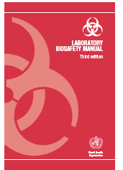
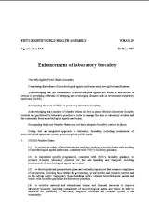
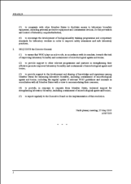
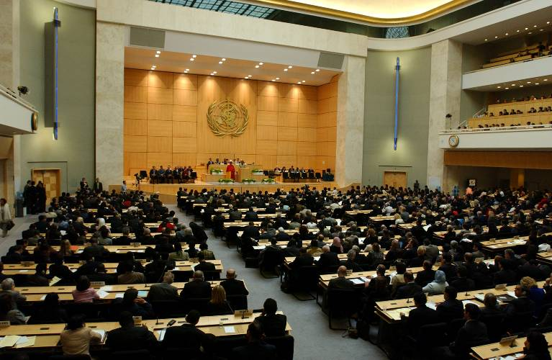
WHA 58.29
Enhancement of laboratory biosafety
May 2005
Member States to:
review safety of labs, follow WHO guidance
implement safety progs, follow WHO guidance
enhance compliance with biosafety guidelines
mobilize human and financial resources
cooperate with other MS(member states) to facilitate access to PPE
encourage dev of biosafety training progs and
competency standards

Slide 10
WHA 58.29
WHO is requested to;
provide Lab. Capacity
Accelerate training efforts
Encourage regional net working
Encourage QA.
Reinforce Biosafety/Biosafety program
Support health programmes and partners
Update relevant guidelines
EQA should be one of the pillar of the laboratory compliance with the IHR (2005), to help the international community to trust – or not - a laboratory result

Slide 11
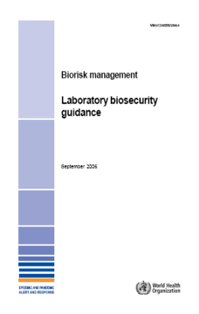
Laboratory biosafety is the basis on which to build laboratory biosecurity
Laboratory biosafety describes containment principles, technologies and practices implemented to prevent unintentional exposure to pathogens and toxins, or their accidental release.
http://www.who.int/csr/resources/publications/biosafety/WHO_CDS_CSR_LYO_2004_11/en/
'Protect people from pathogens'
Prevention of accidental or 'deliberate' release from labs
Laboratory biosecurity describes the protection, control and accountability for valuable biological materials (VBM) within laboratories, in order to prevent their unauthorized access, loss, theft, misuse, diversion or intentional release.
http://www.who.int/csr/resources/publications/biosafety/WHO_CDS_EPR_2006_6/en/index.html
'Protect pathogens from people'

Slide 12
WHO support to countries on BB Publications (1)
Laboratory biosafety manual,
3rd edition, 2004
translated into FR, SP, PO, CH, RU; it, jp, se, vt
available on the web and in hard copies
Biorisk management:
recommendations on how to work safely,
addresses users and policy makers
introduces 'laboratory biosecurity'
►75,686 page views of SP in Sept 07, 2nd only to the
Disease Outbreak News page in EPR
http://www.who.int/csr/resources/publications/biosafety/WHO_CDS_CSR_LYO_2004_11/en/

Slide 13
Biological Toxins &Weapons Convention originally known as BWC
  →“Prohibits the development, Production, destruction and Stockpiling of Bacteriological (Biological) and Toxin Weapons.

Slide 14
International Health Regulations (2005)
International Health Regulations, resolution 58.3 (2005)
  →"Prevention and control of the international spread of disease and public health risks"

Slide 15

International Health Regulations (2005)
An international law,
Legally binding for all 193 WHO Member States,
Purpose:
"prevent, protect against, control and provide a public health response to the international spread of disease"
Requires countries to develop;
- National surveillance & reporting capacity
- International surveillance and reporting capacities
May 2005
http://www.who.int/csr/ihr/en/index.html

Slide 16
International Health Regulations (2005) and Role of Laboratory
→ Assessment of events (insufficient laboratory capacity = serious event) (annex 2)
→Detection – laboratory data = early warning signal (annex 1)
→Response element (laboratory analysis of samples, domestically or through collaborating centres) annex 1)
→ Notification to WHO (continuous communication of laboratory results) (art. 6)
→ Recommendations by WHO with respect to the persons may include any laboratory analysis (art. 18)

Slide 17
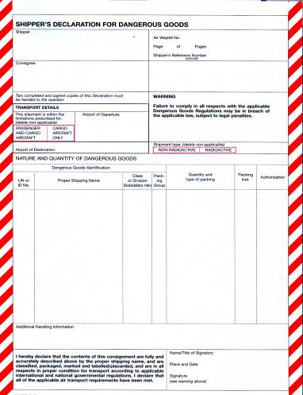
IHR 2005 with regards to diagnostic specimens
lab supplies and other diagnostic materials
  Countries shall for public health response purposes
  facilitate;
  - the transport, entry, exit,of biological substances
  - their processing and disposal,

Slide 18
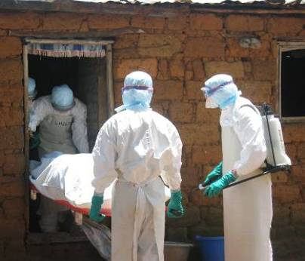
Lab support to outbreak response-
key messages
Laboratory services are to;
- identify causes of outbreaks
- confirm causes of outbreaks.
-Optimal working conditions include:
    communication
    specimen collection and transport
    financial resources
    biorisk management
    trained staff
    suitable infrastructure
    functioning equipment
    appropriate reagents
    reliable results
Laboratory capacity needs can be met supranationally
Notes:
Increasing recognition that WHO cannot replace or make up for weak or missing capacity at national level

Slide 19
United Nations Security Council Resolution 1540
→” The resolution calls for the establishment of a national legal framework include the following elements:
  A system to account for and secure items in production, use, storage or transport;
  Effective physical protection measures;
  Effective border controls and law enforcement measures; and
  Effective national export and trans-shipment controls.

Slide 20
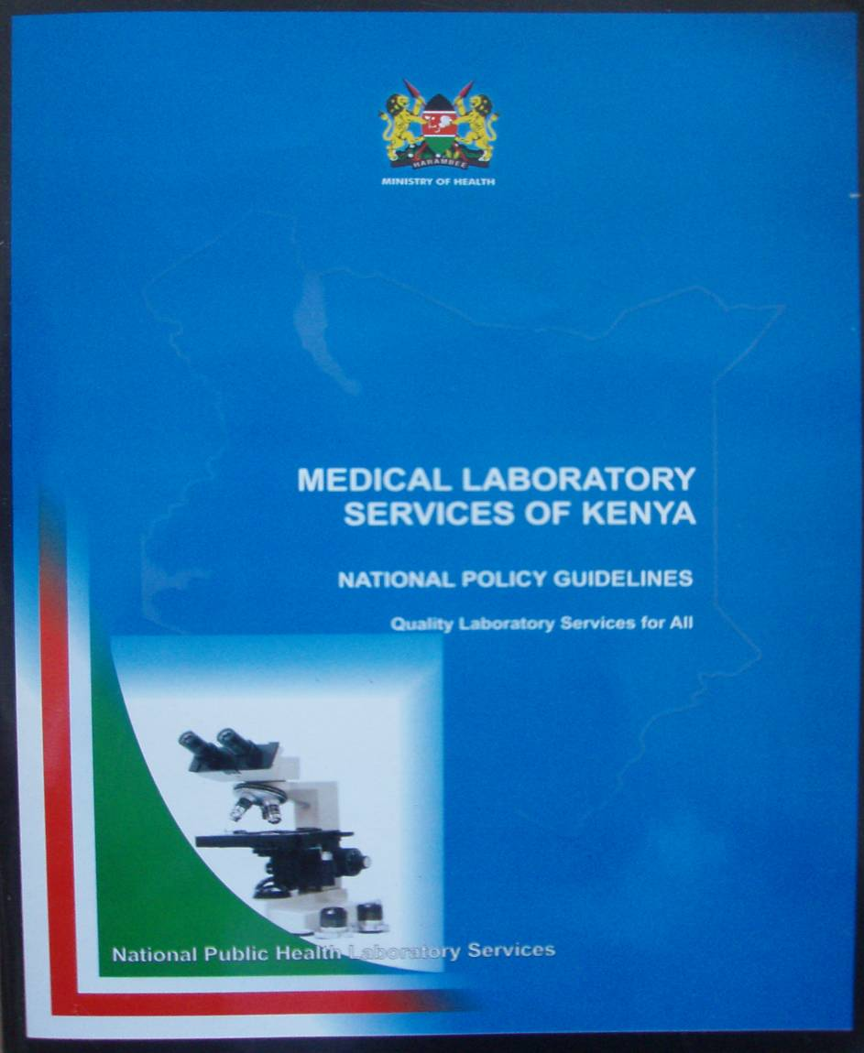
Current status in the AFR (1)
National Lab. policies and strategic plans are being developed
  → Initiation of guidelines to orient countries on the establishment of NPHLS and development of national laboratory policies and strategic plans

Slide 21
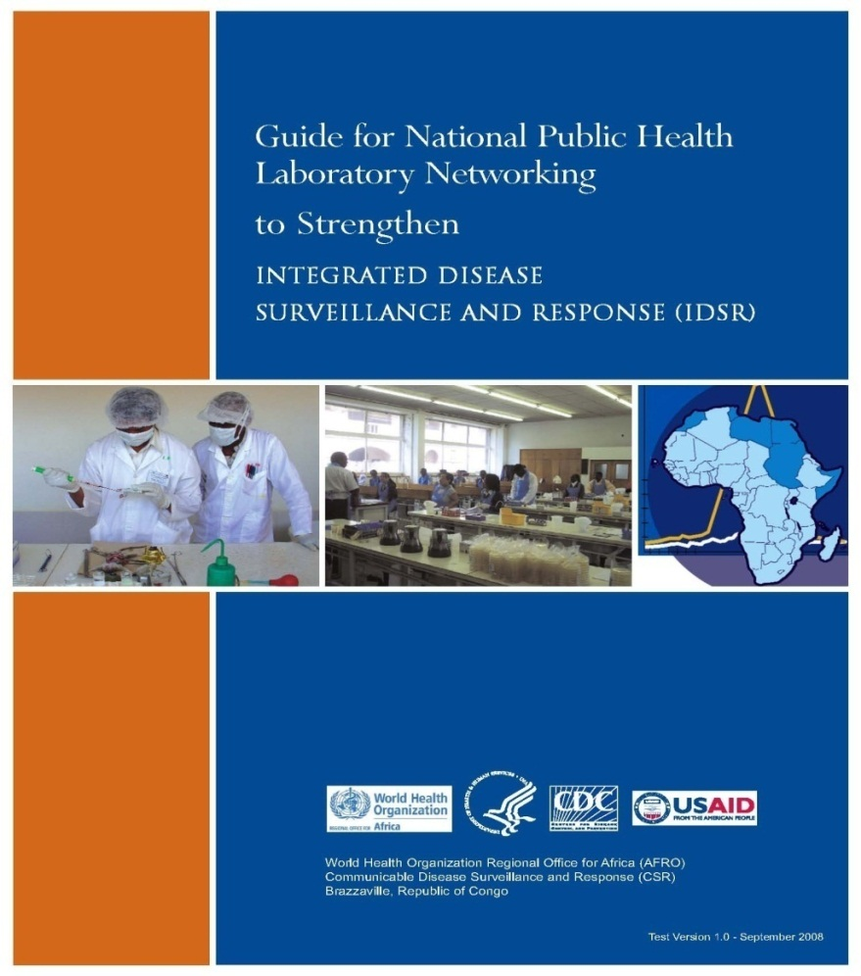
Current status in the AFR (2)
→ Networking of laboratories
“Guide for NPHL Networking to strengthen IDSR”
Out of 33 countries providing information, 22 (67%) countries have national lab network.

Slide 22
Current status in Kenya
Development and enactment of guidelines/policies that govern biosafety& Biosecurity concepts in Kenya
National IPC Guidelines
National Biosafety Policy
National Laboratory Quality Manual
Tuberculosis Infection Prevention Guidelines
Establishment of Biosafety & Biosecurity Office at the NPHLS
Biosafety and Biosecurity Curriculum and Guidelines

Slide 23
National Safety Policies Governing Biosafety Practices and Regulations
The participants are expected to familiarize with
AMONG OTHERS
Kenya National guidelines on Occupational Safety Health Act (OSHA) and its applications.
  - OSHA requirements include establishment of occupational health and safety accounting office with adequate employees
Public Health Act CAP 242

Slide 24
Lab Desirable Requirements
To have comprehensive laboratory capacity to conduct all the lab tests
Organization of Laboratory to be based on;
- Reliable sample collection
- Good transport system,
- Reliable domestic diagnostic capacity for the priority events
- Good networking system
Each member state to asses the structure of their laboratory capacity system and assess its proficiency in order to meet the IHR requirements

Slide 25
Lab Desirable requirements
Having inventory of all labs.and their capacities;
    → A list of laboratories, including toxicology laboratories, designated by the Ministry of Health as part of the national system for alert and response according to the public health priority threats should be available.
Contractual agreements with external Labs;
    →Appropriate external collaborating centres should be identified and liaised with, for confirmation of epidemic-prone diseases and public health risks (chemicals and radiological hazards).

Slide 26
Lab Desirable requirements
Every Member States to ensure Labs have;
- reliable sample collection system
- domestic and international transport system
- Biosafety and Biosecurity guidelines
- Strong focus on quality systems
- Gone through accreditation process

Slide 27
Lab Desirable requirements
All laboratories that are part of the alert and response system should: → Engage in a quality assurance programme
based on national quality standards and
regularly tested through exercises.
  → Belong to an external quality assessment
  schemes through proficiency testing or
  rechecking between laboratories.
  Member countries to have;
  - Accreditation body
  - Collaboration with international accreditation bodies

Slide 28
Thank You.

