Slide 1
Concepts of Biosafety and Biosecurity

Slide 2
Unit 2
Concepts of Biosafety and Biosecurity

Slide 3
Objectives
At the end of this unit, participants are expected to:
  Describe the principles of biosafety
  Explain containment as one of principles of biosafety
  Describe the 4 biosafety levels
  Discuss the 4 microorganisms risk groups
  Explain biosecurity in relation to biosafety
  Describe the Principles of Laboratory Biosecurity
  Describe the components of Laboratory Biosecurity

Slide 4
Definitions
Containment
  Primary containment
  Secondary containment
Biosafety levels
  BSL1
  BSL2
  BSL3
  BSL4

Slide 5
Containment
  Describes safe methods for managing infectious materials in the laboratory to reduce or eliminate exposure of laboratory workers, other persons, and the environment.
  Primary containment
  Protects personnel & immediate lab environment and is provided by good microbiological technique and use of appropriate safety equipment.
  Secondary containment
Protects the environment external to the laboratory and is provided by facility design and construction.

Slide 6
Biosafety Levels
Are combinations of primary and secondary containment and safety guidelines that are designed for use in Clinical and research labs.
They are classified into 4 levels as per the increasing risk.
Designations are based on a combination of the design features, construction, containment facilities, equipment, practices and operational procedures.

Slide 7
Biosafety Level 1
The least level containment
Has minimal potential hazard to laboratory personnel and the environment
Suitable for work involving well-characterized agents not known to consistently cause disease in healthy adult humans such as Bacillus subtilis

Slide 8
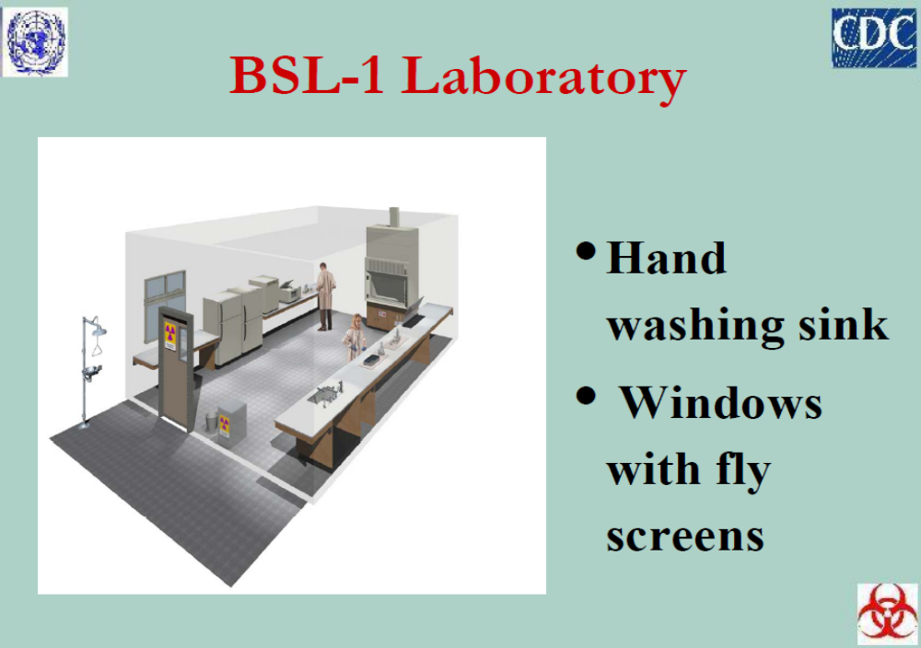

Slide 9
Biosafety Level 2
Appropriate when working with moderate-risk agents that cause human disease of varying severity, transmission by ingestion e.g. Salmonella species and also percutaneous or mucous membrane exposure.
In addition to BSL 1 requirements, the following are key in BSL 2;
Site specific Biosafety manual with SOPs
Availability of autoclave

Slide 10
Biosafety Level 2 Cont’d
Minimize procedures that cause aerosols
Transport materials in special containers

Slide 11
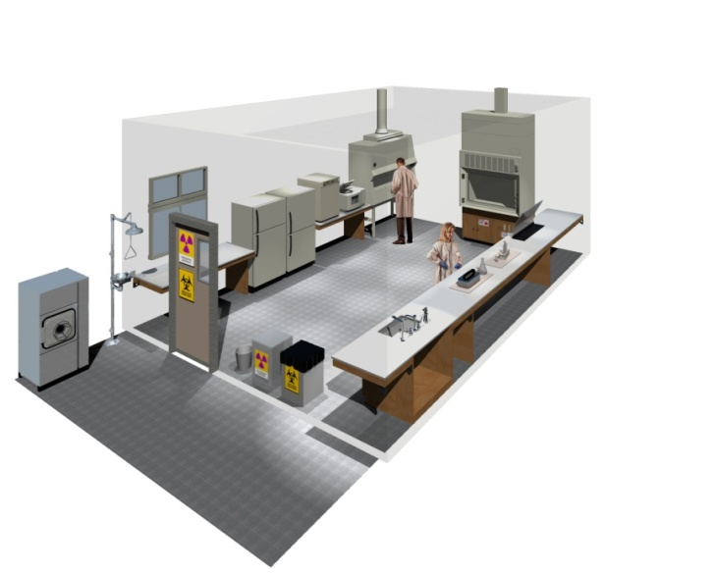
Biosafety Level 2

Slide 12
Biosafety Level 3
work with indigenous or unusual agents that have a known potential for aerosol transmission and that can cause serious and potentially fatal infections e.g. TB or varicella (chicken pox).
In addition to BSL 2 requirements, the following are key in BSL 3
Wrap around to solid front gowns or overalls should be worn over your clothing

Slide 13
Biosafety Level 3
Eye/face respiratory protection worn.
Equipments autoclaved/decontaminated before transport to other areas in the facility
Exit process may include a shower
Optional double door access (air lock for movement of equipment)

Slide 14
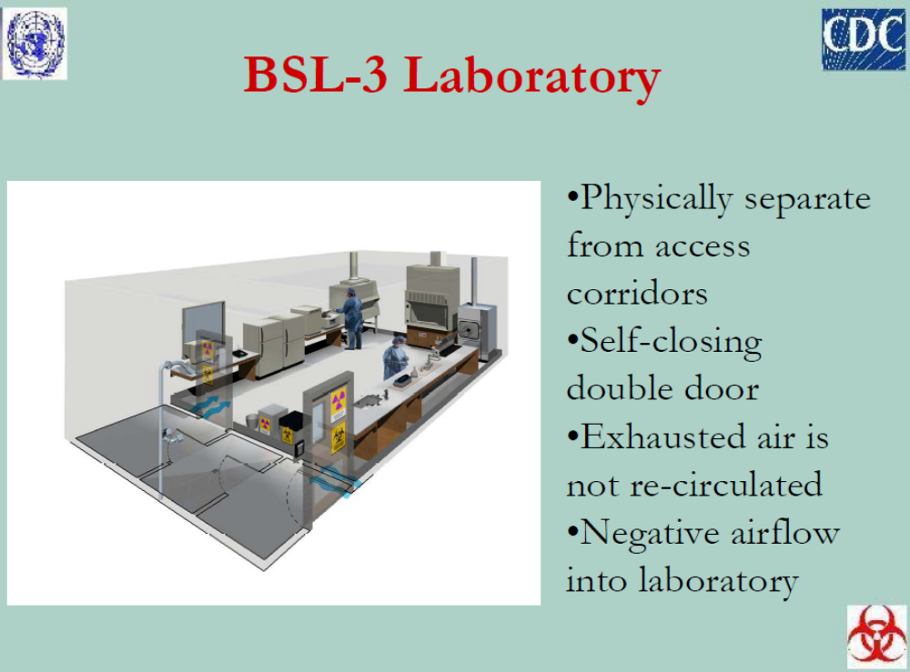

Slide 15
Biosafety Level 4
Required for work with dangerous and exotic agents that pose a high individual risk of aerosol-transmitted laboratory infections
Agents which cause severe to fatal disease in humans for which vaccines or other treatments are not available e.g Marburg virus, Ebola

Slide 16
Biosafety Level 4 Cont’d
In addition to BSL 3, you require the following;
Sign in procedure to monitor personnel
Clothing change before entering the containment
Shower upon exiting
All materials decontaminated.
Biological hazards at this level the use of a positive pressure personnel suit, with a segregated air supply, is mandatory.

Slide 17
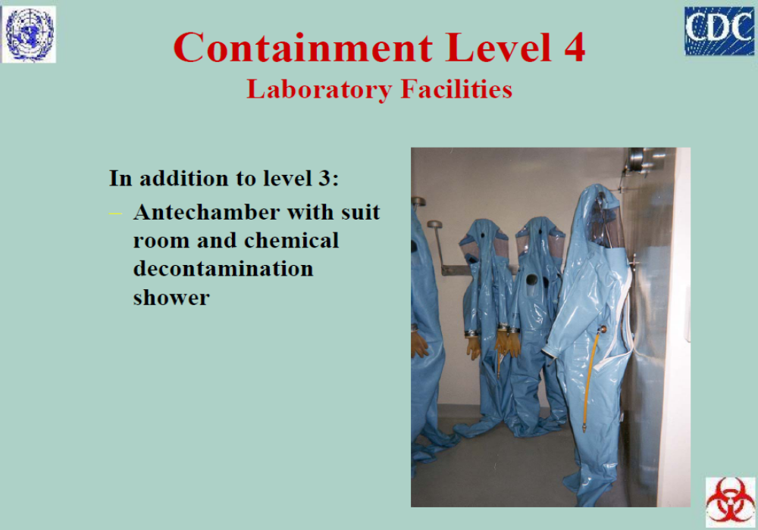

Slide 18
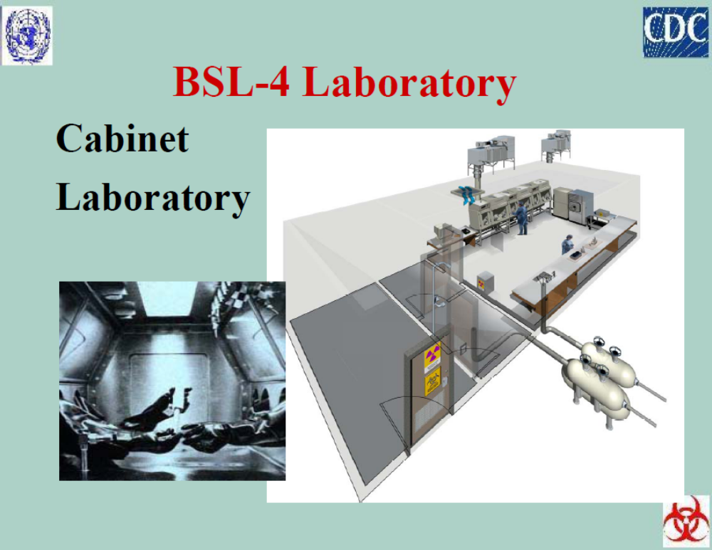

Slide 19
Microorganism Risk Groups
Classification based on;
  Pathogenicity
  Infectious dose
  Mode of transmission
  Host range
  Availability of effective preventive measures
  Availability of effective treatment.

Slide 20
Microorganism Risk Group Classification 2
RG 1 RG 2 RG 3 RG 4
Agents that are not associated with disease in healthy adult humans (Low Individual and Community Risk) | Agents that are associated with human disease which is rarely serious and for which preventive or therapeutic interventions are often available (Moderate Individual Risk, Low Community Risk) | Agents that are associated with serious or lethal human disease for which preventive or therapeutic interventions may be available (high individual risk but low community risk) | Agents that are likely to cause serious or lethal human disease for which preventive or therapeutic interventions are not usually available (high individual risk and high community risk)

Slide 21
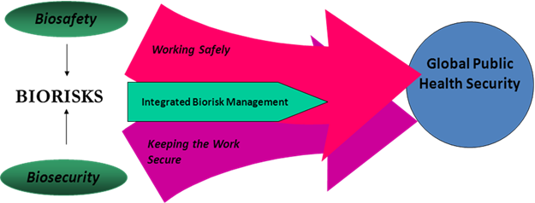
Biosecurity in Relation to Biosafety Programmes

Slide 22
  LABORATORY BIOSECURITY PROGRAM

Slide 23
Valuable biological materials (VBM)
Biological materials that require (according to their owners, users, custodians, caretakers or regulators) administrative oversight, control, accountability, and specific protective and monitoring measures in laboratories to protect their economic and historical (archival) value, and/or the population from their potential to cause harm.
VBM may include pathogens and toxins, as well as non-pathogenic organisms, vaccine strains, foods, genetically modified organisms (GMOs), cell components, genetic elements, and extraterrestrial samples.

Slide 24
Principles of Laboratory Biosecurity Program
Identification of Valuable Biological Materials
Associated agent-based microbiological risk assessment and laboratory biosecurity risk assessment
Bioethical and scientific analysis of research projects before they are authorized
Allocation of responsibilities and authorities among staff and facility managers
Communication between parties involved
Development of and training on emergency plans
Tailored biosecurity training for employees of the facility and for external first responders e.g. in case of fire emergency.

Slide 25
Components of a Laboratory Biosecurity Program
      Laboratory Biosecurity Risk Assessment
      Responsibility for Valuable Biological Materials(VBM)
      Laboratory Biosecurity Plan

Slide 26
Laboratory Biosecurity Risk Assessment
To achieve this biosecurity risk assessment goal, you need to assess the following;
Suitability of personnel
Training
Adherence to VBM protection procedures

Slide 27
Responsibility for Valuable Biological Materials(VBM)
Includes ensuring;
Control and accountability for VBM
Defining their storage location
Describing and scrutinizing their use; identifying personnel (and visitors) who should be granted access to them
Documenting their transfer
Certifying their inactivation and disposal, and
Sharing this information with appropriate counterparts within the facility.

Slide 28
Elements of a Laboratory Biosecurity Plan
An effective biosecurity plan addresses the following;
Policies and procedures
Physical biosecurity
Securing laboratory equipments
Personnel management
Transportation security
Material Control
Information Security
Emergency response protocols addressing security related issues
Training

Slide 29
Elements of LBP cont…..
Policies and procedures
  Establish clear and consistent policies and guidelines
Physical biosecurity
  Comprises of engineering, structural and security personnel elements (access controls)
Securing laboratory equipments
  From unauthorized access, misuse or removal is an important aspect of biosecurity

Slide 30
Elements of LBP cont…..
Personnel Management
  Define the qualifications, roles, responsibilities and authorities of laboratory personnel who need to handle, use, store, transfer and/or transport VBM
Transport Security
  Measures of security during the movement of biological materials outside of the access-controlled areas
Material Security
  Practical realistic steps that can be taken to safeguard and track VBM

Slide 31
Elements of LBP cont…..
Information Security
  Establish good policies for handling sensitive details on VBM.
    Laboratory security plans
    Inventories, and
    Storage locations of VBM
Emergency Response Protocols
  Specific instructions how to engage outside responders (fire brigade, emergency medical personnel or security personnel)
Training

Slide 32
Summary: Activity 1
Based on the lesson on biosafety levels classify your hospital laboratory
What biosafety level is your facility laboratory?
State the reasons for your classification into that biosafety level
Does your laboratory meet the requirements for that biosafety level?
What are the current gaps in this laboratory facility meeting the requirements of that biosafety level?
Outline practical steps in addressing the identified gaps

Slide 33
Activity 2
List what you would consider to be valuable biological material in your health care facility or in your laboratory
How are the VBM kept in your health care facility or laboratory?
Who has access to them?
What kind of diagnostic activities and research are allowed and conducted with the VBM?
Who oversees/supervises the access and use of the VBM?
Who has the ultimate responsibility for these VBM?
Who should have access to information related to these agents, including diagnostic and research results and storage details?

