Slide 1
OCCUPATIONAL SAFETY AND HEALTH
Notes:
OS&H is a cross-disciplinary area concerned with protecting the safety, health and welfare of people engaged in work or employment.
To achieve this requires the development and implementation of a Safety and Health Program

Slide 2
LEARNING OBJECTIVES
Describe how one’s health status affect their job selection
Discuss the hazards associated with specific work activities
Describe risk assessment from specific exposures
Outline preventive measures for work related exposures
Describe the vaccines applicable for prevention
Outline First Aid protocols for various accidents
Describe protocols used for management of exposure to various injuries and/or hazards
Explain the importance and process documenting exposures

Slide 3
OCCUPATIONAL SAFETY &HEALTH
Definition: sum total of all activities and programs that aim to attain and maintain the highest level of health and safety of all health workers.
Covered in the Occupation safety and health Act of 2007
Promotes physical, mental, and social well-being of workers
Requires employer and worker collaboration
Rationale
  Moral
  Economic
  Morale and productivity
Notes:
Poor working conditions of any type have the potential to affect a worker's health and safety.
Overall, efforts in occupational health and safety must aim to prevent industrial accidents and diseases, and at the same time recognize the connection between worker health and safety, the workplace, and the environment outside the workplace. The program be
Work-related accidents or diseases are very costly and can have many serious direct and indirect effects on the lives of workers and their families. For workers some of the direct costs of an injury or illness are:
the pain and suffering of the injury or illness;
the loss of income;
the possible loss of a job;
health-care costs.
workplace hazards are controlled - at the source whenever possible;
records of any exposure are maintained for many years;
both workers and employers are informed about health and safety risks in the workplace;
there is an active and effective health and safety committee that includes both workers and management;
worker health and safety efforts are ongoing.

Slide 4
HEALTH STATUS AND JOB SELECTION
Review of job description (JD)
  Review the prescribed job description against candidate’s physical status.
  Assess capability of the person to perform.
  Based on this accept candidate or recommend re-deployment to a suitable position.

Slide 5
ASSESSMENT OF PERSONAL MEDICAL STATUS IN CONSIDERATION OF JOB
Increased hazard to sub-populations of workers.
Baseline serologic testing should be used for documentation.
Routine medical evaluations are generally not recommended but limited periodic medical evaluations targeted to job.(e.g., respirator usage).
Immunocompromised HCW predisposed to infectious or contagious diseases may be placed under quarantine when necessary.

Slide 6
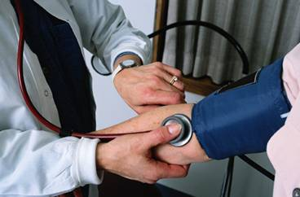
ASEESSMENT BEFORE
WORK BEGINS
Pre-placement medical history
Medical assessments and interventions
Training and Education enhance self-surveillance efforts
  Work-specific
  Species-specific
  Agent-specific
  Method-specific

Slide 7
PRE-PLACEMENT MEDICAL HISTORY
Evaluation of past medical history
  Medical, surgical, social and family history
  Allergies and sensitivities (latex, dander, drugs, foods)
  Previous occupational history and activity
  Medications and other treatments
  Active conditions and review of major body systems
  Review and record past immunization history.
  More info on immunization: www.immunize.org/askexperts

Slide 8
PREVIOUS OCCUPATIONAL HISTORY AND IMMUNIZATION
The previous occupational activities could have exposed you to certain infection. (e.g TB ).
Each worker’s immunization history should be evaluated for:
  completeness and currency at the time of employment
Re-evaluated when the individual is assigned job responsibilities with a new biohazard.
Health workers who are exposed to blood borne pathogens should be immunized against Hepatitis B.

Slide 9
HAZARDS ASSOCIATED WITH SPECIFIC WORK ACTIVITIES
Hazards are situations with the potential to cause harm.
Health care facilities are a safe place to work.
True or False
Name some hazards if any in your work places

Slide 10
HAZARDS ASSOCIATED WITH SPECIFIC WORK ACTIVITIES CONT’
Health worker can get exposed to any of these hazards through the routes illustrated below:
  Ingestion
  Inhalation
  Skin penetration
  Mucous membranes (eyes and mouth)

Slide 11
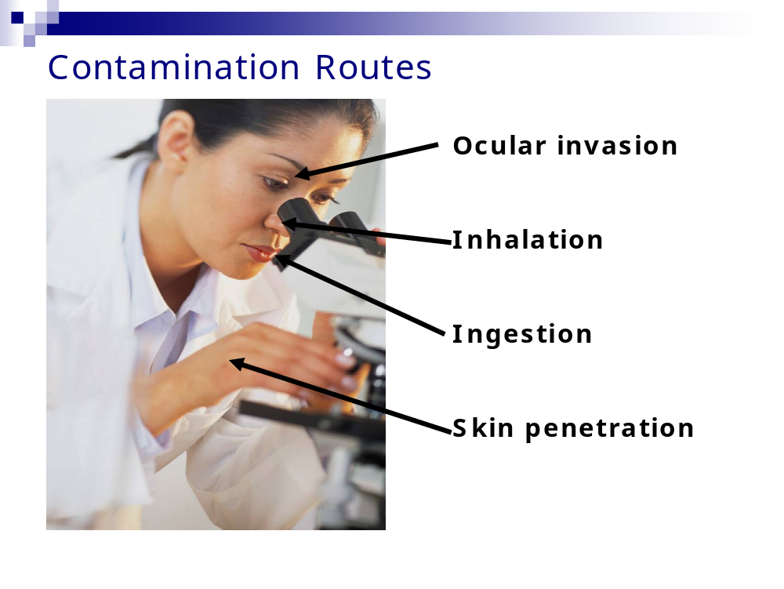
ROUTES OF EXPOSURE

Slide 12
CLASSIFICATION OF HAZARDS IN THE HEALTH CARE FACILITY
It is important to identify potential hazards specific to work place activities. They are classified as:-
Biological
Chemical
Physical
Ergonomic
Mechanical
Psychological
Notes:
Can you name examples in each group?

Slide 13
CLASSIFICATION OF HAZARDS IN THE HEALTH CARE FACILITY
Can you name examples in each group?

Slide 14
CLASSIFICATION OF HAZARDS IN THE HEALTH CARE FACILITY CONT’D
Biological: Patients and HCW may be carrying pathogens of which they are unaware.
If controls are not in place one can be unknowingly be exposed to:
Blood borne pathogens e.g.
  HIV, HBV, HCV among others
Airborne borne pathogens e.g. TB, Flu etc
Other infectious agents and toxins.
Work environment can also introduce biological hazards i.e. molds.

Slide 15
CLASSIFICATION OF HAZARDS IN THE HEALTH CARE FACILITY CONT’D
Chemical: Health facilities use a vast array of chemicals.
Examples of hazardous chemicals may include formaldehyde, used for preservation of specimens for pathology;
Ethylene oxide, glutaraldehyde, and paracetic acid used for sterilization;
Anesthetic gases and numerous other chemicals used in healthcare.
Some drugs administered to patients can be harmful to staff if not properly handled.

Slide 16
CLASSIFICATION OF HAZARDS IN THE HEALTH CARE FACILITY CONT’D
Ergonomic: Are risk factors found in jobs requiring repetitive prolonged exertions or prolonged awkward postures causing musculoskeletal disorders (MSD) e.g:-
  Pipetting
  Lifting patients
  Working in cold and boiler rooms
The level of risk depends on;
  Intensity
  Frequency
  Duration of the exposure to these conditions

Slide 17
CLASSIFICATION OF HAZARDS IN THE HEALTH CARE FACILITY CONT’D
Mechanical: Involves machines or processes:
If equipment is not properly installed or maintained it may;
  Cause a fire
  Electrical safety
Compressed gases or liquids can also be considered a mechanical hazard

Slide 18
CLASSIFICATION OF HAZARDS IN THE HEALTH CARE FACILITY CONT’D
Psychological: Violence or aggression from patients, visitors, residents, staff and clients could take the form of physical, emotional and/or mental abuse.
Stress due long working hours
Trauma working with very sick/dying patients

Slide 19
Risk Assessment from Specific Exposures
Risk assessment has been covered intensively in Module 3 but let us go over them briefly
Can you please define risks?
Risk assessment is a thorough look at your workplace to identify those things, situations, processes, etc that may cause harm, particularly to people.
Notes:
Risks are defined as the probability that a specific adverse event will occur in a specific time period or as a result of a specific situation. It is the combination of likelihood and consequence of a hazard being realized.

Slide 20
RISK ASSESSMENT FROM SPECIFIC EXPOSURES CONT’D
The steps of risk assessment are:
  Identify the risk
  Evaluate how likely and severe the risk is,
  Decides the measures should to put in place to prevent or control the harm.
A risk assessment seeks to answer four simple, related questions:
  Is there a need for action?
  How bad?
  How often?
  What can go wrong?

Slide 21
RISK ASSESSMENT FROM SPECIFIC EXPOSURES CONT’D
A flow diagram showing risk assessment
How Bad?
What can go wrong?
Is there a need for action?
How often?

Slide 22

HAZARD PREVENTION AND CONTROL
Start by determining that a hazard or potential hazard exists
Where feasible, prevent hazards by effective design of job or job site
If the hazard cannot be eliminated, use hazard controls
Eliminate or control hazards in a timely manner
Notes:
Minimizing hazards and preventing exposure are critical to protecting workers.
This is best accomplished through the :-
Hazard identification
site-specific risk assessment process
Corrective, Prevention and control measure
Documentation

Slide 23
PREVENTIVE AND CONTROL MEASURES FOR WORK RELATED EXPOSURES
After a risk has been assessed, measures should be put in place to prevent recurrence (risk management). It involves:
  Recognizing which events (hazards) may lead to harm in the future
  and minimizing their likelihood (how often?) and consequence (how bad?).
The preventative and control measures for work related exposure are specific to the type of hazard

Slide 24
PREVENTIVE AND CONTROL MEASURES FOR WORK RELATED EXPOSURES CONT’D
Biological: Will be effectively reduced by using Standard precautions. These are rules designed to protect HCW from work acquired infections, namely:
Hand washing
Personal protective equipment (PPE)
Needle sticks injury prevention
Respiratory hygiene
Environmental and linen cleaning
Safe waste disposal
Patient care equipment

Slide 25
PREVENTIVE AND CONTROL MEASURES FOR WORK RELATED EXPOSURES CONT’D
Chemical: (this is covered in Module 2 Unit 2)
The Right-To- Know rule is the cornerstone to prevent and control chemical hazards, and is achieved by:
  Consult the MSDS for proper precautions when handling, storing, transporting and disposing different chemicals .
  Notify all personnel before using any hazardous chemical toxin in the laboratory.
  Conduct an annual inventory of all chemical toxin materials used in the laboratory.
  Keep the use of carcinogenic material at the lowest practical volume to reduce potential hazard.

Slide 26
PREVENTIVE AND CONTROL MEASURES FOR WORK RELATED EXPOSURES CONT’D
Physical: Noise is generated by equipment used in work place. It can be minimized by:
  Reducing the number of equipment in the room.
  Using noise protection equipment.
A lot of medical and laboratory equipment produce heat during operation:
  therefore it is important to have good air conditioning systems to ensure good air flow.
Health workers working in the radiology department should have radiation monitoring devices.

Slide 27
PREVENTIVE AND CONTROL MEASURES FOR WORK RELATED EXPOSURES CONT’D
Ergonomics: It is important to recognize symptoms associated with ergonomics risk factors which include:
  low back pain, pain in the thumb, finger, wrist, forearm, elbow, neck and shoulder.
  Other early warning signs include burning, cramping, numbness, swelling, tingling, weakness, or fatigue
Development of task-specific guidelines to reduce and prevent workplace MSDs.
These voluntary guidelines are tools to assist employers and employees in recognizing and controlling ergonomics-related risk factors;

Slide 28
PREVENTIVE AND CONTROL MEASURES FOR WORK RELATED EXPOSURES CONT’D
Recommendations to improve on ergonomics and prevent MSDs:
  Maintain Proper Posture in the work place
  Store heavy objects on shelves below shoulder height whenever possible
  Avoid twisting while carrying an object. The load should be directly in front of the worker
  Shift weight frequently when standing for prolonged time, use a footrest to prop up one foot at a time
  Use thin flexible gloves that fit properly

Slide 29
PREVENTIVE AND CONTROL MEASURES FOR WORK RELATED EXPOSURES CONT’D
Activity
Mention other ways to reduce MSDs at the specific work place.

Slide 30
PREVENTIVE AND CONTROL MEASURES FOR WORK RELATED EXPOSURES CONT’D
Mechanical: Decontamination of any equipment before servicing e.g. Bio-safety cabinets, chemistry analyzers, diagnostic equipment .
Proper tools and protective equipment should be in place
The right personnel for service.
Use of Standard precaution

Slide 31
PREVENTIVE AND CONTROL MEASURES FOR WORK RELATED EXPOSURES CONT’D
Psychological: Health workers should ensure that they take time off (leaves when due).
There should be an open management policy for those with stress to air grievances
Management to support occasional team building exercises.
Supportive counseling should be made available to all workers.

Slide 32
VACCINES APPLICABLE FOR PREVENTION
Vaccination: important component of prevention.
If there is potential of infection and there is protective benefit from immunization such immunization may be a condition for employment

Slide 33
RECOMMENDATIONS ON HEALTH WORKER VACCINATION
Vaccinate for:
Diseases which active immunization is required i.e., hepatitis B, influenza, measles, mumps, rubella, and varicella
Those for which active and/or passive immunization of HCWs may be indicated in certain circumstances (i.e., tuberculosis, hepatitis A, meningococcal disease, typhoid fever, and vaccinia) or in the future (i.e.,pertussis); and
Those for which immunization of all adults is recommended (i.e., tetanus, diphtheria, and pneumococcal disease).

Slide 34
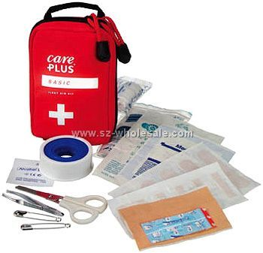
FIRST AID INTERVENTIONS
First aid is the treatment of the sick/injured before regular medical attention can be obtained.
It should never supersede or take the place of proper medical attention.
Needs simple, easy-to-follow guidance
Always linked to further assessment
Should be drilled and practiced

Slide 35
FIRST AID PROTOCOLS
Emergency First Aid Procedures
Notify emergency personnel promptly.
Never administer first aid beyond one’s training/qualifications.
Keep calm and use common sense.
Under most circumstances, no more than two persons are needed to attend to an injured person.
Restrict procedures to approved methods of :
  artificial respiration,
  oxygen administration,
  control of bleeding,
  and treatment for shock or burns

Slide 36
EMERGENCY FIRST AID PROCEDURES
Give the injured person room to breathe.
Do not move an injured person unless fumes, fire, or other hazards exist. Moving may cause additional harm in case of broken bones or head, spinal column, or internal injuries.
Artificial Respiration/Cardiopulmonary Resuscitation procedures are the methods of choice.

Slide 37
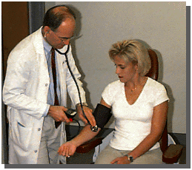
FIRST AID FOLLOW-UP
Assure awareness of first aid and decontamination activities
Assure availability of prompt medical evaluation and follow-up as necessary
Pre-plan for consultations with experts if needed
Plan for “observation” needs of workers
Assure timely incident investigation and remediation if required

Slide 38
POST-EXPOSURE & EMERGENCY PROCEDURES
Develop Exposure Control Plan (post-exposure plan)
First-aid protocols
  Location of first-aid kit; stocking & rotating of content
Initial medical services (who will provide)
  e.g. On-site health facilities, local hospital or emergency room
Is attending clinician aware of laboratory hazard?
Is employee provided with hazard information or card for presentation to health care staff
Follow-up medical services
  Are contracts in place for follow-up care & services?
Notes:
The national guidelines should be used when developing plans,

Slide 39
Management of exposure to blood/body fluids summary table
When | What
Immediately after exposure | First aid Relief from duty Risk assessment Post exposure prophylaxis (PEP) ARV starter pack
As soon as possible (same day) | Documentation and exposure Source assessment Exposure/pre-test counseling Baseline serology for HIV (HBV, HCV) Referral to CCC -if PEP commenced Support of significant others , counseling and testing
1-3 weeks | Post-test counseling and results of baseline serology Occupational health and safety review ARV Adherence counseling
3 months | Pre HIV test counseling Follow up serology – HIV, HBV, HCV
6 months | Follow up serology HBV, HCV HIV (if PEP taken)

Slide 40
DOCUMENTING EXPOSURES
Proper post-exposure response is facilitated by exposure-specific protocols that outlines:
the response plan
method of reporting
an incident reporting tool
      Strategies for responding to exposures should be formulated in advance
Notes:
This should cover, first aid, follow up

Slide 41
DOCUMENTING EXPOSURES
      Incidents/accidents (pathogens, chemicals etc.) must be documented
      Reported to the supervisor/medical support services provider
      Importance of documentation:
        frequency and severity of incidences- reflection of deviation from safe work practices
        support a surveillance system on occupational exposures
        Incidence/accident can be used in future proof for medico-legal reasons

Slide 42
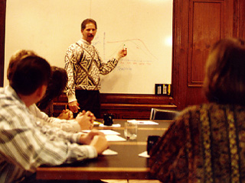
SAFETY AND HEALTH TRAINING
Address the safety and health responsibilities of all personnel
Incorporate it into other training and job performance/practice
Notes:
Training is the backbone of this system. For management to lead, for personnel to analyze the worksite for hazards, and for hazards to be eliminated or controlled, everyone involved must be trained. The scope of the training depends on the size and complexity of the worksite and the hazards involved.
Who Needs Training?
- Target new hires, contract workers, employees who wear PPE and workers in high risk areas. Managers and supervisors should also be included in the training plan.
- Manager training should emphasize their important role in visibly supporting the safety and health program and setting a good example.
- Supervisor training should cover company policies and procedures, hazard detection and control, accident investigation, handling of emergencies, and how to train and reinforce training.
- Long-term workers who have job changes as a result of new processes or materials.
- The entire workforce needs periodic refresher training in responding to emergencies.

Slide 43



SAFETY TRAINING LOWERS OCCUPATIONAL RISK
Training must be fun, interactive, fresh
Effectiveness must be assessed
Messages need repeating often
Take training beyond the classroom
  Drills
  Handbooks/Guides
  Posters
  Cheat Sheets

Slide 44
SAFETY AND HEALTH ORIENTATION
Employees must understand the hazards they may be exposed to and how to prevent harm to themselves and others from hazard exposure
Orientation training must be given to site and casual workers

Slide 45
OSH PROGRAM- POLICY AND GOALS
Clearly state a work place safety and health policy
Establish and communicate a clear goal and objective for the safety and health program
Involve top management in implementing the program

Slide 46
OCCUPATIONAL SAFETY & HEALTH PROGRAM HIGH-LEVEL CHECKLIST
Is there a National policy and national health care worker strategic plan?
  Is there a Responsible agency ?
  Are there Approved guidelines?
  Are there National standards for health care workers?
  Is there a Bio-safety manual reference?
Notes:
Clearly state a worksite safety and health policy
Establish and communicate a clear goal and objective for the safety and health program
Involve top management and all employees in implementing the program Among others

Slide 47
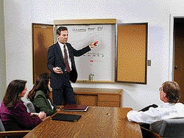
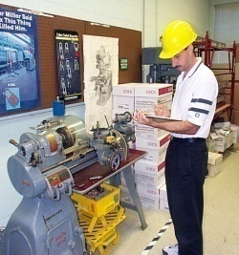
MAJOR ELEMENTS OF AN OCCUPATIONAL SAFETY AND HEALTH PROGRAM
An effective occupational safety and health program includes the following four elements:
    Management commitment and employee involvement
    Hazard/Risk Assessment
    Hazard prevention and control
    Safety and health training
Notes:
The best Safety and Health Programs involve every level of the organization, instilling a safety culture that reduces accidents for workers and improves the bottom line for managers.
What are the common characteristics of a safety and health culture?
Management believes that safety and health on the job is as important a company goal as other organizational objectives, such as cost control, quality, and productivity.
Individuals within the organization believe they have a right to a safe and healthy workplace.
- Each person accepts personal responsibility for ensuring his or her own safety and health.
- Everyone believes he or she has a duty to protect the safety and health of others.

Slide 48

MANAGEMENT COMMITMENT AND EMPLOYEE INVOLVEMENT
These are complementary elements
Management commitment provided by:-
  Oversight & delegate authority
  Resources (Staff & Funding)
  Ensure Training & Implementation
  Evaluation and corrective actions
  Record keeping
Notes:
Management must be committed to safety and health protection as much as other organizational purposes.
Management leadership and employee involvement are tied together because one is not effective without the other. A supervisor can be totally committed, but if employees follow blindly or are not involved, problems will only temporarily be solved.

Slide 49
MANAGEMENT COMMITMENT AND EMPLOYEE INVOLVEMENT CONT’D
Employee involvement allows workers to develop and express commitment to safety and health
Encourage employees to get involved in the program and in decisions that affect their safety and health
Communicate responsibility for all program aspects
Notes:
Employees must commit to safety and health protection for themselves and fellow workers.
Examples: inspection or hazard analysis teams; developing or revising safe work rules; training new hires or co-workers; assisting in accident investigations.

Slide 50
SUPERVISOR RESPONSIBILITIES
  Analyze work to identify potential hazards in area of responsibility
  Maintain physical protections in work areas
  Reinforce employee training through performance feedback and, if needed, enforcement of safe work practices
Notes:
Managers must understand their safety and health responsibilities.

Slide 51
CREATING AND MAINTAINING
A SAFE WORK ENVIRONMENT
Supervisors/Directors
Medical providers
Assess
hazards
Assessment,
Dx, Rx, Advice
Surveillance
Training
Site specific hazard assessment
Employees
Risk assessment
& reduction
Relationships
Work environment,
SOPs, safety manual
Notes:
The medical provider must:
Be knowledgeable about the nature of potential health risks in the work environment
Have access to expert consultation
Review of each occupational injury and illness report with safety professionals
Assist with revision of exposure prevention strategies to minimize occupational health hazards
An annual review for trends is recommended in addition to that performed following an incident

Slide 52
RESPONSIBILITY
Parties responsible for the safety and health program must have authority and resources
Managers, supervisors, and employees must be held accountable for meeting their responsibilities
Program operations must be reviewed at least annually, to evaluate, identify deficiencies, and revise, as needed

Slide 53
SUMMARY
Effective worker safety and health programs:
Reduce work related injuries and illnesses
Improve morale and productivity
Reduce workers’ compensation costs
Include these four elements:
  Management commitment and employee involvement
  Worksite analysis
  Hazard prevention and control
  Safety and health training
Notes:
For more information:
OS&H Act of 2007 Kenya, Biosafety/Biosecurity training manual and the Biosafety/ Biosecurity guidelines.

Slide 54
THANK YOU

