Slide 1
Donning and Doffing of PPE

Slide 2
Guidance for the Selection and Use of Personal Protective Equipment (PPE) in Healthcare Settings

Slide 3
PPE Use in Healthcare Settings
Goal
Improve personnel safety in the healthcare environment through appropriate use of PPE.
PPE Use in Healthcare Settings
Notes:
The goal of this program is to improve personnel safety in the healthcare environment through appropriate use of PPE.

Slide 4
PPE Use in Healthcare Settings
Objectives
Provide information on the selection and use of PPE in healthcare settings
Practice how to safely don and remove PPE
PPE Use in Healthcare Settings
Notes:
The objectives of this program are to provide information on the selection and use of PPE in healthcare settings and to allow time for participants to practice the correct way to don and remove PPE.

Slide 5
Personal Protective Equipment
Definition
“Specialized clothing or equipment worn by an employee for protection against infectious materials” (OSHA)
PPE Use in Healthcare Settings
Notes:
Personal protective equipment, or PPE, as defined by the Occupational Safety and Health Administration, or OSHA, is “specialized clothing or equipment, worn by an employee for protection against infectious materials.”

Slide 6
Hierarchy of Safety and Health Controls
Training and administrative controls
Engineering controls
Work practice controls
Personal protective equipment
PPE Use in Healthcare Settings
Notes:
The protection of healthcare personnel from infectious disease exposures in the workplace requires a combination of controls, one of which is the use of PPE. It is important to recognize that your protection as a healthcare worker also involves other prevention strategies. There are four major components to healthcare worker safety programs. First are training, such as you’re receiving today, and administrative controls, like isolation policies and procedures, and procedures for recognizing patients with a communicable disease before they expose workers. Second are engineering controls like negative pressure rooms for patients with airborne diseases such as TB; third are work practice controls such as not recapping needles, and finally personal protective equipment . While PPE is last in the hierarchy of prevention, it is very important for protecting healthcare workers from disease transmission.

Slide 7
Types of PPE Used in Healthcare Settings
Gloves – protect hands
Gowns/aprons – protect skin and/or clothing
Masks and respirators– protect mouth/nose
  Respirators – protect respiratory tract from airborne infectious agents
Goggles – protect eyes
Face shields – protect face, mouth, nose, and eyes
PPE Use in Healthcare Settings
Notes:
All of the PPE listed here prevent contact with the infectious agent, or body fluid that may contain the infectious agent, by creating a barrier between the worker and the infectious material. Gloves, protect the hands, gowns or aprons protect the skin and/or clothing, masks and respirators protect the mouth and nose, goggles protect the eyes, and face shields protect the entire face.
The respirator, has been designed to also protect the respiratory tract from airborne transmission of infectious agents. We’ll discuss this in more detail later.

Slide 8
Factors Influencing PPE Selection
Type of exposure anticipated
  Splash/spray versus touch
  Category of isolation precautions
Durability and appropriateness for the task
Fit- Correct size
PPE Use in Healthcare Settings
Notes:
When you are selecting PPE, consider three key things.
First is the type of anticipated exposure. This is determined by the type of anticipated exposure, such as touch, splashes or sprays, or large volumes of blood or body fluids that might penetrate the clothing. PPE selection, in particular the combination of PPE, also is determined by the category of isolation precautions a patient is on.
Second, and very much linked to the first, is the durability and appropriateness of the PPE for the task. This will affect, for example, whether a gown or apron is selected for PPE, or, if a gown is selected, whether it needs to be fluid resistant, fluid proof, or neither.
Third is fit. (optional question) How many of you have seen someone trying to work in PPE that is too small or large? PPE must fit the individual user, and it is up to the employer to ensure that all PPE are available in sizes appropriate for the workforce that must be protected.
(Segue to next slide) With this as background, let’s now discuss how to select and use specific PPE. After that we’ll talk about which PPE is recommended for Standard Precautions and the various Isolation Precaution categories.

Slide 9
Gloves
Purpose – patient care, environmental services, other(incinerator-heavy duty)
Glove material – vinyl, latex, nitrile, other
Sterile or non-sterile
One or two pair
Single use or reusable
PPE Use in Healthcare Settings
Notes:
Most patient care activities require the use of a single pair of nonsterile gloves made of either latex, nitrile, or vinyl. However, because of allergy concerns, some facilities have eliminated or limited latex products, including gloves, and now use gloves made of nitrile or other material. Vinyl gloves are also frequently available and work well if there is limited patient contact. However, some gloves do not provide a snug fit on the hand, especially around the wrist, and therefore should not be used if extensive contact is likely.
Gloves should fit the user’s hands comfortably – they should not be too loose or too tight. They also should not tear or damage easily. Gloves are sometimes worn for several hours and need to stand up to the task.
Who uses the other glove options? Sterile surgical gloves are worn by surgeons and other healthcare personnel who perform invasive patient procedures. During some surgical procedures, two pair of gloves may be worn. Environmental services personnel often wear reusable heavy duty gloves made of latex or nitrile to work with caustic disinfectants when cleaning environmental surfaces. However, they sometimes use patient care gloves too.

Slide 10
Do’s and Don’ts of Glove Use
Work from “clean to dirty”
Limit opportunities for “touch contamination” - protect yourself, others, and the environment
  Don’t touch your face or adjust PPE with contaminated gloves
  Don’t touch environmental surfaces except as necessary during patient care
PPE Use in Healthcare Settings
Notes:
Gloves protect you against contact with infectious materials. However, once contaminated, gloves can become a means for spreading infectious materials to yourself, other patients or environmental surfaces. Therefore, the way YOU use gloves can influence the risk of disease transmission in your healthcare setting. These are the most important do’s and don'ts of glove use.
Work from clean to dirty. This is a basic principle of infection control. In this instance it refers to touching clean body sites or surfaces before you touch dirty or heavily contaminated areas.
Limit opportunities for “touch contamination” - protect yourself, others and environmental surfaces. How many times have you seen someone adjust their glasses, rub their nose or touch their face with gloves that have been in contact with a patient? This is one example of “touch contamination” that can potentially expose oneself to infectious agents. Think about environmental surfaces too and avoid unnecessarily touching them with contaminated gloves. Surfaces such as light switches, door and cabinet knobs can become contaminated if touched by soiled gloves.

Slide 11
Do’s and Don’ts of Glove Use (cont’d)
Change gloves
  During use if torn and when heavily soiled (even during use on the same patient)
  After use on each patient
Discard in appropriate receptacle
  Never wash or reuse disposable gloves
PPE Use in Healthcare Settings
Notes:
Change gloves as needed. If gloves become torn or heavily soiled and additional patient care tasks must be performed, then change the gloves before starting the next task. Always change gloves after use on each patient, and discard them in the nearest appropriate receptacle. Patient care gloves should never be washed and used again. Washing gloves does not necessarily make them safe for reuse; it may not be possible to eliminate all microorganisms and washing can make the gloves more prone to tearing or leaking.

Slide 12
Gowns or Aprons
Purpose of use
Material –
  Natural or man-made
  Reusable or disposable
  Resistance to fluid penetration
Clean or sterile
PPE Use in Healthcare Settings
Notes:
There are three factors that influence the selection of a gown or apron as PPE. First is the purpose of use. Isolation gowns are generally the preferred PPE for clothing but aprons occasionally are used where limited contamination is anticipated. If contamination of the arms can be anticipated, a gown should be selected. Gowns should fully cover the torso, fit comfortably over the body, and have long sleeves that fit snuggly at the wrist.
Second are the material properties of the gown. Isolation gowns are made either of cotton or a spun synthetic material that dictate whether they can be laundered and reused or must be disposed. Cotton and spun synthetic isolation gowns vary in their degree of fluid resistance, another factor that must be considered in the selection of this garb. If fluid penetration is likely, a fluid resistant gown should be used.
The last factor concerns patient risks and whether a clean, rather than sterile gown, can be used. Clean gowns are generally used for isolation. Sterile gowns are only necessary for performing invasive procedures, such as inserting a central line. In this case, a sterile gown would serve purposes of patient and healthcare worker protection.

Slide 13
Face Protection
Masks – protect nose and mouth
  Should fully cover nose and mouth and prevent fluid penetration
Goggles – protect eyes
  Should fit snuggly over and around eyes
  Personal glasses not a substitute for goggles
  Antifog feature improves clarity
PPE Use in Healthcare Settings
Notes:
A combination of PPE types is available to protect all or parts of the face from contact with potentially infectious material. The selection of facial PPE is determined by the isolation precautions required for the patient and/or the nature of the patient contact. This will be discussed later.
Masks should fully cover the nose and mouth and prevent fluid penetration. Masks should fit snuggly over the nose and mouth. For this reason, masks that have a flexible nose piece and can be secured to the head with string ties or elastic are preferable.
Goggles provide barrier protection for the eyes; personal prescription lenses do not provide optimal eye protection and should not be used as a substitute for goggles. Goggles should fit snuggly over and around the eyes or personal prescription lenses. Goggles with antifog features will help maintain clarity of vision.

Slide 14
Face Protection
Face shields – protect face, nose, mouth, and eyes
  Should cover forehead, extend below chin and wrap around side of face
PPE Use in Healthcare Settings
Notes:
When skin protection, in addition to mouth, nose, and eye protection, is needed or desired, for example, when irrigating a wound or suctioning copious secretions, a face shield can be used as a substitute to wearing a mask or goggles. The face shield should cover the forehead, extend below the chin, and wrap around the side of the face.

Slide 15
Respiratory Protection
Purpose – protect from inhalation of infectious aerosols (e.g., Mycobacterium tuberculosis)
PPE types for respiratory protection
  Particulate respirators
  Half- or full-face elastomeric respirators(reusable because face piece-cleaned, but filter cartridge discarded)
  Powered air purifying respirators (PAPR)(uses filters- to remove contaminants from air)
  )
PPE Use in Healthcare Settings
Notes:
PPE also is used to protect healthcare workers’ from hazardous or infectious aerosols, such as Mycobacterium tuberculosis. Respirators that filter the air before it is inhaled should be used for respiratory protection.
The most commonly used respirators in healthcare settings are the N95, N99, or N100 particulate respirators. The device has a sub-micron filter capable of excluding particles that are less than 5 microns in diameter.
Respirators are approved by the CDC’s National Institute for Occupational Safety and Health.
Like other PPE, the selection of a respirator type must consider the nature of the exposure and risk involved. For example, N95 particulate respirators might be worn by personnel entering the room of a patient with infectious tuberculosis. However, if a bronchoscopy is performed on the patient, the healthcare provider might wear a higher level of respiratory protection, such as a powered air-purifying respirator or PAPR.

Slide 16
Elements of a Respiratory
Protection Program
Medical evaluation
Fit testing
Training
Fit checking before use
PPE Use in Healthcare Settings
Notes:
Prior to your using a respirator, your employer is required to have you medically evaluated to determine that it is safe for you to wear a respirator, to fit test you for the appropriate respirator size and type, and to train you on how and when to use a respirator. YOU are responsible for fit checking your respirator before use to make sure it has a proper seal.

Slide 17
PPE Use in Healthcare Settings:
How to Safely Don, Use, and Doff PPE
Notes:
This next segment will address how to safely don, use, and remove PPE.
NOTE TO TRAINER: Consider having a participant demonstrate donning and removing PPE as you go through this section.

Slide 18
Key Points About PPE
Don before contact with the patient, generally before entering the room
Use carefully – don’t spread contamination
Remove and discard carefully, either at the doorway or immediately outside patient room; remove respirator outside room
Immediately perform hand hygiene
PPE Use in Healthcare Settings
Notes:
There are four key points to remember about PPE use. First, don it before you have any contact with the patient, generally before entering the room. Once you have PPE on, use it carefully to prevent spreading contamination. When you have completed your tasks, remove the PPE carefully and discard it in the receptacles provided. Then immediately perform hand hygiene before going on to the next patient.

Slide 19
Sequence* for Donning PPE
Gown first
Mask or respirator
Goggles or face shield
Gloves
*Combination of PPE will affect sequence – be practical
PPE Use in Healthcare Settings
Notes:
The gown should be donned first. The mask or respirator should be put on next and properly adjusted to fit; remember to fit check the respirator. The goggles or face shield should be donned next and the gloves are donned last. Keep in mind, the combination of PPE used, and therefore the sequence for donning, will be determined by the precautions that need to be taken.

Slide 20
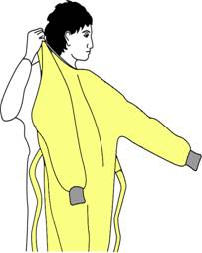
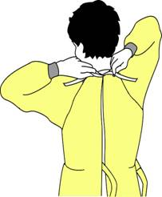
How to Don a Gown
Select appropriate type and size
Opening is in the back
Secure at neck and waist
If gown is too small, use two gowns
  Gown #1 ties in front
  Gown #2 ties in back
PPE Use in Healthcare Settings
Notes:
To don a gown, first select the appropriate type for the task and the right size for you. The opening of the gown should be in the back; secure the gown at the neck and waist. If the gown is too small to fully cover your torso, use two gowns. Put on the first gown with the opening in front and the second gown over the first with the opening in the back.

Slide 21
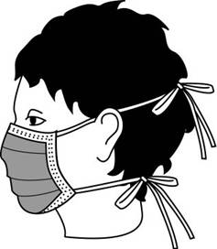
How to Don a Mask
Place over nose, mouth and chin
Fit flexible nose piece over nose bridge
Secure on head with ties or elastic
Adjust to fit
PPE Use in Healthcare Settings
Notes:
Some masks are fastened with ties, others with elastic. If the mask has ties, place the mask over your mouth, nose and chin. Fit the flexible nose piece to the form of your nose bridge; tie the upper set at the back of your head and the lower set at the base of your neck.
If a mask has elastic head bands, separate the two bands, hold the mask in one hand and the bands in the other. Place and hold the mask over your nose, mouth, and chin, then stretch the bands over your head and secure them comfortably as shown; one band on the upper back of your head, the other below the ears at the base of the neck.
Adjust the mask to fit. Remember, you don’t want to be touching it during use so take the few seconds needed to make sure it is secure on your head and fits snuggly around your face so there are no gaps.

Slide 22
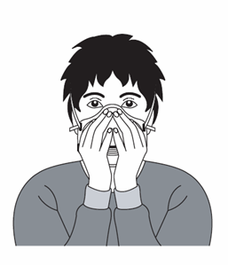
How to Don a Particulate Respirator
Select a fit tested respirator
Place over nose, mouth and chin
Fit flexible nose piece over nose bridge
Secure on head with elastic
Adjust to fit
Perform a fit check –
  Inhale – respirator should collapse
  Exhale – check for leakage around face
PPE Use in Healthcare Settings
Notes:
The technique for donning a particulate respirator, such as an N95, N99 or N100, is similar to putting on a pre-formed mask with elastic head bands. Key differences, however, are 1) the need to first select a respirator for which you have been fit tested and 2) fit checking the device, as you have been instructed, before entering an area where there may be airborne infectious disease. Be sure to follow the manufacturer’s instructions for donning the device. In some instances, the manufacturer’s instructions may differ slightly from this presentation.
You may also be asked to wear an elastomeric or powered air purifying respirator, or PAPR. Guidance on how to use these devices is not included in this presentation. You will need instruction locally to properly use these devices.

Slide 23
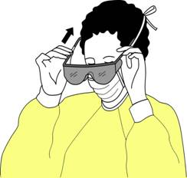
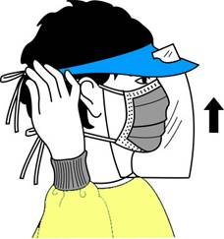
How to Don Eye and Face Protection
Position goggles over eyes and secure to the head using the ear pieces or headband
Position face shield over face and secure on brow with headband
Adjust to fit comfortably
PPE Use in Healthcare Settings
Notes:
If eye protection is needed, either goggles or a face shield should be worn. Position either device over the face and/or eyes and secure to head using the attached ear pieces or head band. Adjust to fit comfortably. Goggles should feel snug but not tight.

Slide 24
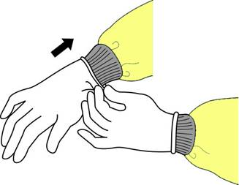
How to Don Gloves
Don gloves last
Select correct type and size
Insert hands into gloves
Extend gloves over isolation gown cuffs
PPE Use in Healthcare Settings
Notes:
The last item of PPE to be donned is a pair of gloves. Be sure to select the type of glove needed for the task in the size that best fits you. Insert each hand into the appropriate glove and adjust as needed for comfort and dexterity. If you are wearing an isolation gown, tuck the gown cuffs securely under each glove. This provides a continuous barrier protection for your skin.

Slide 25
How to Safely Use PPE
Keep gloved hands away from face
Avoid touching or adjusting other PPE
Remove gloves if they become torn; perform hand hygiene before donning new gloves
Limit surfaces and items touched
PPE Use in Healthcare Settings
Notes:
In addition to wearing PPE, you should also use safe work practices. Avoid contaminating yourself by keeping your hands away from your face and not touching or adjusting PPE. Also, remove your gloves if they become torn and perform hand hygiene before putting on a new pair of gloves. You should also avoid spreading contamination by limiting surfaces and items touched with contaminated gloves.

Slide 26
PPE Use in Healthcare Settings:
How to Safely Remove PPE
Notes:
We’ve talked about donning and using PPE. Now we’ll discuss how to safely remove PPE to protect you, your colleagues, and patients from exposure to contaminated materials.

Slide 27
“Contaminated” and “Clean” Areas of PPE
Contaminated – outside front
    Areas of PPE that have or are likely to have been in contact with body sites, materials, or environmental surfaces where the infectious organism may reside
Clean – inside, outside back, ties on head and back
    Areas of PPE that are not likely to have been in contact with the infectious organism
PPE Use in Healthcare Settings
Notes:
To remove PEP safely, you must first be able to identify what sites are considered “clean” and what are “contaminated.” In general, the outside front and sleeves of the isolation gown and outside front of the goggles, mask, respirator and face shield are considered “contaminated,” regardless of whether there is visible soil. Also, the outside of the gloves are contaminated.
The areas that are considered “clean” are the parts that will be touched when removing PPE. These include inside the gloves; inside and back of the gown, including the ties; and the ties, elastic, or ear pieces of the mask, goggles and face shield.

Slide 28
Sequence for Removing PPE
Gloves
Face shield or goggles
Gown
Mask or respirator
PPE Use in Healthcare Settings
Notes:
The sequence for removing PPE is intended to limit opportunities for self-contamination. The gloves are considered the most contaminated pieces of PPE and are therefore removed first. The face shield or goggles are next because they are more cumbersome and would interfere with removal of other PPE. The gown is third in the sequence, followed by the mask or respirator.

Slide 29
Where to Remove PPE
At doorway, before leaving patient room or in anteroom*
Remove respirator outside room, after door has been closed*
* Ensure that hand hygiene facilities are available at the point needed, e.g., sink or alcohol-based hand rub
PPE Use in Healthcare Settings
Notes:
The location for removing PPE will depend on the amount and type of PPE worn and the category of isolation a patient is on, if applicable. If only gloves are worn as PPE, it is safe to remove and discard them in the patient room. When a gown or full PPE is worn, PPE should be removed at the doorway or in an anteroom. Respirators should always be removed outside the patient room, after the door is closed. Hand hygiene should be performed after all PPE is removed.

Slide 30
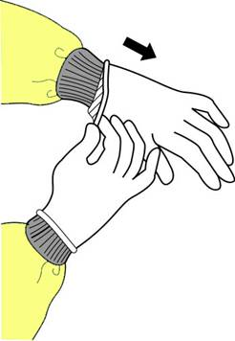
How to Remove Gloves (1)
Grasp outside edge near wrist
Peel away from hand, turning glove inside-out
Hold in opposite gloved hand
PPE Use in Healthcare Settings
Notes:
Using one gloved hand, grasp the outside of the opposite glove near the wrist. Pull and peel the glove away from the hand. The glove should now be turned inside-out, with the contaminated side now on the inside. Hold the removed glove in the opposite gloved hand.

Slide 31
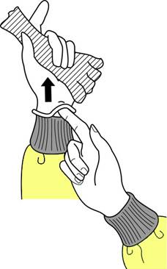
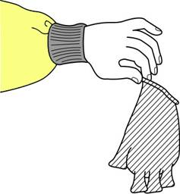
How to Remove Gloves (2)
Slide ungloved finger under the wrist of the remaining glove
Peel off from inside, creating a bag for both gloves
Discard
PPE Use in Healthcare Settings
Notes:
Slide one or two fingers of the ungloved hand under the wrist of the remaining glove. Peel glove off from the inside, creating a bag for both gloves. Discard in waste container.

Slide 32

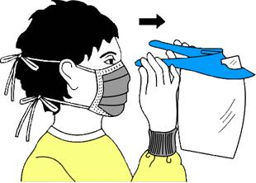
Remove Goggles or Face Shield
Grasp ear or head pieces with ungloved hands
Lift away from face
Place in designated receptacle for reprocessing or disposal
PPE Use in Healthcare Settings
Notes:
Using ungloved hands, grasp the “clean” ear or head pieces and lift away from face. If goggle or face shield are reusable, place them in a designated receptacle for subsequent reprocessing. Otherwise, discard them in the waste receptacle.

Slide 33
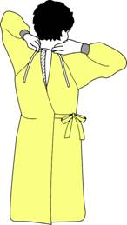
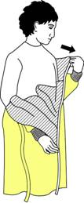
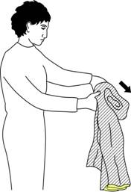
Removing Isolation Gown
Unfasten ties
Peel gown away from neck and shoulder
Turn contaminated outside toward the inside
Fold or roll into a bundle
Discard or place in the dirty linen for cleaning if not single use
PPE Use in Healthcare Settings
Notes:
Unfasten the gown ties with the ungloved hands. Slip hands underneath the gown at the neck and shoulder, peel away from the shoulders. Slip the fingers of one hand under the cuff of the opposite arm. Pull the hand into the sleeve, grasping the gown from inside. Reach across and push the sleeve off the opposite arm. Fold the gown towards the inside and fold or roll into a bundle. (Only the “clean” part of the gown should be visible.) Discard into waste or linen container, as appropriate.

Slide 34
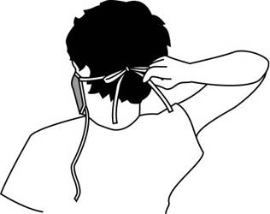
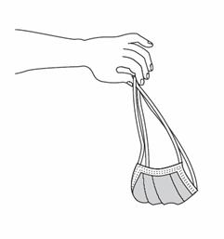
Removing a Mask
Untie the bottom, then top, tie
Remove from face
Discard
PPE Use in Healthcare Settings
Notes:
The front of the mask is considered contaminated and should not be touched. Remove by handling only the ties or elastic bands starting with the bottom then top tie or band. Lift the mask or respirator away from the face and discard it into the designated waste receptacle.

Slide 35
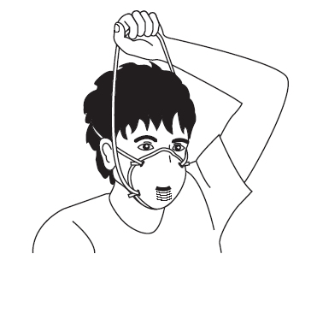
Removing a Particulate Respirator
Lift the bottom elastic over your head first
Then lift off the top elastic
Discard
PPE Use in Healthcare Settings
Notes:
The bottom elastic should be lifted over the head first. Then remove the top elastic. This should be done slowly to prevent the respirator from “snapping” off the face.

Slide 36
Hand Hygiene
Perform hand hygiene immediately after removing PPE.
  If hands become visibly contaminated during PPE removal, wash hands before continuing to remove PPE
Wash hands with soap and water or use an alcohol-based hand rub
* Ensure that hand hygiene facilities are available at the point needed, e.g., sink or alcohol-based hand rub
PPE Use in Healthcare Settings
Notes:
Hand hygiene is the cornerstone of preventing infection transmission. You should perform hand hygiene immediately after removing PPE. If your hands become visibly contaminated during PPE removal, wash hands before continuing to remove PPE. Wash your hands thoroughly with soap and warm water or, if hands are not visibly contaminated, use an alcohol-based hand rub.

Slide 37
PPE Use in Healthcare Settings:
When to Use PPE
Notes:
Thus far we have discussed the various types of PPE, considered various factors that go into selecting appropriate PPE, and described how to don, use, and remove PPE safely. This last segment of this presentation will discuss WHEN to use which PPE.

Slide 38
Standard and Expanded Isolation Precautions
Notes:
Decisions regarding when and which type of PPE should be worn are determined by CDC recommendations for Standard Precautions and Expanded Isolation Precautions.

Slide 39
Standard Precautions
Previously called Universal Precautions
Assumes blood and body fluid of ANY patient could be infectious
Recommends PPE and other infection control practices to prevent transmission in any healthcare setting
Decisions about PPE use determined by type of clinical interaction with patient
PPE Use in Healthcare Settings
Notes:
Standard Precautions is an outgrowth of Universal Precautions. Universal Precautions was first recommended in 1987 to prevent the transmission of bloodborne pathogens to healthcare personnel. In 1996, the application of the concept was expanded and renamed “Standard Precautions.” Standard Precautions is intended to prevent the transmission of common infectious agents to healthcare personnel, patients and visitors in any healthcare setting. During care for any patient, one should assume that an infectious agent could be present in the patient’s blood or body fluids, including all secretions and excretions except tears and sweat. Therefore appropriate precautions, including use of PPE, must be taken. Whether PPE is needed, and if so, which type, is determined by the type of clinical interaction with the patient and the degree of blood and body fluid contact that can be reasonably anticipated and by whether the patient has been placed on isolation precautions such as Contact or Droplet Precautions or Airborne Infection Isolation.

Slide 40
PPE for Standard Precautions (1)
Gloves – Use when touching blood, body fluids, secretions, excretions, contaminated items; for touching mucus membranes and nonintact skin
Gowns – Use during procedures and patient care activities when contact of clothing/ exposed skin with blood/body fluids, secretions, or excretions is anticipated
PPE Use in Healthcare Settings
Notes:
Under Standard Precautions, gloves should be used when touching blood, body fluids, secretions, excretions, or contaminated items and for touching mucous membranes and nonintact skin. A gown should be used during procedures and patient care activities when contact of clothing and/or exposed skin with blood, body fluids, secretions, or excretions is anticipated. Aprons are sometimes used as PPE over scrubs, such as in hemodialysis centers when inserting a needle into a fistula.

Slide 41
PPE for Standard Precautions (2)
Mask and goggles or a face shield – Use during patient care activities likely to generate splashes or sprays of blood, body fluids, secretions, or excretions
PPE Use in Healthcare Settings
Notes:
Mask and goggles or a face shield should be used during patient care activities that are likely to generate splashes and sprays of blood, body fluids, secretions, or excretions.

Slide 42
PPE for Expanded Precautions
Expanded Precautions include
  Contact Precautions
  Droplet Precautions
  Airborne Infection Isolation
PPE Use in Healthcare Settings
Notes:
In some instances, healthcare personnel are required to wear PPE in addition to that recommended for Standard Precautions. The three Expanded Precaution categories (formerly called Transmission-Based Precautions) where this applies are Contact and Droplet Precautions and Airborne Infection Isolation.

Slide 43
Use of PPE for Expanded Precautions
Contact Precautions – Gown and gloves for contact with patient or environment of care (e.g., medical equipment, environmental surfaces)
    In some instances these are required for entering patient’s environment
Droplet Precautions – Surgical masks within 3 feet of patient
Airborne Infection Isolation – Particulate respirator*
*Negative pressure isolation room also required
Notes:
Contact Precautions requires gloves and gown for contact with the patient and/or the environment of care; in some instances, use of this PPE is recommended for even entering the patient’s environment. Droplet Precautions requires the use of a surgical mask, and Airborne Infection Isolation requires that only a respirator be worn.

Slide 44
Hand Hygiene
Required for Standard and Expanded Precautions
Perform…
  Immediately after removing PPE
  Between patient contacts
Wash hands thoroughly with soap and water or use alcohol-based hand rub
PPE Use in Healthcare Settings
Notes:
Hand hygiene has been mentioned several time during this presentation. Hand hygiene is an essential infection control practice to protect patients, healthcare personnel and visitors and is required for both Standard and Expanded Precautions. Hand hygiene should be performed immediately after removing PPE, even during PPE changes and removal if necessary, and between patient contacts. Wash your hands thoroughly with soap and warm water or, if hands are not visibly soiled, use a alcohol-based hand rub.

Slide 45
PPE Use in Healthcare Settings:
Final Thoughts
PPE is available to protect you from exposure to infectious agents in the healthcare workplace
Know what type of PPE is necessary for the duties you perform and use it correctly
Notes:
These are a few final thoughts before ending today’s presentation. Remember, PPE is available to protect you from exposure to infectious agents during healthcare. It is important that you know what type of PPE is necessary for the procedures you perform AND that you use it correctly.
Thank you for your attention and participation. Are there any questions?

Slide 46
Thank you

