Slide 1
Transport of Biohazard Materials

Slide 2
Objectives
Define hazardous goods/infectious substances
Categorize infectious substances
Classify biohazards goods
To pack infectious substances using the triple packaging system
Describe the regulation on shipment of infectious materials
Labeling of packages for shipment appropriately
To Document shipment appropriately
To describe necessary training required for personnel involved in shipment of infectious materials

Slide 3
Introduction 1
Transport of infectious substances is subject to strict national and international regulations:
  proper use of packaging materials
  proper labeling, notification
  Courier requirement (means and routes of transportation)
  Chain of custody
Compliance:
  reduces likelihood of damaging packages
  minimizes exposure (personnel and environment)
  improves carrier’s efficiency and confidence in package delivery
Notes:
The transportation of infectious or potentially infectious material whether it be between laboratories within a department/faculty, or between institutions involves a level of risk of unintentional release of the material to the environment.
Legal requirements which regulate how material may be transported

Slide 4
Introduction (2)
Subject to regular amendments
  shippers refer to latest issuances of national and international regulations for regulations
International regulations not intended to supersede local or national requirements
  where national requirements do not exist, international regulations should be followed
  Laboratories should have a written guideline on how to pack and transport hazardous substances

Slide 5
Definition of terms 1
Biohazard material/substance- substance known or believed to contain infectious agent or agents
Infectious substances- For purposes of transport, infectious substances are defined as substances which are known or are reasonably expected to contain pathogens
Cultures-pathogens are intentionally propagated for research or diagnosis

Slide 6
Definition of terms 2
Patient specimens-materials, collected directly from humans or animals for research and/or diagnosis
Biological products- Biological products are those products derived from living organisms used to prevent, treat, or diagnose of disease in humans or animals
A GMO or GEO is an organism whose genetic material has been altered using genetic engineering techniques.

Slide 7
Definition of terms 3
Medical or clinical wastes -normally refers to waste products produced from healthcare facility.

Slide 8
Protection of First Responders & Health Care Workers
Knowledge
Universal Precautions
Communication
Vaccination
Prophylaxis

Slide 9
Safety First
First Responders
  Personal Protective Equipment
  Established protocols
Transporters
  Regulations
Lab Personnel
  Personal Protective Equipment
  Established protocols
  Biosafety Containment
  Vaccinations
Use Universal Precautions – treat everything as if it were contaminated

Slide 10
Safety
First Responders
  Know what you “might be” dealing with
  Protect yourself
  Protect the community
  Protect the next in line (transporter)
  Recommendations for the Selection and Use of Protective Clothing & Respirators Against Biological Agents:
www.bt.cdc.gov/DocumentsApp/Anthrax/Protective/10242001Protect.asp

Slide 11
Safety
Transporter/Shipper
  Know what you “might be” dealing with
  Protect yourself
  Protect the public
  Follow rules and regulations
    IATA, USPS, DOT, Etc.

Slide 12
Safety
Laboratory Personnel
  Handle & process according to Biosafety Level Classifications (Level 1, Level 2, Level 3, Level 4)
    Biosafety in Microbiological & Biomedical Laboratories CDC/NIH, 4th Edition.
  Protect yourself
  Protect other laboratorians
  Protect the public

Slide 13
International regulations
Transport of infectious substances are based on Recommendations by the Committee of Experts on the Transport of Dangerous Goods (UNCETDG)
The Recommendations form a Model of Regulations to cover:
  Air (ICAO, IATA and DRG)
  Rail (RID)
  Road (ARD)
  Sea
  Post
Notes:
a) Air The Technical Instructions for the Safe Transport of Dangerous Goods by Air published by the International Civil Aviation Organization (ICAO); The International Air Transport Association (IATA) publishes Dangerous Goods Regulations (DGR) that incorporates the ICAO provisions and may add further.
b) Rail: Regulations concerning the International Carriage of Dangerous Goods by Rail (RID) apply to countries in Europe, the Middle East and North Africa
The International Maritime Dangerous Goods Code published by the International Maritime Organization (IMO) is of mandatory application for all 155 contracting parties to the International Convention for the Safety of Life at Sea (SOLAS).
c) Road: The European Agreement concerning the International Carriage of Dangerous Goods by Road (ADR) applies to 40 countries.
e) Post: The Letter post manual published by the Universal Postal Union (UPU) reflects the United Nations Recommendations using the ICAO provisions as the basis for shipments. The World Health Organization serves in an advisory capacity to UNCETDG and ICAO.

Slide 14
National regulations
Many countries adopt the United Nations Model Regulations
Some countries apply variations but where national standards are not available the international regulations are used.
Countries are advised to have their own regulations.

Slide 15




Methods of Transport
Couriers
Postal service
Yourself – car/public transport

Slide 16
Important
If transporting by air dangerous goods must not be carried as either:
  Checked in baggage;
  Hand luggage; or
  On person.
If transporting by road, regulations apply:
  As soon as you use a vehicle on the public highway; and
  If you use your own vehicle.
Notes:
Don’t even think about taking it with you.

Slide 17
Definition of biohazard/ Dangerous Goods
Liquid or solid substances and articles containing them that have been tested and assessed against internationally-agreed criteria
And
Found to be potentially hazardous when carried.
Assigned to different Classes depending on their predominant hazard

Slide 18
Classification of biohazard/ Dangerous Goods
Dangerous goods are assigned UN numbers and proper shipping names according to their hazard classification and their composition.
Infectious substances are classified in Division 6.2 and assigned to UN 2814, UN 2900, UN 3291 or UN 3373 as appropriate

Slide 19
Hazard Classes
Class 1 Explosive substances and articles
Class 2 Gases
Class 3 Flammable liquids
Class 4.1 Flammable solids, self-reactive substances & solid desensitised explosives
Class 4.2 Substances liable to spontaneous combustion
Class 4.3 Substances which, in contact with water, emit flammable gases
Class 5.1 Oxidizing substances
Class 5.2 Organic peroxides
Class 6.1 Toxic substances
Class 6.2 Infectious substances
Class 7 Radioactive material
Class 8 Corrosive substances
Class 9 Miscellaneous dangerous substances and articles

Slide 20
Class 6.2 – Infectious substances
Substances known or reasonably expected to contain pathogens
Can cause disease in humans or animals
  Cultures
  Clinical material
  GMMs (if infectious)
  [Waste]
  [Biological products]
Notes:
Infectious substances are defined as anything known or reasonably likely to contain pathogens ie micro-organisms (including bacteria, viruses, rickettsiae, parasites and fungi) or other agents which can cause disease in humans or animals.

Slide 21
Classification - Class 6.2: Infectious substances
Divided in 2 classes based on risks during transport
  Category A
  Category B
Notes:
UN classes of Hazardous Goods – 9 in total – Class 6 covers infectious substances (6.1 is toxic materials)
Category A list – in the handouts
Category B covers specimens of human or animal material such as excreta, secreta, blood and its components, tissue and tissue fluid and body parts

Slide 22
Category A
An infectious substance which is carried in a form that, when exposure to it occurs, is capable of causing permanent disability, life-threatening or fatal disease in humans or animals (by reference to indicative list)
Assign to UN 2814 or UN 2900
  Proper shipping name(s): infectious substance affecting humans (animals)

Slide 23
Category B
An infectious substance that does not meet the criteria for inclusion in Category A
Assign to UN 3373
  Proper shipping name: Biological substance Category B
  Not cultures (with some exceptions for certain agents being sent for clinical diagnosis)

Slide 24
Samples From Humans or Animals
Category B as a minimum
Category A on the basis of:
  Medical history/symptoms
  Local conditions
  Professional judgement on source material

Slide 25
Biological material
For the purposes of shipping, biological materials may be classified as infectious substances
  including “biological substances, category B” and “patient specimens”
  biological products, genetically modified organisms, or medical/clinical waste.
The shipment of certain genetically modified organisms is also regulated.

Slide 26
Other Materials That Could Contain Infectious Substances
Category A or B as appropriate
Exemptions & exceptions:
  Contains micro-organisms not pathogenic for humans or animals
  Material has been treated to inactivate/neutralise any pathogenic micro-organisms that might be present
  Material does not pose a significant risk of infection eg food/water/soil samples
  Blood/body parts for transfusion/transplant

Slide 27
Other Classifications
Class 9 Miscellaneous dangerous goods:
  Non-infectious GMMS – if could alter animal, plant or microbiological substances in a way that does not occur naturally – assign to UN 3245
  Dry ice – assign to UN 1845
Exempt human/animal specimens
Non- hazardous biological material – eg naked DNA
Notes:
Exempted human/anima specimens for which there is minimal likelihood that m/os are present - ??how sure can we be. Uk advice is to err on side of caution and use 3373

Slide 28
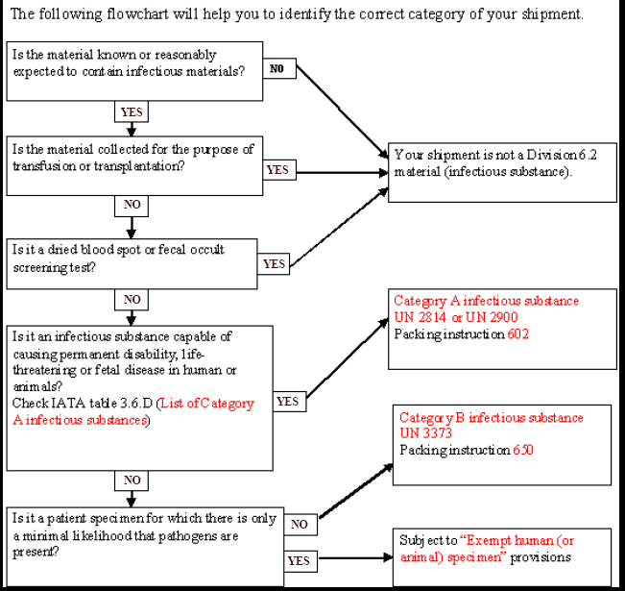
Notes:
This chart can be found in the IATA website.

Slide 29
Chain of Custody
Always observe a Chain of Custody
Evidence (Documentation)
Collector→Transporter →Laboratory
  Each person to touch the sample must sign for it.
Laboratory –
  Signed for each time the sample is manipulated

Slide 30

Planning
Call Recipient:
  Verify shipping address
  Obtain contact name & phone
  Verify when to ship

Slide 31
Transporting within/without the health facility
Triple packing (This can be home made)
The primary container must be closed and secured
Should have a biohazard label
If not transported by courier the following information is required:-
  Identification of the material
  The address of receiving party
  The address of the sender
  Date sent.

Slide 32
Triple Packing System
It consists of three layers:
  the primary receptacle,
  the secondary packaging
  the outer packaging

Slide 33
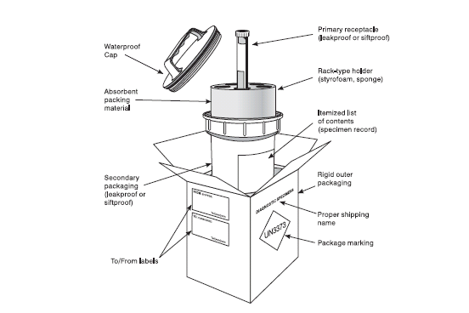
Notes:
Category B

Slide 34
Packaging
Primary Sample Container
  Waterproof & Leak-proof
  Seal plates/tubes with tape
  Wrap specimen container in absorbent material
    Enough to absorb entire liquid contents
  Ziplock Biohazard bag
    Solids – 1 bag
    Liquids – 2 bags
  Pre-freeze specimens if shipping frozen

Slide 35
Packaging
Secondary Container
  Complete Packaging System
    Unbreakable
    Water-proof
    Leak-proof
    Biohazard Label
  Commercial Suppliers of Certified Packaging Systems
    i.e. Saf-T-Pak, EXAKT-PAK

Slide 36
Packaging
Certified Outer Shipping Package
  Strong enough to hold capacity & mass
    Indicated on the bottom of box
  Choose appropriate package
  Must meet UN Class 6.2 Specs
    Must bear the UN Packaging Specification Marking
  4G CLASS 6.2 / 99
  CAN / 8-2 SAF-T-PAK
U
N

Slide 37
Packaging
Certified Outer Shipping Package
  Each comes with:
    Inner Packaging
    Labels
  Do NOT make any substitutions
    UN-certification becomes invalid
  Refurbishment kits may be used

Slide 38
Packaging
Certified Outer Shipping Package
  Closing instructions included
  Over-packs?
    Shipping packs & over-packs
      Marked & Labeled identically
      Additional Label:
      “Inner packages comply with prescribed specifications”

Slide 39
Protection of handlers/health care workers
The shipper should;
Know well the agent being handled,
Practice universal precaution,
Protect transporters and the environment
use appropriate PPE,
Be trained and vaccinated accordingly
Follow shipment rules given by WHO, IATA e.t.c

Slide 40
Packaging, labeling and documentation of Category A infectious substances
Triple layer packaging (materials used for transport must be tested to ensure sample won't leak)
Absorbent material
Itemized contents list
Outer package must bear Class 6.2 Infectious Substance diamond label
Packing Instruction 602
Additional labeling and marking requirements
  Shipper's Declaration required
  Shipment and storage temperatures

Slide 41
Marking for Class A
The shipper’s name, phone and address
The receiver’s name, phone and address
UN number followed by the proper shipping name (UN 2814 “INFECTIOUS SUBSTANCE, AFFECTING HUMANS” or UN 2900 “INFECTIOUS SUBSTANCE, AFFECTING ANIMALS only”, as appropriate)
Temperature storage requirements (optional)

Slide 42

Labeling (A)
There are two types of labels that include:
Hazards labels in form of square set at an angle of 450C (diamond shaped) – required for most dangerous goods.
Handling labels in various shapes- Required either alone or in addition to hazard labels
What does this label mean???

Slide 43
Documentation (A)
To be prepared and signed by the shipper:
The shipper’s Declaration for Dangerous Goods an import and/or export permit and/or declaration if required.
To be prepared by the shipper or the shipper’s agent:
An air waybill for air transport or equivalent documents for road, rail and sea shipments.

Slide 44



Examples of Labels
Hazard warning diamond and proper shipping name and UN number
Hazard warning diamond plus the statement “BIOLOGICAL SUBSTANCE CATEGORY B”
UN 1845 Dry ice ** kg
Notes:
Outer and inner may both need labelling

Slide 45
Packaging, labeling and documentation of Category B infectious substances
Triple layer packaging
Materials used for transport must be tested to ensure sample won't leak
Outer package must bear UN3373 diamond label
Packing Instruction 650 used
Outer package and air waybill must bear "Biological Substance, Category B" statement
No Shipper's Declaration required; only airway bill

Slide 46
Marking for Class B
Each package shall display the following information:
The shipper’s name, address and telephone number
The receiver’s name, address and telephone number
The proper shipping name (“BIOLOGICAL SUBSTANCE, CATEGORY B”) adjacent to the diamond-shaped mark
Temperature storage requirements (optional).

Slide 47
Handling Exempt Specimens
Triple pack ie fit for purpose
No quantity limits
Label as “exempt human/animal specimen” + consignor/consignee addresses + emergency contact details
Add dry ice labels as necessary
Paperwork inside as per Category B
Notes:
Same for non hazardous biological materials but no labelling needed – recommend that paperwork make clear the nature of the material

Slide 48
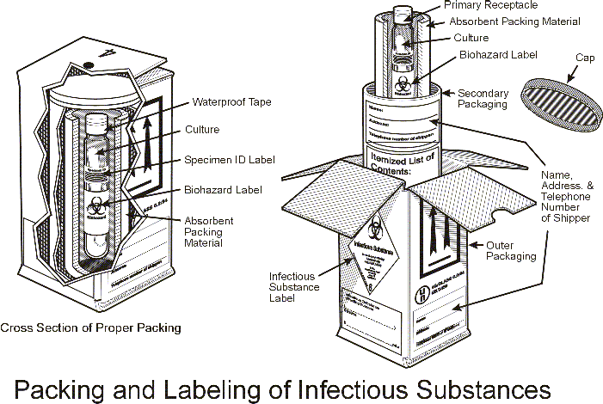

Slide 49
Shipping Using Dry Ice
Dry Ice is considered a Dangerous Good. Training and certification are required, and the package must be labeled and shipped accordingly. (Class 9)
Use PPE when handling and work in aerated space
Dry ice MUST be declared with marking, labeling and documentation
Dry ice must NEVER be placed in a sealed container
Use Packing Instruction 904 for shipment with dry ice

Slide 50
Marking and Labeling of Dry ice
Packaging-use a vented container of sufficient strength to hold the amount of dry ice
Labeling- Name and address of the shipper and recipient, “Dry Ice, UN 1845”, quantity of dry ice in kilograms
Documentation- Inclusion of quantity of dry ice and UN 1845 in airway Bill

Slide 51
Documentation
Shipping papers can be in the form of:
  a bill of lading or freight bill
  hazardous waste manifest, or other shipping document.
At a minimum, a properly prepared shipping paper clearly identifies
  a hazardous material by its proper shipping name, hazard class or division number
  identification number, packing group (if any),
  and total quantity.
Additional hazard warning and handling information, such as ``POISON'' and ``CARGO AIRCRAFT ONLY,'' must be entered on the shipping paper.

Slide 52
Training & Certification
Anyone directly involved with the shipping of diagnostic materials or infectious substances.
1 individual per institution must be trained at a minimum.
By certified training authority
That person trains others

Slide 53
Examples
Culture of Japanese Encephalitis virus?
Assign to Category A - UN 2814
  JEV appears on the indicative list of Category A pathogens for cultures only (ie clinical material known to contain the agent could be transported as a Category B substance).

Slide 54
Examples
Blood sample taken from a patient which has not been screened for hepatitis B or HIV?
Assign to Category B – UN 3373.
  Pathogens assigned to Category B may cause disease in humans (or animals), but the conditions in transport are such that the likelihood of the disease being contracted from a sample in transport is extremely remote.

Slide 55
Examples
E. coli K-12 with a modified plasmid that carries cloned genes of unknown potential to modify other micro-organisms
Assign to Class 9 – UN 3245
  Agent does not cause disease in humans or animals, therefore not an infectious substance. But could be capable of transforming other micro-organisms

Slide 56
Examples
Culture of Mycoplasma mycoides sub species mycoides containing a non-mobilisable, non-transmissible plasmid carrying an insert coding for GFP.
Assign to Category A – UN 2900
  Although a GMM, the infectious properties of the agent must be considered first and are the most hazardous, therefore must be classified as a Category A substance – note that this affects animal species only, so use UN 2900

Slide 57
Summary
Safety affects all the key stakeholders
Triple packaging is the standard way of transporting infectious substances.
Appropriate labeling and documentation is necessary during shipment.
Staff involved in shipment should be trained and certified.

