Slide 1
CHEMICAL MANAGEMENT & SELECTION OF DISINFECTANTS

Slide 2
Introduction
Why learn about chemical hazards?
common & significant health hazard
can combine with other chemical = new hazards
All hazards must be taken in to account when using and storing chemicals

Slide 3

Before Lab Work, Get to Know:
Hazards of materials & agents and their prescribed safety procedures
Emergency spill procedures, use of absorbents and disinfectants
Designated escape route and alternate
Location of fire ext., eye wash, shower, first aid, and spill kits

Slide 4
Training Objectives
Recognize chemical hazards commonly encountered in Labs
Provide examples of Physical and Health Hazards
How to Use and Understand a Material Safety Data Sheet / Material safety data base
Explain warning properties of various chemical hazards, how to control and evaluate them.
Chemical Hygiene Plan
Chemical Spill kits
How to select disinfectants

Slide 5
Hazardous Material
(HAZMAT)

Slide 6

Chemical Characteristics
Understanding chemical characteristics helps identify the hazards & protect yourself.
Information obtained from MSDS / MSDB of a specific chemical.
MSDS must be available and easily accessible to accessible to every employee.
All must understand how to use it.

Slide 7

Information found on MSDS
Chemical Identity
Manufacturer's Name and Contact Information
Hazardous Ingredients/Identity Information
Physical/Chemical Characteristics
Fire and Explosion Hazard Data
Reactivity Data
Health Hazard Data
Precautions for Safe Handling and Use
Control Measures
  Solubility of a chemical
  Explosive limits of a chemical
  Melting point of a chemical
  Specific gravity and density
  Vapor density
  Flash and boiling points
  Vapor pressure and auto ignition temperature

Slide 8
Chemical Hazard Recognition
Degree of hazard associated with a specific chemical will depend on:
  Physical properties
  Chemical properties
  Toxicity
  The way it is used in the lab
  The environment in which it is encountered

Slide 9
Chemical Hazard Recognition
Degree of hazard associated with a specific chemical will depend on:
  Physical properties
  Chemical properties
  Toxicity
  The way it is used in the lab
  The environment in which it is encountered

Slide 10

Chemical Hazard Recognition
Physical Classification – Solid
  Lead pipe ( sanded & welded = lead dust / fumes)
  Nickel contact = dermatitis

Slide 11

Chemical Hazard Recognition
2. Physical Classification - Liquid
Contact with skin- absorption
Some chemicals help other
contaminants to penetrate the skin
e.g. Dimethyl sulfoxide is extremely
well absorbed in the skin and is used
in medicine to transport drugs.
Liquids present a splash hazard ; goggles, face shields, gloves coveralls prevent aye and / or skin contact
Some liquids combine with others = new hazards: house hold bleach and ammonia releases chloramine vapors
Notes:
- The degree of hazard depends on its ccts and handling
- eg. Inhalation is the 1⁰ entry route of chemicals into the
body
- Due to this, vapor pressure in vital to determine the
hazard ( low vp= low airborne concentration= low
toxicity & viz avi.

Slide 12

Chemical Hazard Recognition
3. Physical classification - Gas/Vapour
Vapors are evaporation products
of chemicals that are normally liquids
at room T⁰
Routes of entry to the two:
inhalation, injection, ingestion and eye/ skin contact.
At gas state molecules are unrestricted by cohesive forces.

Slide 13
TRIVIA
The degree of chemical hazards depends on certain properties. Which of the following physical properties are potential skin hazards?
Solid
Liquid
Aerosol
Gas and vapor

Slide 14
Chemical Hazard Recognition
Degree of hazard associated with a specific chemical will depend on:
  Physical properties
  Chemical properties
  Toxicity
  The way it is used in the lab
  The environment in which it is encountered

Slide 15
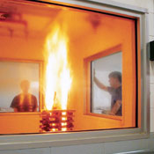
Chemical Hazard Recognition
1. Chemical Characteristics - Flashpoint
  The lowest Tº at which a chemical gives off enough vapor to form combustible concentration of gas.
  The flash point is an indication of how easy a chemical may burn.
  The lower the flashpoint, the more flammable and hazardous
  An open flame is not always necessary to ignite the gas. A hot surface like a heating element or warm machine will do for chemicals with more than high hazard
  Eg acetone, ethanol
Notes:
The flash point of a chemical is the lowest temperature where it will evaporate enough fluid to form a combustible concentration of gas. The flash point is an indication of how easy a chemical may burn.
Materials with higher flash points are less flammable or hazardous than chemicals with lower flash points
An open flame is not always necessary to ignite the gas. A hot surface like a heating element or warm machine will do for chemicals with more than high hazard.

Slide 16
Chemical Hazard Recognition
Degree of hazard associated with a specific chemical will depend on:
  Physical properties
  Chemical properties
  Toxicity
  The way it is used in the lab
  The environment in which it is encountered

Slide 17
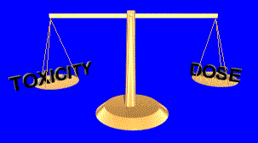
Chemical Hazard Recognition
Toxicity vs. Dose
Dose is the AMOUNT of something you are exposed to, or come in contact with.
The less the toxicity, the greater the dose you can tolerate without ill effects.
The greater the toxicity, the less dose you can tolerate without becoming sick

Slide 18
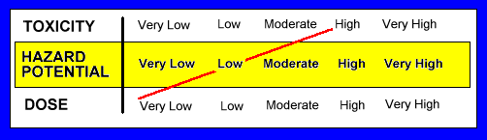
High Toxicity - Low Dose
E.g. acetone is a highly toxic chemical. However, safe to use in a well ventilated room where your dose would be very low.

Slide 19
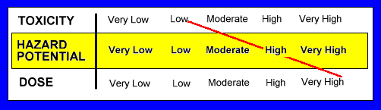
Low Toxicity - High Dose
E.g. Nitrogen gas has a low toxic rating.
However, exposure to nitrogen in a confined space (a very high dose),can lead to affixation

Slide 20
Chemical Hazard Recognition
  The environment in which it is encountered
1. Vapour Pressure - Is the pressure exerted on the sides of the container, and is promotional to T⁰ (mm Hg)
The higher the vapor pressure the more volatile the liquid.
2 .Explosive limits: Range of concentration of gases in air to support explosive process. Its measured by UEL/LEL

Slide 21
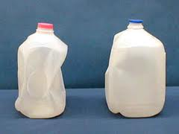
Trivia
Vapor pressure is pressure exerted by a vapor against the sides of a closed container. If vapor pressure is temperature dependent, what does a container of a liquid with the sides pushed out mean?
1). The container is old 2). Container is leaking. 3). Was exposed to heat 4). Was exposed to cold.

Slide 22
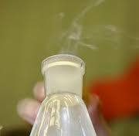
WARNING PROPERTIES
Presence of chemical in the air
  Odor threshold (airborne concentration)
    This must be taken by caution due to ranges in individuals sense of smell.
    Sense of smell can be reduced by: allergies, head colds and olfactory fatigue.
  Color product: (nitric acid = red, chlorine =blue)
  Other sensory signal: mild irritation of eyes, nose or throat or taste.

Slide 23
TRIVIA
Odor threshold is the concentration at which hazardous chemicals can be detected by smell. Which of the following choices has the ability to impair the bodies ability to smell?
1) Allergies
2) A cold head
3) fatigue
4) All the above

Slide 24
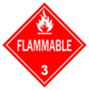

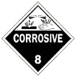
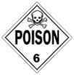
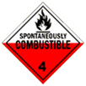
Chemical Hazard Classes
Flammables-Isopropanol
Oxidizers - Formalin
Corrosives depending on pH Value, Sulfuric Acid
Inorganic or Organic (CH₂0H, Ca, Cd, H₂SO₄)
Toxins
Reactive Chemicals
Be aware that some chemicals have multiple hazards and therefore require further segregation

Slide 25
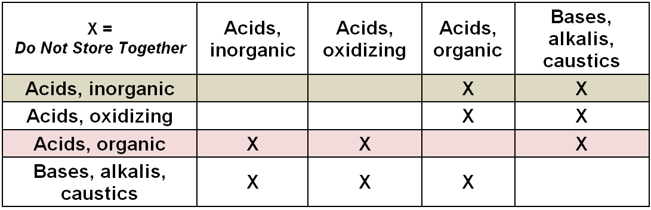
2. Chemical Hazard Classes - Corrosives
Acids
  Inorganic - HCl, H₂SO₄
  Organic acids – Lactic acid, Formic acid
  Oxidising acids – Nitric acid
Bases (Alkalis, Caustics)
  NaOH
Storage Segregation
Notes:
Acids are corrosive in any form, and in high concentrations destroy body tissue and cause severe burns on contact with the skin and eyes.
Some acids are strong oxidizing agents and react destructively and violently with organic and other oxidizing agents.
A Corrosive waste is a liquid with a pH less than or equal to 2 or a pH greater than or equal to 12.5. Examples: hydrochloric acid, glacial acetic acid

Slide 26
Corrosives
Aqueous solutions between pH 6.0 to 10.0 may be disposed of down the sink. (avoid heavy metals & flammable organic solvents)
Acids and alkalis that are within the pH range of 3.0-11.0 can be disposed via sanitary sewer drain followed by a water flash during and after disposal to flush the material from the traps and piping (avoid pesticides).
Recommended piping are glass or dura-iron piping for this pH. hydrofluoric acid and nitric acids are excluded from this type of disposal.
Cleanup and decontamination may require the use of neutralizing agents.

Slide 27

3. Chemical Hazard Classes - Oxidizers
Class 4
  An oxidizing material that can undergo an explosive reaction when catalyzed or exposed to heat, shock or friction hydrogen peroxide (>91% conc.)
Class 3
  An oxidizing material that will cause a severe increase in the burning rate of combustible material which it contacts or will undergo vigorous self-sustained decomposition when catalyzed or heat - hydrogen peroxide (52-91% conc.)
Class 2
An oxidizing material that will moderately increase the burning rate or which may cause spontaneous ignition of combustible material which it contacts -Linseed oil (flax seed oil)
Class 1
An oxidizing material whose primary hazard is that it may increase the burning rate of combustible material with which it comes in contact

Slide 28
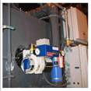
Oxidizers
oxidizing chemicals and agents should be disposed in the thermal oxidizer evaporator
designed to completely evaporate liquid waste, leaving only a non hazardous dry ash residue.

Slide 29
4. Chemical Hazard Classes - Toxins
Acute & Chronic Poisons; Highly Toxic
Carcinogens asbestos, Dimethyl sulfate
Reproductive & Developmental Toxins
  Ethidium brominde
Neurotoxins, organ specific toxins, Irritants

Slide 30

Reactive Chemicals….
  Store in an isolated area within the lab, in a water-tight cabinet or secondary container
  Store in air-tight containers without oxygen or moisture (sure seal bottles, glove boxes)
  Separate from flammables, but in flame resistant container when practical
  Self Decomposing Check frequently

Slide 31
IDENTIFYING HAZARDS
National Fire Protection Association (NFPA)
Hazardous Materials Information System (HMIS)
Uniform Laboratory Hazard Signage (ULHS)

Slide 32
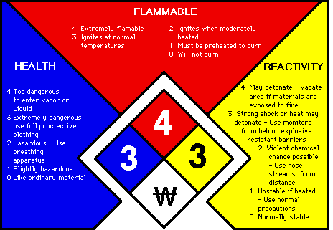
National Fire Protection Association (NFPA)
The diamond identification system
Uses four colors and a 0-4 numeral rating for hazards
Blue Health
Red Flammability
Yellow Reactivity
White Special information
Numerical rating begins at 0 and goes thorough to 4 -
0 least severity and 4 most severity in hazard

Slide 33
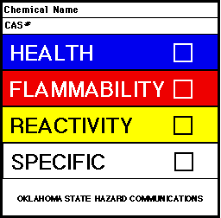
Hazardous Materials Information System (HMIS)
Rating of 0 in this system indicates the least severity: will not burn, stable, no hazard
Rating of 4 in this system indicates the most severity: deadly.

Slide 34

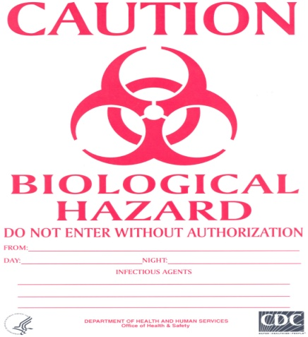
Uniform Laboratory Hazard Signage (ULHS).
The pictograph identification system
These symbols used to help identify hazards

Slide 35
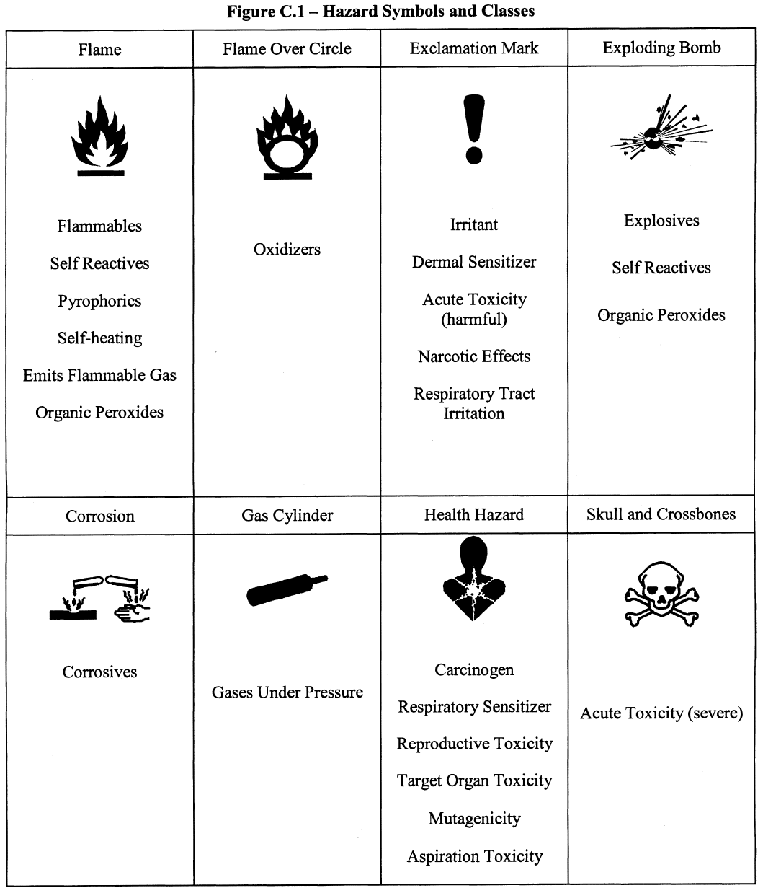


Slide 36
Chemical Hygiene Plan
MSDS
Outlines procedures to protect employees from health hazards associated with chemicals
Include occupational health surveillance
Copies of job hazard analysis
Annual CHP inspection
Chem. Inventory
Proper & adequate PPE

Slide 37
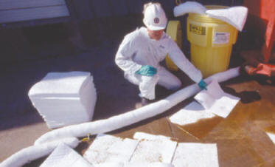
SPILL CONTROL & SPILL PREVENTION

Slide 38
Before cleaning a spill….
Individuals should be familiar with the properties and hazards of the materials with which they work with.
adequate training for cleaning up small spills is required
appropriate types and amounts of spill clean-up materials and personal protective equipment are immediately available.
Improper clean-up of a chemical spill may result in injury, illness, fire, a release to the environment, or property damage.
consult the MSDS for the specific chemical
Pre-planning is essential to safely and properly handling a spill

Slide 39
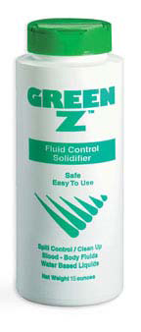
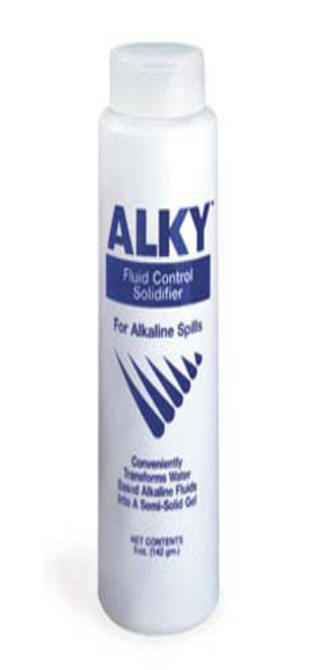
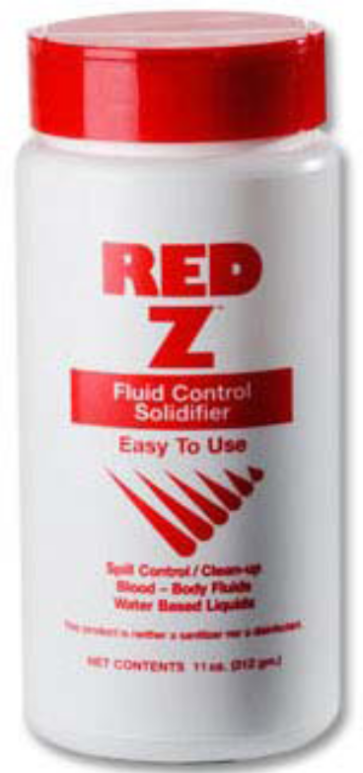
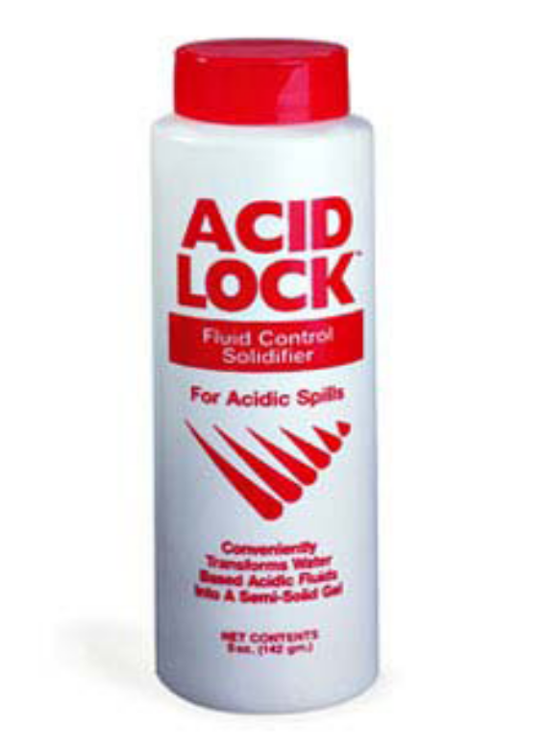
SPILL KITS
Red Z solidifier
Green Z solidifier
Acid Lock solidifier
Alky solidifier
Universal spill boom ( 5’X 17’)
Universal spill pads (17’ x 19’)
Universal pillow ( 17’X17’)
Nitrile gloves
Scoop/scraper
9"x12" zip lock bag
Hazardous waste label
Non-Hazardous waste label

Slide 40
General hazard control practices
Avoid direct contact with the chemical
Limit exposure levels and time
Enforce good hygiene practice, PPE
Take appropriate fire prevention & control measures
Use equipment not affected by metal being handled
Ensure the chem is not mixed with others
Use engineering & good common sense
Ensure you have proper disinfectants.

Slide 41
Summary
Recognize chemical hazards which are dependent on physical properties, toxicity, use and environmental conditions present.
Familiarize yourself with chemical and physical characteristics as well as the warning properties of chemical hazards you may encounter
Be aware of the effects environmental factors may have on a potential hazard
Always consult MSDSs or other ref. sources
Familiarize yourself with hazard classes.
Notes:
Methods to reduce risks associated with chemicals hazards

Slide 42
Employee Training
Within 1ST week of initial employment or assignment to a new job
Whenever new hazards or chemicals are introduced to the workplace
In case of an incident / exposure / accident
Annually

Slide 43
Employee must be informed
Physical & chemical characteristics
The Right to Know Law
Chemicals in the Work Place
Location & Availability of MSDS & MSDB
Spill kits and Choice of disinfectants

Slide 44
SELECTION OF DISINFECTANTS

Slide 45
DISINFECTANTS
Definition: chemicals used to kill micro-organisms on infected instruments.
Disinfectants are not meant to be used on the skin or mucous membranes ( used on inanimate).
Notes:
Decontamination: the removal of disease-producing microorganisms to leave an item safe for further handling.
Disinfection: the inactivation of disease-producing microorganisms. Disinfection does not destroy bacterial spores. Disinfectants are used on inanimate objects in contrast to antiseptics, which are used on living tissue. Disinfection usually involves chemicals, heat or ultraviolet light. The nature of chemical disinfection varies with the type of product used.

Slide 46
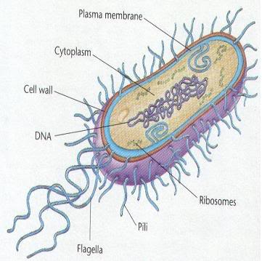
Effectiveness of Disinfectants
In the selection of disinfectants, they must;
Kill or inhibit the growth of the undesirable micro-organisms.
Not be harmful to the instrument/equipment on which it is used.
Be used only on clean, rinsed and dried instruments/equipment.
Protein material, detergent and soap will inhibit some disinfectants.
Be used in the proper concentration.
Be used within the stipulated lifetime after dilution

Slide 47
Factors to consider before choosing disinfectants
Nature of the item to be disinfected
Number of micro-organisms present
Resistance of micro-organisms
Type and concentration of disinfectant used.
Presence of organic material
Duration of exposure and temperature
Choice of Disinfection Methods
Personnel
Notes:
It is important to recognise that some organisms are less susceptible to certain disinfectants, while the disinfecting properties of chemical agents may also be reduced under specific conditions

Slide 48
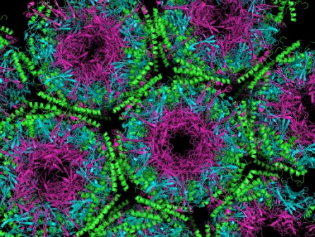
Factors to consider before choosing disinfectants
1. Nature of the item to be disinfected
The rougher the surface, the longer the contact time required for disinfection (crevices, hinges, lumen).
2. Number of micro-organisms present
The number of micro-organisms present will lengthen the time for effective disinfection to take place. In general, higher bio-burden requires more time for disinfection.

Slide 49
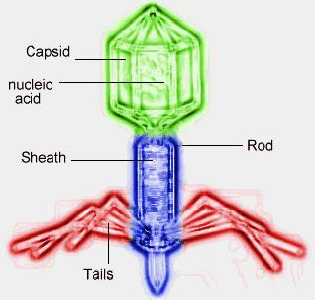
Factors to consider before choosing disinfectants
3. Resistance of micro-organisms
Some micro-organisms are more resistant to disinfection than others.
The generally accepted order from the most resistant to the least resistant is: bacterial spores mycobacteria hydrophilic viruses fungi vegetative bacteria lipid viruses.
Example - Disinfecting a spill with a small concentration of bacterial spores will require longer disinfection time than a large concentration of lipid viruses.
Notes:
The ‘typical’ order of resistance to disinfectants from high to low is as follows: spores, mycobacteria, non-enveloped small viruses, oocysts, amoebal cysts, fungi, Gram-negative bacteria (esp. Pseudomonads), Gram-positive bacteria, protozoa, enveloped viruses.

Slide 50
Factors to consider before choosing disinfectants
4. Type and concentration of disinfectant used.
Resistance of micro-organisms depends on the type of disinfectant used.
A particular micro-organism may be more resistant to one type of disinfectant than another.
For instance, alcohol (isopropyl or ethyl) is effective against vegetative bacteria and most lipophilic viruse (eg HBV), but is not effective against bacterial spores or most hydrophilic viruses (rhinovirus, Hep A).
Many disinfectants are broad spectrum; that is, effective against all or most forms of microbial life.
Notes:
Lipophilic viruses are those which have a waxy or lipid shell (or envelope) around them. These viruses are easier to inactivate with a disinfectant which can readily remove and destroy the lipid envelope. Lipophilic viruses include HIV, RSV and hepatitis B.
Hydrophilic viruses do not have a shell but rather have a very tough protein coat that some disinfectants cannot enter. Hydrophilic viruses include poliovirus, rhinovirus and hepatitis A.
Vegetative cells are bacteria that are actively growing, metabolizing and dividing. When vegetative cells are subjected to environmental stresses such as nutrient deprivation they eventually die

Slide 51
Factors to consider before choosing disinfectants
5. Presence of organic material
The presence of organic soiling matter will compromise disinfection.
Blood, blood products, body fluids, and faeces contain significant amounts of proteins, and protein will bind and inactivate some disinfectants or slow their action - require high concentrations)
Notes:
. Extremities of pH can also cause some chemicals to become less effective, while continuous exposure to light may cause them to degrade prematurely - so proper storage is important. It is worth considering these facts when choosing a suitable disinfecting
High protein based materials absorb and neutralize some chemical disinfectants.
Presence of organic matter and other compounds such as soaps may neutralize some disinfectants

Slide 52
Factors to consider before choosing disinfectants
6. Duration of exposure and temperature
The longer the duration of exposure, the higher the degree of disinfection achieved.
Some disinfectants require a longer contact time to achieve killing, and some microorganisms need longer exposures to be killed.
Higher temperatures increase the killing power of most disinfectants, whereas lower temperatures may slow the killing power of most disinfectants.
Notes:
, be free from air pockets
Shelf-life
Know the shelf-life of your disinfectant. When diluted to working concentrations the stability of a disinfectant can vary significantly from its concentrated form and in some cases may only remain active for hours

Slide 53
Factors to consider before choosing disinfectants
7. Choice of Disinfection Methods
When compatible with other requirements, disinfectants used should be bactericidal rather than bacteristatic; active against a wide range of micro-organisms and should not be readily inactivated.

Slide 54
Factors to consider before choosing disinfectants
8. Personnel
The disinfectants are diluted by knowledgeable personnel in manageable quantities
Dilutions of Household Bleach
Volume of Bleach | Volume of Water | Dilution Ratio | Sodium Hypochlorite(%) | Available Chlorine (PPM)
Undiluted 1 1 | 0 9 99 | 1:1 1:10 1:100 | 5.25 0.5 0.05 | 52, 500 5,000 500
Notes:
Net Concentration (Minus 1)=Parts of water
0.5
Then the ratio will be Parts of water obtained: one part of bleach.
CDC Recommendations for Cleaning spills of blood and body substances for Prevention of HIV Transmission in Health-Care Settings, Sterilization and Disinfection
5,000 ppm Sodium Hypochlorite (1:10 dilution of household bleach) are effective depending on the amount of
organic material (e.g., blood, mucus) present on the surface to be cleaned and disinfected

Slide 55
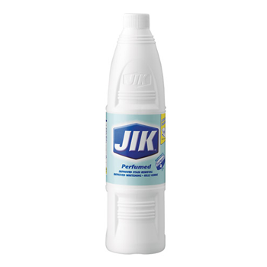
Dilutions of Household Bleach
  JIK (Kenya) – 3.5% Chlorine
  FORMULAE
Net Concentration (Minus 1) = Parts of water
0.5
Then the ratio will be - Parts of water obtained : one part of bleach.
3.5 / 0.5 (Minus 1) = Parts of water = 6
Therefore to make 0.5% Sodium Hypochlorite
1 PART JIK to 6 PARTS WATER
Notes:
CDC recommendations for sterilization and disinfection, cleaning spills of blood and body substances for prevention of HIV Transmission in Health-Care Settings=
effective depending on the amount of organic material (e.g., blood, mucus) present on the surface to be cleaned and disinfected

Slide 56
Bleach Dilution
In Kenya household bleach is usually used for decontamination/disinfection and has 3.5% available chlorine and 0.5% is required.
To prepare a solution of 0.5% available chlorine from a 3.5% bleach solution:
  % chlorine liquid bleach - 1 = parts of water per part of bleach
  % chlorine desired
  3.5% - 1 = [7] – 1 = 6 parts water for each part bleach
  0.5%
Therefore, you must add 1 part bleach to 6 parts water to make a 0.5% chlorine solution
Can you calculate the amount of bleach required if the stock is 8.5%?

Slide 57
Disinfectant concentration.
Proper concentration use of a disinfectant is important for each situation, i.e.
  Body spills
  Spills on surfaces
Some products will have different dilutions depending on the desired use of the product i.e.
  static versus
  cidal action.
Although some disinfectants may be more efficacious at higher concentrations, these levels may be limited by
  The degree of risk to personnel,
  Surfaces or equipment
  Cost of the chemical.

Slide 58
Disinfectant concentration.
An important consideration with alcohols is the concentration used, with 70-90% being optimum (use of 70% due to cost less evaporation).
Higher concentrations (95%) are actually less effective because some degree of water is required for efficacy (to denature proteins).

Slide 59
70% Alcohol Calculation
The formula for this calculation is C1*V1=C2*V2,
  C1 = starting concentration
  V1 = volume of the solution (unknown)
  C2 = final concentration
  V2 = volume of the dilution.
  If Alcohol is 100%
  100*V1=70*500, V1=35000/100, V1= 350
  If Alcohol is 95%
  95*V1=70*500, V1=35000/100, V1= 368.4

Slide 60
Disinfectant concentration
However, over-dilution of a product may render the disinfectant ineffective to the target microorganism.
The product label/and or insert will list the best concentration to use for each situation and shelf life.
Be sure to consider any standing water or other water sources (i.e., rainfall, body fluids) in the area as a potential dilution source for a disinfectant.

Slide 61
Contact time.
Appropriate contact times are essential. Disinfectants may vary in the contact time needed to kill versus inactivate microorganisms. For example,
  70% isopropyl alcohol can destroy Mycobacterium tuberculosis in 5 minutes, whereas 3% phenol requires 2-3 hours.
The minimum contact time needed is normally stated on the product label.
Areas being disinfected should be well soaked with the disinfectant selected to avoid drying before the end of the optimum contact time.
KNOW REQUIRED CONCETRATION and CONTACT TIME OF THE PRODUCT USED in your facility and have SOPs in place.

Slide 62
Stability and storage
Some disinfectants (i.e., sodium hypochlorite) lose stability quickly
  after being prepared for use.
  when stored over long periods, especially in the presence of heat or light.
To maximize stability and shelf life, stocks should be stored in a dark, cool location.
Sensible to prepare working solutions daily.
Use of an outdated or inactivated product may result in the use of a non-efficacious product and will lead to a false sense of security

Slide 63
Types of disinfectants
High-level disinfectants
Intermediate-level disinfectants
Low-level disinfectants
Notes:
Decontamination: the removal of disease-producing microorganisms to leave an item safe for further handling.
Disinfection: the inactivation of disease-producing microorganisms. Disinfection does not destroy bacterial spores. Disinfectants are used on inanimate objects in contrast to antiseptics, which are used on living tissue. Disinfection usually involves chemicals, heat or ultraviolet light. The nature of chemical disinfection varies with the type of product used.

Slide 64
Types of disinfectants
High-level disinfectants
(Glutaraldehydes, Formaldehyde, paracetic acid)
Kill bacteria, viruses, fungi, Mycobacterium tuberculosis and some bacterial endospores.
Formaldehyde can be used to disinfect rooms, cubicles and safety cabinets ( neutralised with ammonia following decontamination)
Formulated for use on medical devices, but not on environmental surfaces such as laboratory benches or floors
Notes:
Aldehydes (formaldehyde can be extremely hazardous – used in fumigation of microbiology safety cabinets and not for general disinfection purposes)

Slide 65
Types of disinfectants
2. Intermediate-level disinfectants
a) chlorines (e.g. Bleach & Chloros)
  Effective against a wide variety of microorganisms (vegetative bacteria and viruses). Preferred disinfectant for HIV and hepatitis viruses.
  Use at 0.1% (sodium hypochlorite) as a general disinfectant.
  Less suitable in the presence of organic matter (such as blood). Concentration must be increased to retain action (0.5%).
  Strength decreases on standing (make fresh solutions daily).
  High concentrations corrode metal surfaces, and bleach and damage fabrics.

Slide 66
Types of disinfectants
2.Intermediate-level disinfectants
b) Alcohols (e.g. 60%- 70% isopropanol, 80% v/v ethanol)
  Used to disinfect skin and decontaminate clean surfaces.
  Effective against fungi, vegetative bacteria, Mycobacterium species and some lipid-containing viruses.
  Not effective against spores.
  May swell rubber or harden plastics.

Slide 67
Types of disinfectants
3. Low-level disinfectants
a) Phenolics
    Active against a range of microorganisms.
    Fungi, spores and enteric viruses require higher concentration.
    No toxic end-products of decomposition.
    Do not use on aluminium, copper, zinc or brass.
    Lysol
b) 3% H₂O₂
  Active against bacteria and lipid-containing viruses.
  Not active against spores and non-lipid-containing viruses.
  Active in presence of organic matter.
  Use for disinfecting floors, walls, benches and other furniture.
.
Notes:
Phenolics -They are not effective against nonenveloped viruses and spores. These disinfectants maintain their activity in the presence of organic material. This class of compounds is used for decontamination of the hospital environment, including laboratory surfaces, and noncritical medical items.

Slide 68
Disinfectant | Vegetative bacteria | Spores | Fungi | Viruses |  | Mycobacteria | issues | Examples
 |  |  |  | Enveloped | Non- enveloped
Hypochlorites | Y | Y | Limited | Y | Y | Limited | Inactivated by organic matter. Working solutions should be changed frequently | Jik
Alcohols | Y | N | N | Y | Y | Y | Must not be used undiluted Flammable Poor penetration of organic material | 80% ethanol 70% isopropyl alcohol
Peroxygen compounds | Y | Y | Y | Y | Y | Y | limited shelf-life once activated | Virkon 3%H2O2
Aldehydes | Y | Y | Y | Y | Y | Y | Glutaraldehyde is a potent respiratory sensitiser formaldehyde is toxic and potentially carcinogenic | Formaldehyde

Slide 69
Employee Exposure Report Forms (EERF)
Accident report form used for reporting of chemical exposure, blood borne pathogen or infectious exposure
This report is used for documentation of a work-related exposure.
It is a protective measure to ensure proper medical care is received due to a work-related illness
Documentation provides proof and protection.

Slide 70
Summary
Always recognize chemical hazards commonly encountered in Laboratory.
Chemical management plan involves the safe use of chemicals.
Incompatible chemicals should be stored separately.
Disinfectants should be used appropriately.
MSDS should be easily available and accessible.

Slide 71
cont’
Training on chemical management is key
CHP protects employees from health hazards associated with chemicals.

Slide 72



