Slide 1
BIORISK ASSESSMENT
(Bio risk Risk assessment, Management & communication)

Slide 2
Introduction
This presentation shall cover Biorisk assessment within a healthcare facility.
The training is designed to give you tips of carrying out an effective Biorisk assessment
Notes:
The World Health Organization (WHO) describes risk analysis as a process composed of three elements-risk assessment, risk management and risk communication.1 Risk assessment includes using scientific information to describe the likelihood and magnitude of harm attributed to a specific hazard. Risk management includes all activities undertaken to control a hazard. Risk communication is the exchange of information and opinions about a hazard among concerned parties. Risk analysis is accomplished through the efforts of separate but integrated assessment, management and communication teams.

Slide 3

Objectives
By the end of this unit you should be able to:
Define the terminologies used in biorisk assessment
Identify biological risk
Undertake a biological risk assessment
Link biosafety risk assessment with Biosecurity risk assessment

Slide 4
Apply the hierarchy of control for risk reduction
Recognize workplace hazards that may pose environmental risks
Determine acceptable risks after putting all the control measures
Write a risk report
Communicate the outcome of a risk assessment.

Slide 5
Definition of Key Terminology
Bio risk: Combines Biological agent risks and Biological security risks
Risk: the probability that harm, injury, or disease will occur; the probability of an adverse (health) effect
Assessment: The process of gathering and judging evidence in order to decide whether a person has achieved a standard or objective

Slide 6
Types of Risks in the Workplace
Mechanical
Radiation
Fire & explosions
Temperature
Harzadous Environment
Electrical
Biological
Chemical & Hazardous Substance
Gases
Personal

Slide 7
Five General steps of Risk assessment
Identify the hazards
Decide who might be harmed and how
Evaluate the risks and decide on precautions
Record your findings and implement them
Review your assessment and update if necessary

Slide 8
Biorisks Assessment
Biorisk = Biological risks + Biosecurity risks.
This session will only cover these two types of risks in the workplace.
There are other types of risk in the workplace as stated earlier.
All these risks require detail assessments in order to manage them adequately.

Slide 9
Biorisk Assessment
A biorisk assessment is a process which evaluates the risk posed by the agent, the procedure (s), and the worker to:
  work
  staff
  environment
  community
Notes:
Some risks posed by agents of concern will be reviewed along with procedure and worker related risks

Slide 10
5 Steps (Ps) of Biorisk assessment
Pathogen (Agent)
Procedures (Protocol)
Place (lab facility)
Protective Equipment
Personnel (host)

Slide 11

Step 1
Identify Agent (Pathogen) Hazards

Slide 12
Biosafety Risks associated with Biological agents
Two steps of identifying biological agents risks:
Biological Hazard Recognition.
Agent Based Risk Assessment.

Slide 13



Biological Hazard Recognition
Biological organism
Pathogenicity
Mode of transmission
Work practices
Animal work
Training
Personnel
Workplace surveys
Publications/research

Slide 14
Risk Assessment: Agent Basis
What is known about the agent (Category, Amount of agent, Transmissibility)?
What information is in the literature?
Is an LD⁵⁰, ID⁵⁰ or TCID⁵⁰ given?
Is the agent/material known to cause infectious or toxigenic disease?
Notes:
Has it been classified according to risk?
Can you find it in a risk group or in an agent summary statement?
There are some LD⁵⁰, ID⁵⁰ or TCID⁵⁰ in the literature, but conditions may be difficult to duplicate (media,stage of microbial growth, dose, animal host,,time, temperature,etc.) and procedures can be different in newer protocols.
LD - An index of toxicity (lethal dose 50%), the amount of the substance that kills 50% of the test population of experimental animals when administered as a single dose.
ID - The dose of microorganisms required to cause infection in 50% of the experimental animals; a special case of the median effective dose.
TCID - Median tissue culture infective dose; that amount of a pathogenic agent that will produce pathological change in 50% of cell cultures inoculated
Agent Summary statements provide recommendations for handling based on risk assessements.
There are some LD⁵⁰, ID⁵⁰ or TCID⁵⁰ in the literature, but conditions may be difficult to duplicate (media,stage of microbial growth, dose, animal host,,time, temperature,etc.) and procedures can be different in newer protocols.
LD - An index of toxicity (lethal dose 50%), the amount of the substance that kills 50% of the test population of experimental animals when administered as a single dose.
ID - The dose of microorganisms required to cause infection in 50% of the experimental animals; a special case of the median effective dose.
TCID - Median tissue culture infective dose; that amount of a pathogenic agent that will produce pathological change in 50% of cell cultures inoculated
Agent Summary statements provide recommendations for handling based on risk assessements.
Has it been classified according to risk?
Can you find it in a risk group or in an agent summary statement?
There are some LD⁵⁰, ID⁵⁰ or TCID⁵⁰ in the literature, but conditions may be difficult to duplicate (media,stage of microbial growth, dose, animal host,,time, temperature,etc.) and procedures can be different in newer protocols.
LD - An index of toxicity (lethal dose 50%), the amount of the substance that kills 50% of the test population of experimental animals when administered as a single dose.
ID - The dose of microorganisms required to cause infection in 50% of the experimental animals; a special case of the median effective dose.
TCID - Median tissue culture infective dose; that amount of a pathogenic agent that will produce pathological change in 50% of cell cultures inoculated
Agent Summary statements provide recommendations for handling based on risk assessements.
Has it been classified according to risk?
Can you find it in a risk group or in an agent summary statement?
There are some LD⁵⁰, ID⁵⁰ or TCID⁵⁰ in the literature, but conditions may be difficult to duplicate (media,stage of microbial growth, dose, animal host,,time, temperature,etc.) and procedures can be different in newer protocols.
LD - An index of toxicity (lethal dose 50%), the amount of the substance that kills 50% of the test population of experimental animals when administered as a single dose.
ID - The dose of microorganisms required to cause infection in 50% of the experimental animals; a special case of the median effective dose.
TCID - Median tissue culture infective dose; that amount of a pathogenic agent that will produce pathological change in 50% of cell cultures inoculated
Agent Summary statements provide recommendations for handling based on risk assessements.

Slide 15
Agent Based Risk Assessment
Ordinary work procedures and type of work to be done (clinical samples, research, large scale, concentration)
Is the host range limited or broad?
Is post-exposure treatment, vaccine or prophylaxis available?
Notes:
Are there reports of:
severe disease?
epidemics?
laboratory acquired infections (LAI)?
transmission to animal cage mates or sentinel animals?

Slide 16
Agent Based Risk Assessment
Potential outcome of exposure
Natural route of infection/other routes of infection (parenteral, airborne, ingestion)
Stability in the environment

Slide 17
Agent Based Risk Assessment
Information available (animal studies, laboratory-acquired infections, clinical reports
Laboratory activity (sonication, aerosolization, centrifugation, etc.)
Genetic manipulation

Slide 18
Agent Based Risk Assessment
  Ordinary work procedures and type of work to be done (clinical samples, research, large scale, concentration)
  Worker (host) factors (training, health)
  Other agent related questions?

Slide 19
Biosecurity Risks associated with Biological agents
The 4 steps are:
Identify the biological materials that exist at the institution, form of the material, location and quantities, including non-replicating materials (i.e. toxins).
Evaluate the potential for misuse of these biologic materials.

Slide 20
Evaluate the consequences of misuse of these biologic materials.
Prioritize the biologic materials based on the consequences of misuse (i.e. risk of malicious use

Slide 21

Step 2
Evaluate Lab Activities (Procedure) to Identify Potential Hazard

Slide 22
Biosafety Risks associated with Workplace Activities (Procedure)
2 steps of identification of Lab activity risks:
Conduct a protocol based biohazard risk assessment .
Evaluate workplace procedure hazards to determine potential hazards.

Slide 23
protocol based biohazard risk assessment
Conduct a protocol based biohazard risk assessment
Include laboratory activities that may not be listed in protocols
Notes:
Example: 1) Inoculation of rabbits

Slide 24
Evaluate workplace procedure hazards
Potential routes of transmission for workplace acquired infections form the basis for evaluation of workplace hazards.
The following has to be put into consideration:
What?
How?

Slide 25
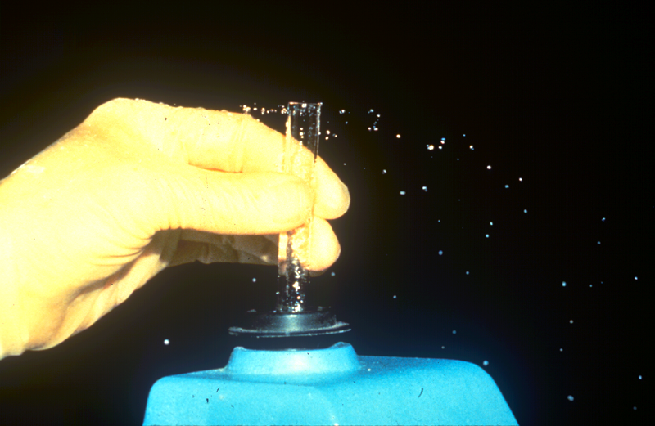
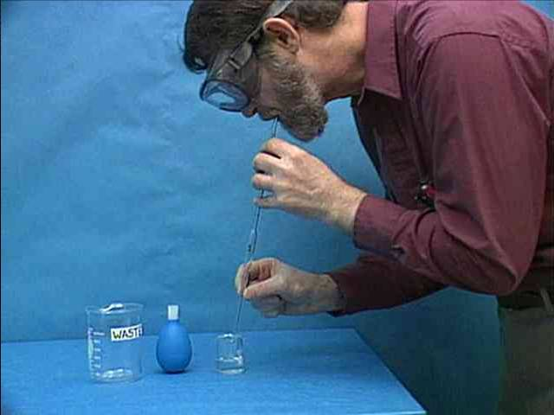
Evaluate workplace procedure hazards
What: Investigate potential routes of transmission for Laboratory Acquired Infections
How? Identify activities which could release the organism and expose the worker, co-workers and/or the environment

Slide 26
Biosecurity risks associated with workplace procedures
3 Steps:
Develop a list of possible biosecurity scenarios
Evaluate the probability of each scenario materializing
Prioritize or rank the scenarios

Slide 27
Develop a list of possible biosecurity scenarios
  For this activity consider:
  Access to the agent within your laboratory.
  How the undesired event could occur.
  Protective measures in place to prevent occurrence.
  How the existing protection measures could be breached (i.e., vulnerabilities).

Slide 28
Evaluate the probability of each scenario materializing
Your assumptions should include:
  Although a wide range of threats are possible, certain threats are more probable than others.
  All agents/assets are not equally attractive to an adversary.
  Valid and credible threats, existing precautions.

Slide 29
Prioritize or rank the scenarios
Prioritize or rank the scenarios by risk for review by management

Slide 30

Step 3
Preliminary Determination of Biosafety Level (Place)

Slide 31
Biosafety Risks associated with Workplace (Place)
This requires the following:
A comprehensive understanding of the practices.
Safety equipment at the workplace.
Laboratory facility safeguards.

Slide 32
Determination of preliminary Biosafety level establishes a “Starting Point”.
Training in module five gives necessary skills.
Biosecurity risks associated with workplace are similar to those of workplace procedure.

Slide 33
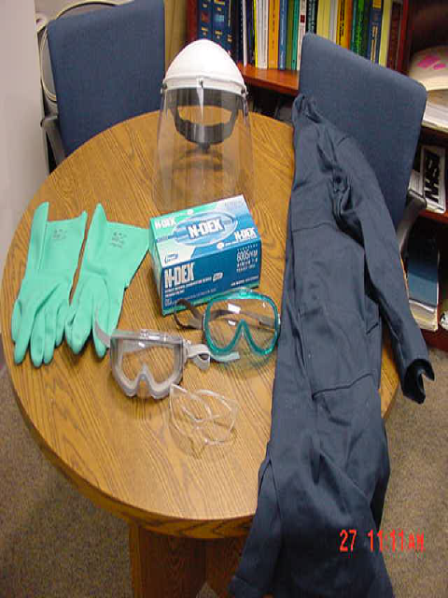
Step 4
Protective equipment

Slide 34
Biosafety risks considerations of Protective Equipment
There are 2 key strategic approaches to use of PE. These are:
Engineering Control: keep the hazards away from the workplace environment.
Personal protective Equipment: keep the worker from the hazards in the workplace environment.

Slide 35
Risk assessment of the workplace and procedures determines the protective equipment to be applied.
The personnel should also be accessed for determination of personal protective equipment to be worn.
In order to carry out a protective equipment risk assessment training in module 4 is required.

Slide 36

Step 5
Personnel

Slide 37
Biosafety Risks Associated with Personnel
To carry out Biosafety worker assessment focus on identifying gaps in:
Worker assessment.
Work hazard analysis.
Immunization considerations.

Slide 38
Worker Assessment
Worker assessment must focus on identifying gaps:
  Worker experience
  Occupational health and safety (includes prophylaxis and fit testing)

Slide 39
Worker Assessment
Should include:
Previous training and experience
Expertise in specific protocols
Good microbiological practices
Attitude toward use of safe practices, PPE
New worker and medical surveillance program

Slide 40

Work Hazard Analysis
List major procedure or process
Break procedure down into individual components
Determine hazard(s) associated with individual component
Identify way to deal with each hazard (hazard mitigation)

Slide 41
Host (Worker) Considerations
  Immunocompromised because of drug therapy or illness or primary infection.
  Age
  Pregnancy
  Fatigue and stress
  Worker proficiency and training
  Attitude
  Recent medical procedures
Chronic illness/infection

Slide 42
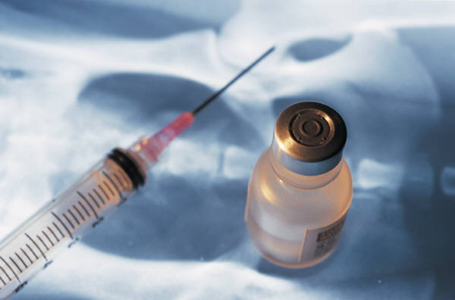
Immunization Considerations
  Hepatitis B virus, Hepatitis A virus
  Rabies
  Tetanus
  Meningococcal Immunization
  Vaccinia
  Typhoid
  Botulinum
  Yellow Fever

Slide 43
Risk Mitigation/ Risk reduction
Risk mitigation is a systemic reduction in the extent of exposure to a risk and/or the likelihood of its occurrence.
The hierarchy of control is a well recognized method of risk reduction.

Slide 44
Hierarchy of control
There are six hierarchies namely:
Elimination,
substitution,
isolation,
engineering control,
Administrative control
personal protective equipment (PPE).

Slide 45
Environmental Risk
Environmental risk management is also of importance in the risk assessment process.
laboratory hazards that contribute to high environmental risks aspects are as follows:
Chemicals wastes
Radio isotopes waste
Biological wastes (Animal, plant material and microbiological)

Slide 46
Waste paper
PCBs and CFCs
Plastics
The contribution is dependent on the following considerations:
Quantities
Potential environmental impact
Existing controls

Slide 47
Risk Assessment Review
There is risk in everything that we do
Never underestimate biological organisms
Don’t underestimate the value of good training
Assume that any unknown illness in your lab is a potential LAI until proven otherwise
Have a plan to deal with unrecognized illness
Be conservative when dealing with unknowns or unfamiliar agents
Develop an overall communication plan

Slide 48
Acceptable(Residual) risk
Risk cannot be reduced to zero, ie cannot be eliminated what remains is called acceptable risk.
Risk reduction criteria is used to reduce risk to acceptable level.
Acceptable risk level is established after applying the risk mitigation strategies covered in this module.

Slide 49
Risk Assessment report
A risk assessment report contains the findings of the risk assessment . The format is as follows:
Assessors
Aim / purpose of risk assessment
Scope of the risk assessment

Slide 50
Objectives of the risk assessment.
Methodology / risk assessment approach.
Hazards identified indicating weighting.
Risk mitigation plan with clear action plans indicating who, what and when.

Slide 51
Executive Summary
The executive summary is a summary of the risk assessment report. It usually covers:
Purpose
Scope
Risk assessment approach
Methodology
Key risks with high impact to the organisation.
The key risks should not be more than three.

Slide 52
RISK COMMUNICATION
Risk communication refers to communicating risks with the objective of changing or consolidating the recipients views about the issue.

Slide 53
COMMUNICATION
Three elements of communication:
Communicator (status, credibility, appeal, trust and presentation)
Message (verbal/non verbal, appeal/fear, presentation style)
Recipient (attitude, education, environment and persuasibility)

Slide 54
COMMUNICATION STRATEGY
An effective communication strategy should address 4 desired objectives:
Define the key goals of the communication exercise by identifying what the main issues are and what messages must be communicated.
Adopt an open multidisplinary approach to communication process by involving where possible all stakeholders.

Slide 55
Include information from all relevant sources and avoid presenting an obviously one sided or biased viewpoint.
Prepare a balance presentation for messages being communicated and avoid making claims that are clearly difficult to support.

Slide 56
Increase level of knowledge and understanding of the issues among stakeholders.
Allow stakeholder participation in the communicating process.
Give stakeholders opportunity to present their views on the issue

Slide 57
Bottom Line Risk Management Recommendations
When in doubt, be conservative
Use Standard Precautions as a starting point
Complacency and routine can be deadly
Constantly remind clinicians and pathologists to notify lab personnel if suspicion exists
Risk Assessment requires information about the agent and the work along with good judgment
Acknowledge and make aware of “close calls”

Slide 58
Summary
Does your risk management solution:
Make Scientific Sense?
Make Logical Sense?
Make Practical/Common Sense?

Slide 59

Discussions

