Slide 1
Case discussions on lab emergencies.

Slide 2
Course Overview
This course is a linear series of pages, where if you work in a lab, you will get important Emergency Health &Safety information and keep you work in lab safely and a good habit on work safety.
There are some CASE STUDY and QUIZ inserted

Slide 3
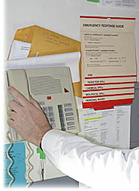
Emergency Response
When you take a job in a new laboratory, one of the first things you should do is ask your director to review with you the emergency response plans for the lab. Make particular note of the locations of:
  Emergency telephone numbers.
  Eyewash fountains and emergency showers.
  Spill kits.
  Emergency exits and evacuation routes.

Slide 4
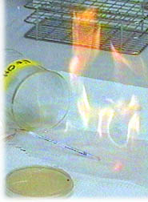
Fire Hazard
Fire is the most potentially devastating emergency in the laboratory. It is imperative that you know how to prevent fires and be prepared to respond should a fire occur
Preventing fires. Use of flammable solvents is a primary cause of lab fires. Always follow these prudent practices:
  Use the smallest quantities of flammable solvents practicable.
  Store stock quantities in flammables storage cabinets.
  Separate flammable solvents from sources of ignition. Never use a Bunsen burner in any area where flammable solvents are handled.

Slide 5
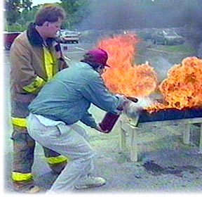
Fire Hazard
Being prepared:
  Know the fire emergency response procedures of your laboratory.
  Keep the lab aisles and evacuation routes free of equipment and other objects that could obstruct safe passage.
Remember:
  Safe passage is for your benefit and for the benefit of emergency responders.
  Periodically practice emergency response procedures.

Slide 6

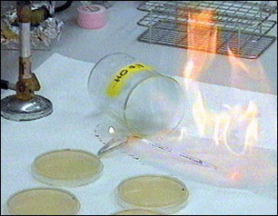
Lab bench Fire
A flammable liquid has just spilled out onto the top of bench and caught a fire

Slide 7

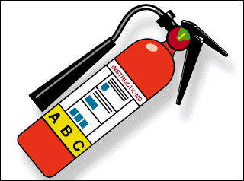
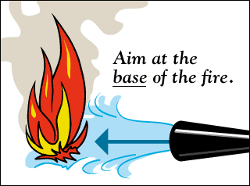
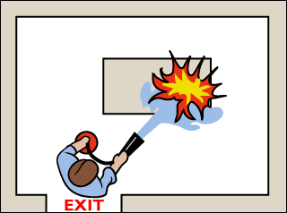

Case study: Lab bench Fire
Alert people in Lab and activate alarm
2. Smother fire or use fire extinguisher
3. Aim extinguish at base of fire
4. Stay on exit side of fire
5. Report the incident to you director

Slide 8
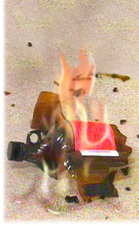
Emergency procedures: Major lab fire
Follow these immediate procedures in case of a major lab fire:
  Alert people to evacuate the area.
  Activate nearest fire alarm or call for emergency response.
  Close lab doors to confine fire.
  Have a person who is knowledgeable about the lab and
  the incident ready to assist emergency personnel.

Slide 9

Emergency procedures: Medical
Follow these immediate procedures in a medical emergency:
  Remain calm.
  Initiate lifesaving measures if required.
  Call for emergency response.
  Do not move the person unless there is danger of further
  harm.
  Keep the injured person warm.

Slide 10
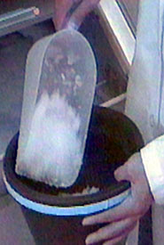
Slip and fall! Help!
A grad student from another lab just took a nasty fall in front of the ice machine. She complains that she can not feel her feet. What is the first thing you should do?

Slide 11
Which is best answer
Lift her into a chair.
Lift her legs and check if she can hold them up unaided.
Call for help immediately.
Ask if she can wiggle her toes.
Remember!!!
Moving your colleague, even if just her legs, could cause further injury. You should call for help immediately

Slide 12
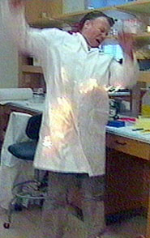
Clothing fire! Help!
Your colleague just dropped a 250 ml beaker of alcohol that splashed on the bench top and the front of his lab coat. A nearby Bunsen burner caused the alcohol to burst into flame.

Slide 13
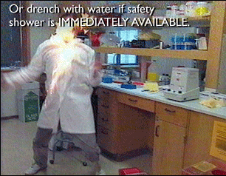
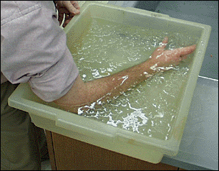
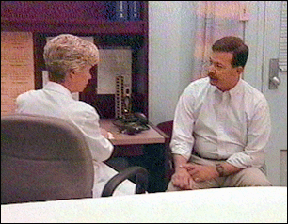
How to handle this kind of case
1. Put out the fire:
  Drop and roll; roll around on the floor to smother the flames.
2. Chill the burn with cool water.
3. Seek medical attention, and report the incident to your director.

Slide 14


Slide 15
Hazard communication
Do you know:
  Where to find information concerning the hazards of the chemicals present in your work area?
  When to use a laboratory chemical hood?
  How to select appropriate eye protection?
  What about gloves?
  What to do in case you are involved in a fire or chemical emergency?
All of this is information that you need to know to help you do your work in the safest manner possible. It is also information that you have a right to know under OSHA standards enacted to protect your health and safety through better communication, better training, and better work practices.

Slide 16
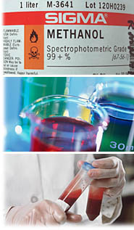
Key elements of the OSHA standards:
You must receive adequate training in working with hazardous chemicals.
2. Material Safety Data Sheets must be made available to you.
3. You must be informed of hazardous chemicals present in your work area and of operations in which they are involved.
4. You should know how to detect the presence or release of a hazardous chemical.
5. You must be provided personal protective equipment and engineering controls.
6. You must know the proper procedures for responding to emergencies.

Slide 17
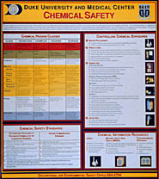
Chemical Hygiene Plan
Your host institution has a written Chemical Hygiene Plan. The Plan conveys the hazards of chemicals which may be present in your work area, and describes appropriate work practices, procedures and controls which are in place to protect you from those hazards.
You should become familiar with your host institution's Chemical Hygiene Plan or other laboratory safety documents. You may request copies of these materials from your supervisor or your host institution's environmental health and safety office.

Slide 18


Material Safety Data Sheets
Another important reference for health and safety information is the Material Safety Data Sheet, or MSDS. A Material Safety Data Sheet is prepared for each chemical by its manufacturer. It describes the physical and chemical properties of the product, the health hazards, and appropriate emergency response procedures. And, it can tell you of acute and chronic effects that can be caused by exposure to hazardous chemicals.

Slide 19
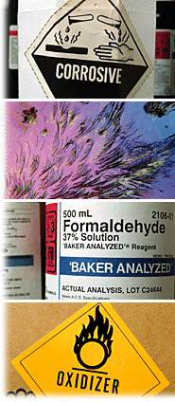
Hazardous substances
Carcinogens. Substances that may cause cancer in humans and animals under certain conditions. An example is chromic acid.
Corrosives. Substances that cause visible destruction or permanent change to skin tissue on contact. An example is hydrochloric acid.
Hepatotoxins. Substances that may cause damage to the liver. An example is chloroform.
Mutagens. Substances that may cause changes in the genetic material of cells. An example is ethidium bromide.
Nephrotoxins. Substances that may cause damage to the kidneys. An example is acetonitrile
Neurotoxins. Substances that are harmful to the nervous system. An example is acrylamide
Teratogens. Substances that may affect the development of an embryo or fetus. An example is formamide

Slide 20
Which one is best answer
May cause cancer.
May alter genetic material
May damage the liver
May damage the kidneys
All of the above.
Warning:
Repeated exposure to chromic acid may cause several chronic effects including cancer, alteration of genetic material, and damage to the liver and kidneys. Acute exposure can also be very serious. Chromic acid is extremely destructive to mucous membranes, eyes, and skin.

Slide 21
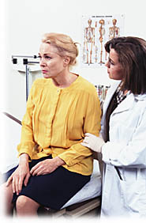
Medical conditions and symptoms
You should talk with your supervisor or doctor if you are working with hazardous chemicals and
  You are taking medication.
  You are pregnant.
  You have a medical condition such as chronic allergy.
  And, always see your physician if you develop symptoms or an illness that could be associated with your laboratory work.

Slide 22
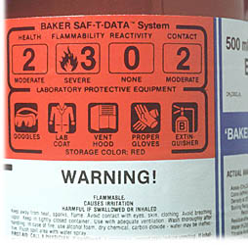
Container labels
Labels are another good reference for information on chemical hazards. Labels on containers of purchased chemicals include:
  The common name of the substance.
  An appropriate hazard warning.
Other label information may include procedures for:
  Proper handling.
  Storage.
  Emergency response.

Slide 23
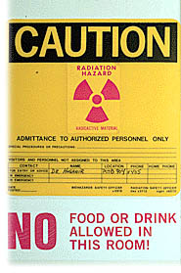
Working with radioactive materials
If you are working in a laboratory that uses radioactive materials, you should:
  Recognize the warning or caution signs indicating the presence of radioactive materials such as hose shown here.
  Be trained in specific safe work practices for your laboratory or workplace.
  Know and follow meticulously the safe work practices of your host institution.
If you have concern about entering a laboratory where radioactive materials are handled, talk with your supervisor. Chances are there would be no hazardous radiation exposure to you.

Slide 24


Slide 25
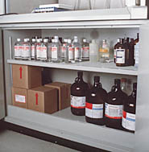
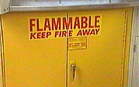
Chemical storage
Safe storage of chemicals is a necessity in every laboratory. It will:
  Provide for effective management of chemicals.
  Lessen the risk of fire.
  Prevent accidental mixing of incompatible chemicals in emergencies.
  Minimize exposure to corrosive and toxic chemicals.
Safe chemical storage may seem to be a matter of common sense. Yet in fact, it requires an awareness of each chemical's potential hazards, and a lot of thought.

Slide 26
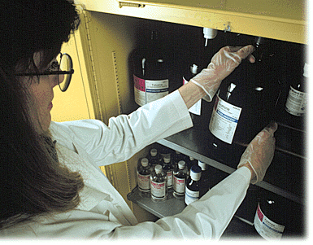
Safe storage
Have an experienced co-worker or your supervisor show you the designated storage areas and help you become familiar with the specific storage locations of each chemical. Pay particular attention to how acids, flammables, and detergents are stored. When you remove a chemical from storage, always remember to return it to the same spot. This is being considerate of your co-workers as well as safe practice.
If you have a question concerning the proper storage of a hazardous chemical, don't guess; ask your director for guidance.

Slide 27

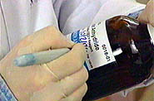
Rules of thumb for safe storage
Do not store more chemicals than you will need over a reasonable period.
Always read the chemical's label and mark it with the date of receipt before storing.
Never store highly reactive chemicals for longer than 6 months.
Never store a chemical with an obscured or missing label.
Separate chemicals into compatible groups and store alphabetically within the groups.
Designate separate storage areas for highly toxic chemicals.

Slide 28
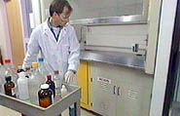
Rules of thumb for safe storage, (continued)
Store chemicals that can ignite at room temperature in a flammables cabinet. If flammable chemicals require cold storage, store only in refrigerators approved for such use.
Storage areas for corrosive, toxic, flammable, and highly reactive chemicals should be near a laboratory chemical hood to encourage use of the hood when transferring chemicals.

Slide 29
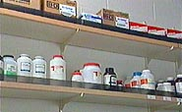
Rules of thumb for safe storage, (continued)
Store only cleaning materials directly under the sink.
Never store liquid hazardous chemicals above eye level.
Store heavy chemical containers on lower shelves, not on the floor.
Store chemicals on shelves with raised edges.

Slide 30
QUIZ
Your supervisor asks you to clean up your work area and put away all of the chemical containers that are out. As you begin, you find an unlabeled container that is half full of a colorless liquid. What should you do?
Store it next to a chemical container that has the same shape.
Pour it down the drain because it's most likely harmless.
Take the container to the waste disposal pick-up area.
Ask your supervisor for advice about what to do.
Remember:
  Always bring a question like this to the attention of your supervisor. You should never try to store, dispose of, or send out for disposal an unidentified chemical.

Slide 31
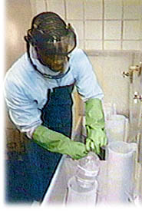
Personal PPE
You can do a lot to protect yourself while working with detergents and hazardous chemicals. Wear long pants, a long-sleeved shirt, closed-toe shoes, a laboratory coat, eye protection, and gloves.
When handling acids wear a rubberized apron for added protection.

Slide 32
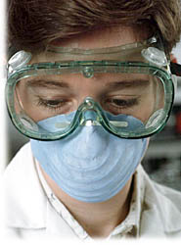

Always protect your eyes
Safety glasses with side eye shields, splash goggles, and full face shields offer varying degrees of protection against splattering chemicals. Choose safety glasses with side eye shields when there is a splash hazard with a small quantity of a hazardous chemical, for instance, when opening or closing a bottle.

Slide 33
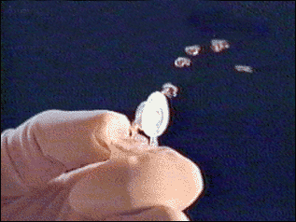
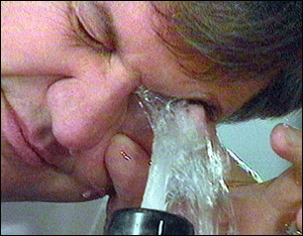
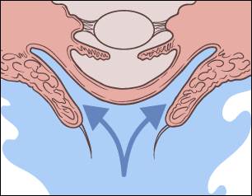
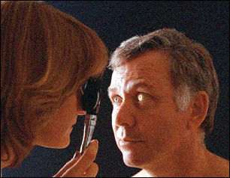
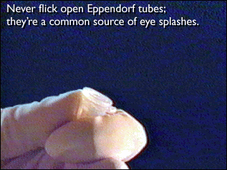
CASE STUDY: EYES SPLASH
Working quickly, you flicked open an closed tube and several droplets of phenol hit you eyes.
1. Immediately wash eyeball and inner surface of eyelid for 15 minutes
2. Forciblely hold eye open to ensure effective wash behind eyelids
3. Obtain medical attention
4. Report the incident to your director

Slide 34
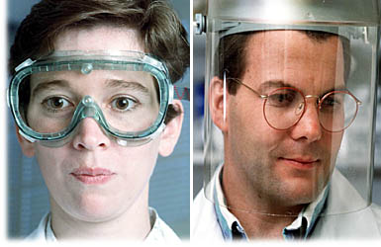
Goggle and Face Guard
Wear goggles when you are handling a chemical that is highly caustic or in a larger volume, perhaps a liter or more.
Wear a face shield when you are handling a very large volume of a hazardous chemical, or when you need to protect your face and your eyes. For example, wear a face shield when you are removing a closed container from liquid nitrogen.

Slide 35
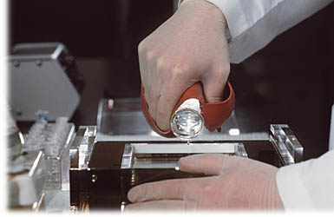
Gloves
Wearing gloves is a simple and effective way to protect yourself from chemical contact, but the gloves must be resistant to the specific chemical with which you are working.
No glove material is impermeable to all chemicals, therefore, the most effective practice in using protective gloves is to change them frequently and whenever they are contaminated.

Slide 36
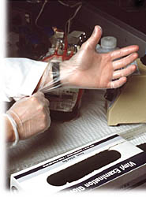
Choose the correct gloves
1. You should know the characteristics of the different glove types and understand the hazards of the chemicals involved in each procedure.
2. Gloves that allow good dexterity will offer no or little resistance to chemicals.
3. Special gloves that provide a higher degree of resistance should be used when contact with hazardous chemicals is unavoidable, however, contact time should be limited.
4. Ask for guidance from your safety program when selecting a glove type for handling chemicals that have PEL values with a "skin" notation. These chemicals can cause adverse health effects through skin absorption.
5. And, always wash your hands thoroughly with soap and water when changing into fresh gloves, and after working with any hazardous substances

Slide 37

Case study
Can I borrow your chair for a minute? I need to get a box off the top shelf.
1. Sure, but be careful. It swivels.
2. Why don't I give you a boost to the counter top?
3. You should really use that stepladder over there.
4. I usually open the bottom drawer and stand on it.
Remember:
Just as in your laboratory, you should use the proper tool for the job.

Slide 38
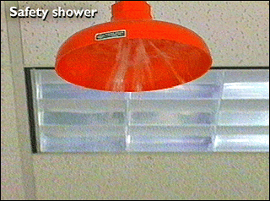
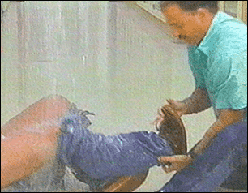
Case study: Chemical Spill
A colleague has just spilled acid on his clothes
1.Flood exposed area with running water from faucet or safety shower at least 15 minutes
2.Remove contaminated clothes at once and make sure chemical has not accumulated in shoes
3.Obtain medical attention, and report the incident to your director

Slide 39
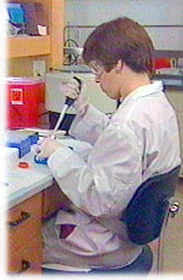
Practicing safe science with chemicals
Working with chemicals safely means doing all the things required for doing good science:
  Know your protocol; execute procedures meticulously.
  Know your chemicals.
  Use smaller quantities of chemicals; consider safer
  replacement protocols.
  Wear safety glasses, proper gloves, and a lab coat when handling hazardous chemicals; avoid splash hazards.
  Use a laboratory chemical hood when handling stock quantities of volatile hazardous chemicals.
  Be alert for hazardous situations; use a healthy dose of common sense; maintain concentration.

Slide 40


Slide 41
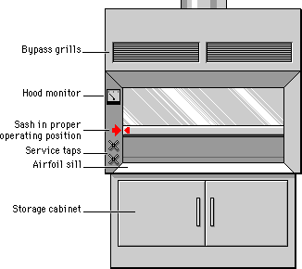
Laboratory chemical hoods
The laboratory chemical hood is a ventilated enclosure that protects you from being exposed to chemical fumes, gases, and aerosols that are generated within the enclosure. Protection is provided by room air that is drawn into the hood and vented to the atmosphere. The hood ventilation provides further protection by diluting the concentration of flammable gases below explosion limits.
The hood should always be on. Notify the facility staff or the safety office immediately if the hood is off or you observe contaminants escaping from it

Slide 42
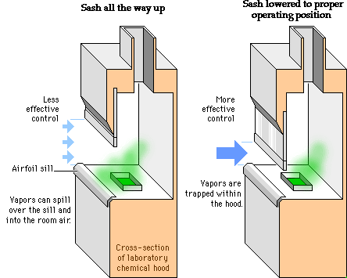
How the Hood works
You can place dry ice into a hood and see how it actually works. If the sash is all the way up, the vapor spills out of the hood easily, compromising protection.
When the sash is pulled down to the marked position, there is better control. The dry ice vapors are captured readily, increasing protection

Slide 43
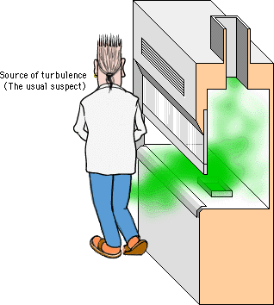
Turbulence around the hood
The aerodynamic design of the hood opening, including the airfoil sill, smoothes the airflow as it enters the hood, lessening turbulence. Room air drafts, rapid hand movements into and out of the hood, and obstructions at the airfoil sill can affect performance. Even a small disturbance near the hood, like someone closing a door or walking by, can create drafts that cause vapor to escape from the hood.
When planning to do a hazardous experiment, you should ask your colleagues to reduce activities such as walking past the hood or opening and closing the lab doors while you are working.

Slide 44
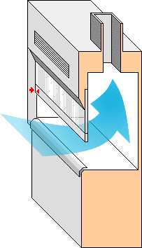
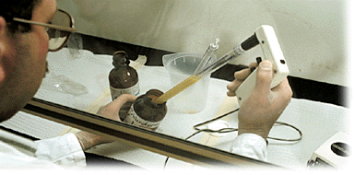
Limit the open sash area
The most important decision you will make in controlling hood performance is the sash height. You have seen how the hood's performance improves as the area of the sash opening decreases. Keeping the sash at or below the safe sash-opening marker is good practice. Placing the sash at the lowest level for convenient operation will provide the best protection.

Slide 45
Quiz
What is the principal way by which a laboratory chemical hood protects the worker?
The hood draws air from the room and vents it to the atmosphere.
The sash of the hood shields the worker from hazards.
Room air dilutes the concentration of hazardous gases.
The hood provides a designated area in which to conduct hazardous work.
Remember:
The room air that is drawn into the hood captures contaminants that have been generated inside of the hood and vents them outside. This keeps the contaminants from escaping from the hood into your work environment. A partial physical barrier like the sash, air dilution, and a designated work area will not by themselves protect you when you are handling hazardous chemicals.

Slide 46
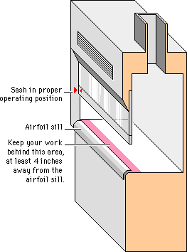
Using laboratory chemical hoods
Plan your experiment: First, assess the risks of your experiment. If a laboratory chemical hood is required, place everything you need in the hood before starting.
Lower the sash: Always make sure the sash is pulled down to the marked level. The best protection is provided when the sash is brought to the lowest level for convenient operation.
Watch your activity: Use slow and deliberate motions. Place supplies so that they do not obstruct the airflow at the airfoil sill or the exhaust slots at the back of the hood. Do not work within four inches of the airfoil sill.

Slide 47
quiz
The best way to protect yourself when working at a laboratory chemical hood is to:
  Lower the sash only to the sash-opening marker.
  Lower the sash to the most convenient point at or below the safe sash-opening marker.
  Leave the sash in the exact position where you found it.
  Raise the sash wide open.
Remember:
Placing the sash at the lowest level for convenient operation will provide the best protection. Never assume that the position where you find the sash is the safest position for you. Raising the sash above the safe sash-opening marker will increase your risk of exposure.

Slide 48
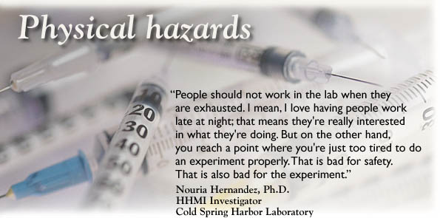

Slide 49

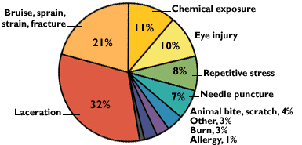
Research employee injuries 1993 - 1997
The most common serious injuries: cuts due to careless use of razor blades.
Source: Howard Hughes Medical Institute, Office of Laboratory Safety. All reported injuries are shown, without regard to severity.

Slide 50
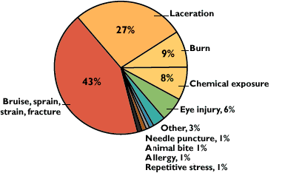
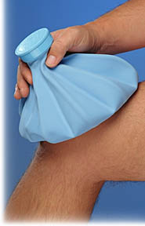
Laboratory support injuries, 1993 - 1997
The most common serious injuries: strains and fractures due to falls and improper lifting of heavy objects.
Source: Howard Hughes Medical Institute, Office of Laboratory Safety. All reported injuries are shown, without regard to severity.

Slide 51
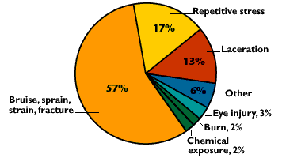

Administrative support injuries, 1993 - 1997
The most common serious injuries: strains and fractures due to falls and improper lifting of heavy objects.
Source: Howard Hughes Medical Institute, Office of Laboratory Safety. All reported injuries are shown, without regard to severity

Slide 52
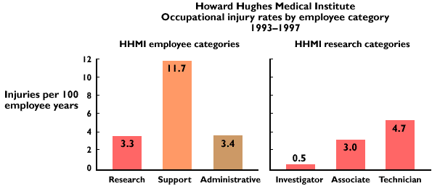

Slide 53




Case study: minor cuts and injuries
While removing an old label with a sharp blade, you’ve given yourself a deep cut on the finger
1. Vigorously wash injury with soap and water for several minutes
2. Obtain medical attention
3. Minor cuts and injuries should be seen by the health clinic, even if exposure to a hazardous material is not an issue

Slide 54


Physical hazards
A chemical laboratory, like any other workplace, presents a variety of physical hazards that can be minimized by using good laboratory practice and common sense, by staying alert, and by always thinking about where the hazards are. Keep floors dry and uncluttered to prevent slips, trips, and falls. Whenever possible, open flames should be replaced by electrical heating.

Slide 55


Physical hazard
Respect the dangers of high voltage, ultraviolet light, heat sources, and cryogenic materials. When transporting hazardous substances, make certain that the containers are sealed and use secondary containers. Try not to take routine manipulations for granted, especially those involving glass, needles, or sharps. And, if you are tired or distracted, take a break, relax and refocus. If you notice any unsafe conditions or have an accident or injury, talk with your supervisor.

Slide 56

Physical hazard
High voltage equipment: When using high voltage equipment like in electrophoresis, be sure that the power is off before you start making connections. Handle power leads one at a time, with one hand only, and never if your hands are wet or sweaty. Beware of loose connections that could allow sparks or an electrical arc. Keep the equipment away from a sink or wet area. And, if you feel a tingle when you touch the unit, stop using it immediately until it is repaired.
Microwave ovens: Microwave ovens can be dangerous pieces of equipment when not used properly. Capped containers can explode. Superheating of liquids can occur. Inappropriately selected plastic containers can melt.

Slide 57


Slide 58


Glassware washing hazard: In a modern lab everyone who supports the scientists shares two responsibilities to carry out his or her duties with great care, and to work safely.
PPE: You get important protection from hazards by wearing a lab coat and closed-toe shoes with rubber soles. And, always remember to wear your safety glasses and rubber gloves.
Maintaining a safe workplace: Watch out for anything that could cause a slip, trip or fall. A non-slip surface and floor mats provide a good margin of safety.
Always clean up any minor spills or breakage right away. This protects you, and protects your co-workers who might not realize there's a hazard in the area.

Slide 59


Preliminary procedures in glassware washing
Contaminated items: Return glassware that contains chemicals or contamination to the researcher for proper disposal.
Broken glassware: Dispose of any chipped or cracked items in a proper disposal container.
Removing labels: When scraping labels, always brace the bottle against the sink so you have good control and the bottle doesn't slip.
Presoak glassware: At many facilities items are presoaked with EDTA sulfonate-based detergent to aid in cleaning and eliminate any need for acid cleaning.

Slide 60


Acid washing precautions
If you use chromic acid, ask your supervisor to select a safer method. Most facilities do not use acid cleaning methods at all because of the hazard of handling acid. But if acid washing is done at your facility, follow these safety precautions:
1. Protect yourself: Wear lab coat, long-sleeved acid-resistant gloves, heavy-duty apron, goggles, full-face shield, and closed-toe shoes with rubber soles. Work carefully to prevent splashing acid. Never pour water into acid.
2. Contain acid: Carry and store acid in a secondary acid-resistant container or bottle carrier. Do not use or store acid near bleach or other incompatible chemicals. And, keep acid containers covered when not in use.
Adopt the buddy system:
Always have another person stay nearby when you are using acid.

Slide 61


Case Study: burn injury
A co-worker has just had his arm splashed with scalding water
1. Help him to immediately get his arm submerged into cool water
2. Call for emergency assistance
3. Keep the arm submerged in cool water until emergency help arrives
4. Report the incident to your director

Slide 62
Additional QUIZ 1
As you are unloading dirty glassware from the soaking tub you find a closed flask that contains a colored liquid. What should you do?
Unscrew the cap and carefully pour the liquid down the drain.
Put it aside and later ask your supervisor if you should wash it.
Return it to the lab that sent it to the glasswash facility.
Toss the flask and its contents into the waste disposal bin.
The liquid may be a hazardous chemical or other contaminated material. Return the flask to the lab where the material can be positively identified and disposed of properly. Showing such care in handling this problem may also encourage the lab to be more careful in the future with their dirty glassware.

Slide 63
QUIZ 2
Phenol is slowly leaking from a cracked bottle. It has seeped over the counter and onto your colleague's leg. What is the first thing you should do?
Call for assistance.
Get her to an emergency shower.
Have her remove her clothing.
Make her comfortable until help arrives.
Get to an emergency shower as quickly as possible

Slide 64

QUIZ 3
Your co-worker is removing the rack from the autoclave and a bottle explodes splashing her arm with scalding water. She starts to scream. What is the first thing you should do?
Call for emergency assistance.
Help her to get her arm submerged into ice water immediately.
Wrap her arm in a blanket.
Report the incident to your supervisor.
Ice water immersion is the best immediate treatment for a burn because it helps to stop the burning process. After submerging the arm into ice water, call for emergency assistance. After the emergency is over, you should report the incident to your supervisor.

Slide 65
QUIZ 4
You enter a laboratory that has a radiation hazard warning sign on the door and find a person who has slipped and fallen to the floor. The person is breathing but can not move. What should you do?
Call for emergency assistance and then move the person out of the radiation laboratory.
Call for emergency assistance and do not move the person.
Move the person out of the radiation laboratory and then call for emergency assistance.
Call the radiation safety office and ask what to do.
You should immediately call for emergency assistance and do not move the person unless there is danger of further harm. To do otherwise would delay getting emergency help or possibly cause even greater harm to the person.

Slide 66
QUIZ 5
Your risk of radiation exposure when entering lab where basic radiation safety practices are routinely carried out is:
Low.
Moderate.
High.
Little to none.
Little to non, insured by basic radiation safety procedure and your good lab practice

Slide 67
QUIZ 6
Most occupational injuries among the support staff result in:
Bruises, sprains, strains, and fractures.
Cuts.
Burns.
Exposure to laboratory chemicals.
Almost half of all injuries to support staff in HHMI laboratories from 1993 through 1997 resulted in bruises, sprains, strains, or fractures. A quarter of the injuries were cuts. And, nearly 10 percent were burns. The support staff has a higher percentage of cuts and burns than either the laboratory staff or the administrative staff.

Slide 68
QUIZ 7
Your co-worker is removing the rack from the autoclave and a bottle explodes splashing his arm with scalding water. What is your first response?
Call for emergency assistance.
Help your co-worker to immediately get his arm submerged into cold water.
Run to the ice machine and get some ice to help cool down the arm.
Report the incident to your supervisor
Help your co-work to immediately get his arm submerged into cold water

Slide 69
QUIZ 8
You have been asked to wear a lab coat, closed-toe shoes with rubber soles, safety glasses, and rubber gloves. What glass washing procedure are you prepared to carry out?
Acid washing.
Removing glass bottles containing water from the autoclave.
General sorting of dirty glassware.
Opening the autoclave door.
All of the above.
Your personal protective equipment is appropriate for general sorting of dirty glassware. You will need, in addition, a full-face shield, long-sleeved acid-resistant gloves, and a heavy-duty apron to do acid washing; heat-resistant gloves to open the autoclave; and heat-resistant gloves and a rubber apron to remove glass bottles containing water from the autoclave.

Slide 70
QUIZ 9
Which is the most potentially devastating emergency in the modern biology laboratory?
Chemical spill.
Radiation spill.
Fire.
Fire is the most potentially devastating emergency because it can cause serious or lethal injury and destroy an entire research program.

Slide 71
QUIZ 10
Safety glasses with side eye shields are an appropriate choice for protecting your eyes when:
Handling small amounts of chemicals where a splash hazard exists.
Pouring acid from a one-liter bottle.
Removing glass ampoules from storage in liquid nitrogen.
All of the above.
You should choose safety glasses with side eye shields when there is a splash hazard with a small quantity of a hazardous chemical.

Slide 72
QUIZ 11
What should be your first response if you cut yourself with a piece of broken glass?
Vigorously wash the cut with soap and water for several minutes.
Cover the cut with a bandage.
Seek medical attention.
Report the injury to your supervisor
You should first vigorously wash the cut with soap and water for several minutes.

